Slide 1
Airplane Safety Review
NTSB Accident Database

Slide 2
Safety Review of Aircraft
Defining Safety of an Airplane:
Frequency of accidents
Severity of accident (serious injury or fatality)
Airplane features to consider:
Engine type
Airplane type
Boeing vs. Airbus

Slide 3
Safety Review of Aircraft
Three questions:
Does the type of engine on an aircraft affect the severity of accident?
Does the type of aircraft affect the severity of accident?
Do Boeing or Airbus planes get in more accidents?

Slide 4
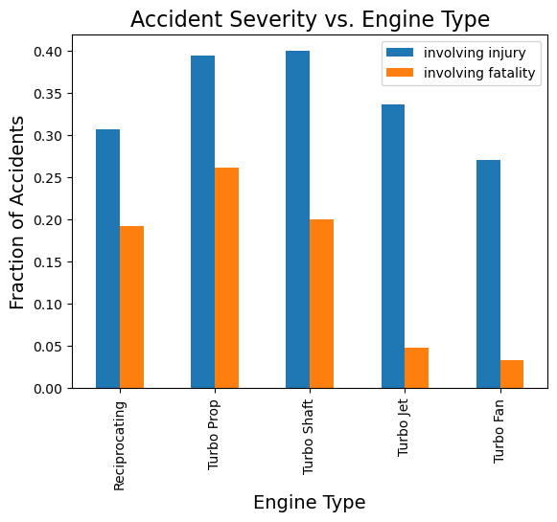
Type of Engine
Turbo Jet and Turbo Fan airplanes: less likely accident will involve a fatality

Slide 5
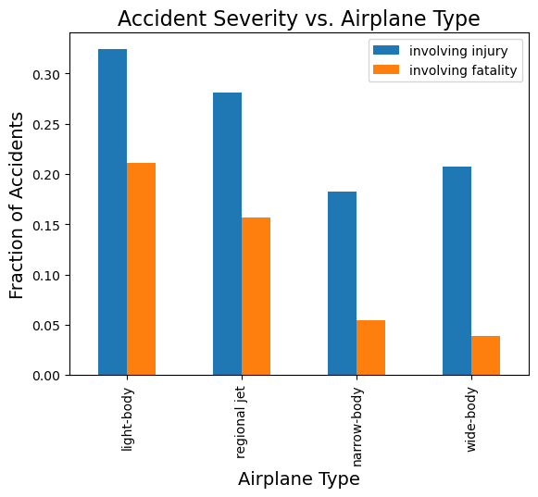
Type of Airplane
Narrow-Body and Wide-Body aircraft: less likely an accident will involve an injury or fatality.

Slide 6
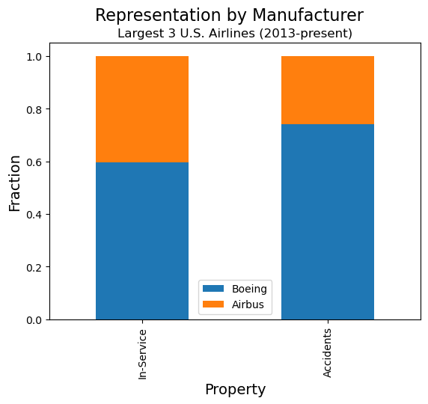
Make
Boeing airplanes are slightly overrepresented in the number of accidents.

Slide 7
Conclusions
These features can help to minimize the safety risk of an airplane:
Engine Type: Turbo Jet or Turbo Fan
Airplane Type: Narrow-Body or Wide-Body
Make: Airbus

Slide 8
Next Steps
Control for different numbers of planes in field
Determine if differences are statistically significant
Account for accident causes

Slide 9
Questions?

