Slide 1
Airplane Safety Review
NTSB Accident Database

Slide 2
Safety Review of Aircraft
Accident Data by Type of Airplane
Business-Jet
Narrow-Body
Wide-Body
Accident Data by Model

Slide 3
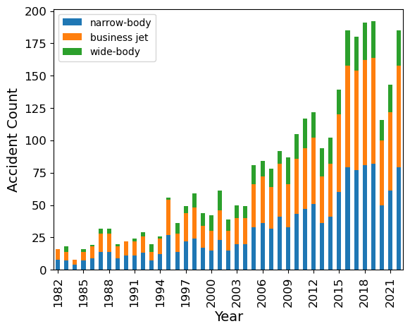
Accidents vs. Time by Aircraft Type

Slide 4
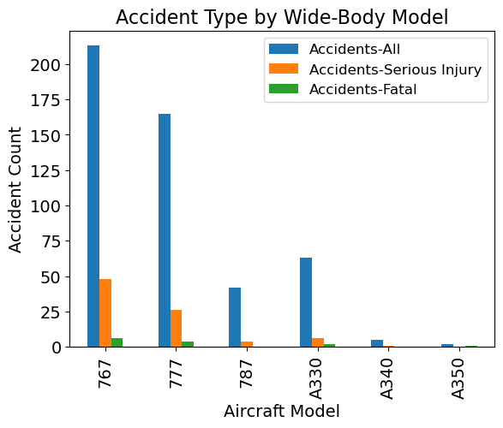
Wide-Body Airplanes

Slide 5
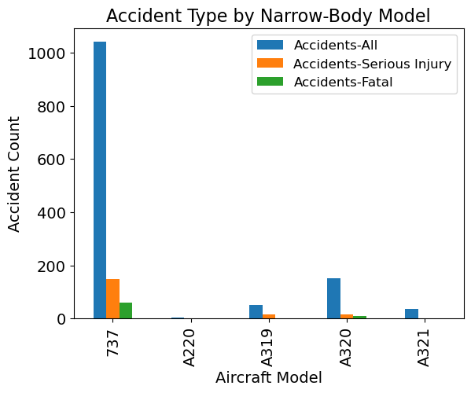
Narrow-Body Airplanes

Slide 6
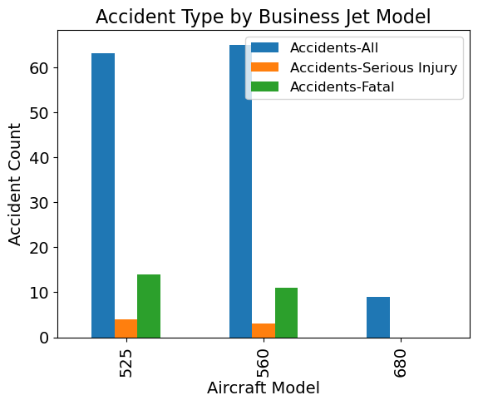
Business Jet

Slide 7
Recommendations
Type of Aircraft
Wide-Body
Model to Select:
Wide-Body: Airbus A350
Narrow-Body: A220
Business Jet: Cessna 680

Slide 8
Next Steps
Control for different numbers of planes in field
Determine if differences are statistically significant
Account for accident causes

Slide 9
Questions?

