Slide 1

Movie Pitch
Jeffrey Goett
Notes:
Exciting Opportunity
Potential Partners
Studios bring expertise to process

Slide 2
Business Questions
Does the amount we invest affect the return on investment?
In our budget range, which movie studios make high ROI films?
In our budget range, does genre and quality affect ROI?

Slide 3
Key Findings
Spending up to $12 Million gives a good chance at profitability.
Universal, Paramount, and Columbia make high ROI films in this budget range.
These studios make well-reviewed, profitable comedy and drama movies in this budget range.

Slide 4
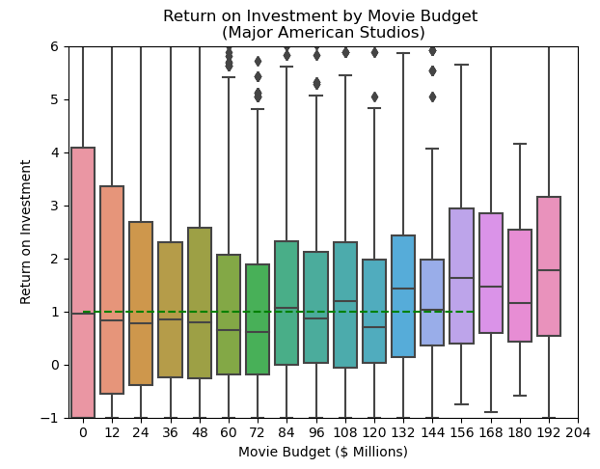
Studio Overview
Good ROI: Budgets under $12 Million

Slide 5
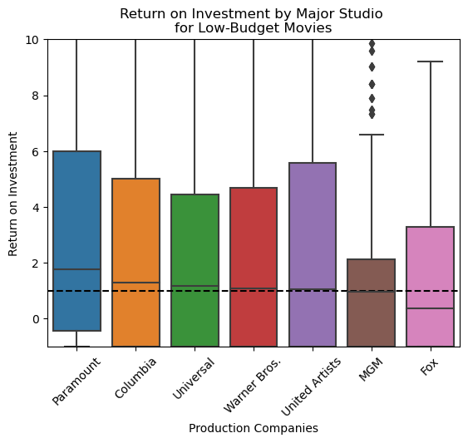
Successful Movie Studios
Paramount, Columbia, and Universal make profitable films for under $12 million.

Slide 6
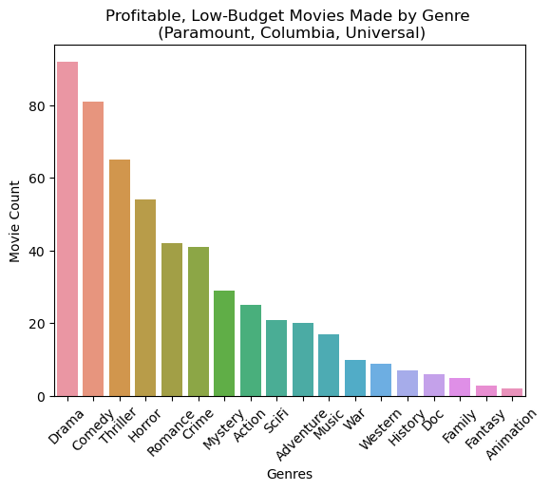
Genres
These studios make many profitable dramas and comedies for under $12 million.

Slide 7
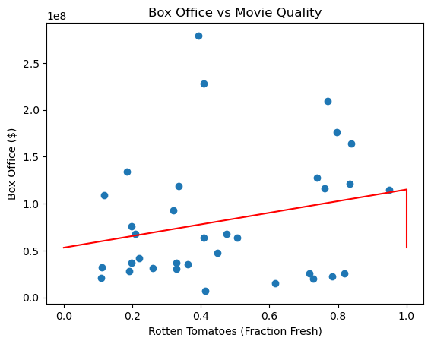
Quality
A moderate correlation between quality and ROI.

Slide 8
Recommendations
Target movies with budgets under $12 million.
Approach Paramount, Columbia, and Universal to make film.
Explore options for high-quality comedy and drama films.

Slide 9
Thank You!

