Slide 1
Movie Pitch

Slide 2
Business Questions
Does the amount we invest affect the return on investment?
In our budget range, which movie studios make high ROI films?
In our budget range, does genre and quality affect ROI?

Slide 3
Key Findings
Spending $2 Million - $12 Million gives a good chance at profitability.
Universal, Paramount, and Lionsgate make high ROI films in this budget range.
These studios make well-reviewed, profitable horror, thriller, and drama movies in this budget range.

Slide 4
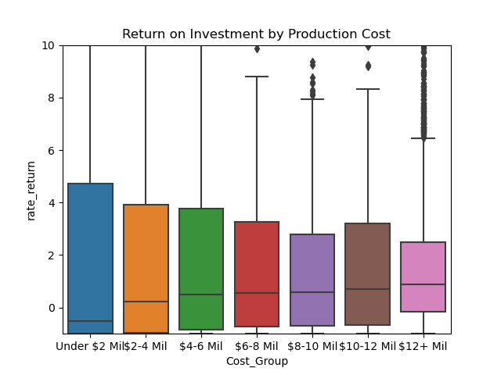
Investment Amount
Investing $2 - $12 Million gives a good ROI.

Slide 5
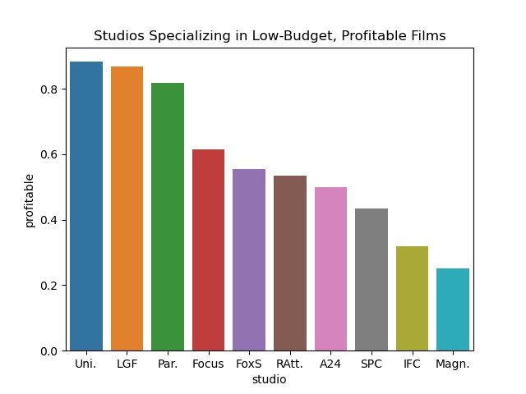
Successful Movie Studios
Universal, Lionsgate, and Paramount make profitable films in our budget.

Slide 6
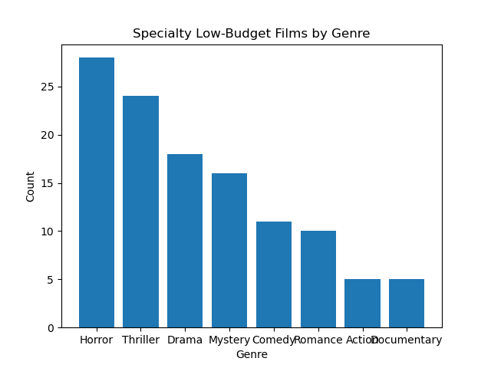
Genres
These studios make profitable horror, thriller, and drama films in our budget.

Slide 7
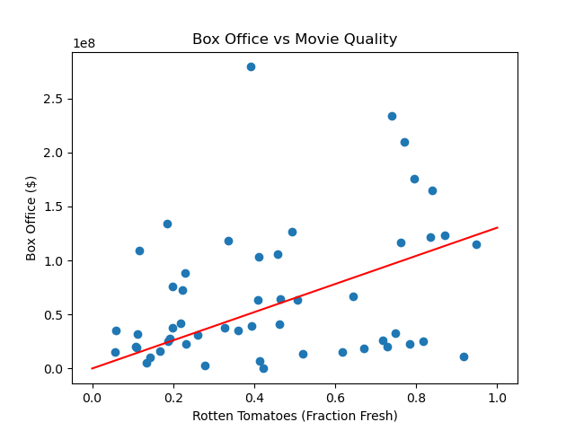
Quality
A moderate correlation between quality and ROI.

Slide 8
Recommendations
Target movies with budgets between $2-$12 million.
Approach Universal, Lionsgate, and Paramount to make film.
Explore options for high-quality horror, thriller, and dramas.

Slide 9
Thank You!

