Slide 1
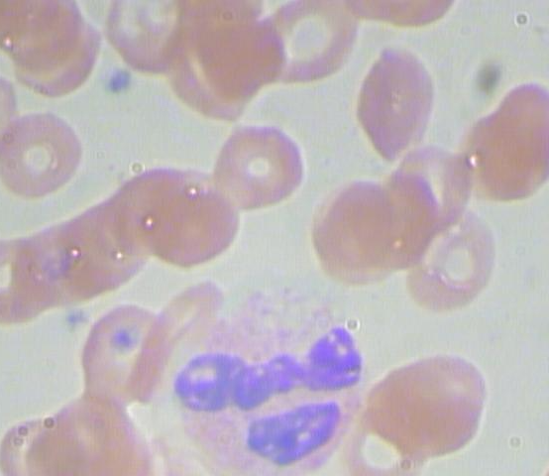
White Blood Cell Identification
Jeffrey Goett
Phase 3, Flatiron School

Slide 2
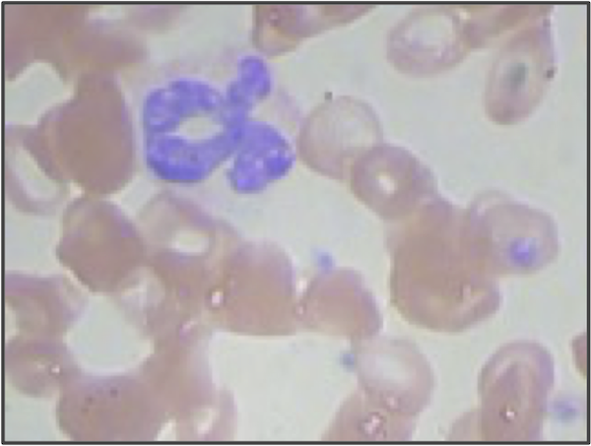
Complete Blood Count (CBC)

Slide 3
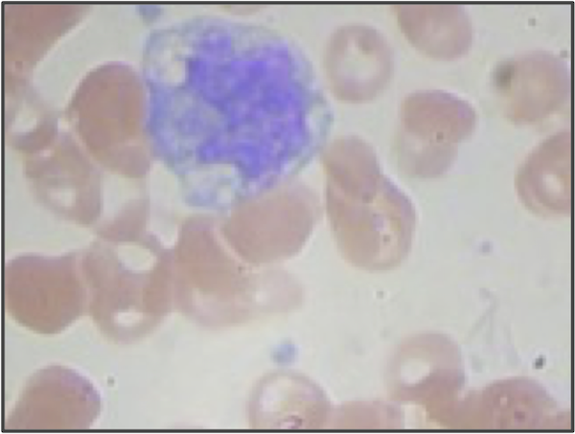
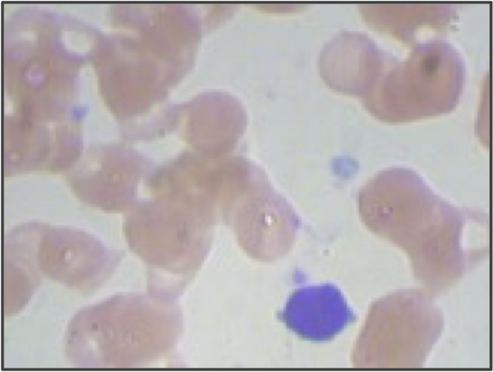
White Blood Cell Type
Granulocyctes
Monocytes
Lymphocytes

Slide 4
Business Question
Can a simple computer vision algorithm classify white blood cell type at a satisfactory rate?

Slide 5
Results
Decision Tree Results (Best)
Granulocytes: Precision: 92% Accuracy: 70%
Monocytes: Precision: 0% Accuracy: 78%
Lymphocytes: Precision: 27% Accuracy: 88%

Slide 6
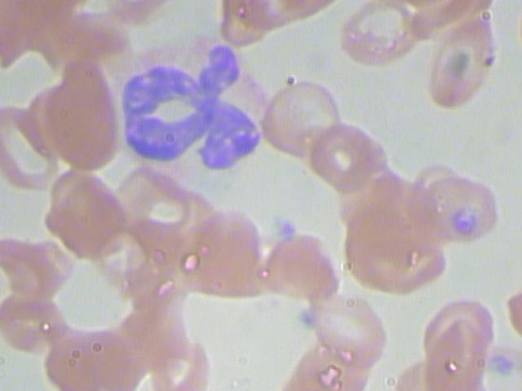

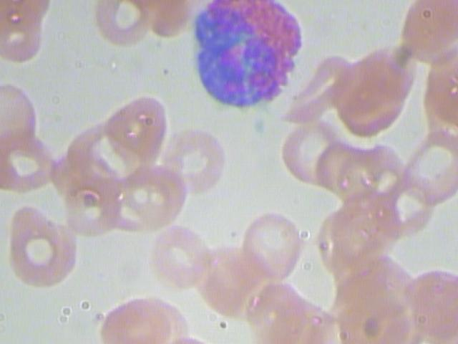

Data Preparation – Normalize Data

Slide 7
Data Preparation – Vectorize
(0, 0, 0, 0,……..0, 255, 255, 255, 255,…0, 0, 0, 0, 0, 0)
Granulocytes
(0, 0, 0, 0,……..255, 0, 0, 0, 255,…0, 0, 0, 0, 0, 0, 0, 0, 0)
Monocytes

Slide 8
Data Preparation – Model and Results
Data:
Features: 410 arrays with 40,000 features each; target: cell type
Classifiers Used:
Logistic Regression
KNN Classifier
Decision Tree

Slide 9
Results
Decision Tree Results (Best)
Granulocytes: Precision: 92% Accuracy: 70%
Monocytes: Precision: 0% Accuracy: 78%
Lymphocytes: Precision: 27% Accuracy: 88%

Slide 10
Results and Next Steps
Decision Tree did not meet industry standards
Neural nets will do better.

