Slide 1
Measuring Curriculum Rigor
Jeffrey Goett
Flatiron School, Phase 5 Project

Slide 2
Background
College Board offers a thorough framework of skills and knowledge for AP subject areas.
For Example: AP Computer Science A – Skills:
1. Program Design and Algorithm Development
2. Code Logic
3. Code Implementation
4. Code Testing
5. Documentation

Slide 3
Background
College Board offers a thorough framework of skills and knowledge for AP subject areas.
For Example: AP Computer Science A – Skills:
2 Code Logic:
2.A: Apply the meaning of specific operators
2.B: Determine the result or output based on statement execution order in a code segment without method calls.

Slide 4
Example Question
Consider the following code segment. Assume num is a properly declared and initialized int variable. if (num > 0) { if (num % 2 == 0) { System.out.println(num/5); } else { System.out.println(num/5.0); } } Which of the following best describes the result of executing the code segment?

Slide 5
Example Question
1.C: Determine code to interact with completed code.
2.A: Predict the output of code with operators.
4.A: Use test cases to identify errors in code.
Consider the following code segment. Assume num is a properly declared and initialized int variable. if (num > 0) { if (num % 2 == 0) { System.out.println(num/5); } else { System.out.println(num/5.0); } } Which of the following best describes the result of executing the code segment?

Slide 6
Example Question
1.C: Determine code to interact with completed code.
2.A: Predict the output of code with operators.
4.A: Use test cases to identify errors in code.
Consider the following code segment. Assume num is a properly declared and initialized int variable. if (num > 0) { if (num % 2 == 0) { System.out.println(num/5); } else { System.out.println(num/5.0); } } Which of the following best describes the result of executing the code segment?

Slide 7
Example Question 2
Consider the following class:
class Student {
private String name;
public Student(name) {
this.name = name;
}
public void setName(name) {
this.name=name;
}
}
Suppose an object of class Student name student1 has been instantiated. What method call could be used to change the student1 instance variable name to “Alex”

Slide 8
Example Question 2
1.C: Determine code to interact with completed code.
2.A: Predict the output of code with operators.
4.A: Use test cases to identify errors in code.
Consider the following class:
class Student {
private String name;
public Student(name) {
this.name = name;
}
public void setName(name) {
this.name=name;
}
}
Suppose an object of class Student name student1 has been instantiated. What method call could be used to change the student1 instance variable name to “Alex”

Slide 9
Example Question 2
1.C: Determine code to interact with completed code.
2.A: Predict the output of code with operators.
4.A: Use test cases to identify errors in code.
Consider the following class:
class Student {
private String name;
public Student(name) {
this.name = name;
}
public void setName(name) {
this.name=name;
}
}
Suppose an object of class Student name student1 has been instantiated. What method call could be used to change the student1 instance variable name to “Alex”

Slide 10
Goal
Given an assessment question, classify it by skill.
Compare the accuracy of different methods:
TF-IDF + Logistic Regression,
Sentence Transformer + Logistic Regression
ChatGPT

Slide 11
Results
TF-IDF + Logistic Regression: 70% accuracy Sentence Transformer + Logistic Regression: 80% accuracy
ChatGPT Classifier: 48% accuracy

Slide 12
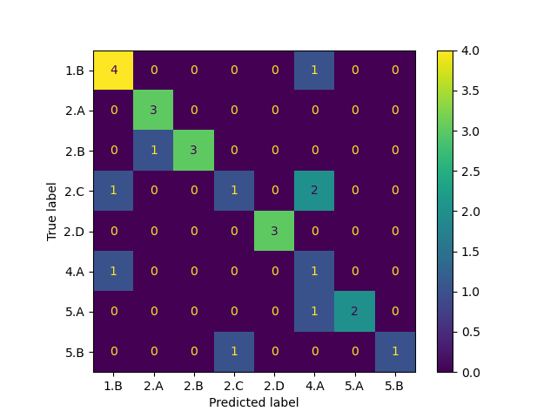
TF-IDF + Logistic Approach
Vectorize questions and train Logistic Regressor to classify by skill.

Slide 13
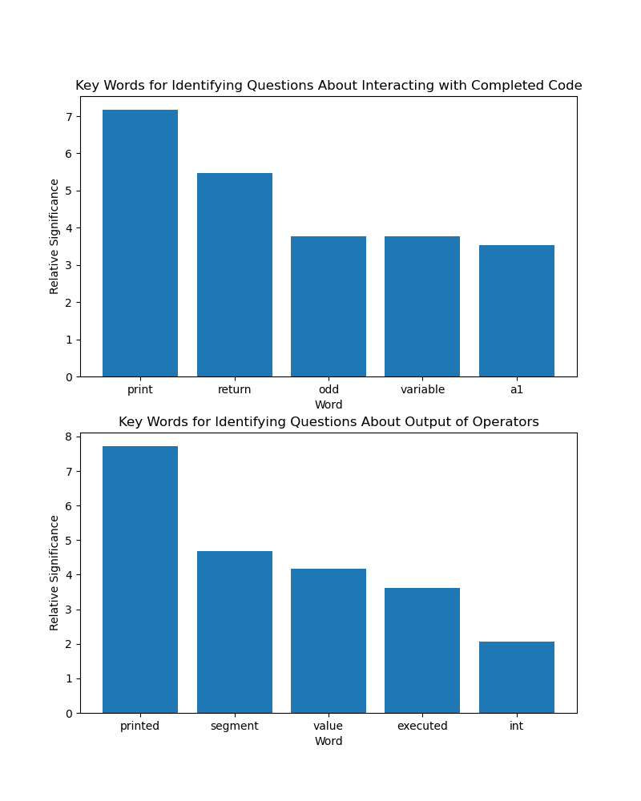
TF-IDF: Interpretation

Slide 14
TF-IDF: Interpretation

Slide 15
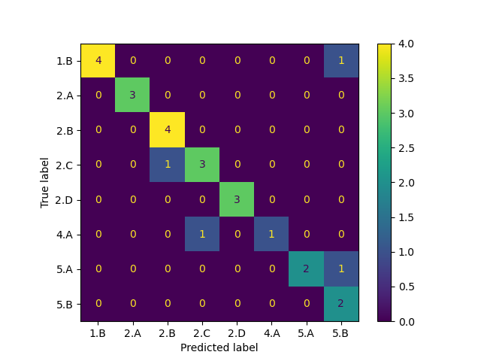
Sentence Transformer + Logistic Regression

Slide 16
ChatGPT Approach
API call + prompt:
”Given these definitions for skills … and these examples, classify the skill assessed”

Slide 17
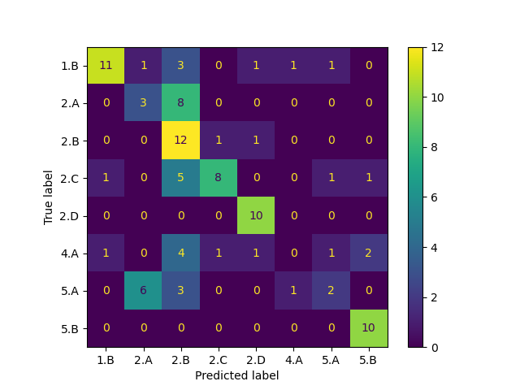
ChatGPT Results

Slide 18
Results
TF-IDF + Logistic Regression: 70% accuracy Sentence Transformer + Logistic Regression: 80% accuracy
ChatGPT Classifier: 48% accuracy

Slide 19
Questions

Slide 20

Thank You!
https://www.linkedin.com/in/jeffg456123

