Slide 1

Game Theory and Sustainability

Slide 2
What is game theory?
Game theory is the study of strategic interaction among rational agents
It provides a way to think about interaction between players
Allows us to formally think about bargaining, tragedy of the commons, nuclear war, and the way markets work

Slide 3
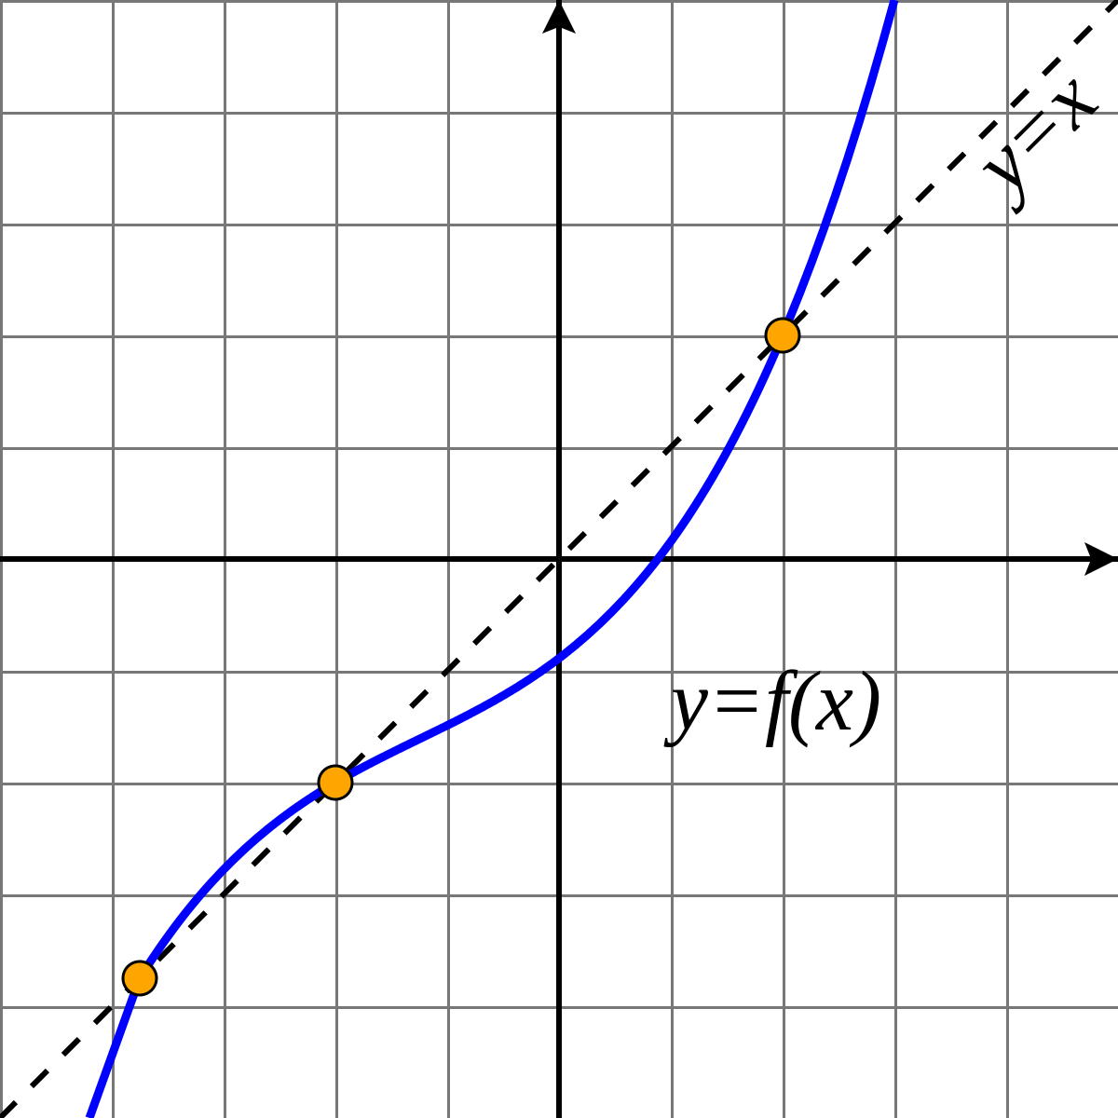
Solution to games: Idea of a fixed point

Slide 4

Nash Equilibrium
Nash equilibrium is a self-fulfilling contract
If you play x and your opponent plays y, and neither of you want to change your play, it is a Nash equilibrium
Not all games have a Nash equilibrium
Not all games have a unique Nash equilibrium
Not obvious Nash equilibrium will get played

Slide 5
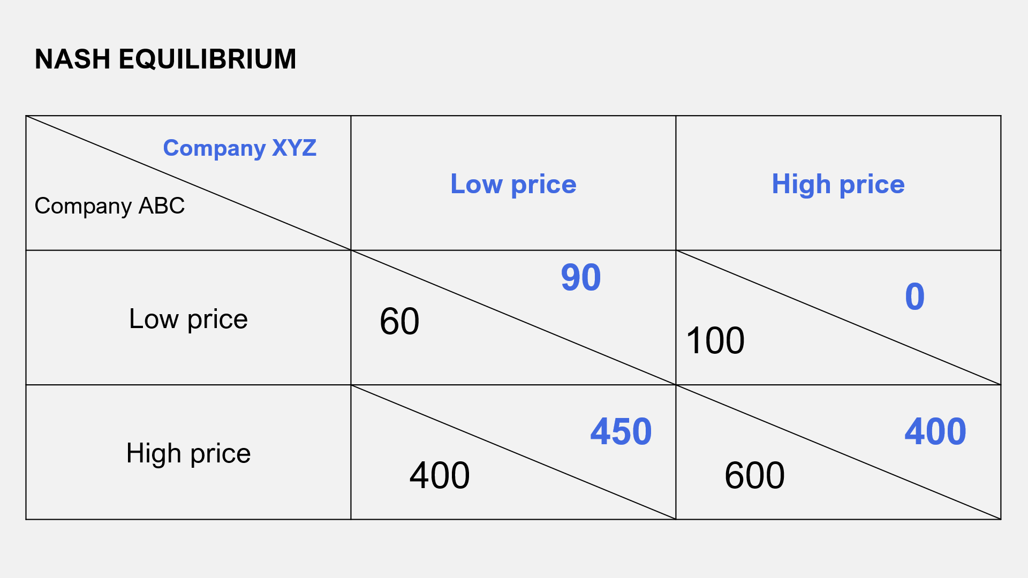
Finding a Nash Equilibrium: Normal Form Games
Column player on right
Row player on left
Compare top left blue to top right blue
Compare top black to bottom black
Star larger
If two stars, this is NE

Slide 6
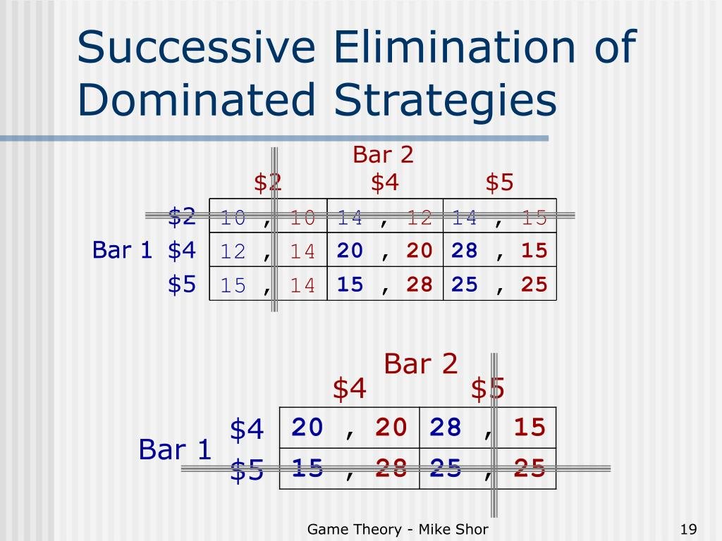
Sequential elimination of dominated strategies
Eliminate bad strategy
Now look for new dominant strategy
Repeat
Can yield wrong answers if order of elimination matters

Slide 7
Dominant Strategy
Something a player will always do regardless of response
Always best response
It’s hard to regulate collusion because often firms would have done something anyways

Slide 8
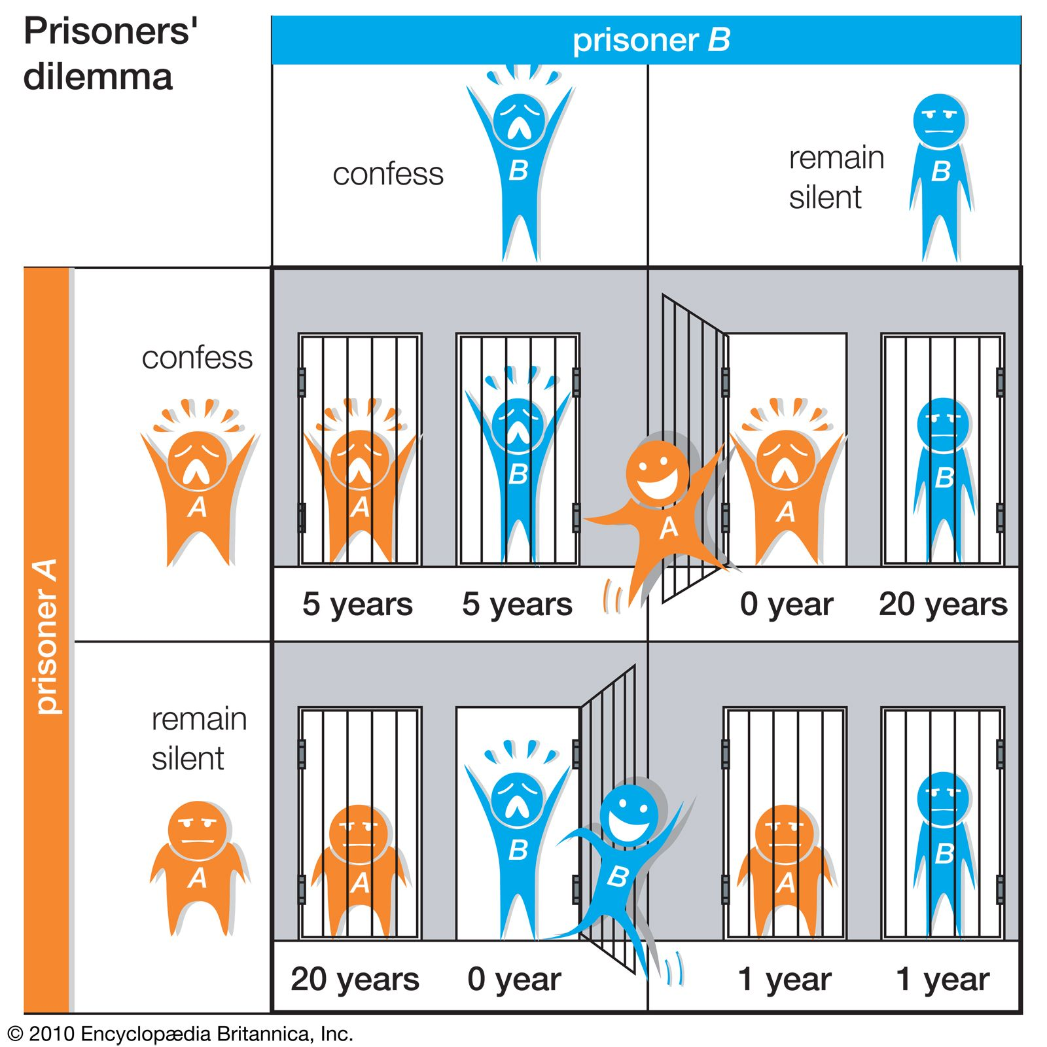
Prisoner’s Dilemma

Slide 9
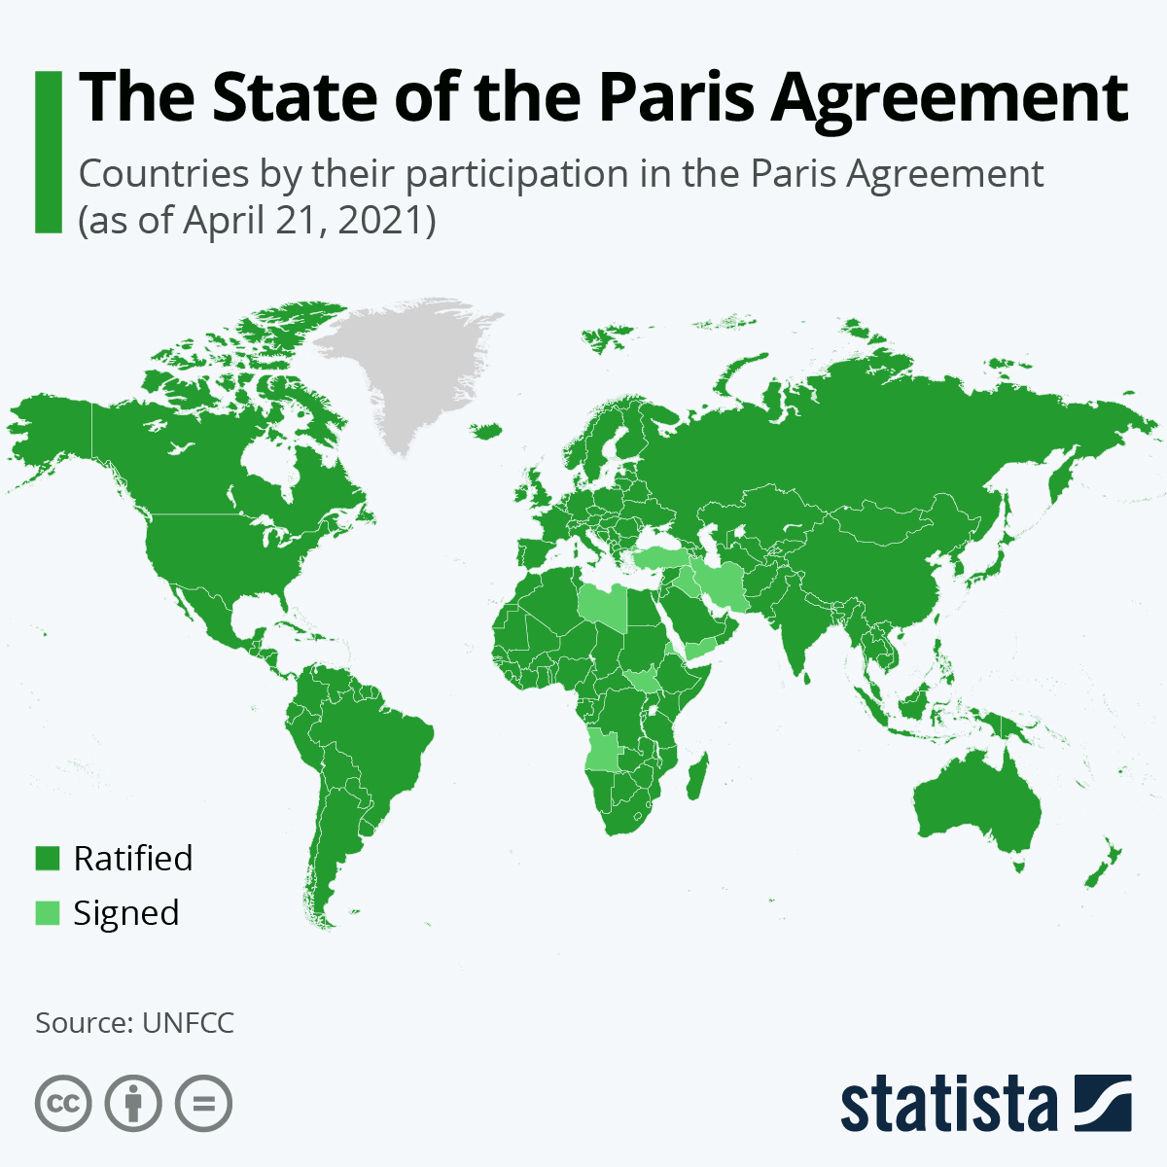
Can you think of a real world Prisoner’s dilemma?

Slide 10
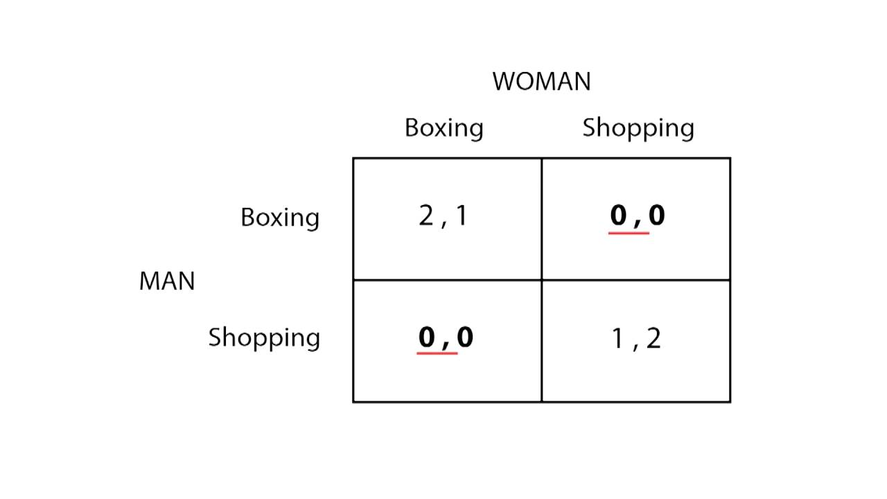
Battle of the Sexes

Slide 11
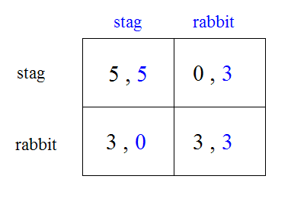
Stag Hunt: The problem of coordination

Slide 12
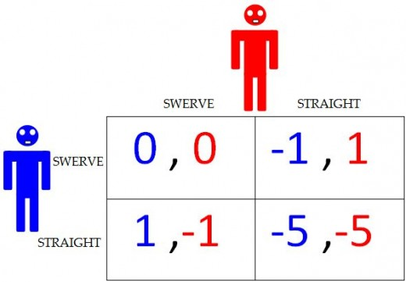
Chicken

Slide 13
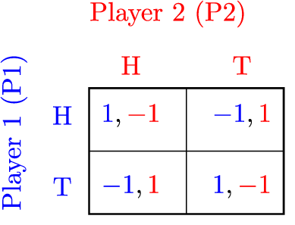
Matching Pennies (MSNE)

Slide 14
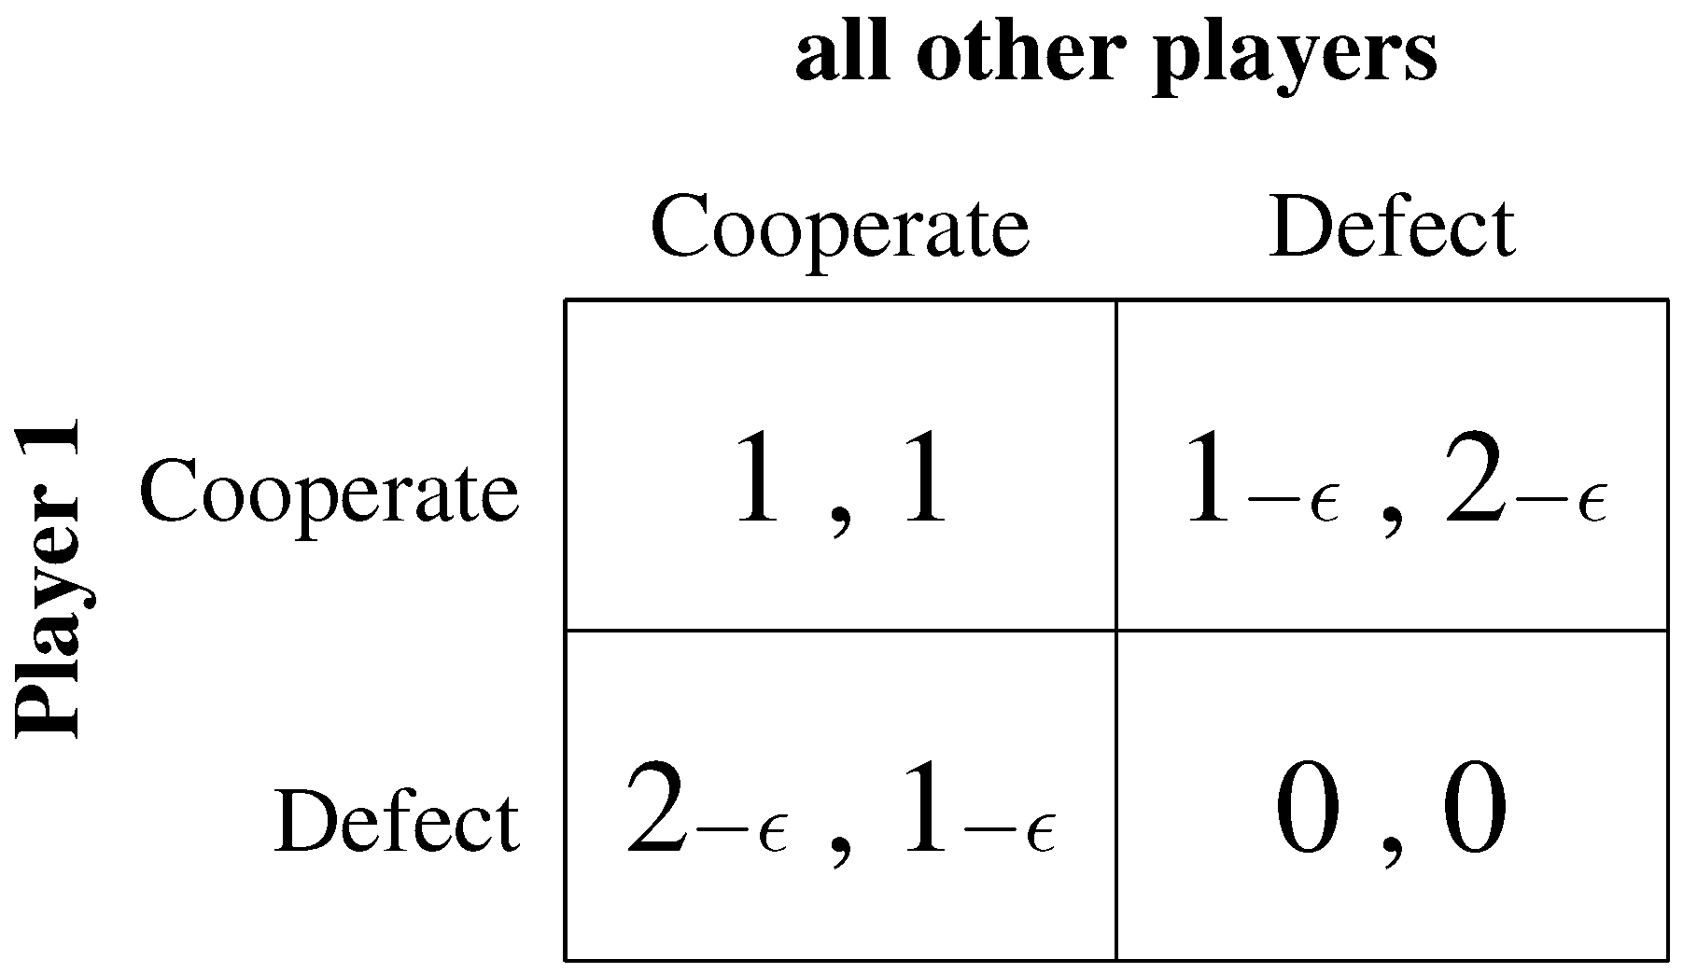
Tragedy of the Commons

Slide 15
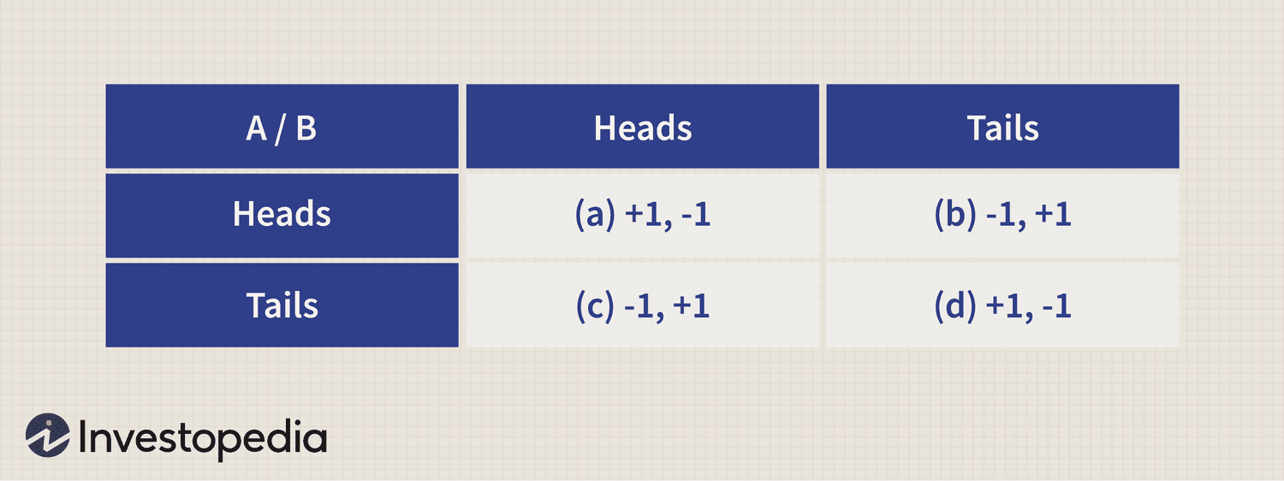
Zero-sum Games

Slide 16
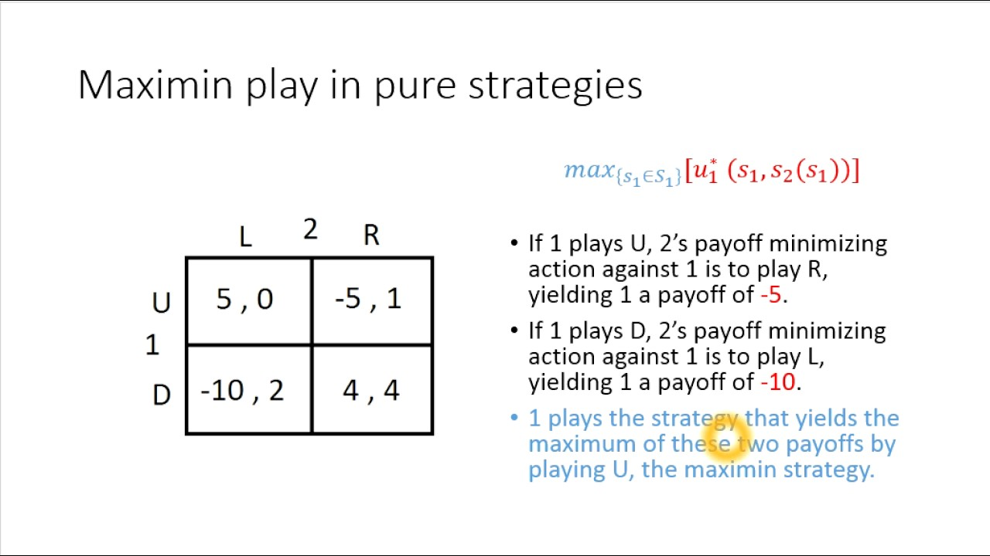
Minimax

Slide 17
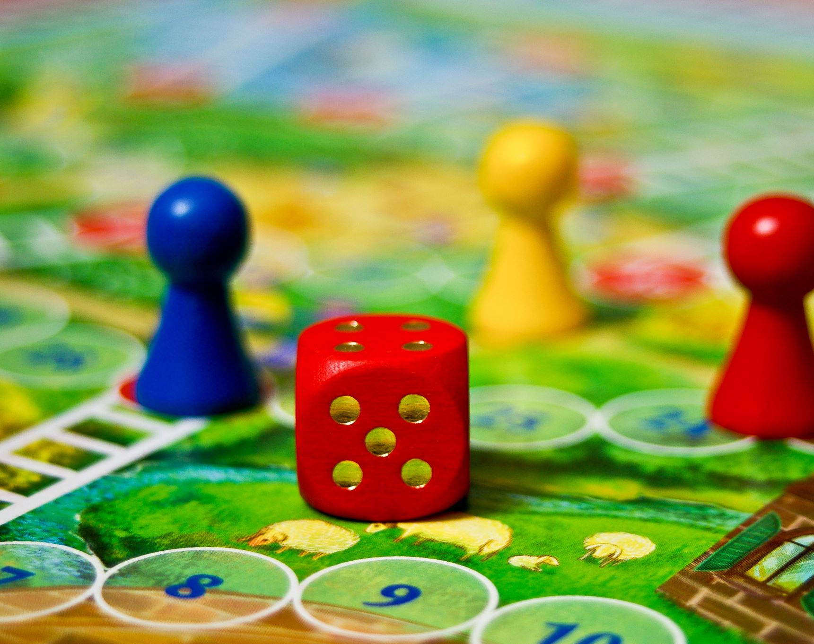
Can you think of a real-life zero sum game?

Slide 18
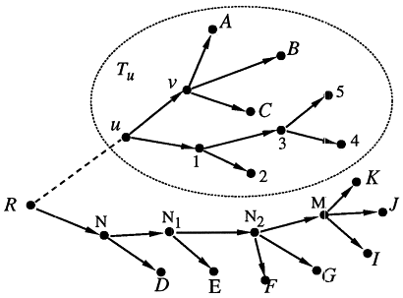
Induction games: Backwards Induction
Form we have seen until now called the normal form
In these games, players play simultaneously with no knowledge of other moves
However in real life, games often happen sequentially
To solve a sequential game, work backwards
Pick the best strategy for final mover at each final node, then previous mover at each above node

Slide 19
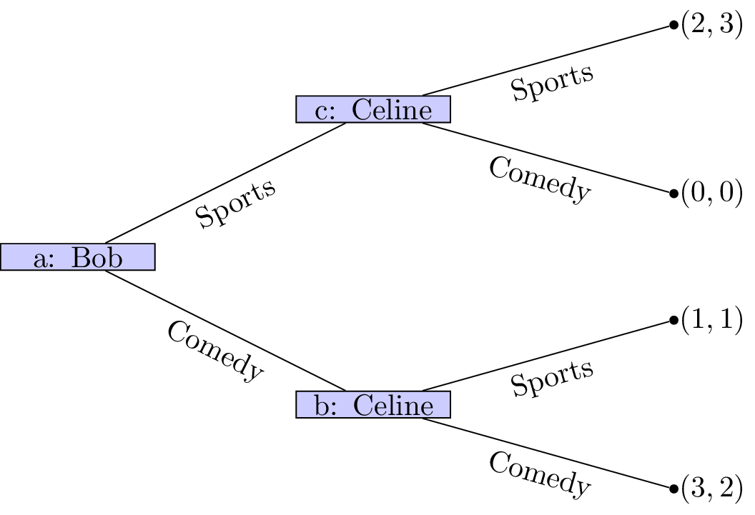
Induction games Example

Slide 20
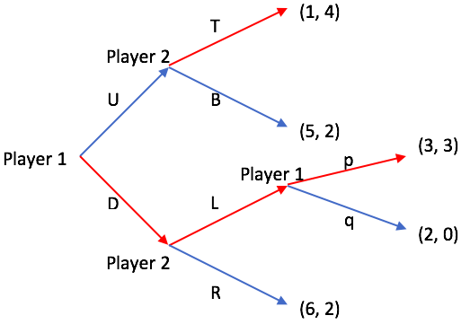
Induction games Example

Slide 21
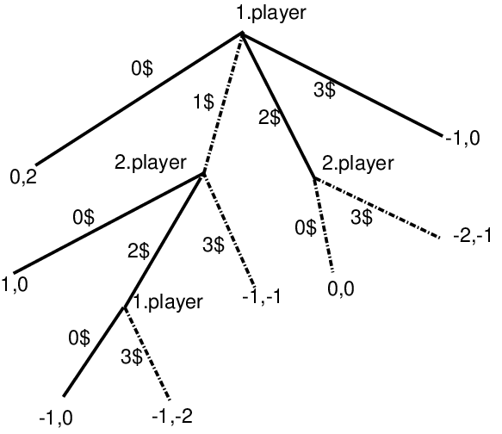
Dollar Auction

Slide 22
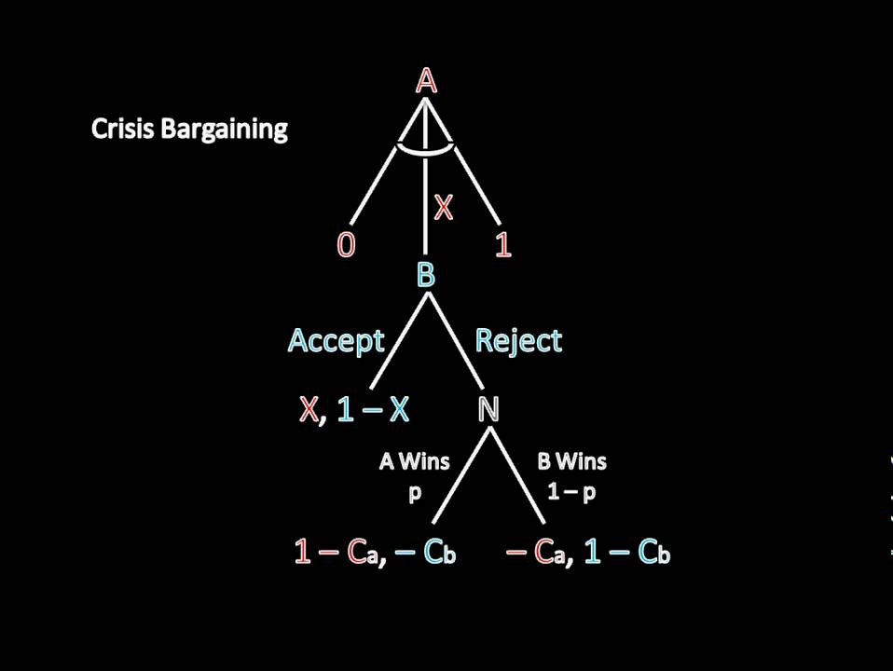
Bargaining Games
Players can either accept or reject
If no agreement, players leave with zero
How to determine who gets what?
Very important in negotiation of environmental treaties

Slide 23
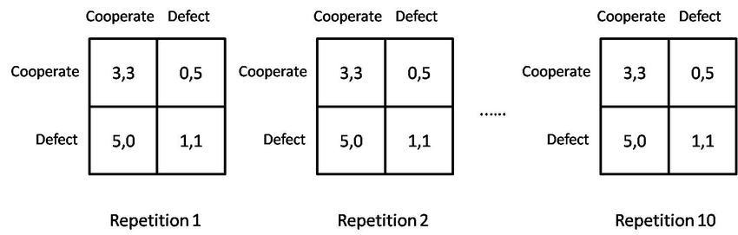
Repeated Games
One solution to the prisoner’s dilemma? Repeat the game
Players discount future value by some amount, if low enough can sustain cooperation
By punishing other player, can achieve no defection
Grim trigger

Slide 24
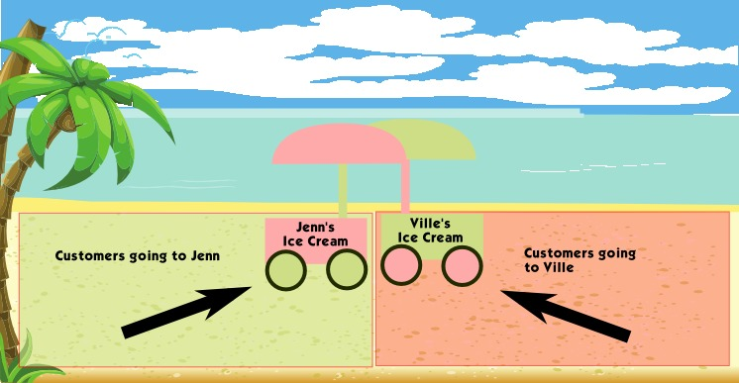
Hotelling Games: Ice cream and Politics

Slide 25
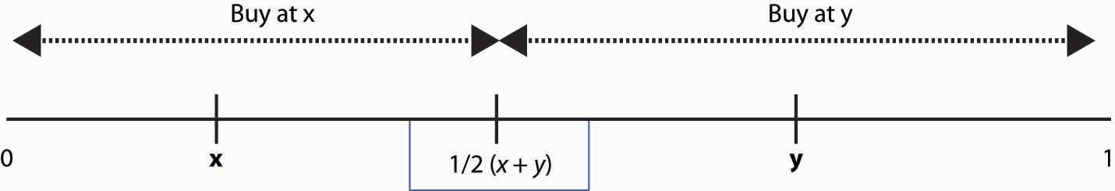
Hotelling games math

Slide 26
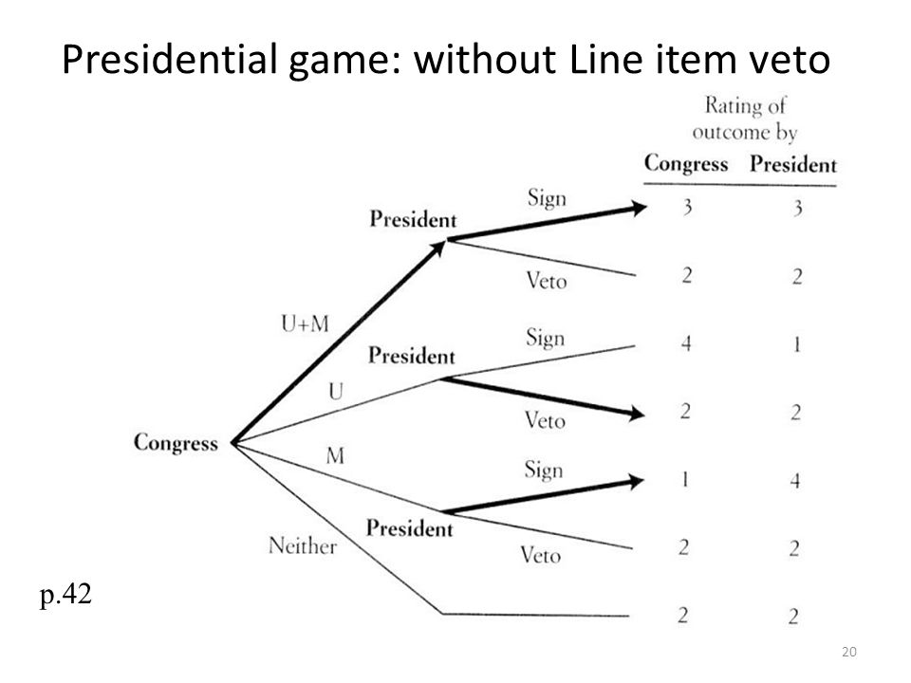
Game theory and congress

Slide 27
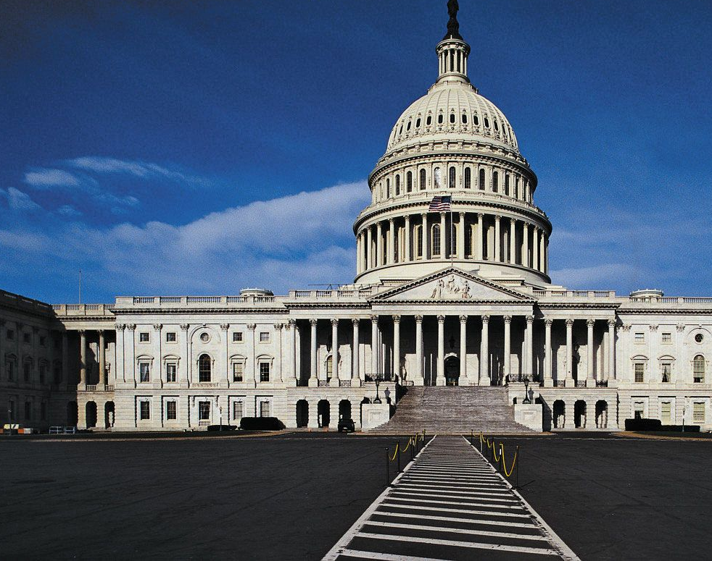
Congressional Activity Friday
On Friday, we will have a congressional activity
Bills will be introduced by the author or a brave soul willing to introduce (2 minutes followed by one minute of questions)
A rebuttal will be heard of the same length
Arguments will be heard going back and forth (1:30 plus 45 seconds of questions)
This continues until speakers list runs out. Then vote and move on to next bill

