Slide 1
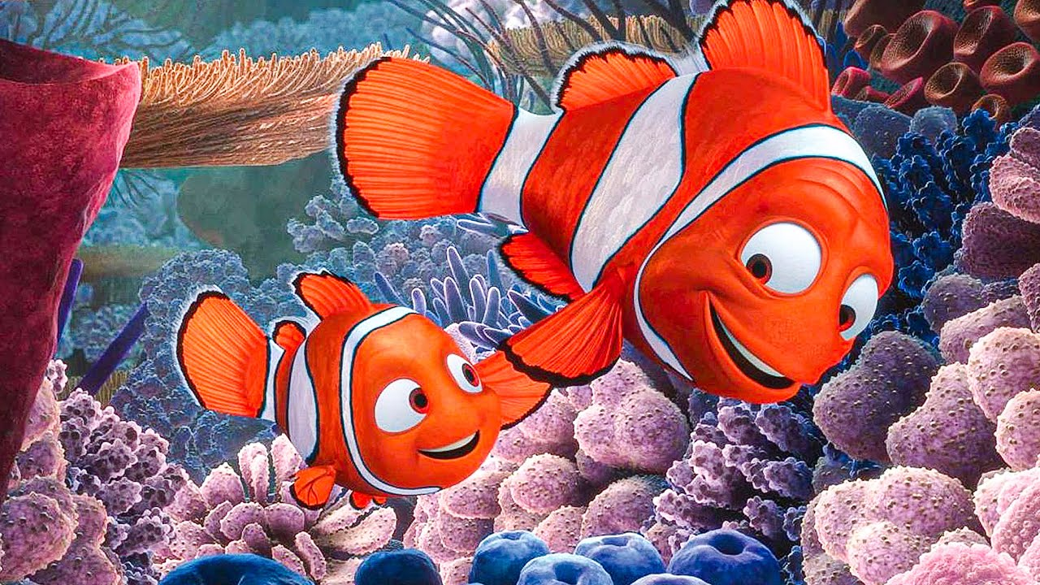
Fish Economics: How Nemo participates in the free market economy

Slide 2
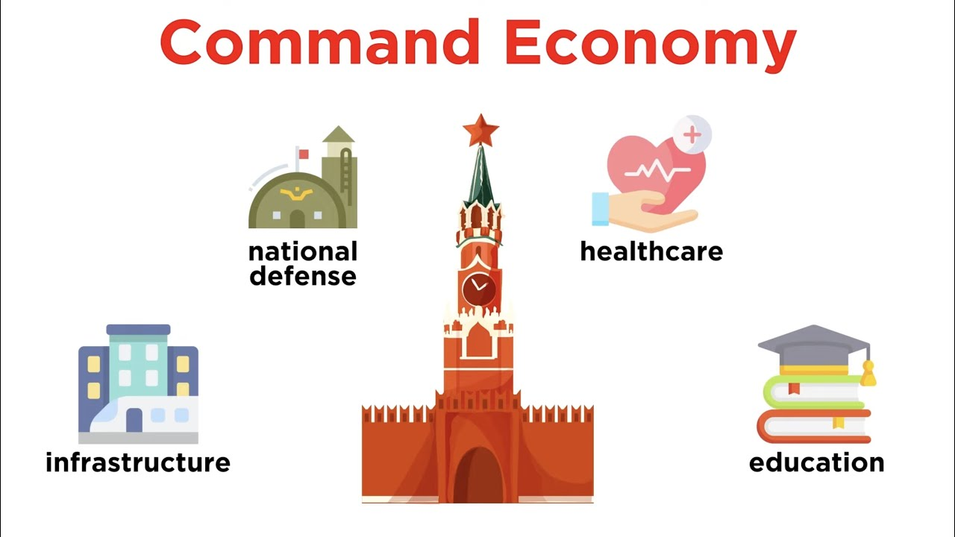
Command and Control Strategies

Slide 3
How to conduct environmental policy?
Decentralized Environmental Policies
Command and Control Strategies
Incentive Based Strategies

Slide 4

What is a command and control strategy?
Command and control strategies create optimal
Some people will compare it to socialism or communism, but it happens all the time in America
Most common type of command and control environmental strategy standards

Slide 5
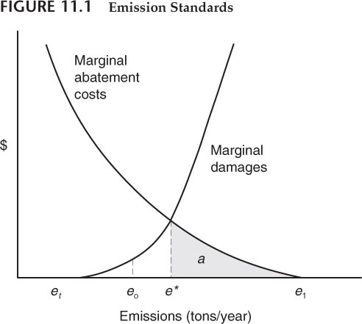
Standards on a graph
Officials mandate no more pollution than e*

Slide 6
Benefits of Standards
Clear targets, much easier to work with, no need to worry about individual demand
Some activities are so dangerous or irresponsible, they need to be banned
Cell phone use while driving, speed limits
Radiation leaks, rat poison in coffee
Public goods require public standards to ensure mass adoption

Slide 7

Problems with standards
What do you think the problem with standards is?

Slide 8
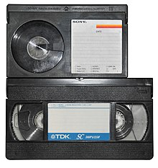
Problems with Standards
Many different governments can establish many different standards
Can adopt worse technology
Betamax
Lightning cables
Static efficiency vs. Dynamic efficiency
Can be expensive and difficult to follow
Does not consider firm heterogeneity and incentives

Slide 9
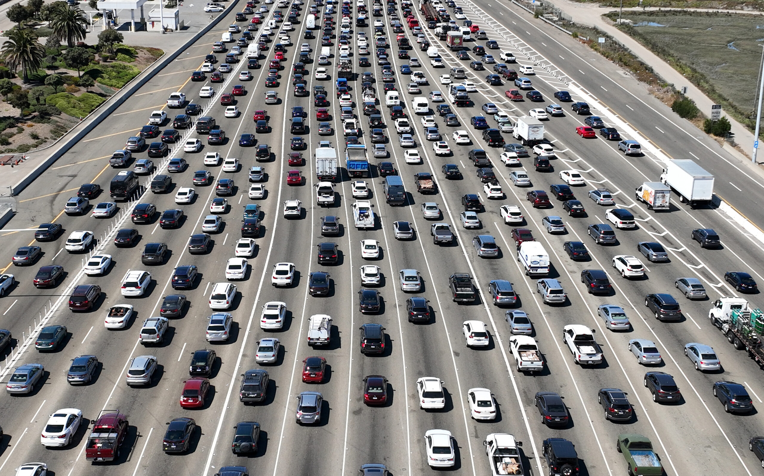
The California effect

Slide 10
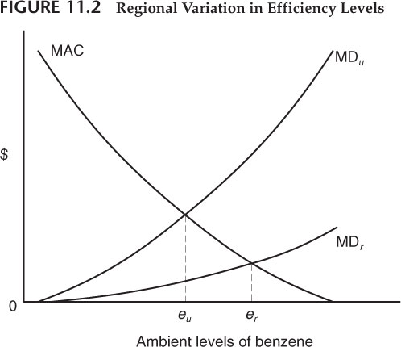
Regional Variation in Standards

Slide 11

Technological Standards
Techniques polluters must adopt to deal with pollution
Mandate of a particular way of going about the solution
Catalytic Converters, emissions testing
Not just used for environment
EU in about everything GPDR
Can create problems

Slide 12
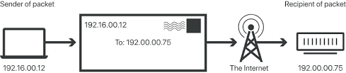
Can you think of a technological standard not implemented by government?

Slide 13
Economics of Standards
In some cases, truly require zero risk
In others, just need to set cost equal to benefits
A little bit of rat poop in ketchup

Slide 14

How to choose standards: Significant tightening
Increase standards until no significant improvement from further increases

Slide 15
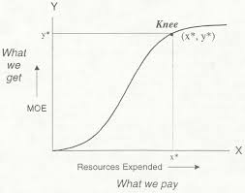
Knee of the curve
Tighten until major drop-off in benefits from further increases
Where would this work well?

Slide 16
De minimis rule
Standards should be such that any additional risks are minor
How could this be done in practice?
Where would this work?

Slide 17
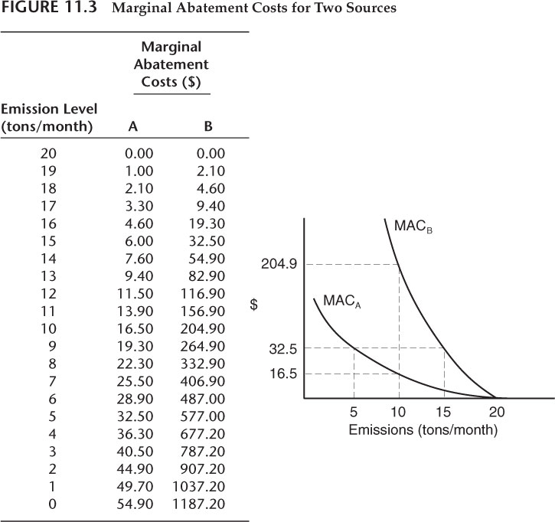
Equimarginal Principal Standards

Slide 18
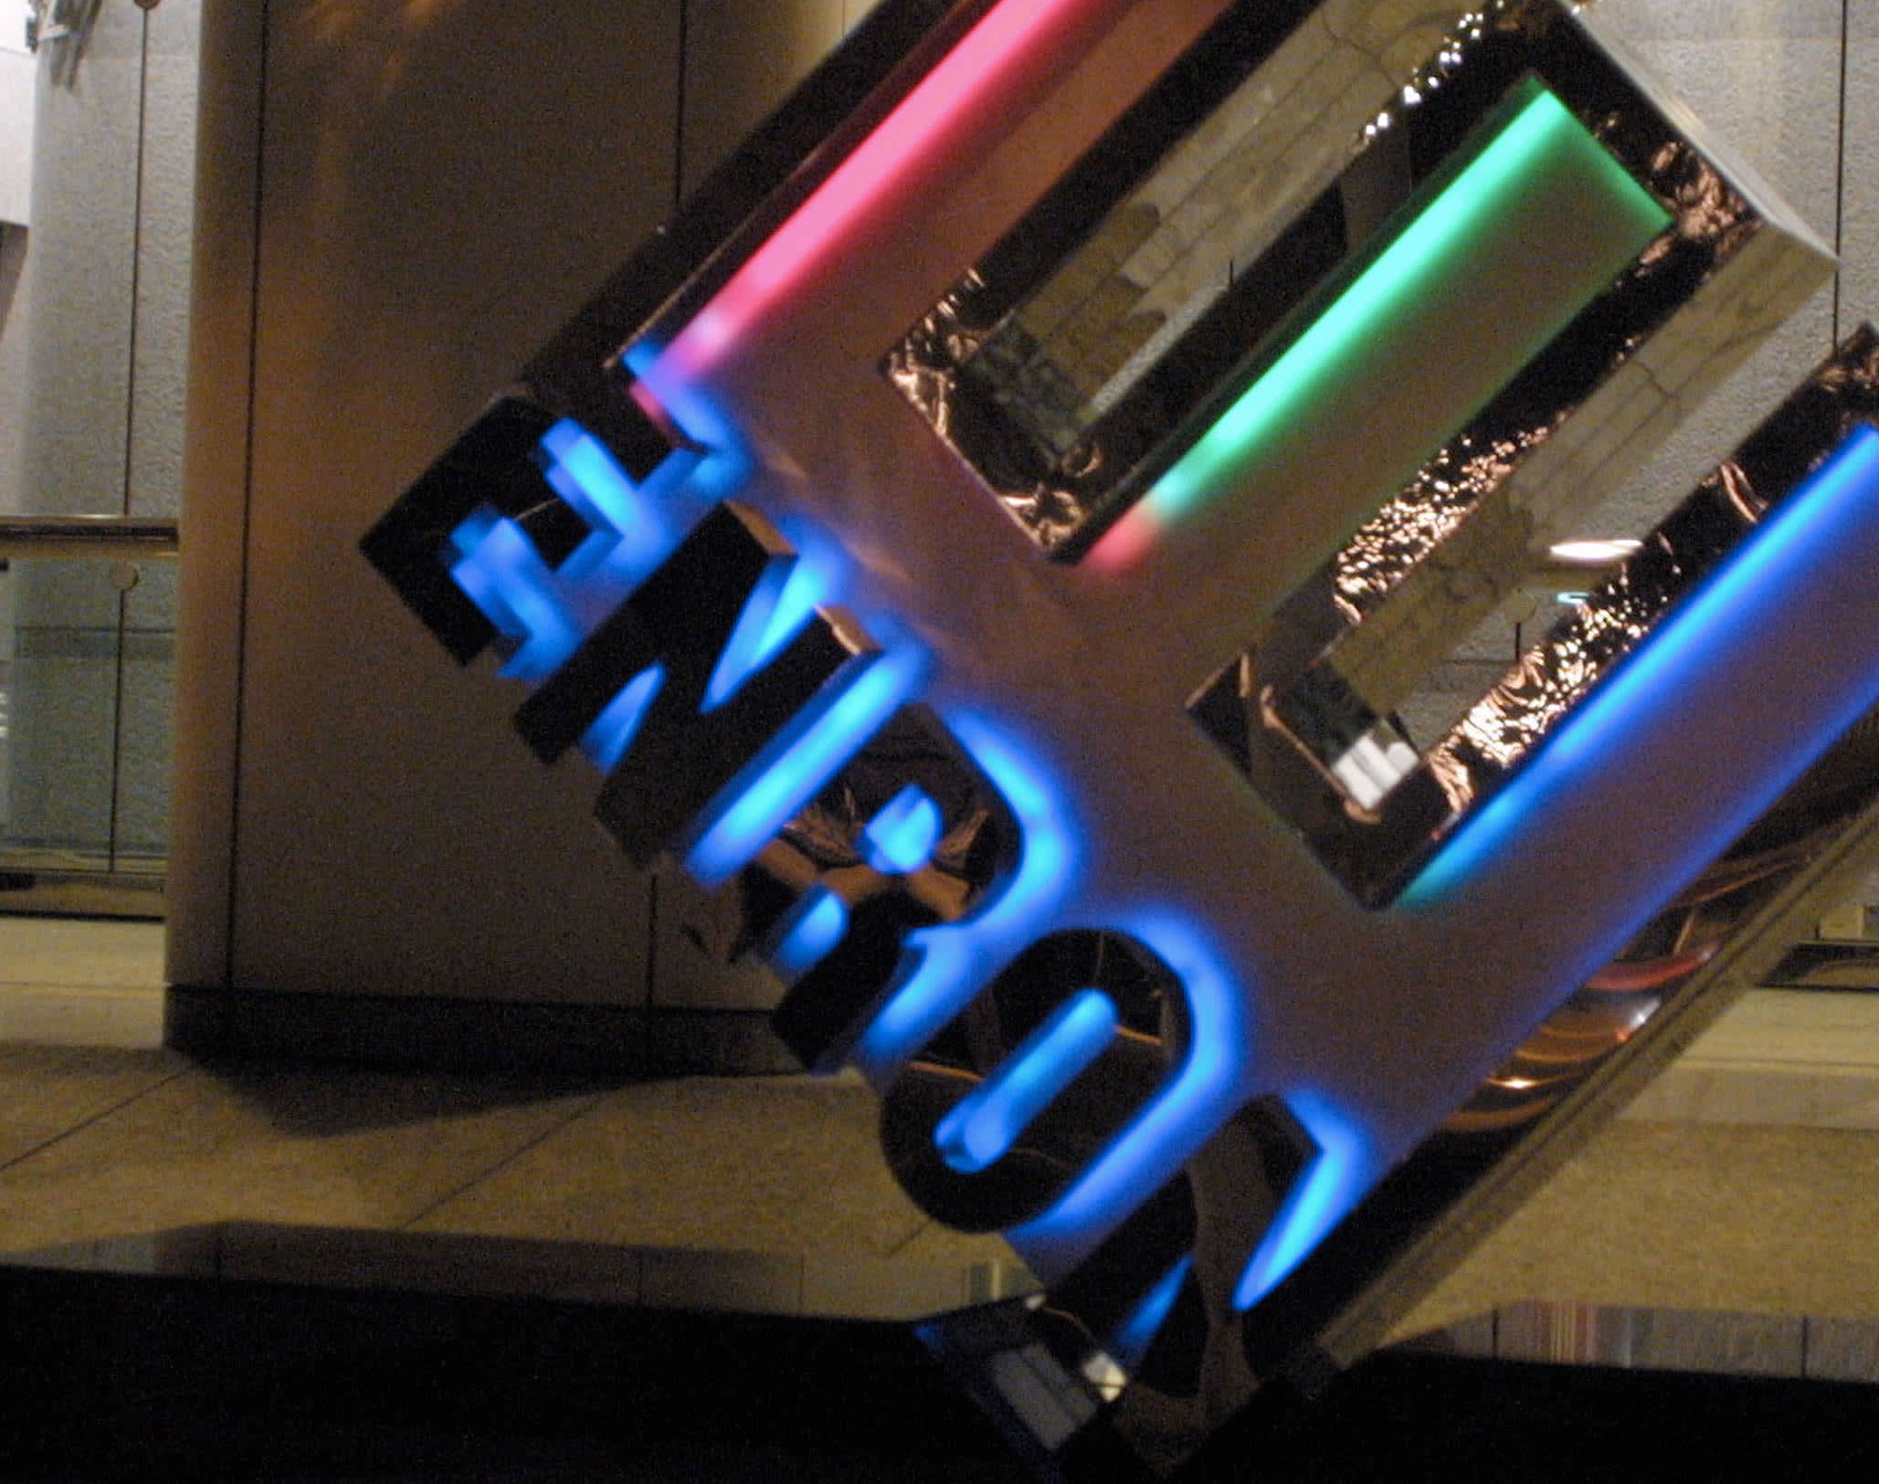
Enforcing Standards
If standards set too high, may not be followed
Firms are rational actors that follow incentives
Cost to enforce standards

Slide 19
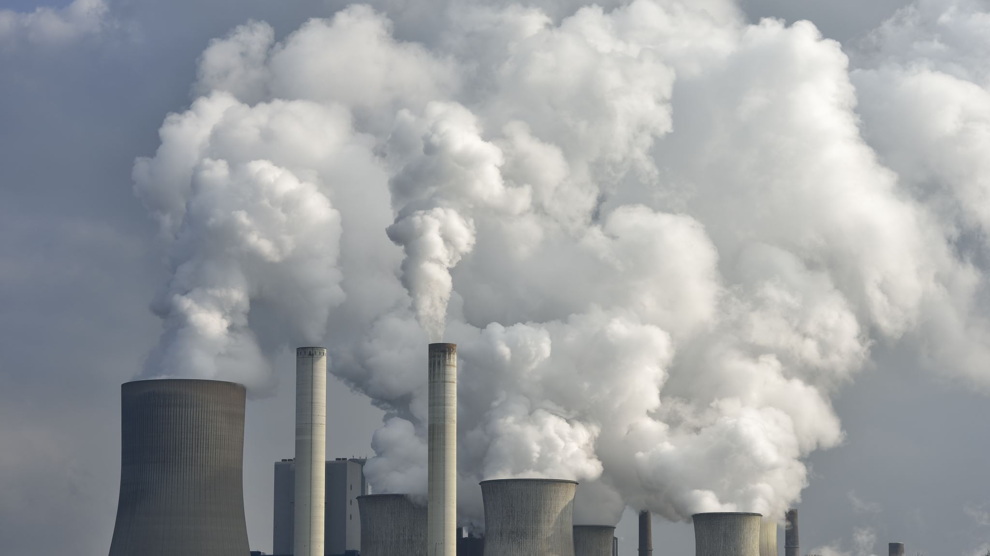
Incentive based standards
Total emissions = total output* inputs used for unit of output * emissions per input
Standards expressed as allowable emissions per unit of output
Polluters can reduce input per unit or emissions per unit
Encourages innovation

Slide 20
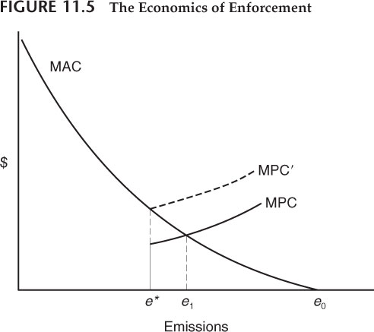
How firms view standards

