Slide 1

Environmental quality

Slide 2

Economic Efficiency vs Equity
Efficiency promotes the outcome that maximizes output while minimizing costs
No one can be made better off without making someone else worse off
Is this a smart way to think about the world?
Equity promotes making sure that resources are evenly distributed across the population. Focus on fairness

Slide 3
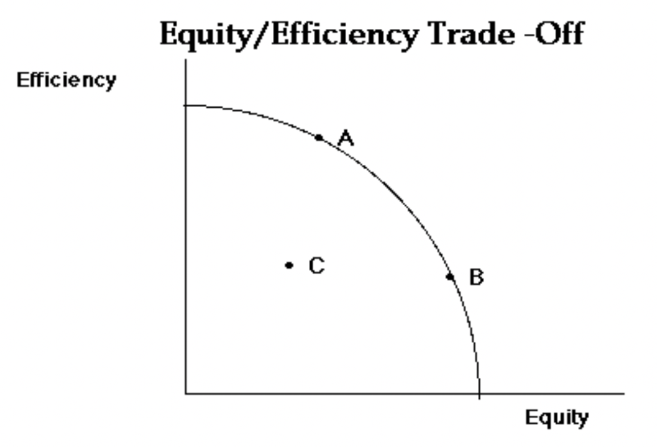
Efficiency-Equity Tradeoff: Is this the right visual?

Slide 4
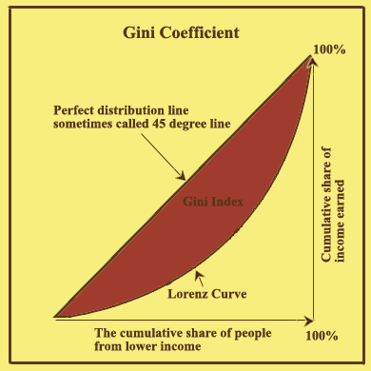
Gini Coefficient
Measures concentration of wealth
Coefficient of 0 means wealth evenly distributed
Coefficient of 1 means all wealth controlled by one person

Slide 5
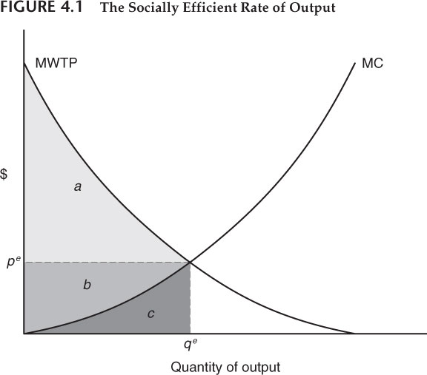
Economic Efficiency:
Marginal Willingness to pay equals marginal cost
Must take into account externalities
Where is producer surplus?
Where is consumer surplus?
Where is total cost?

Slide 6
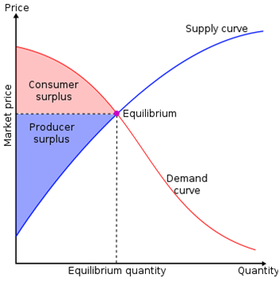
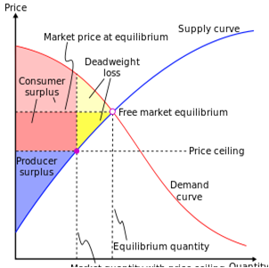
Deadweight Loss
A loss without a corresponding gain
What actions might result in deadweight loss?

Slide 7
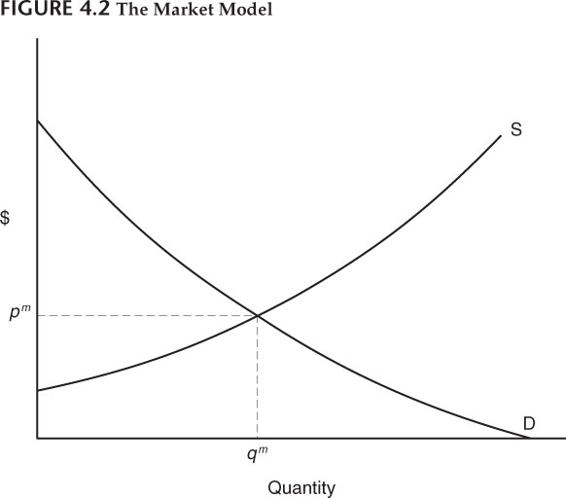
Free markets
Buyers and sellers agree on a set market-clearing price
Generally agreed to be allocatively and productively efficient under most circumstances
How, what, and for whom to produce decided by markets
What is the benefit of free markets?
When might free markets fail?

Slide 8
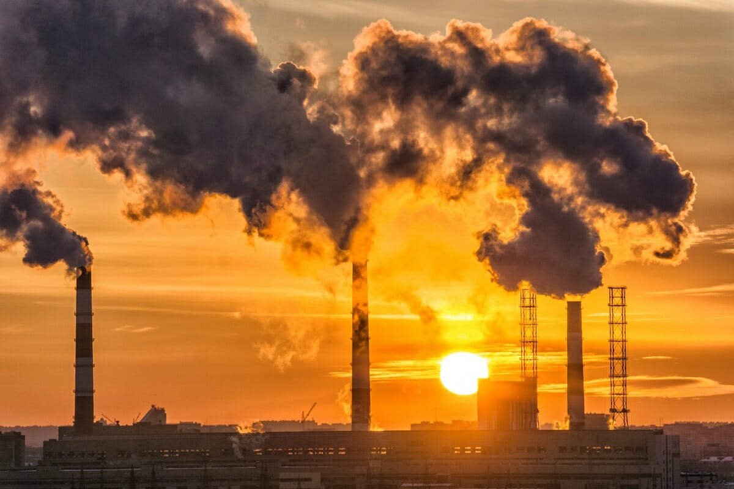
Externalities
Externalities are cost borne by people who do not participate in a transaction.
What is an example of a negative externality?
What is an example of a positive externality?

Slide 9
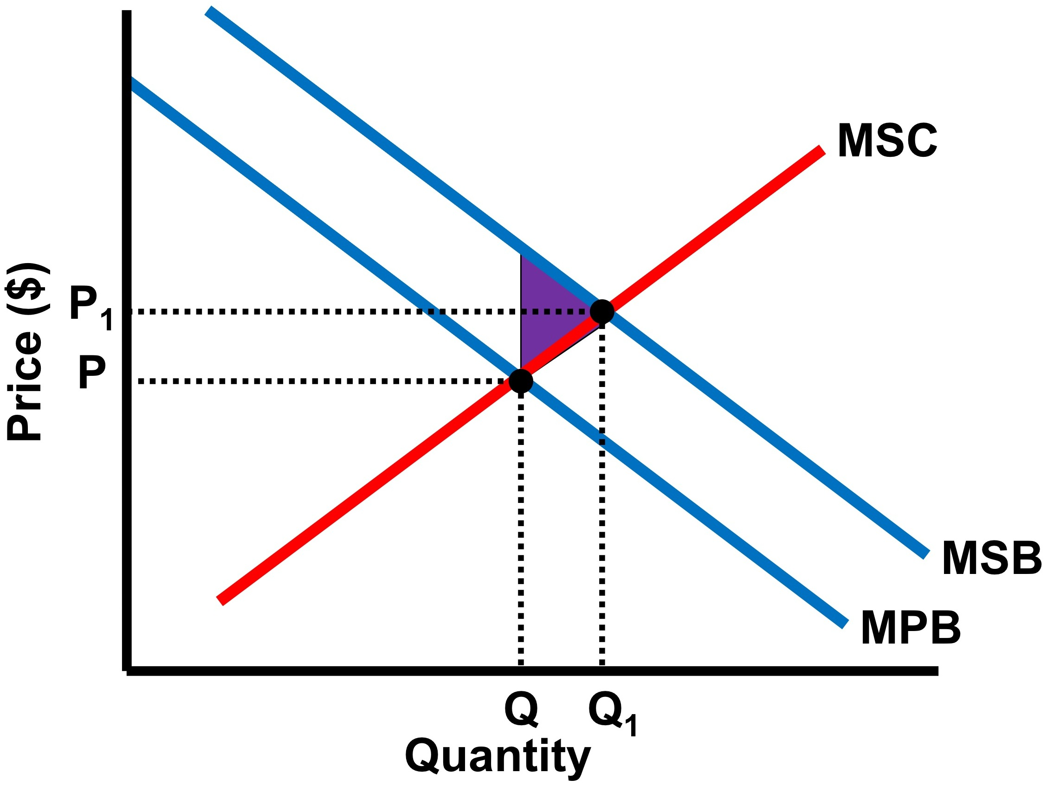
Positive Externality
A gain accrues to society but not to the participants in the transaction
How could we fix this problem?
Why are vaccines a positive externality?
Would it be efficient to vaccinate everyone?

Slide 10
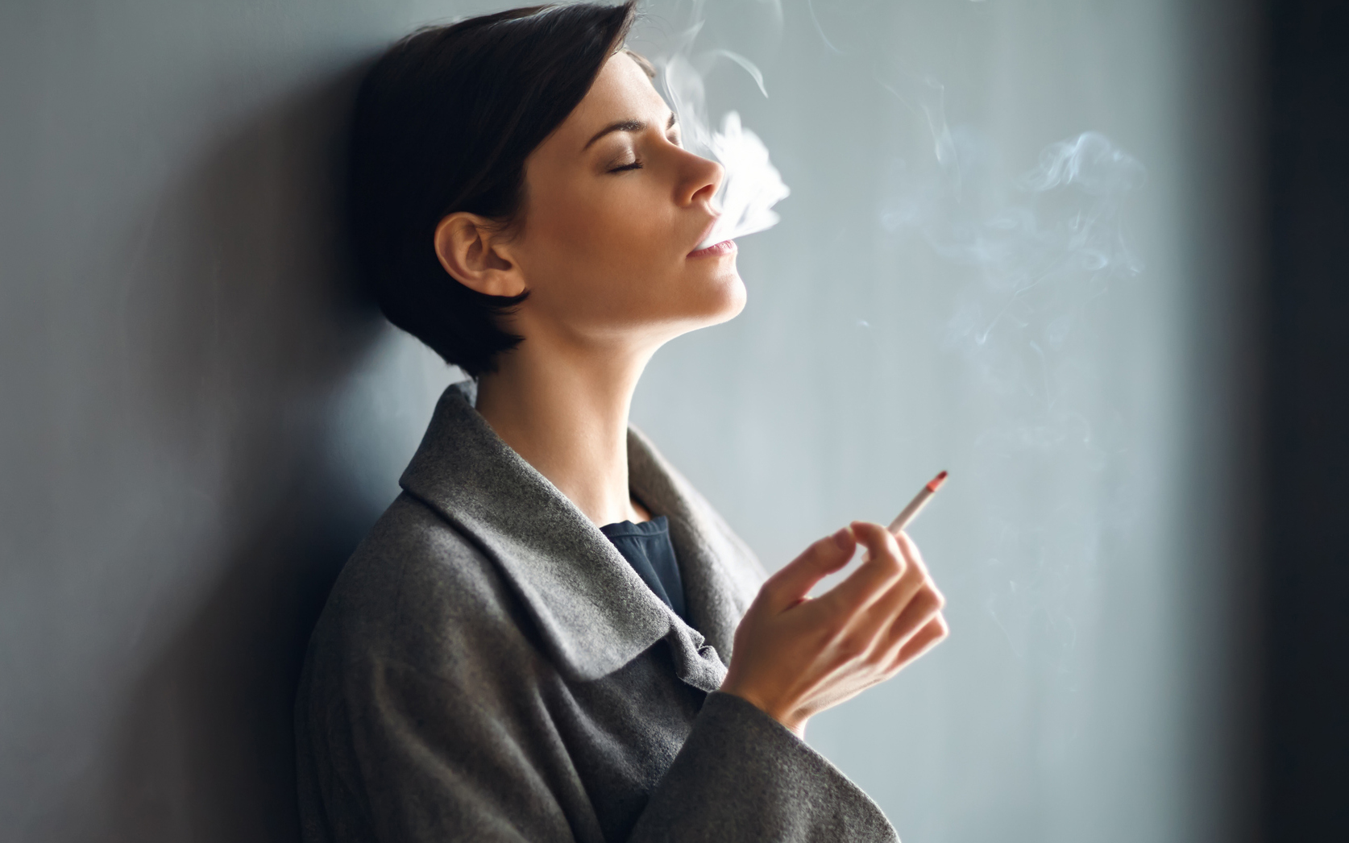
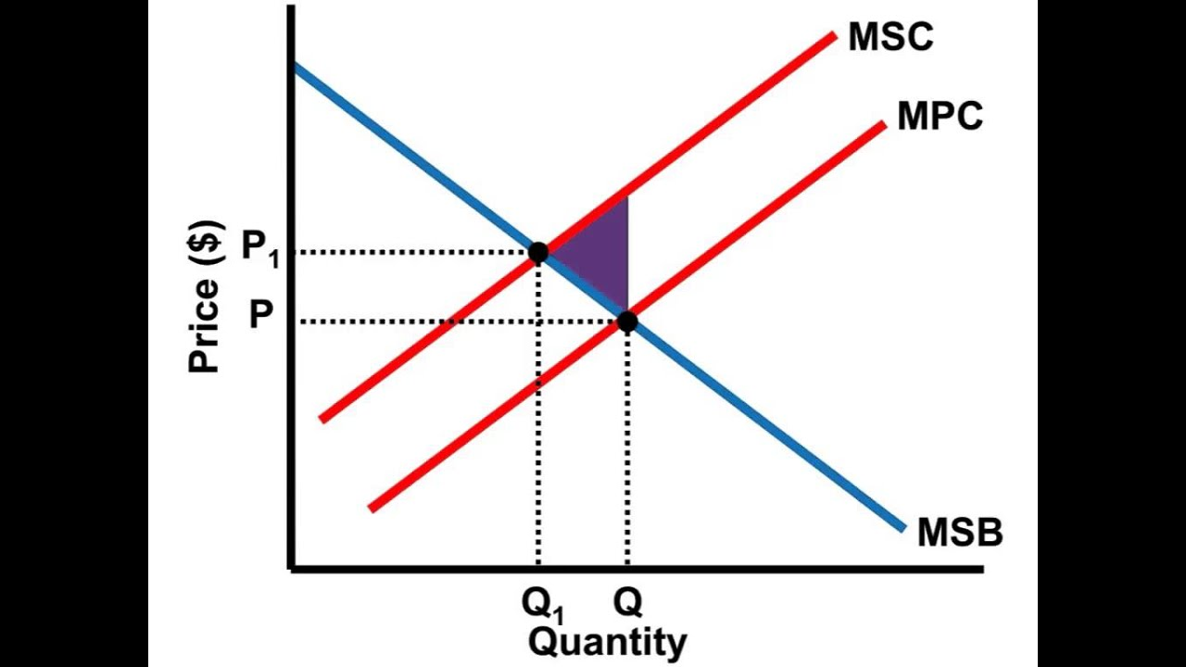
Negative Externality
A cost borne by society but not by participants in the transaction

Slide 11
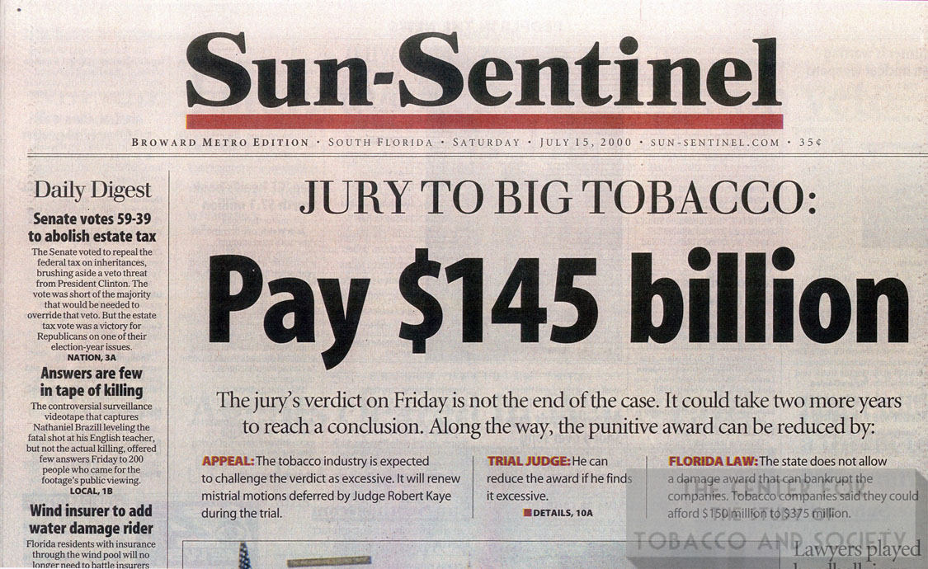
Tobacco lawsuit

Slide 12
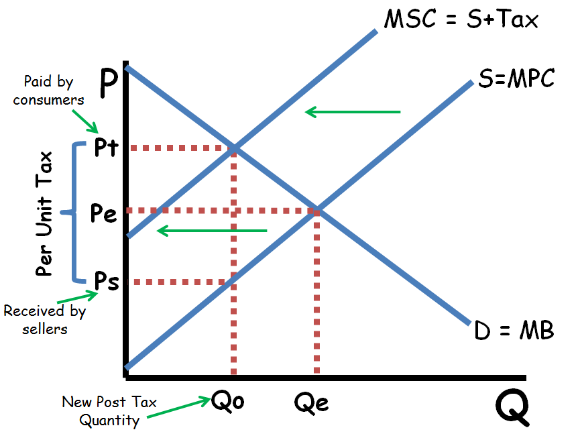
Tax to fix Negative Externality
Tax negative externality so market produces socially optimal amount
How else could we fix?

Slide 13
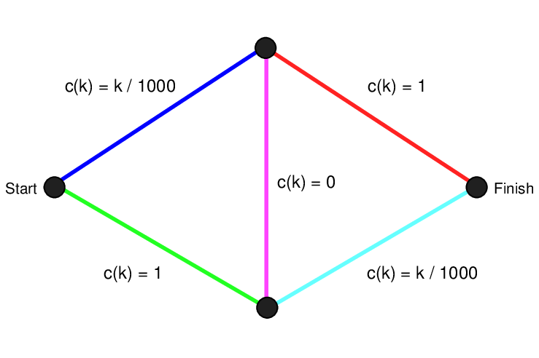
Congestion Games: How roads cause externalities

Slide 14
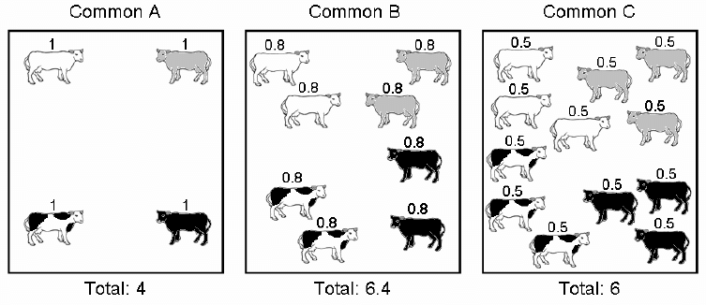
Tragedy of the Commons
When resources are available to everyone, they are over-used
World’s fisheries, roads, public parks
The main case for private property

Slide 15
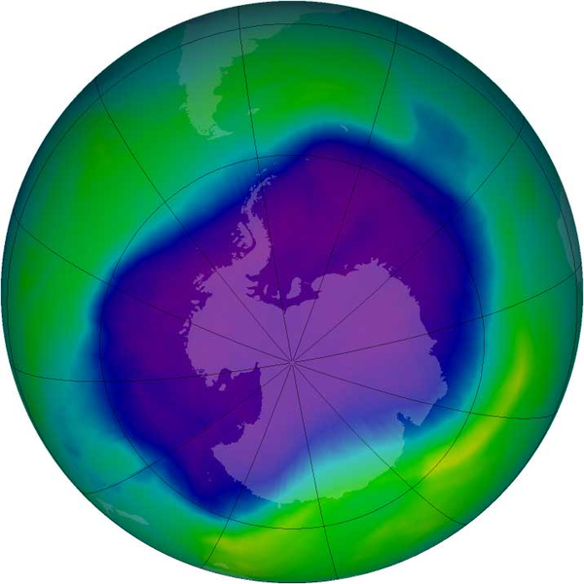
The Ozone Hole: A successful case of environmental policy

Slide 16
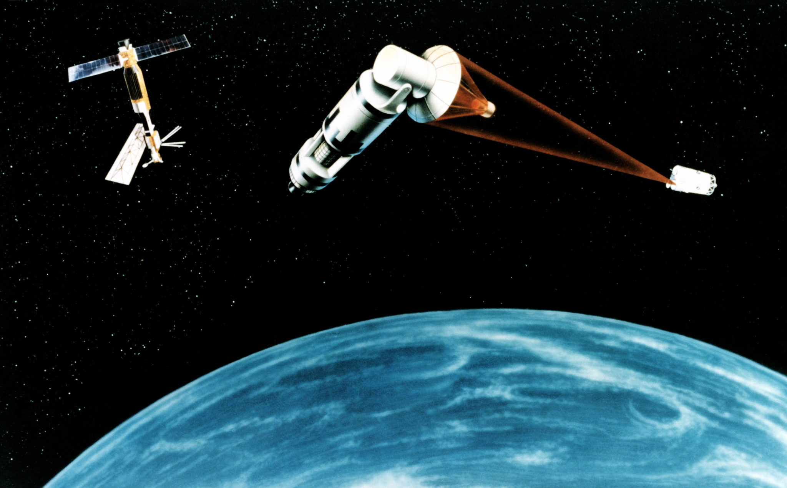
Public goods
Nonrival and nonexcludable
National security, public roads, environmental quality
Private markets will not provide
Why not?

Slide 17
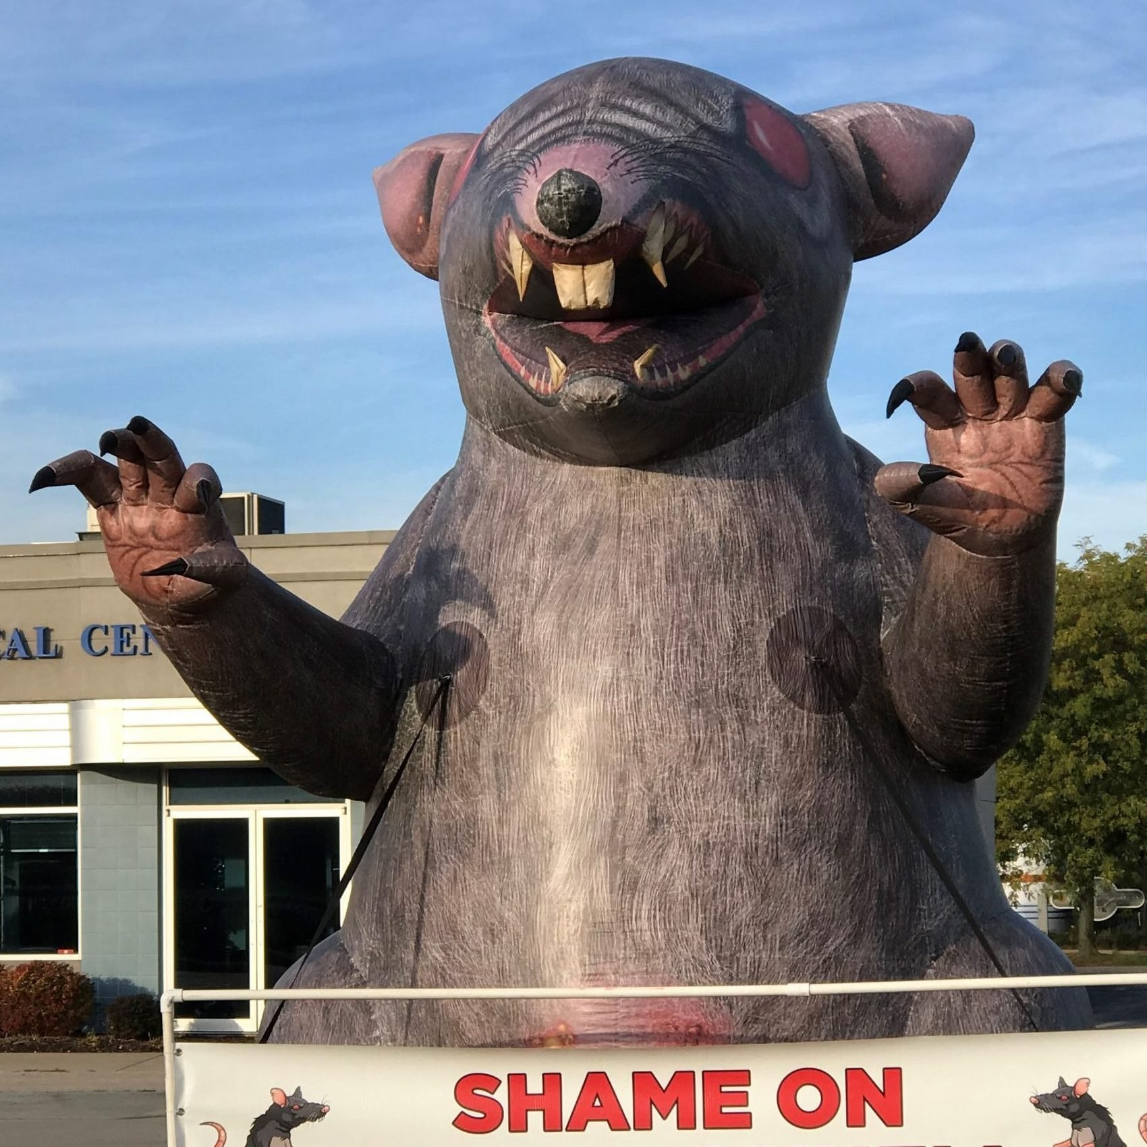
Free Rider Problem
If one person deviates, they face no cost but receive all the gains
One of the main reason, labor unions don’t get all members to pay dues
Can you think of other examples?
How to fix?

Slide 18
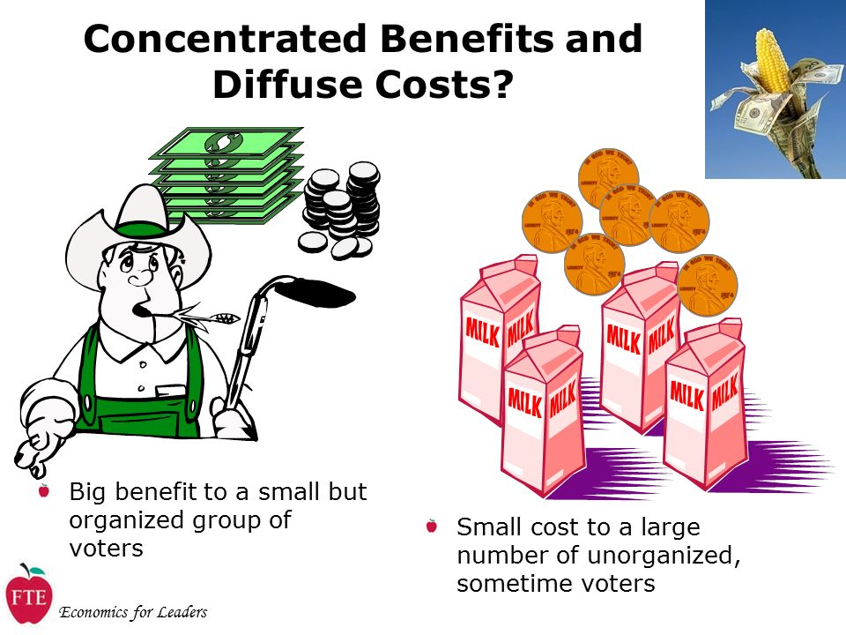
Agricultural subsidies

Slide 19
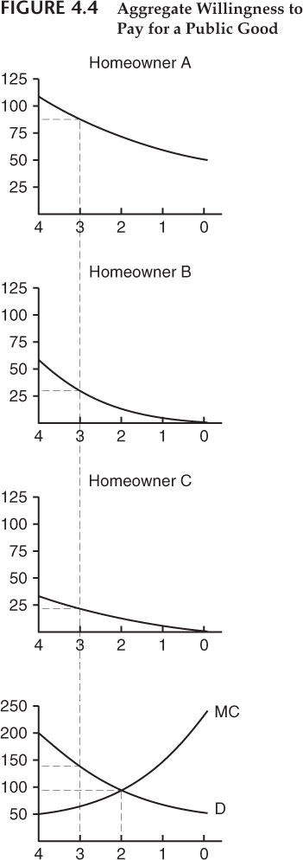
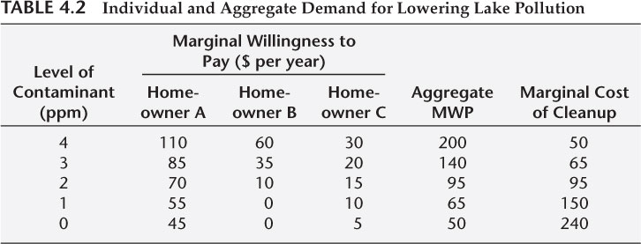
Efficient level of pollution
Where is efficient pollution delivered?

