Slide 1
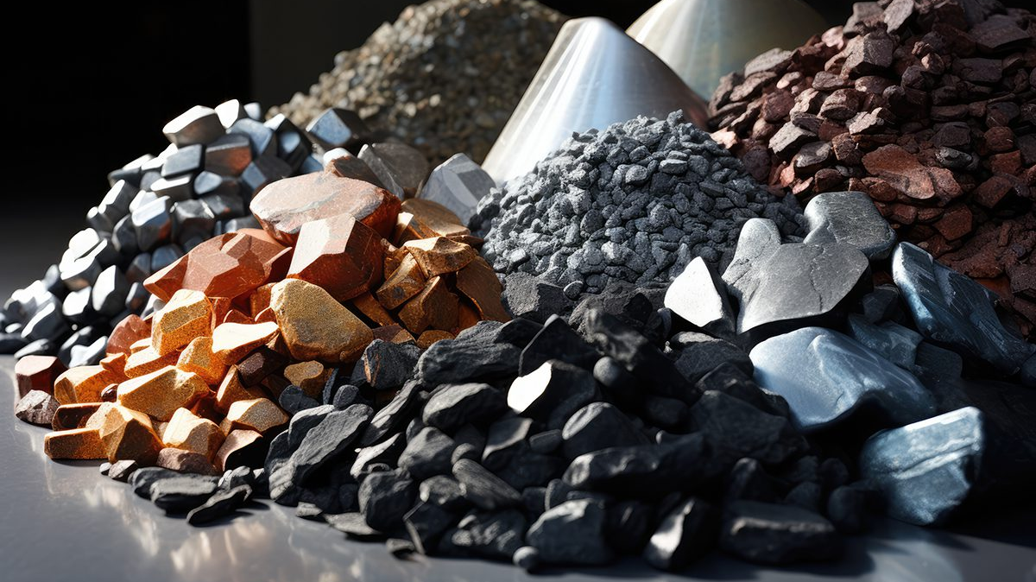
Critical Mineral and the Shame of the Modern World
Dana Golden

Slide 2
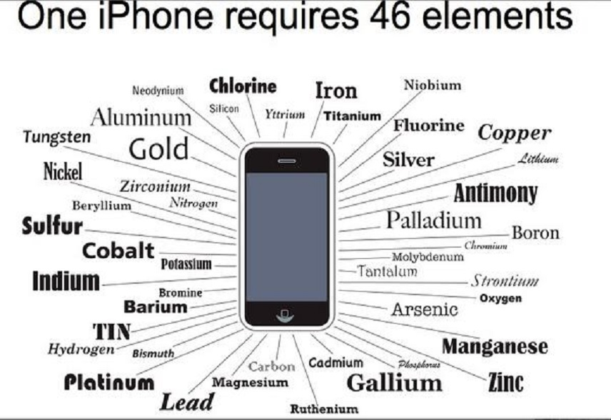
How Metals get used
Notes:
We are living in an era of metals. Now, more than ever, metals from around the world are required for even the most basic products. The number of periodic table elements required to make consumer products has exploded over the past quarter century. Whereas rotary phones contained fewer than 10 different metals on the periodic table, a modern cell phone requires 46 elements. The metals used in a cell phone are also highly difficult to substitute. The screen cannot make certain colors without europium and terbium, and modern technology would be absolutely nothing within the magical silicon that makes it all work.

Slide 3
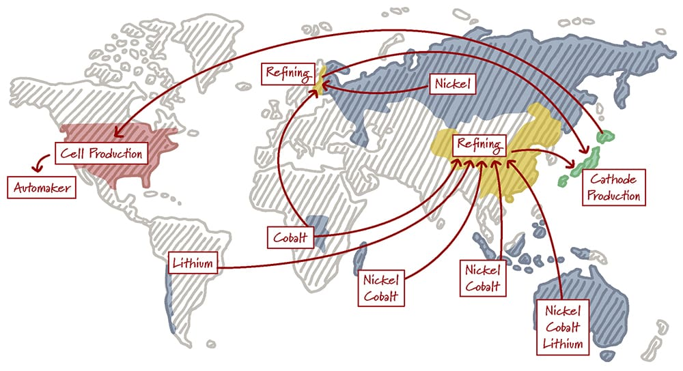
Critical Minerals Supply Chain
Notes:
The critical minerals supply chain is a long one and requires metals from all over the world be extracted in one country, refined in another, and combined to make products. Metals are often invisible, but they are essential to our way of life, and their journey from the dirt to our pockets has immense impact on the lives of people we will never meet in surprising and sometimes incredibly damaging ways.

Slide 4
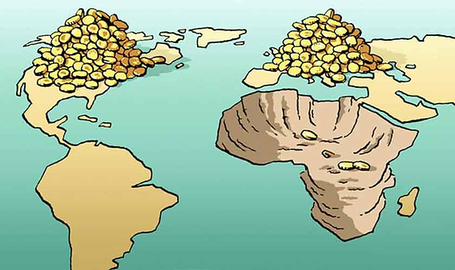
Colonial History of Exploitation
Notes:
Exploitation in the commodities sector is in no way a new trend. It is one of the oldest features of mercantile and now capitalist economics. Most history classes focus heavily on exploitation within the agricultural sector and how slaves languished in the fields of the American South picking cotton or died in Haiti on sugar plantations. However, metals are fundamental to the heart of capitalism. The story of the industrial revolutions and the rise of the computer age are in fact stories of small improvements in the production and usage of steel and copper. Mining has a history of colonial exploitation far more severe than agriculture that continues to this day.

Slide 5
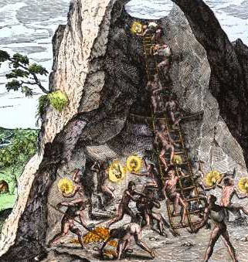

Potosi Indigenous labor
Notes:
Starting with the Columbian exchange, South America was plundered by the Spanish for its metals, particularly iron ore, gold, and silver. At the Potosi silver mine in Bolivia for instance, thousands of indigenous people were forced into slavery to feed the Spanish conquerors’ hunger for raw materials. Then, 60000 African slaves were brought to continue the mining practices. Without sufficient protective equipment, many suffered gruesome deaths. Much of South America was forced to become banana republics with limited economic development outside of the sector of commodities. These countries suffer to this day from a legacy of default and economic desperation even with tremendous economic potential.

Slide 6
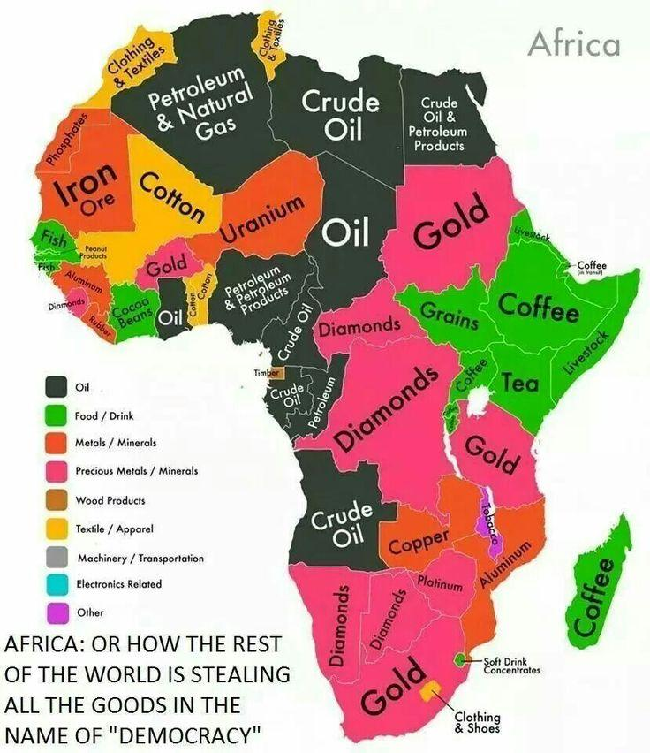
Scramble for Africa
Notes:
The most heinous metals exploitation however happened in Africa where an entire continent was ripped apart for its resources to feed the machines of the industrial age. Not only was labor harshly exploited by European actors but also European nations prevented the modernization of industries in Africa and redrew colonial tribal boundaries in order to create neat objects for organization of colonies. The legacy of colonialism lives on to this day.

Slide 7
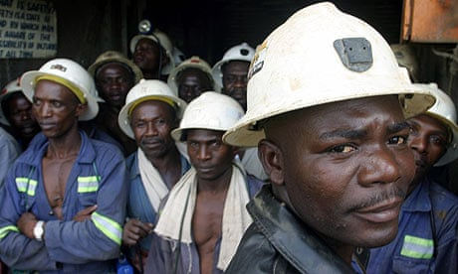
Modern exploitation of labor
Notes:
The modern world has not escaped the history of metals exploitation. In a world that continually seems to be more and more intangible and in the cloud, mining has grown exponentially. In fact, we are living at the moment in a material age fueled by work of workers in the third world.

Slide 8
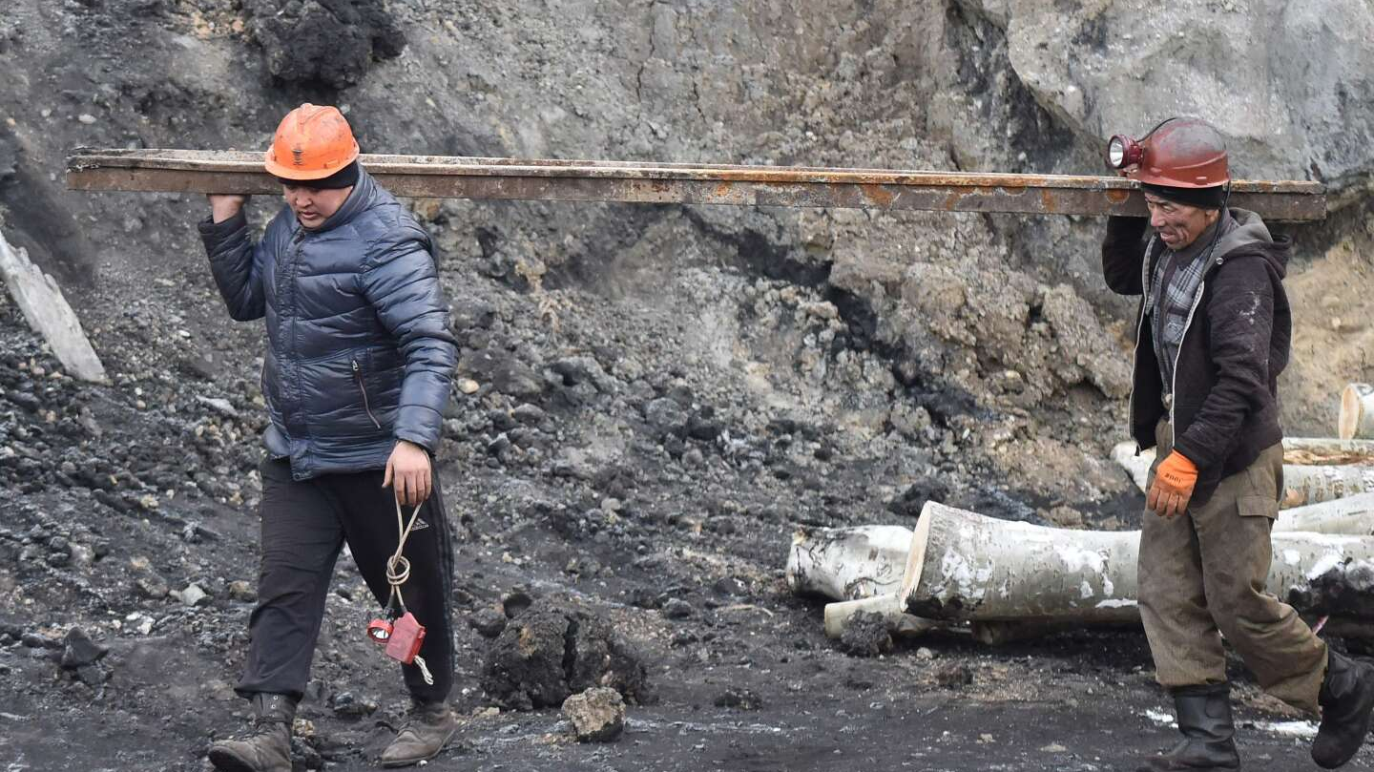
Forced labor in Xianjiang
Notes:
China remains a leader in rare-earth metals and metals in general. China has substantial rare-earth resources and also the most significant operations for refining of most other types of metals such as lithium and nickel. When China does not have mineral resources, the middle kingdom has begun to use a new form of colonialism to retrieve those resources from poorer countries. China makes loans to countries in Africa and becomes an owner in substantial infrastructure in the countries when default occurs. China also engages in coercive labor practices closer to home. The Uyghur people, historically Muslim ethnic Chinese in Western China, have been subjected to forced labor and brutal working conditions in a high tech surveillance state.

Slide 9
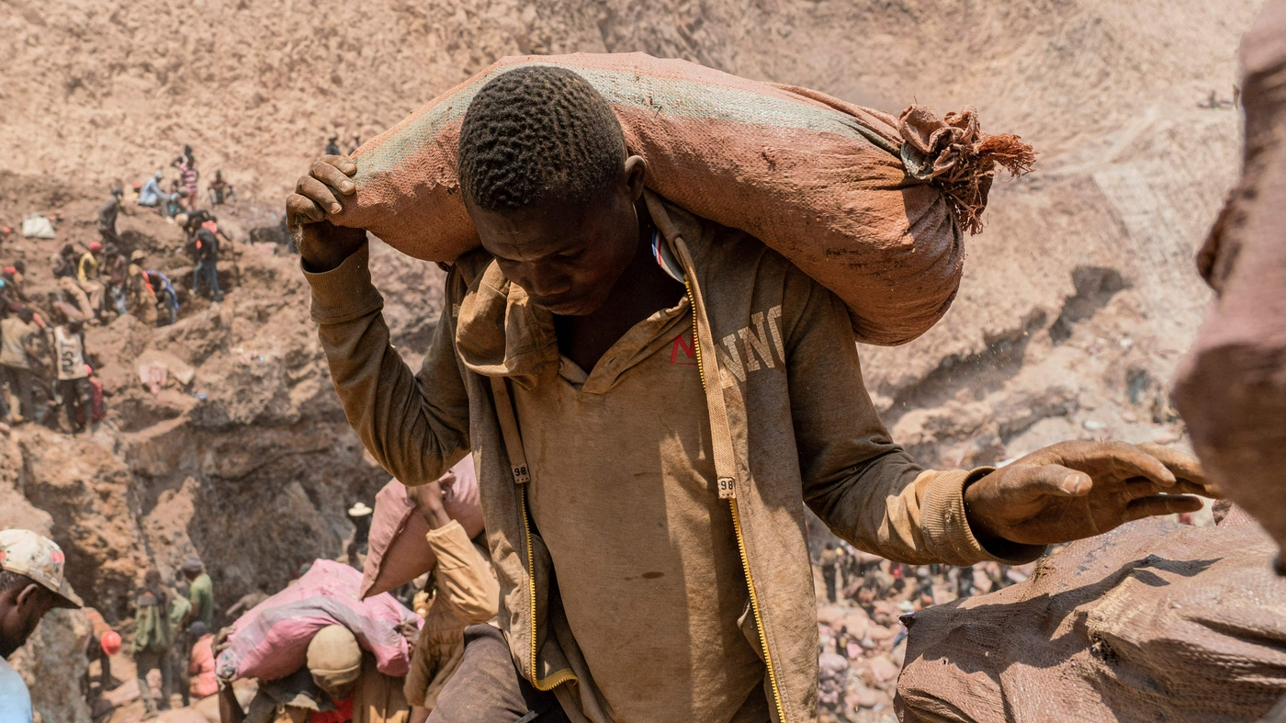
Artisanal Mining in the Congo
Notes:
The greatest metals exploitation occurs within the Congo where forced labor and artisanal mining rule the day. While Congo is rich in cobalt and other important metals crucial to modern society, corruption and modern day slavery have stunted development and prevented the riches of these mines from reaching the people. Unfortunately, once minerals exit the Congo and find their way into the metals supply chain, there is truly no way to tell where they came from and whether or not they are linked to slavery. The overwhelming likelihood is that significant portions of the metals used by pretty much every Western technological company find its routs in exploitive labor in the Congo. The mines in the Congo are supposed to be automated and highly safe, but this is simply not true with many “automated” mines composed almost entirely of people dragging stones from place to place.

Slide 10

Mine Eats Town South America
Notes:
While exploitation of labor has played a central role in the brutal costs associated with the metals age, other stakeholders also face significant harms. In particular, local communities must deal with the strain of mining. In some South American towns, the advent of new technologies to get more out of older mines has led to increasing debris from mines that have enveloped the surrounding town forcing residents to move elsewhere. Even though the mine provides good jobs for those in the region, by ruining the landscape and destroying the town, it forcibly displaces many of those whose lives it is designed to improve.

Slide 11
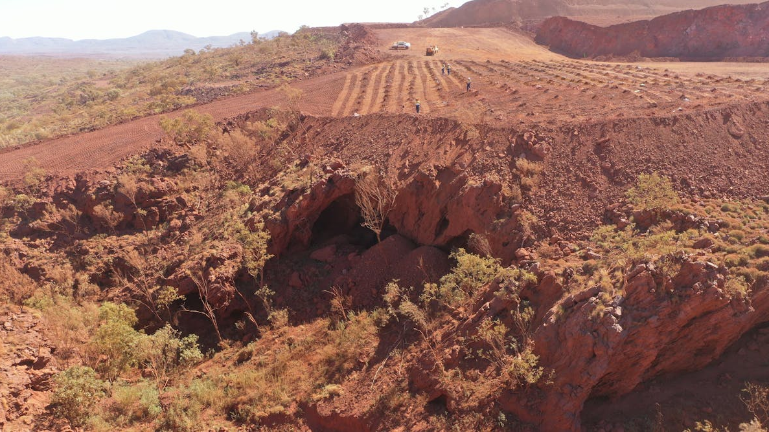
Destruction of Juukan Gorge
Notes:
Indigenous people have had to deal with significant upheaval for centuries, but recent pushes for mining ever more rare metals have had outsized impact on Native land. In Australia—specifically a region of Australia called the Pilbara known for its iron ore resources, Rio Tinto, a prominent mining company, received permits from the Australian government to build a mine and in the process to destroy Junkan Gorge. Junkan Gorge is one of the oldest continuously used sites in human history with human inhabitation going back 40,000 years. At the site, archeologists found a belt made of human hair that was 4000 years old and found by DNA testing to be related to local Aborigines. The Aboriginal people were not made aware of the process to prevent the destruction or the full extent of the damage. The destruction was devastating to the indigenous people and a major PR hit to Rio Tinto that eventually culminated in CEO resignation.

Slide 12
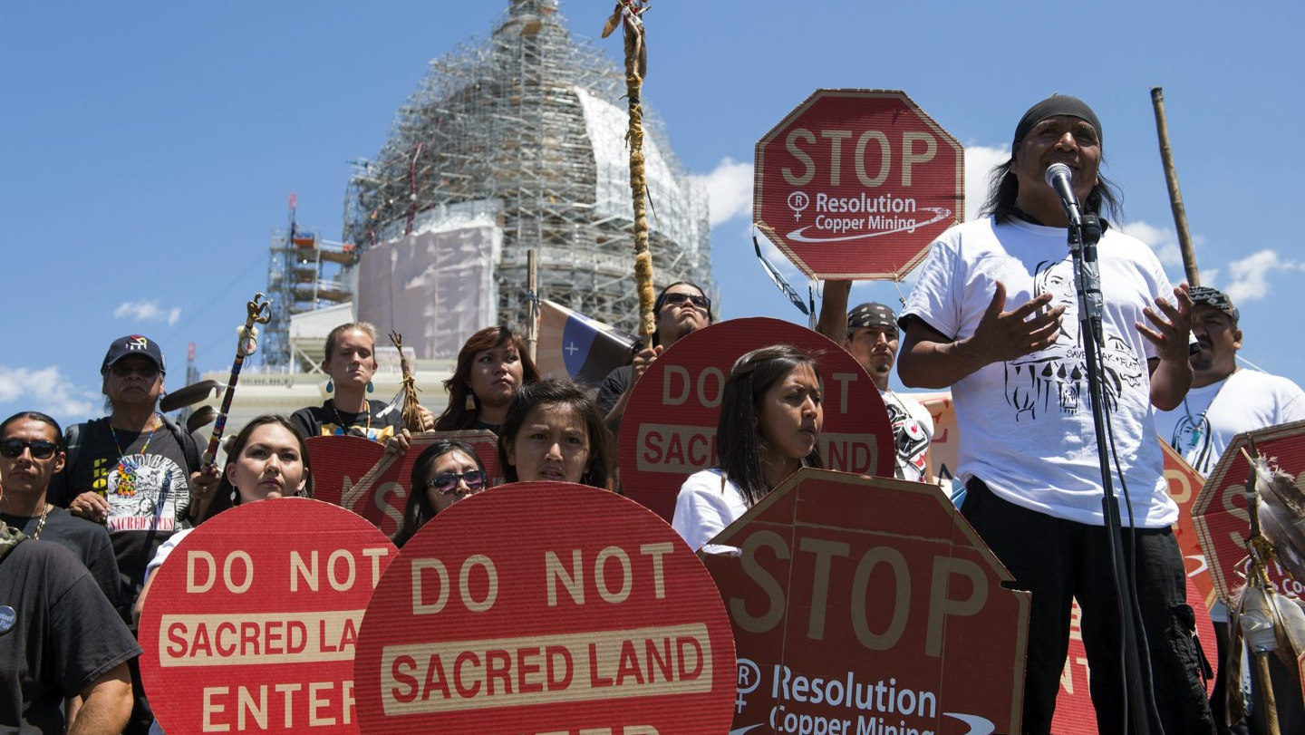
Resolution Copper
Notes:
Right now, Resolution Copper is in the works for development. It will be the first copper mine opened by the United States in years and a significant resource of domestically mined copper. However, the project is hung up because it falls on land of historical and religious significance to the Apachi. The argument between those who want to protect the legacy of indigenous people and save the world from climate change is incredibly difficult and politically charged. How should these competing aims be weighed?

Slide 13
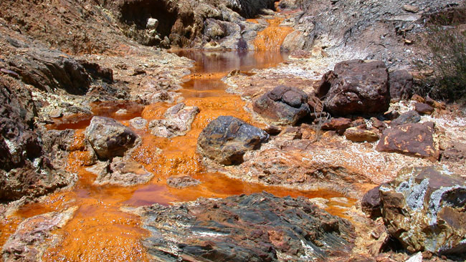
Environmental Considerations
Notes:
It should not surprise anyone in this room that mining is not the most environmentally friendly activity. It rips a hole in the ground that is difficult to repair and restore to original conditions. Mining can also devastate local wildlife as well as lead to pollution of the water supplies. This makes it crucial for mining companies to responsibly mine, something mines outside of the developed world often shirk.

Slide 14
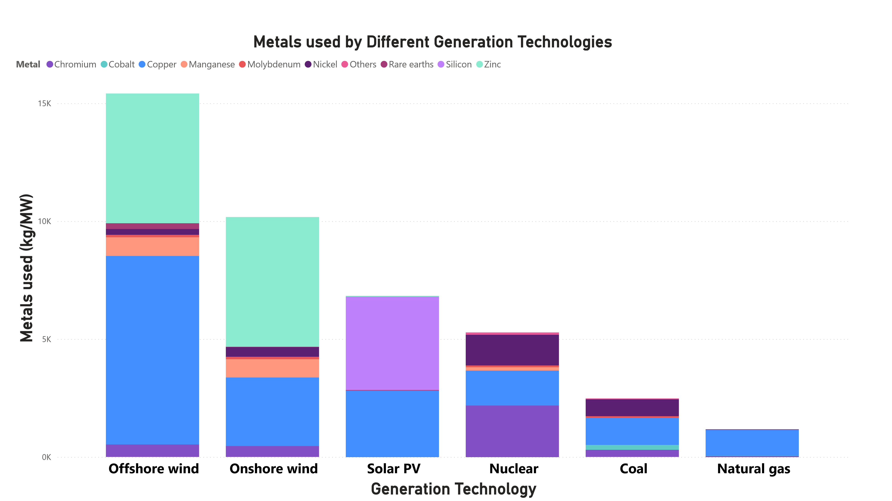
The Need for Critical Minerals for Climate Change
Notes:
With all the evils inflicted upon the environment and mankind in the pursuit of the molecules that make up cell phones, laptops, and Toyotas, it may be easy to characterize the metals industry as a dirty and evil. It may be easy to write off the industry and attempt to turn a blind eye. However, the world is in the middle of an energy transition to fight climate change. For this energy transition, we will require metals—lots of them. The simple truth is that electricity means copper. We will have to mine more copper than we’ve ever produced before. Electric generation via renewable resources requires significantly more metals than electric generation via fossil fuel resources. Whereas coal and natural gas have high variable costs and require constant feeding of generators by fuel, wind and solar have high fixed costs and require major investments in minerals before usage. These resources do not simply require more minerals, they require more diverse sets of minerals.

Slide 15
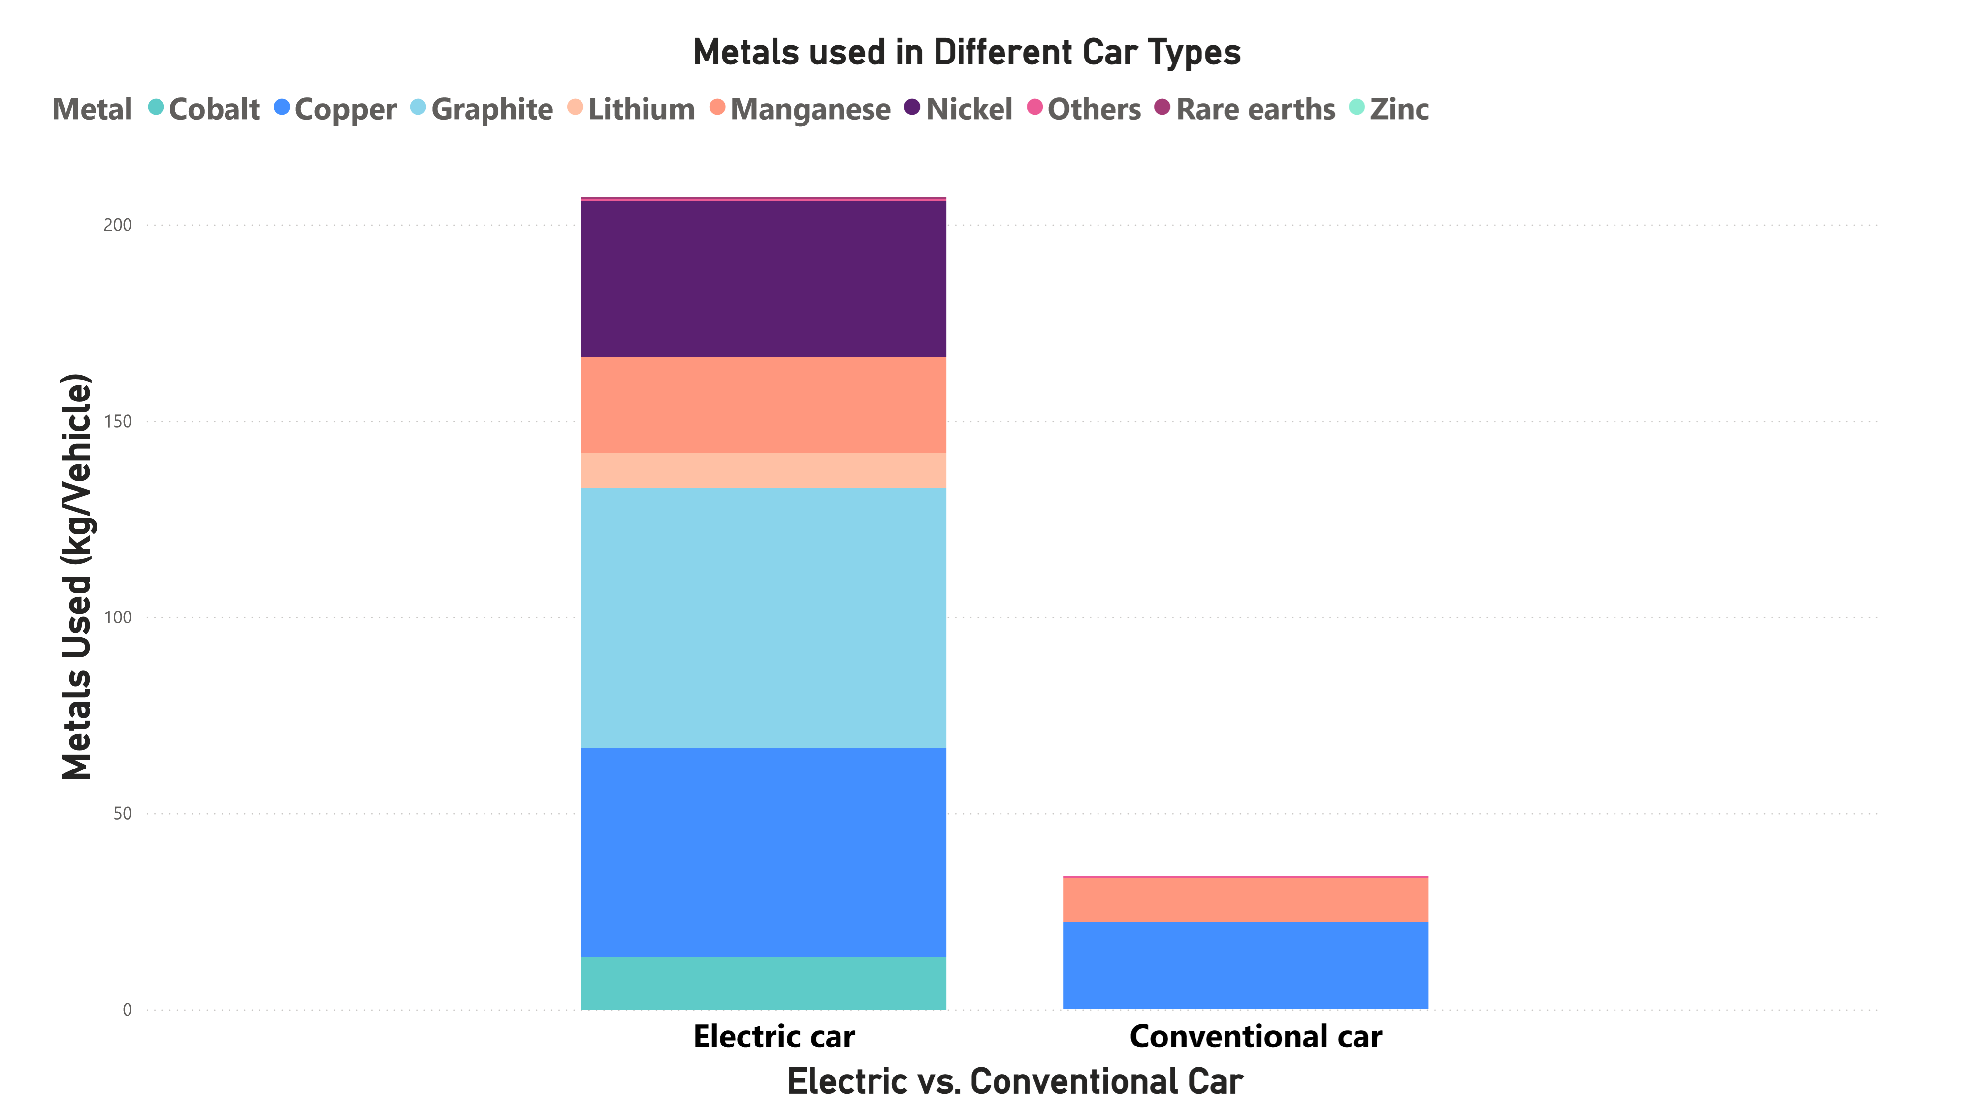
Critical Mineral Usage Electric Vehicles

Slide 16
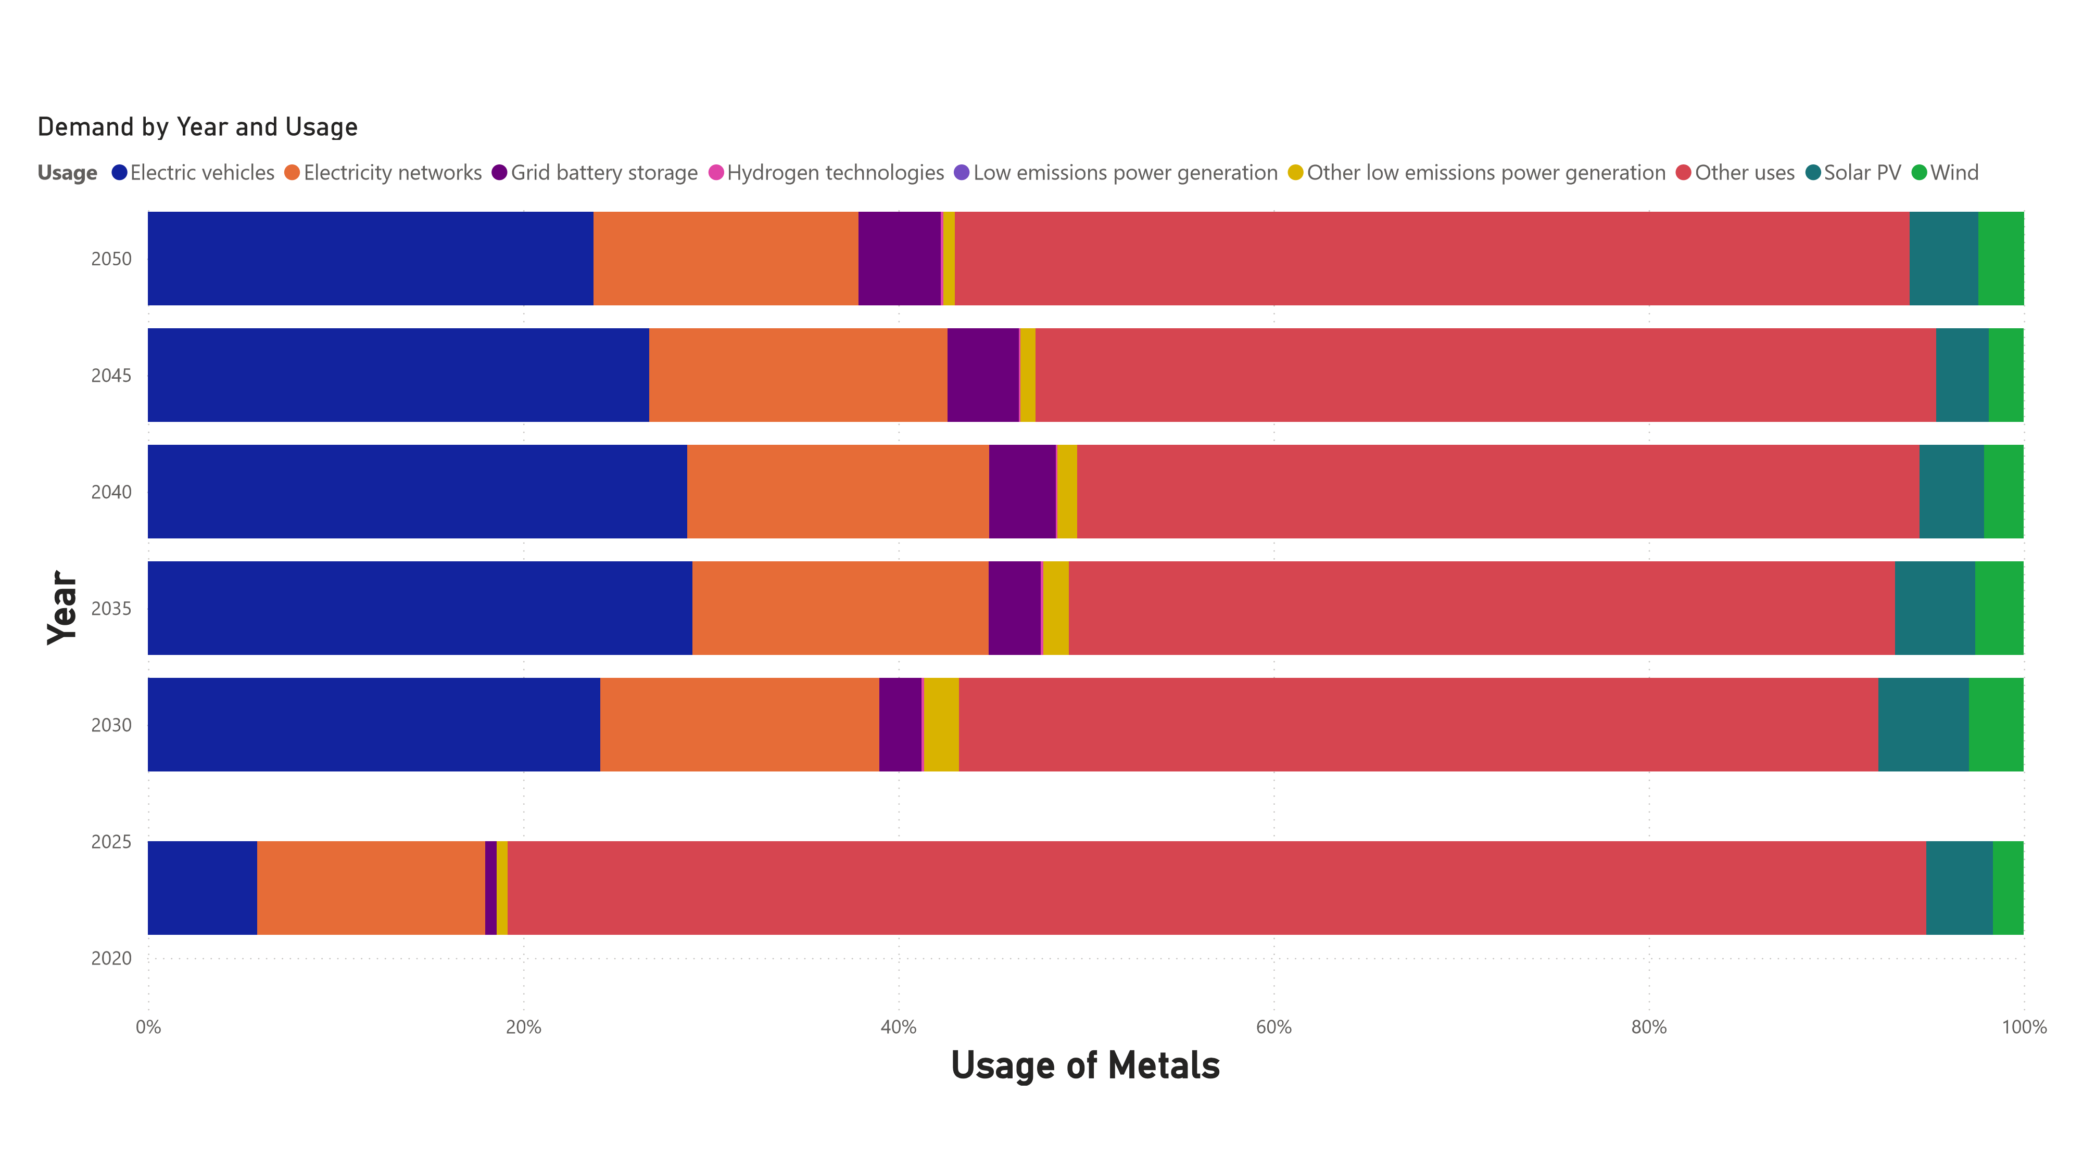
Over Time More Metals will be Needed to fight Climate Change

Slide 17
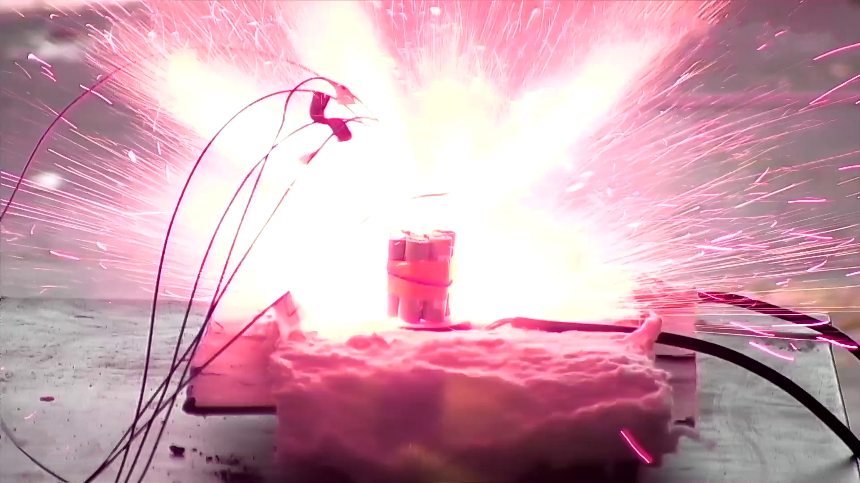
Lithium is highly reactive
Notes:
Most problematically, many environmental technologies are heavily reliant on cobalt from the Congo or lithium mined in South America. Lithium presents substantial challenges to mining because it is the most reactive metal on the periodic table and has a tendency to catch fire when being mined. New techniques are being created to mine lithium more safely but right now, it remains remarkably dangerous.

Slide 18
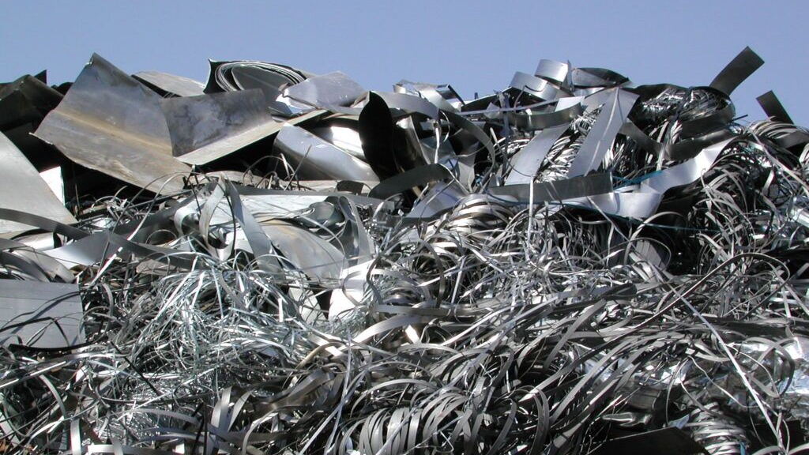
Recycling of Metals
Notes:
With the onset of the clean energy revolution, mankind has the potential to save itself from the evils of the fossil fuel age. We can defeat the existential risk of climate change and pay the debts to our planet that our grandparents passed to us. In our rush to beat climate change, we should not hastily leave our children with their own crisis. Metals mining can be done sustainably and responsibly but if we fail to live up to this goals, we are simply trading one unsustainable non-renewable resource for another.

Slide 19
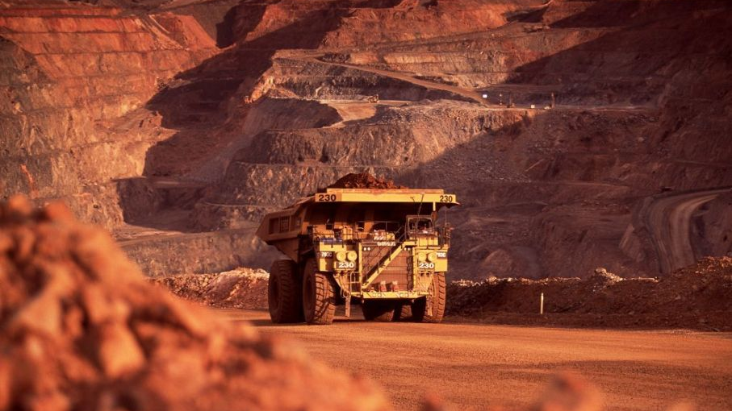
Mining is a reality
Notes:
It is also easy to try to pretend that you can somehow absolve yourself of complicity with the mining industry. You can buy local. You can simply wash your hands of investing in companies that participate in these industries. This is a false narrative. In the modern world, there is no escape from complicity in the metals and commodities trade. If you own a phone, drive a car, or live in a house, you take part in the exploitation of men, women, and children and the enslavement of Africans in the Congo, and Muslims in Western China. By simply turning a blind eye to this industry, you fail those people as they now must suffer in silence. If you refuse to invest in companies complicit in ese practices, you forfeit any ability to control the conduct of these companies.

Slide 20

What can be done?
Notes:
So what can be done about this old and dark industry? First, we can act as consumers and as owners of capital to hold companies to account and require them to attempt to implement ethical sourcing for critical minerals. Next, we must establish a sustainable pipeline for metals. First and foremost, this means finding ways to mitigate pollution from mining. This also means increasing recycling in the mining industry. In most industries, recycling only saves about 20 percent of the recycled good. In metals, these numbers can get as high as ninety percent. We also need to find ways to make steel production more environmentally friendly and less reliant on coal or at least reliant on mitigated coal emissions.
Finally, we have to mine in the United States. No one wants a mine in their backyard. It is a desecration of the land. Many oppose mining on the grounds that it is dirty and will make this beautiful land ugly. However, not mining is not an option and will only lead to the destruction of civilization as we know it. Exporting the ills of extraction to places where we cannot see it may see a tempting option. However, by doing so, the United States fails to live up to its promise and yields its moral authority to those countries that are willing to live in the real world and accept that the burden of solving this crisis ought not fall solely on those who did not cause it.
The United States is not the most green nation on the planet; however, it has standards for air pollution and environmental protection that put other resource-rich countries to shame. The United States has a far from perfect record on labor exploitation and labor standards, but it is much better on this front than many other mining nations.
We must promote permitting reform to make it easier to build mines and streamline the bureaucratic process to open mines while upholding the environmental standards of the Clean Air Act. We must not withhold the beacon of American markets from the world. Instead, we must work with countries that already have good standards and hold other countries accountable and utilize control over our markets and the concept of free and fair trade to promote equitable labor standards. It is a fallacy that allowing developing countries to exploit labor, so that they can grow is beneficial to the workers. In point of fact, no one would benefit from the rule of law and protections of labor regulations than the people of Xinjiang and the Congo. Refusing to intervene on laborer’s behalf only ensures that what gains occur accrue to the least worthy, those willing to exploit the corruption at the heart of the system. Similarly, we should find ways to allow the countries that will face the most significant burden of mining to take part some in the economic growth of the manufacturing sector that will use the mined minerals.
Unfortunately, mining more will mean hard choices. Mining more will mean the displacement of peoples and yes occasionally the desecration of religious sites held holy by those already marginalized. These are not issues to be dismissed. However, the United States and the West better prepared other countries to recognize the risks of mining and work alongside stakeholders to reach equitable solutions and to properly consider the cost benefit tradeoff when difficult decisions must inevitably be made.
If we are to remain a global commodities superpower in the clean energy age, we must embrace a level of pragmatism.
On another note, Brett is conducting research on the economics of the metals industry. If you would like to work on a metals project with him, let him know.
Thank you!

