Slide 1

Incentive-Based Strategies

Slide 2
Types of Environmental Policies
Decentralized Environmental Policies
Command and Control Strategies
Incentive based policies

Slide 3
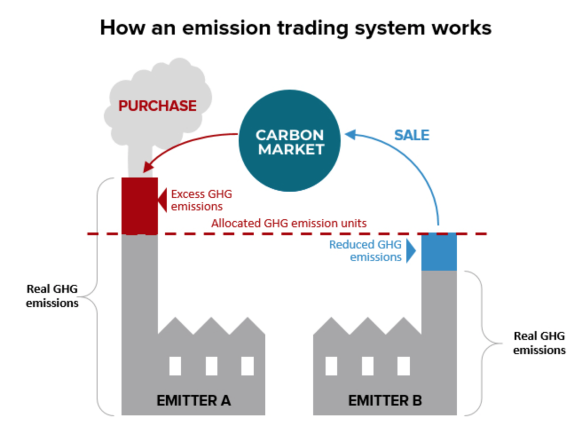
What are Incentive Based Strategies?
Taxes and subsidies
Emission charges
Transfer discharge permits
Punish bad behavior and reward good behavior

Slide 4
Emissions Charges
A tax on emissions or subsidy for abatement
Charge price for emissions
Example: Carbon markets

Slide 5
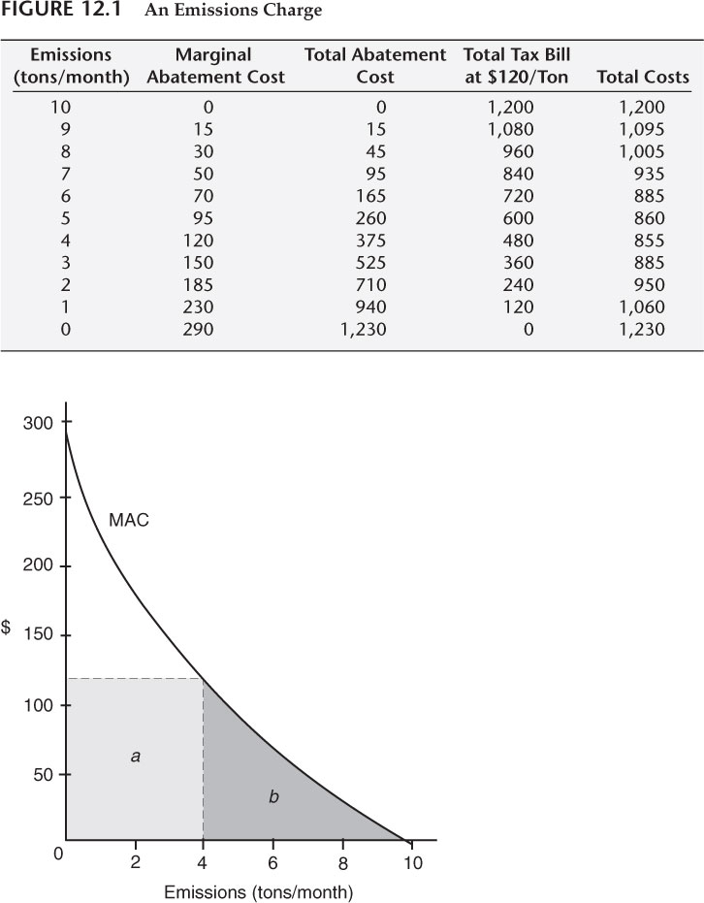
Emissions charge example

Slide 6
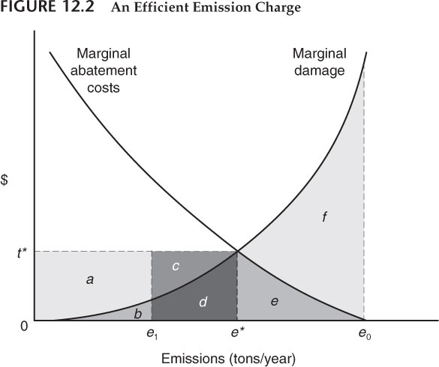
Efficient emissions charges

Slide 7
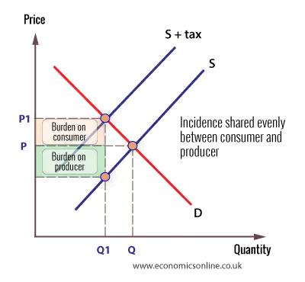
Will taxes be charged to consumers?

Slide 8

How to choose level of emissions charge?
Equimarginal principle
Set charge and learn costs over time
Can make long range planning harder for firms
Talk to scientific experts

Slide 9
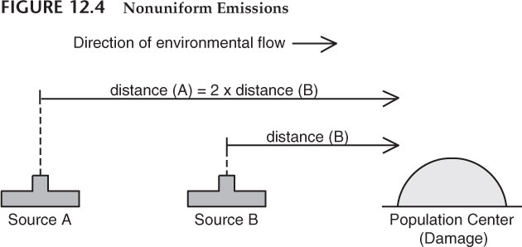
Zoned emissions charges
Sometimes firms cause different damages and must be treated differently

Slide 10
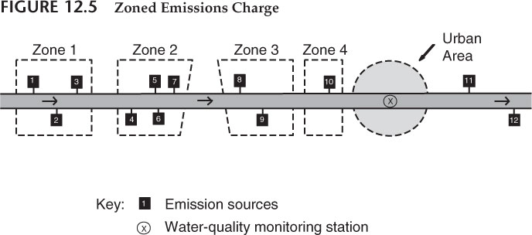
Zoned Emissions Charges Example

Slide 11

Emissions Charges and Enforcement Costs
Charge systems require accurate measurable information on the item being taxed.
Non-point sources are often spread over wide areas making them difficult to measure and monitor.
The most ideal measures would be to have permanent monitoring stations measuring emissions continuously overtime. Technology may not yet be available.
Self monitoring can lead to underestimations.

Slide 12

Distributional Impacts of Emissions charges
Effects of tax expenditure from charges
Effects of subsidies on wealth distribution
May put small businesses out of business
May lead to unemployment of some individuals
How should emissions charge money be spent?

Slide 13
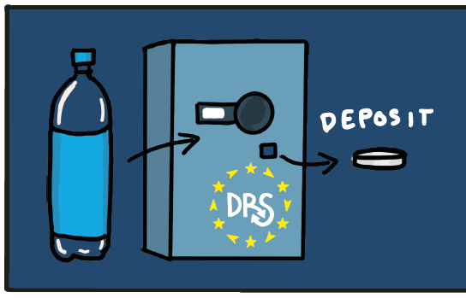
Deposit-refund systems
Combination of a tax [deposit] and subsidy [refund].
Suited to products widely dispersed and difficult to monitor. Bottle deposit-refund systems. Collection systems must be convenient for customers to comply.
Other examples include batteries, car tires and cars in some countries.

