Slide 1
Supply and Demand

Slide 2

Willingness to Pay
Defines demand Curve
Determinants
Individual values and preferences.
Wealth, Income or ability to pay.
Expectations of future prices.
Relative prices of substitutes.

Slide 3
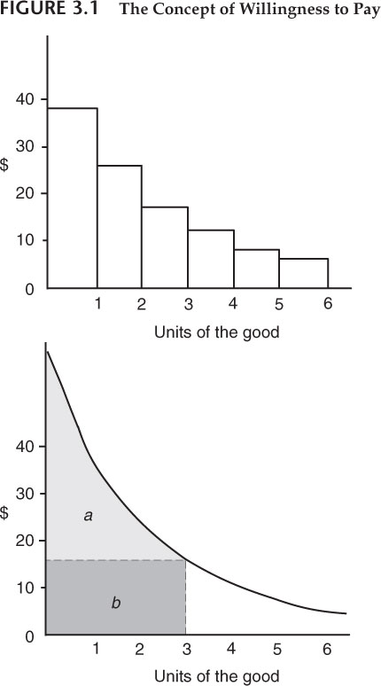
Diminishing Marginal Willingness to Pay
Marginal willingness: how much you would pay for one more unit
Total willingness to pay: How much you would be willing to pay for all units

Slide 4
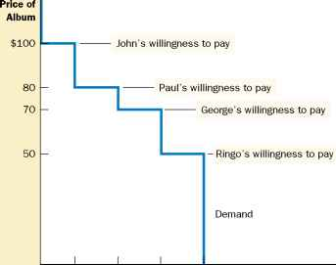
Demand and Willingness to Pay

Slide 5
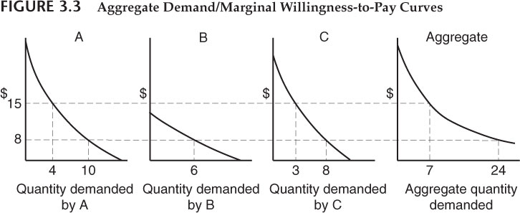
The demand Curve is the sum of individual demands

Slide 6
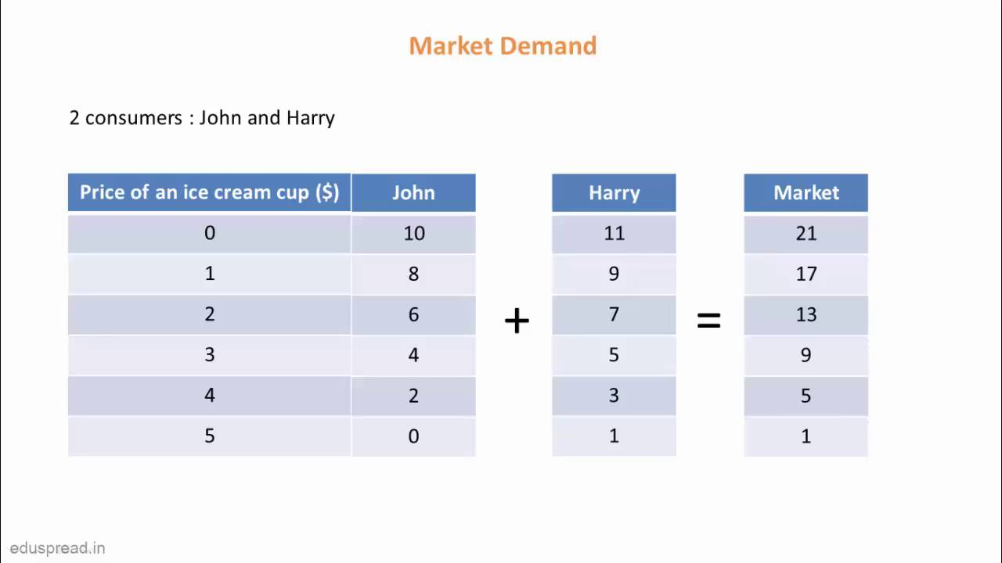
Demand Curve as Sum of Individual willingness to pay

Slide 7
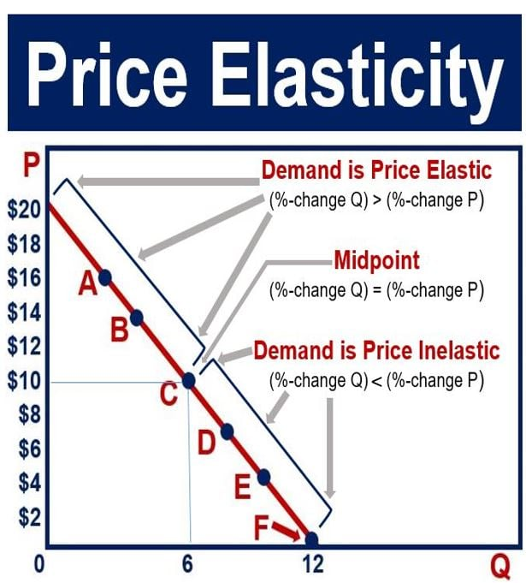
Elasticity
Percentage change quantity demanded over percentage change in price
If price goes down and revenue goes up, elastic
If price goes down, and revenue goes down inelastic
Heroin has a very inelastic demand
Housing has a very inelastic supply
How inelastic do you think water is?

Slide 8
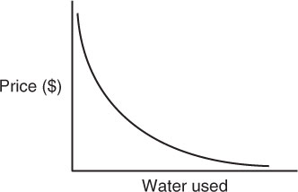
Demand for Water: More inelastic at higher prices

Slide 9
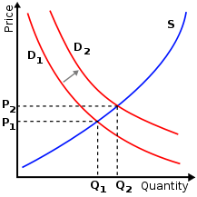
Shifts in the Demand Curve
Normal goods: if income rises, you purchase more
Inferior goods, if income rises you purchase less
Luxury goods, if income rises you purchase much more
What type of good is environmental quality?
What shifts out the demand for environmental quality?

Slide 10
Costs
Opportunity cost: Value of next best alternative
Marginal cost: Additional cost of producing an additional unit.
Private costs: Fixed cost + variable cost
Social costs: Private costs + externalities
Externalities: Costs not borne by participants in a transaction e.g. pollution, degradation

Slide 11
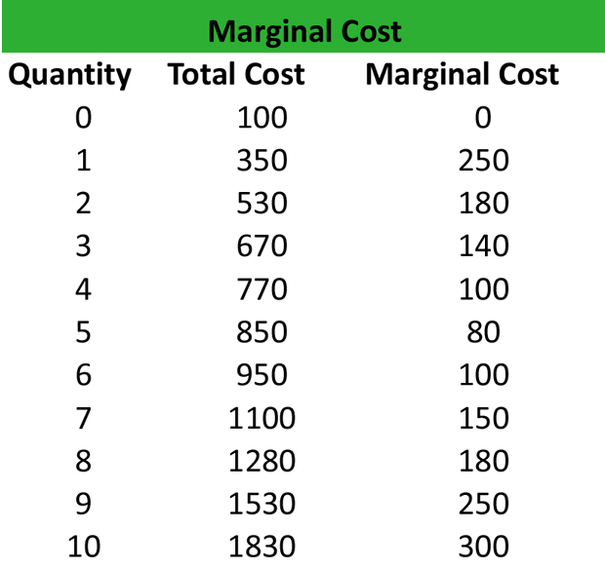
Marginal Cost
The cost of producing one additional unit
Maximizes profit when equal to marginal benefit
Usually experience increasing marginal costs. Why?

Slide 12
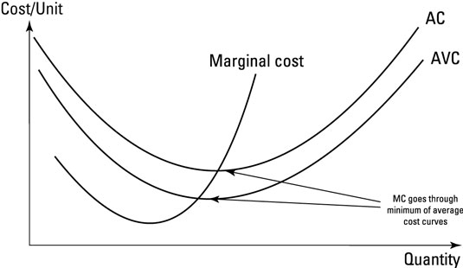
Marginal Cost Curve: Firm’s supply curve

Slide 13
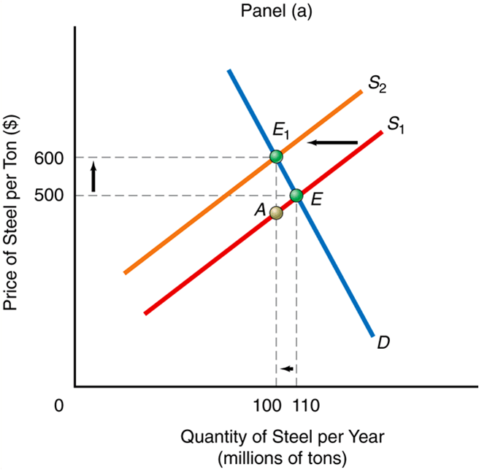
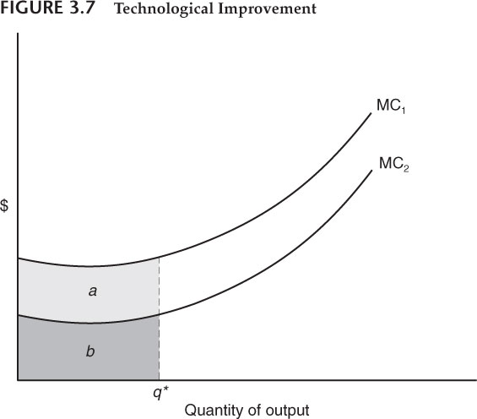
Shifting the Marginal Cost Curve

Slide 14
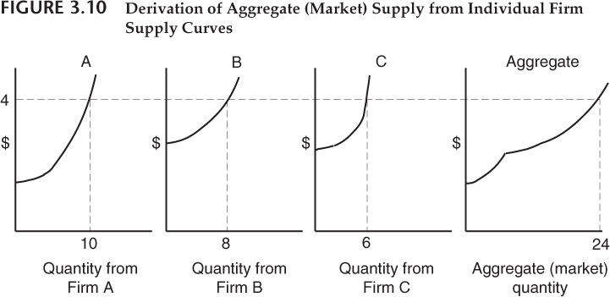
Market supply: Sum of all individual supply curves

Slide 15
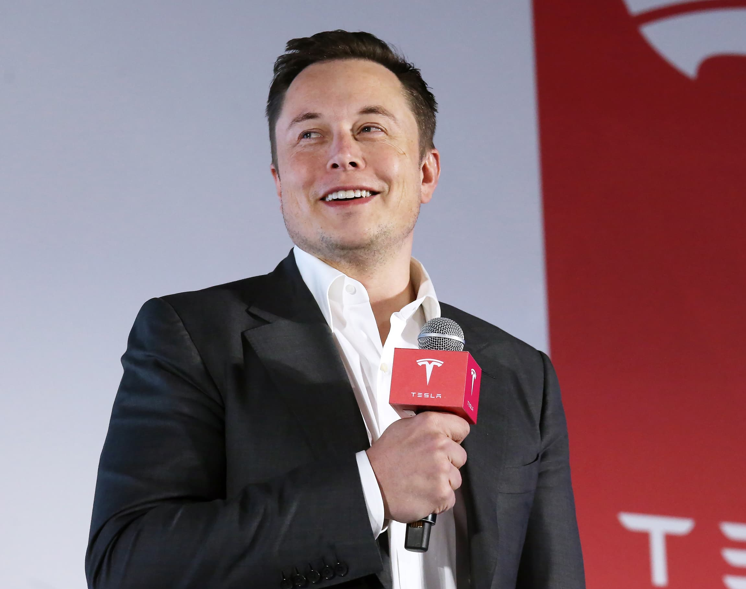
Technology
Amount of goods and services a firm can produce from raw materials depends on the level of technology; capital formation, human capabilities, underlying processes
Technological change can provide ways to produce goods and services with fewer environmental side effects.
Example: Tesla, solar power, energy-efficient buildings

Slide 16
Shifts in marginal cost curve
What shifts the marginal cost curve left? Right?
What are the effects of rising oil prices on the marginal cost curve?

Slide 17
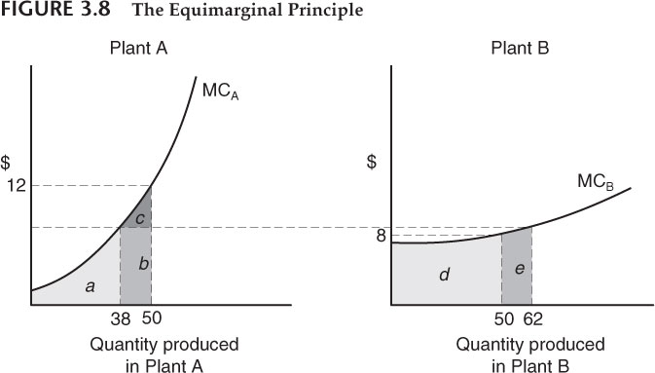
The Equi-marginal Principle
Set marginal benefits equal to marginal costs
Minimize total cost by equalizing marginal costs from multiple sources of production

Slide 18
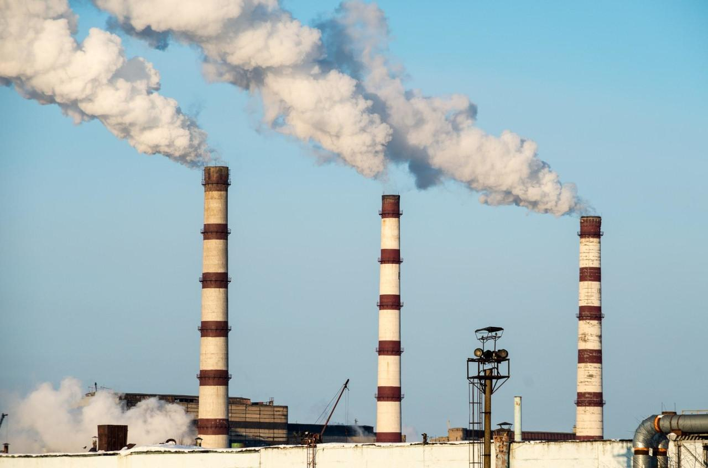
Private vs. Social willingness to pay

Slide 19

Externalities of a firework?

