Slide 1
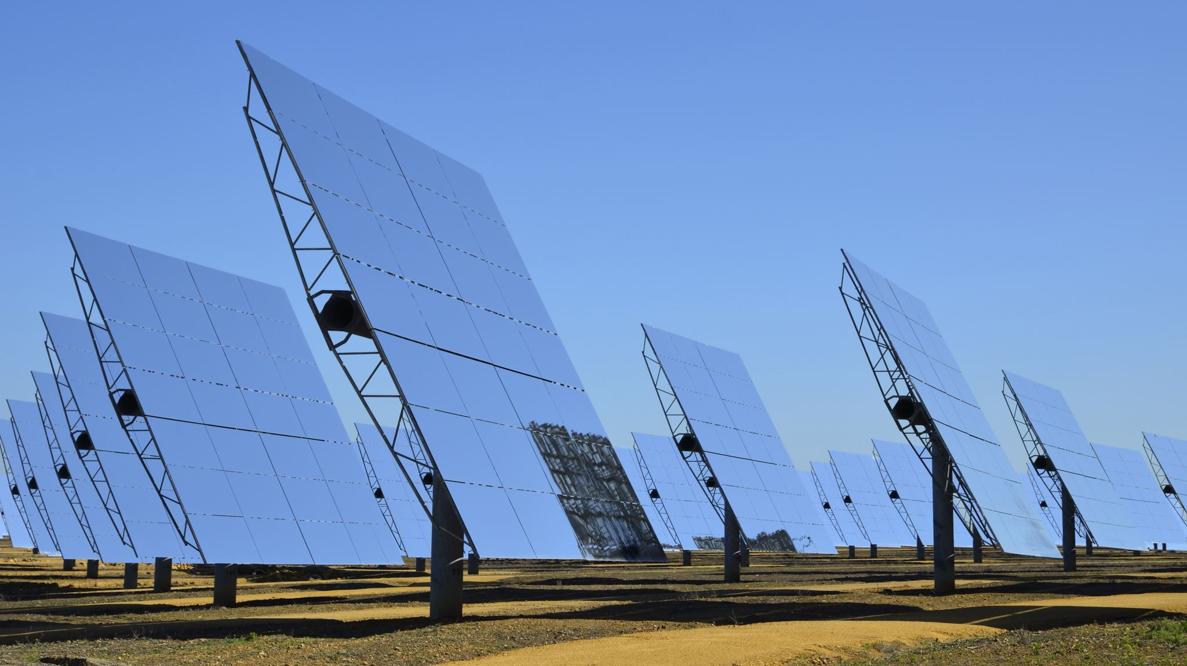
Sustainable Development Indicators and Insurance Markets

Slide 2
Why indicators needed?
Hard to measure and compare variables related to sustainability
Ecosystem damage, pollution levels
Mortality, education
Economic growth
Need a way to compare societies with differences across different dimensions

Slide 3
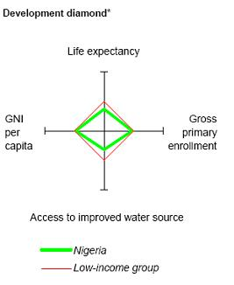
Three Environmental Quality Indicators
Cost of remediation: Cost of moving from present environment to acceptable environment
Environmental elasticity: ratio of aggregate percentage change in environment to economy
Developmental and environmental diamonds

Slide 4

Measuring Sustainability Tools
Benchmark: Reference point/goal
Sustainable development goals
Index: Combines many sources of data into one measure
Human Development Index
CPI
GDP

Slide 5
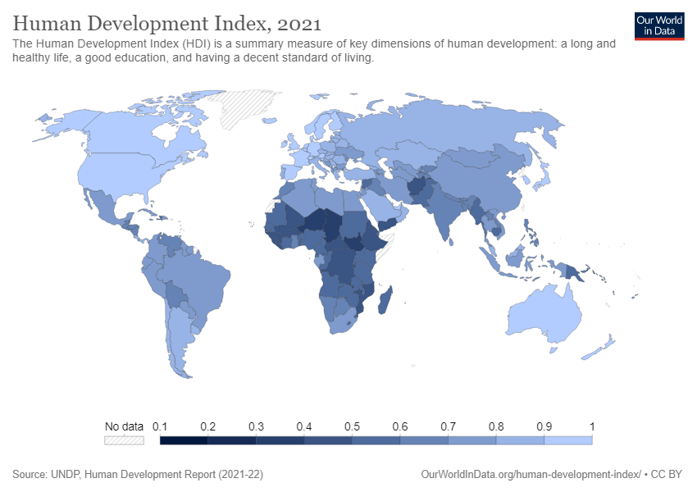
Human Development Index 2021

Slide 6
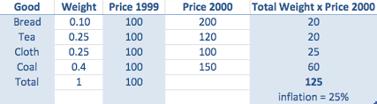
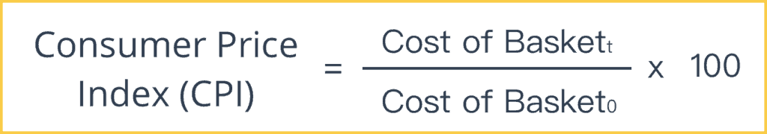
Consumer Price Index
CPI aggregates information about aggregate prices
Measures rates of inflation
Created by measuring changes in cost of basket
Overstate inflation?

Slide 7
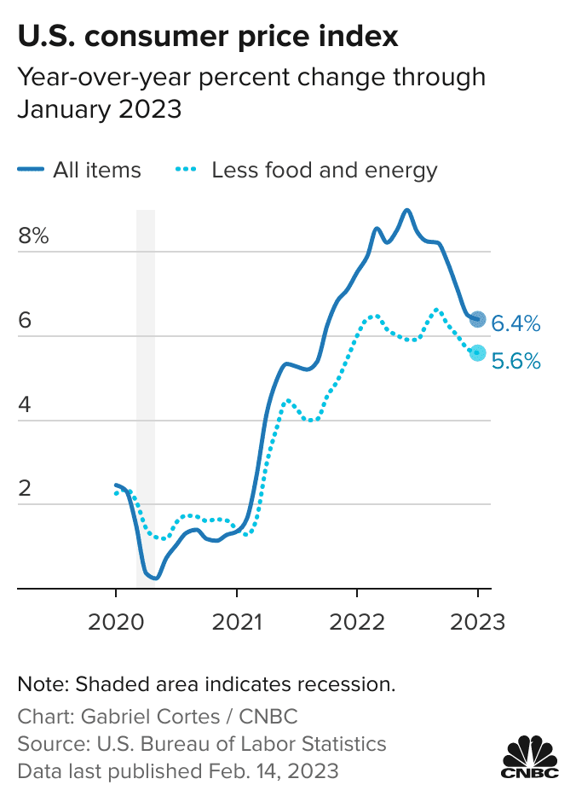
Consumer Price index Lately

Slide 8
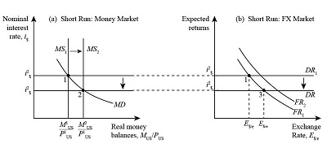
Exchange Rates
Increases in Interest rates lead to appreciations in currency
Exchange rates matter a lot to developing countries

Slide 9
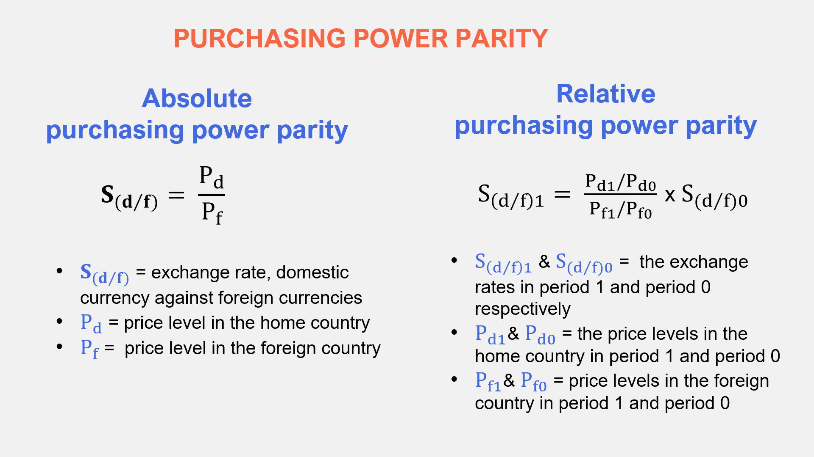
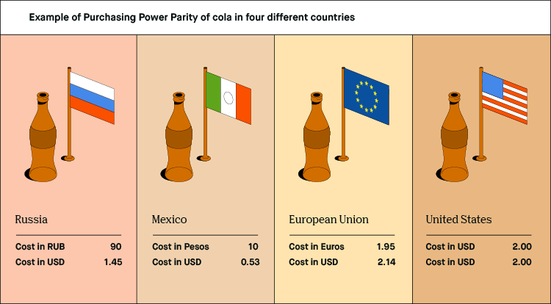
Purchasing Power Parity
Exchange rates only tell half the story
Purchasing power parity compares currencies based on relative prices in each country

Slide 10
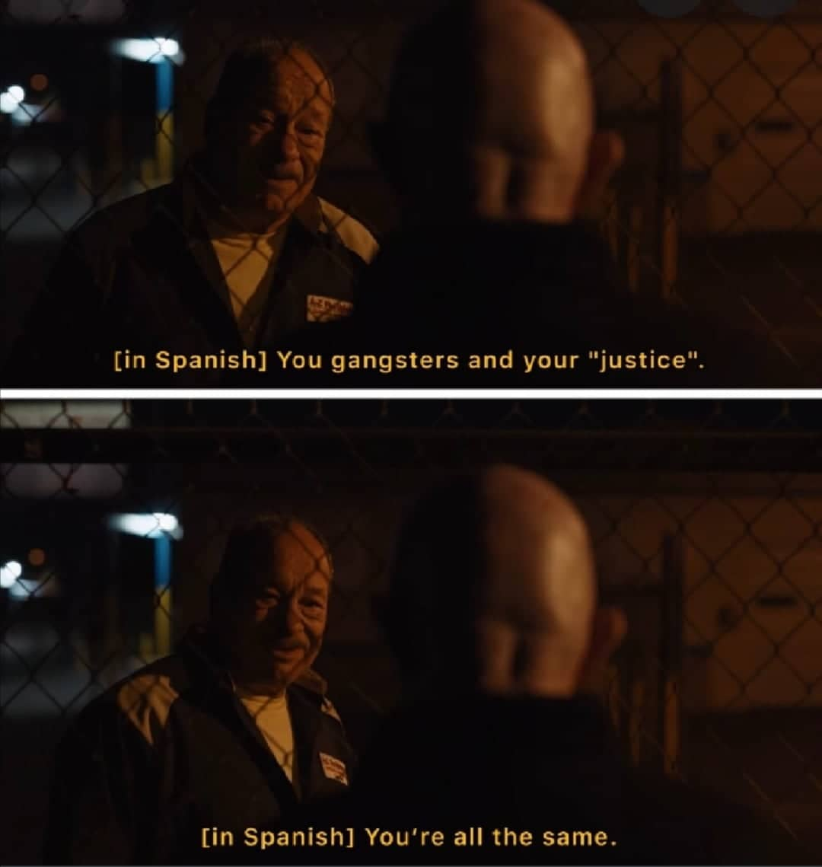
Environmental Justice
According to the DoE:
Environmental justice is the fair treatment and meaningful involvement of all people, regardless of race, color, national origin, or income, with respect to the development, implementation, and enforcement of environmental laws, regulations, and policies. Fair treatment means that no population bears a disproportionate share of negative environmental consequences resulting from industrial, municipal, and commercial operations or from the execution of federal, state, and local laws; regulations; and policies. Meaningful involvement requires effective access to decision makers for all, and the ability in all communities to make informed decisions and take positive actions to produce environmental justice for themselves.

Slide 11

What does environmental justice mean to you?

Slide 12

Insurance Markets

Slide 13
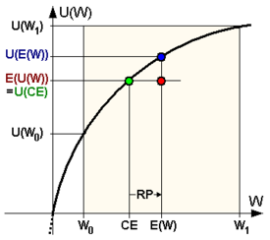
Risk aversion
People don’t like risks
People
People will pay to avoid them
Companies are risk neutral
People pay companies to take on their risk

Slide 14
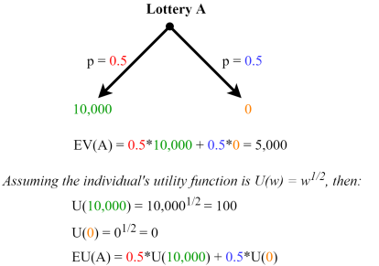
Certainty equivalent
The certainty equivalent is the amount of money I would have to give you for certain instead of a lottery
Insurance tries to make you whole in any state of world
Insurance gives certainty equivalent

Slide 15
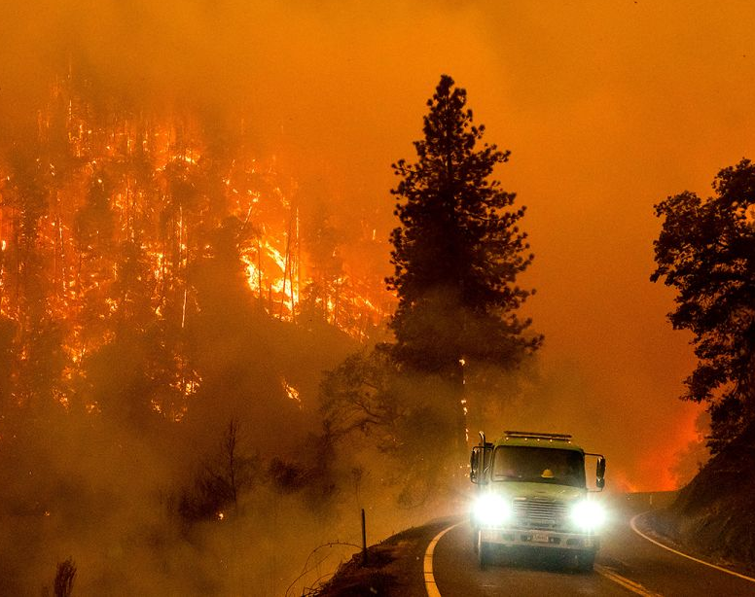
Insurance Market Example
Bob has a house with a value W
With probability 1/3, there will be a fire that causes L damage
Bob has utility of money Sqrt(X)
Insurance Co is risk neutral and offers Bob a contract where he pays x now and receives y if there is a flood
What can Alice get that Bob would accept?
What should Alice pay Bob?

Slide 16
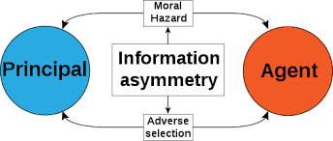
Asymmetric Information
Asymmetric information occurs when one side has information the other does not
Information not perfectly observable
Adverse selection
Moral hazard
Principle Agent models
Huge in insurance markets

Slide 17
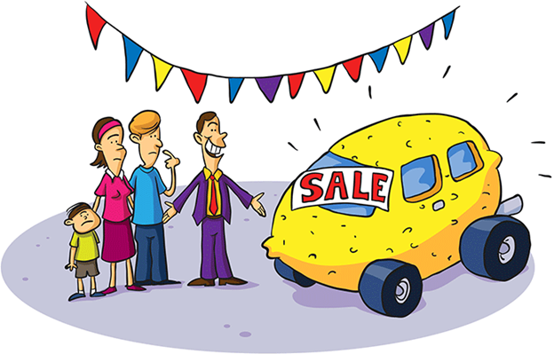
The Market for Lemons
Two types of sellers sell cars
Sellers of lemons (bad cars) with low quality
Sellers of peaches (good cars) with good quality
Buyers cannot distinguish between lemons and peaches
If too many lemons, leave market

Slide 18
Market for lemons example 1
 | Q_1 | Q_2 | Q_3
Buyer Value | 1100 | 1800 | 2500
Seller Value | 1000 | 1500 | 2000
Fraction | 1/3 | 1/3 | 1/3
Finite fixed supply of cars
Infinitely many buyers
Distribution of cars as follows
What are market equilibrium prices?
Say sellers can credibly signal car value for 400$. What is the new equilibrium?

Slide 19
Market for Lemons example 2
 | Q_1 | Q_2 | Q_3 | Q_4
Buyer Value | 1100 | 1800 | 2500 | 3000
Seller Value | 1000 | 1500 | 2000 | 2500
Fraction | 1/3 | 1/3 | 1/6 | 1/6
Compute market equilibrium
Replace first 1/3 by x and adjust the remaining fractions to be the same proportion as before
What is the smallest x such that q1 and q2 sell?

Slide 20
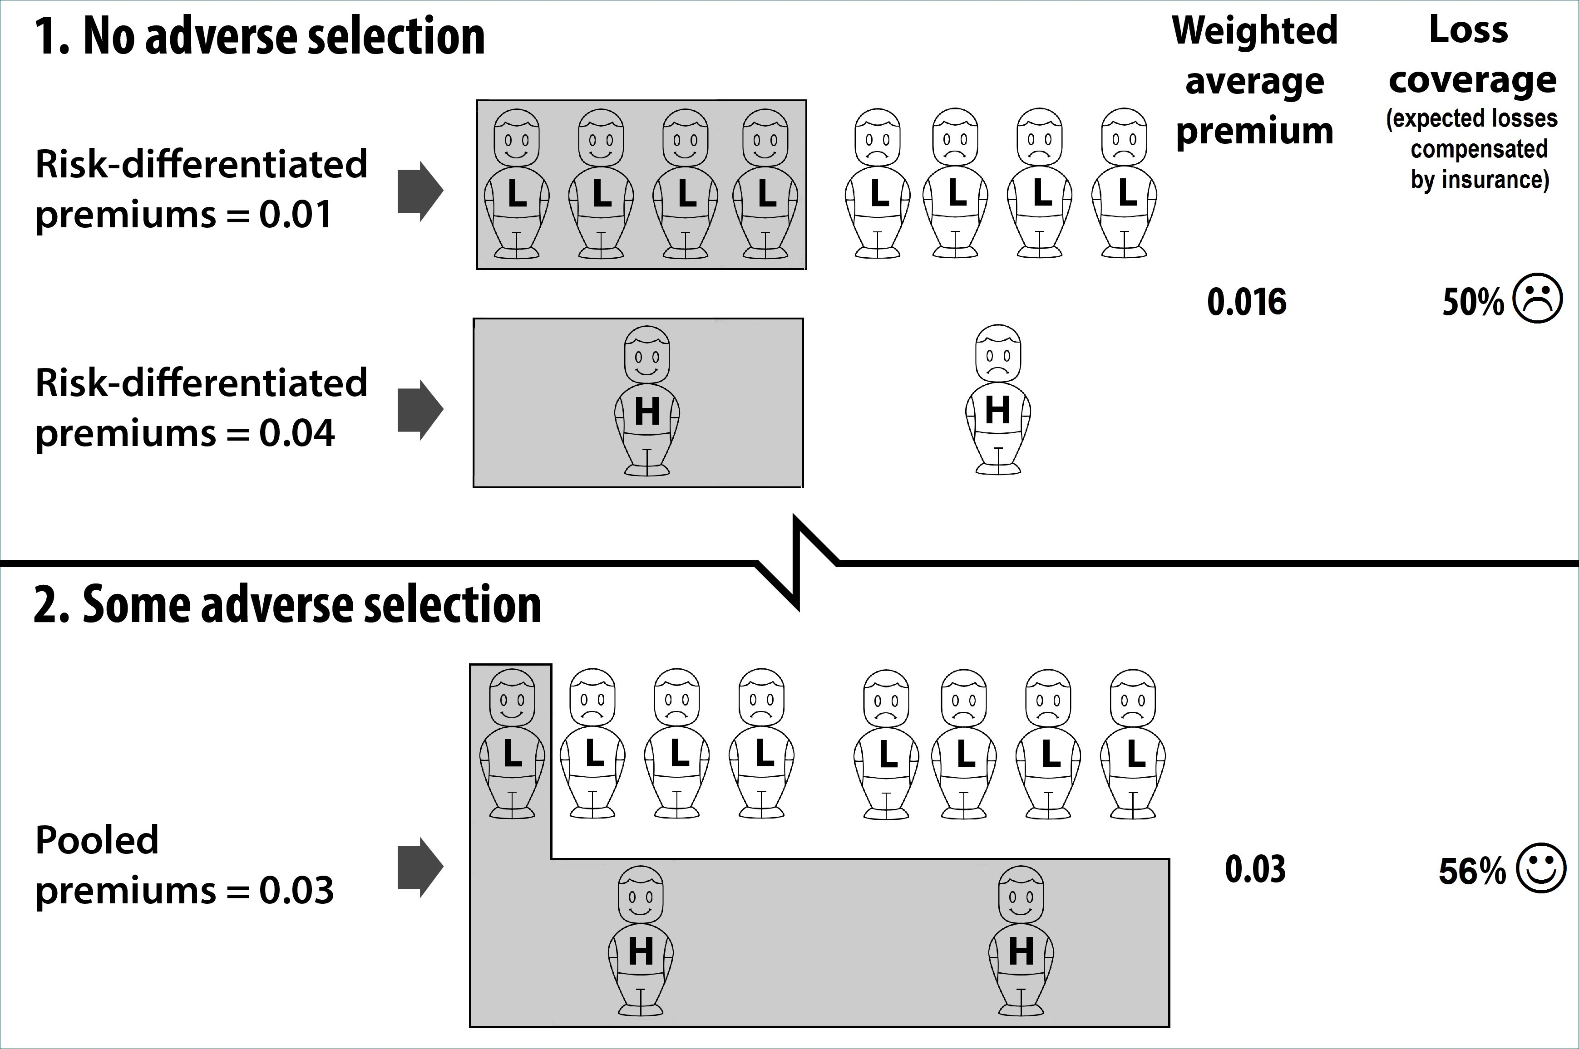
The market for lemons and sustainability
Car market
Insurance markets
California fires

Slide 21
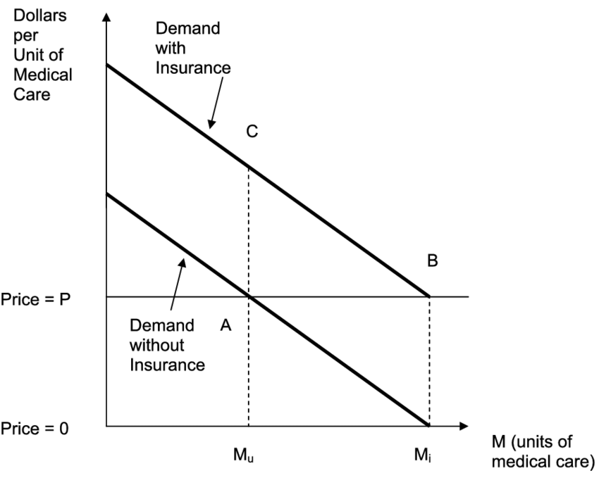
Moral Hazard
If you decrease the cost of risk, people take on more risk
I have broken three phones in the last year. I don’t even care!
My friend Sara broke her leg recently
PG&E, Enron

Slide 22
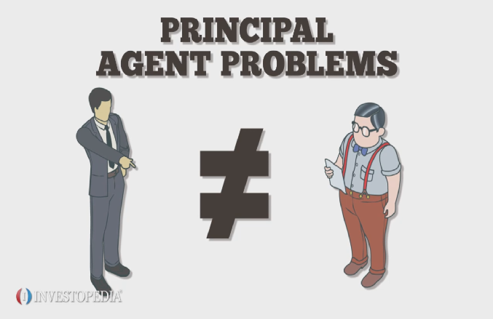
Principal Agent Models
People don’t like to do their job
Just because someone works for you doesn’t mean they will act in your best interest
People like to slack off and commit fraud
Need to design contracts to ensure people do their jobs

Slide 23
Principal Agent Problem Example 1
Principal pays salesman to approach client
Reservation utility of salesman 3 and utility function of wage sqrt(w)-a
Effort Unobservable
How to induce high effort?
Best contract to offer?
Level of Effort | Probability/sale value | Probability/sale value | Probability/sale value
Low a=0 | .4/0 | .4/100 | .2/400
High | .2/0 | .4/100 | .2/400

