Slide 1
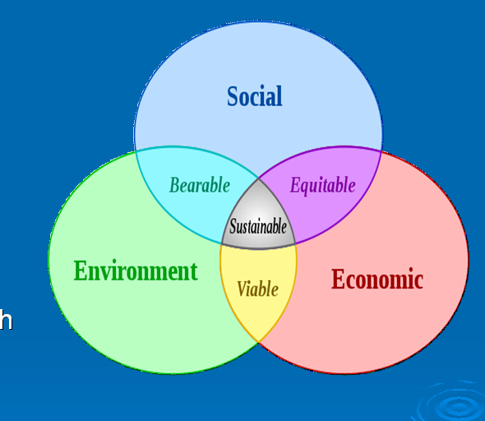
Sustainable Development

Slide 2
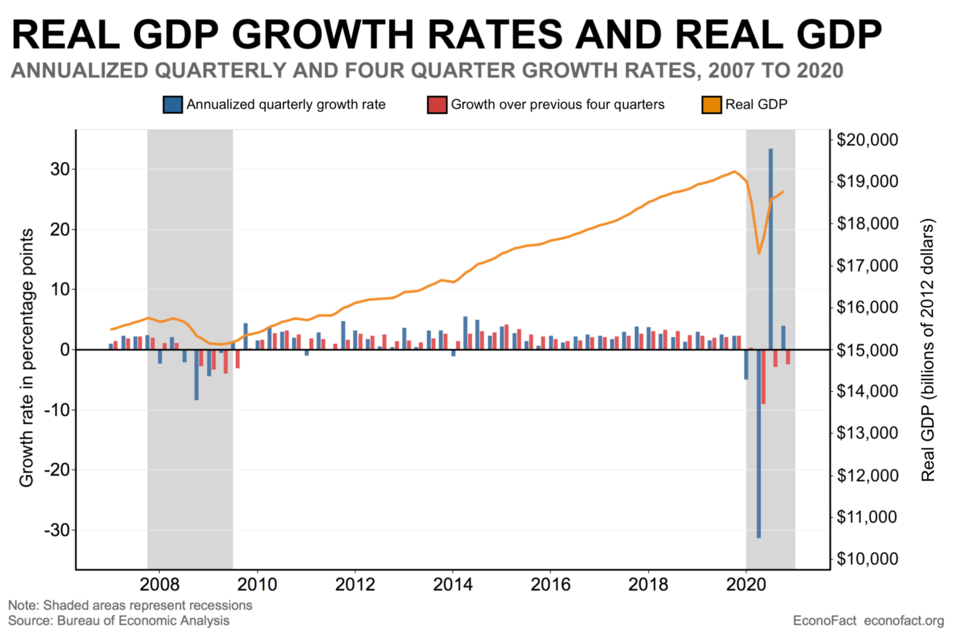
The economic approach
Maximize income while maintaining constant or increasing stock of capital
GDP growth matters, everything else is cannon fodder
Let future generations have an opportunity to make as much as we did

Slide 3
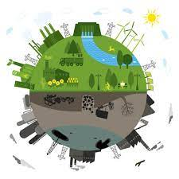
The ecological approach
Maintain the resilience and robustness of biological and physical systems
Live with the planet

Slide 4
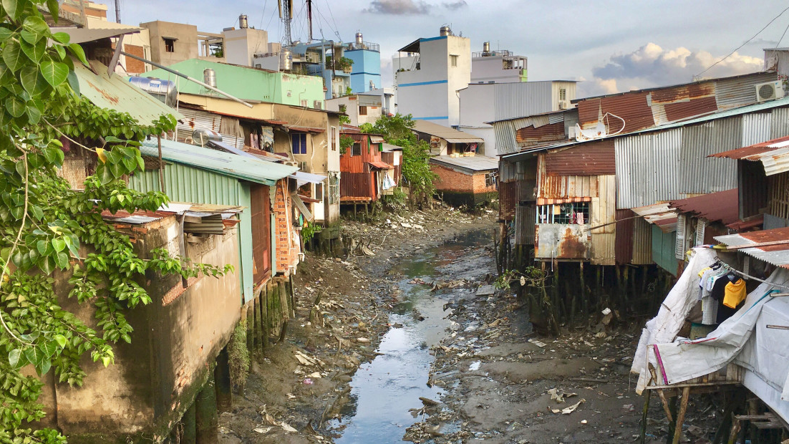
The socio-cultural approach
Maintain the stability of social and cultural systems.
Help lift up as many people as we can
What should we do if the three approaches conflict?
Would you accept more poverty for a better environment?
Would you accept more unemployment for a better environment?

Slide 5
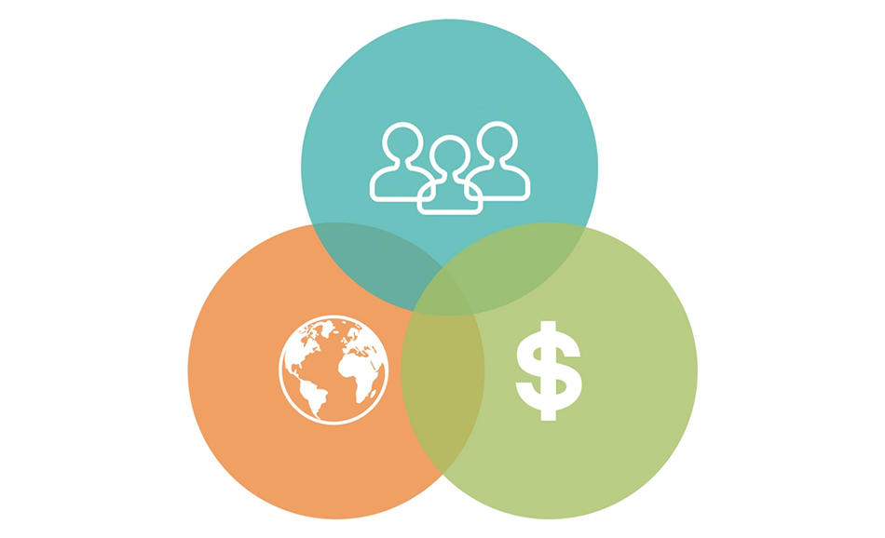
Triple bottom line
Economic objectives should not be maximized without satisfying environmental and social constraints.
Environmental benefits should not necessarily be maximized without satisfying economic and social constraints.
Social benefits should not be maximized without satisfying economic and environmental constraints.

Slide 6
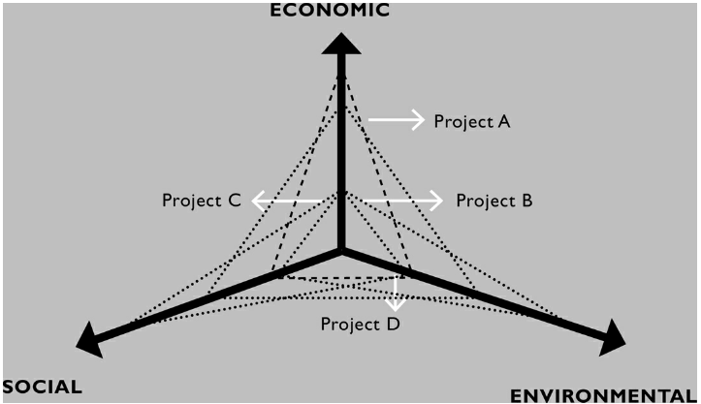
Comparing projects by impact
Project A: Large-scale irrigation project with high economic returns
Project B: Save spotted Deer
Project C: Subsidize hospital in sparsely populated urban area
Project D: Rural water supply project
Can you think of another project? Where would it go?

Slide 7
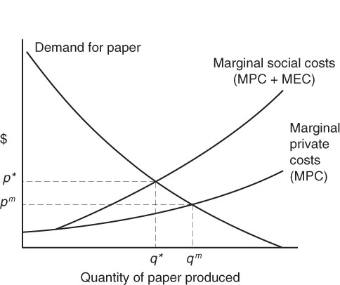
Market Failure
Prices do not reflect social costs
Creates deadweight loss
Marginal social benefit does not equal marginal social cost
Externalities, monopoly, public good, discrimination, basic research

Slide 8
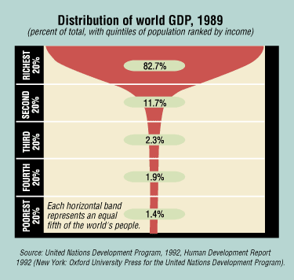
Global wealth distribution
Wealth is incredibly unevenly distributed.
Poor get richer in most countries slower than rich get richer
Why does inequality happen?
Should we care more about local or global inequality?
How can we fix inequality globally?

Slide 9
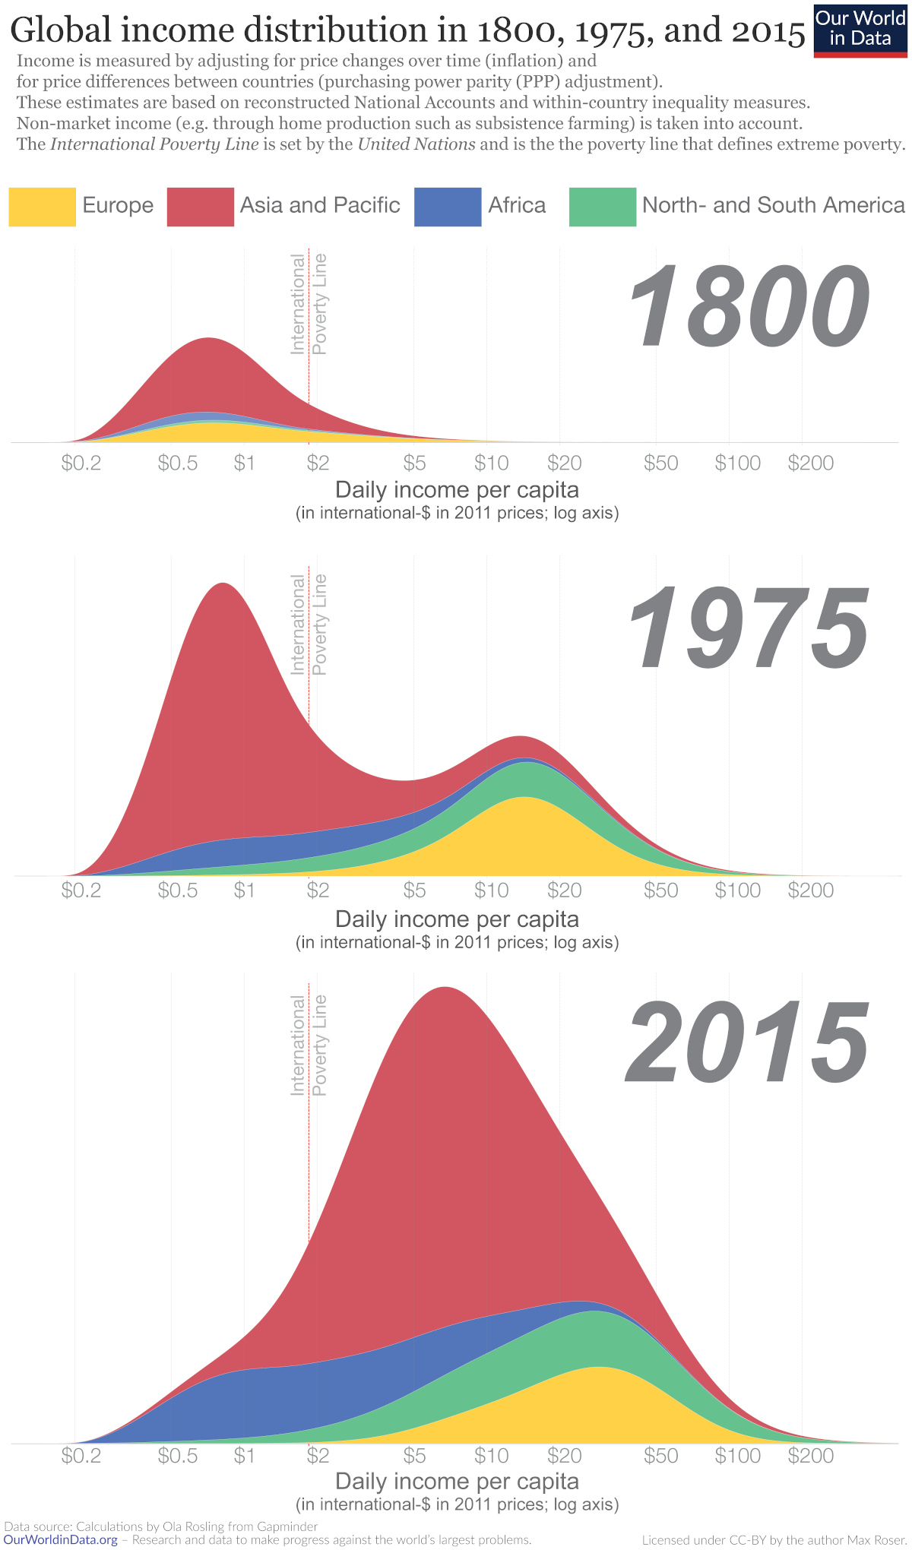
Income by region over time: Anything you notice?

Slide 10
Myths of sustainable development
Most environmental degradation is caused by the poor.
The majority of pollution and CO2 emissions come from the wealthiest
Poverty reduction necessarily leads to environmental degradation.
Decrease in extreme poverty makes people use less carbon-intensive energy
Population Growth necessarily hurts the environment
Technology and better resource management can mitigate these effects
Poor are too poor to invest in the environment
Property rights amongst poor individuals lead to massive environmental improvements

Slide 11
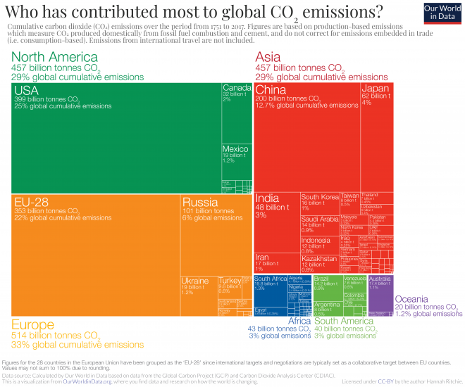
Poor countries contribute less to CO2 per capita but growing quickly

