Slide 1
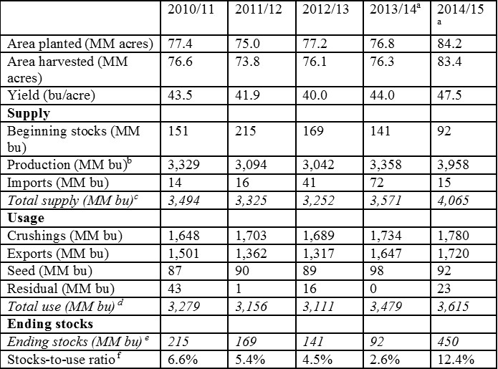
Forecasting and the Balance Sheet

Slide 2

What are Commodities Markets?

Slide 3

What is the Balance Sheet?
Contains information about forecasts and actual values of commodity
Supply, demand, and all market info in one sheet
A market moving document for any commodities market
Massive undertaking to create
Based on real world data, models, and insight

Slide 4
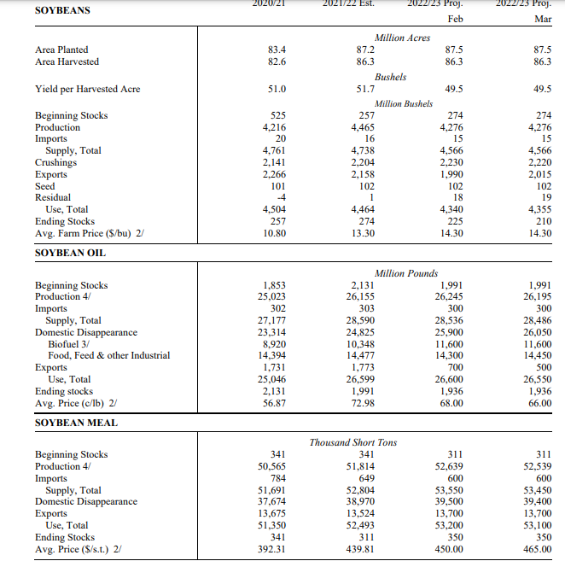
Walking through an Agricultural Balance sheet

Slide 5
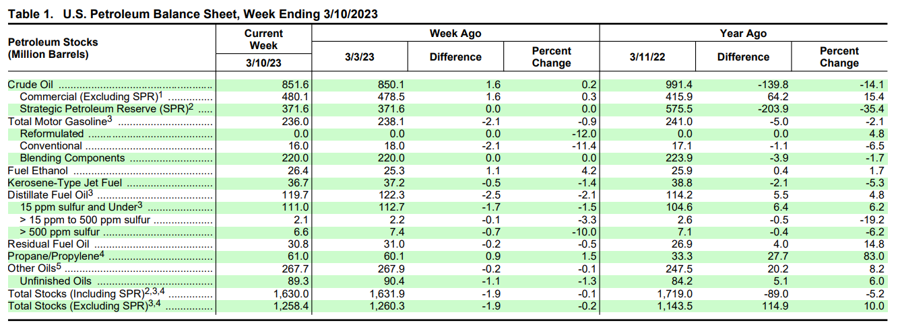
Walking through an energy balance sheet: Stocks

Slide 6
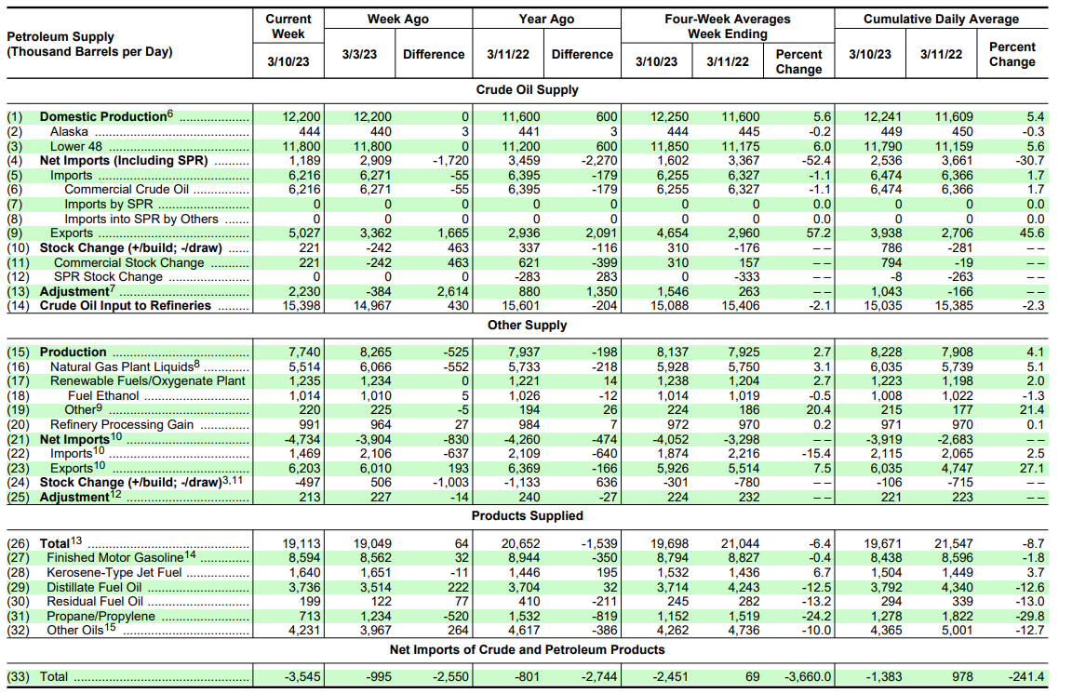
Walking through an energy balance sheet: Supply

Slide 7

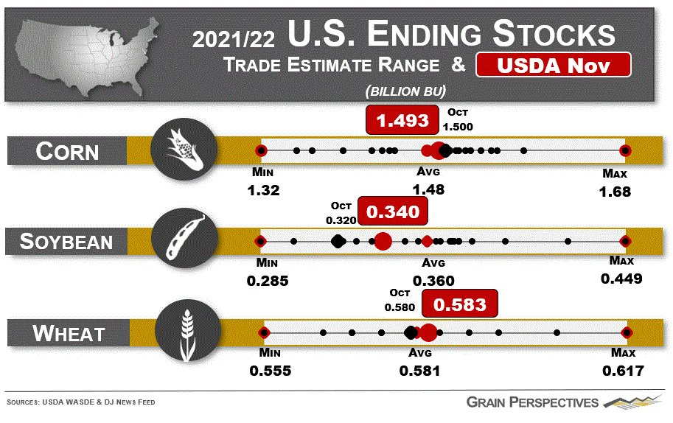
Why do stocks matter?

Slide 8
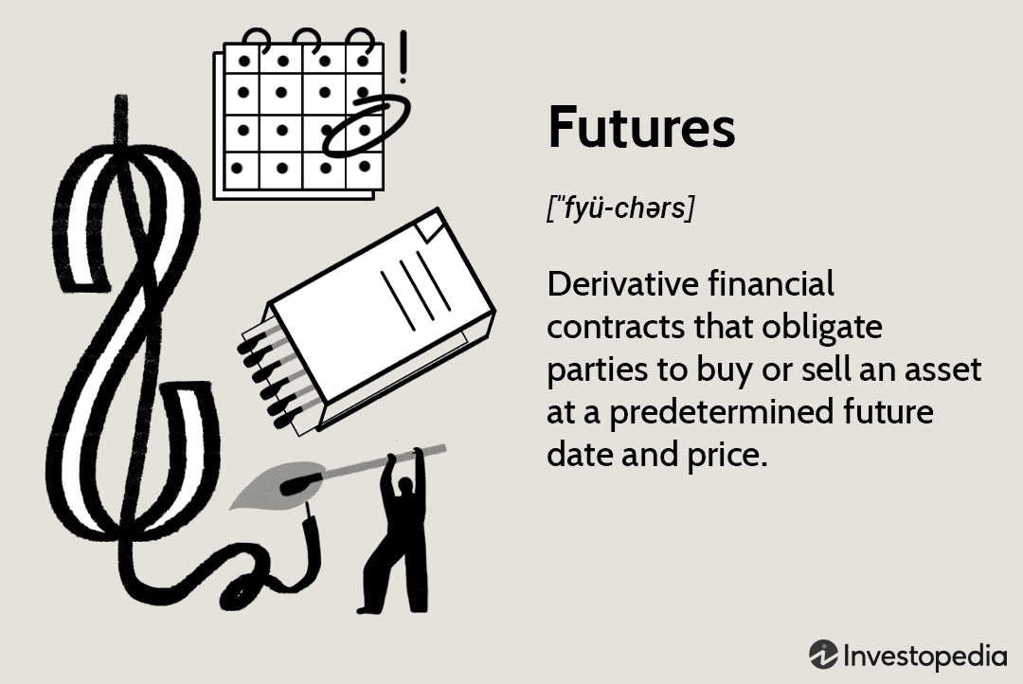
What are futures?

Slide 9

How futures Work
You buy a future contract, you go long if you believe the commodity price will increase
Otherwise you sell if you believe it will decrease
Very useful for hedging
You have the option of cash or physical settlement
If you settle physically, must transfer commodity to agreed destination on set day of month

Slide 10
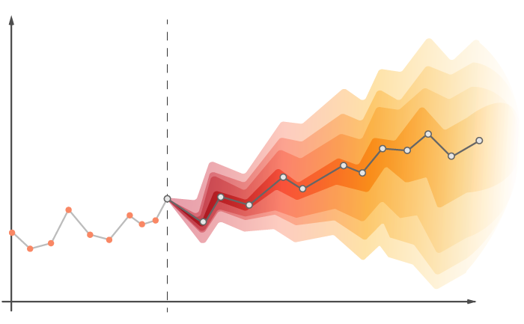
What is a time series?
A time series is a random variable indexed by time
A series of observations with some order
With cross-sectional data, draw from one distribution
With time series data, distribution changing

Slide 11
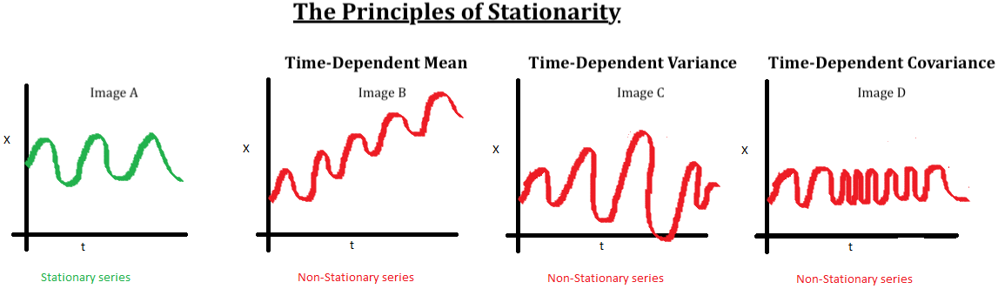
Stationarity
Both mean and variance not dependent on time
Series not changing over time
Easiest to forecast because less information

Slide 12

Random walk
Flip a coin. Heads move up, tails move down
Direction unpredictable
Most stock markets considered to be random walks. Implications?
With drift means that one direction more likely

Slide 13
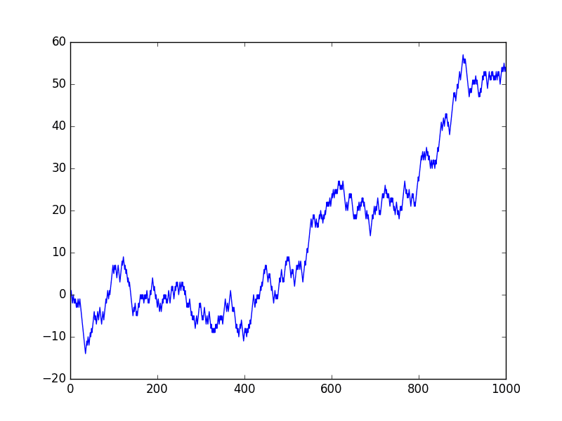
Random walk Visualized

Slide 14
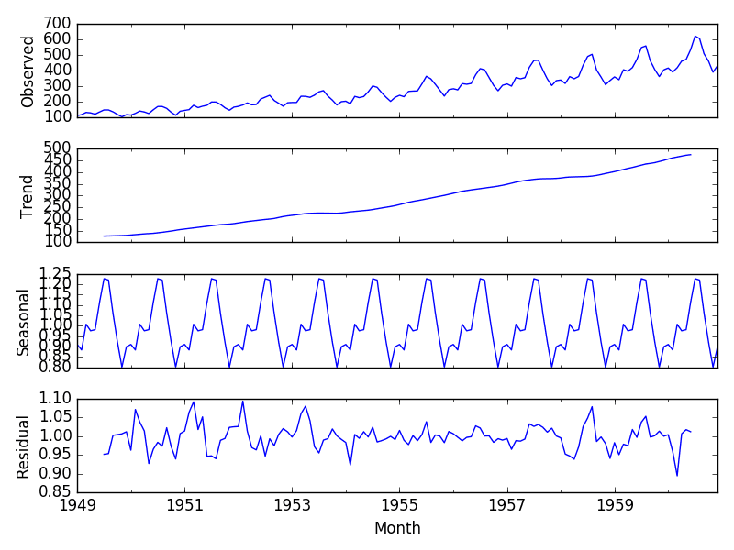
Components of a time series
Trend
Long term direction of a series
Seasonality
Residual
Part of the time series that is not trend or seasonal
Ideally for forecasting is white noise process

Slide 15
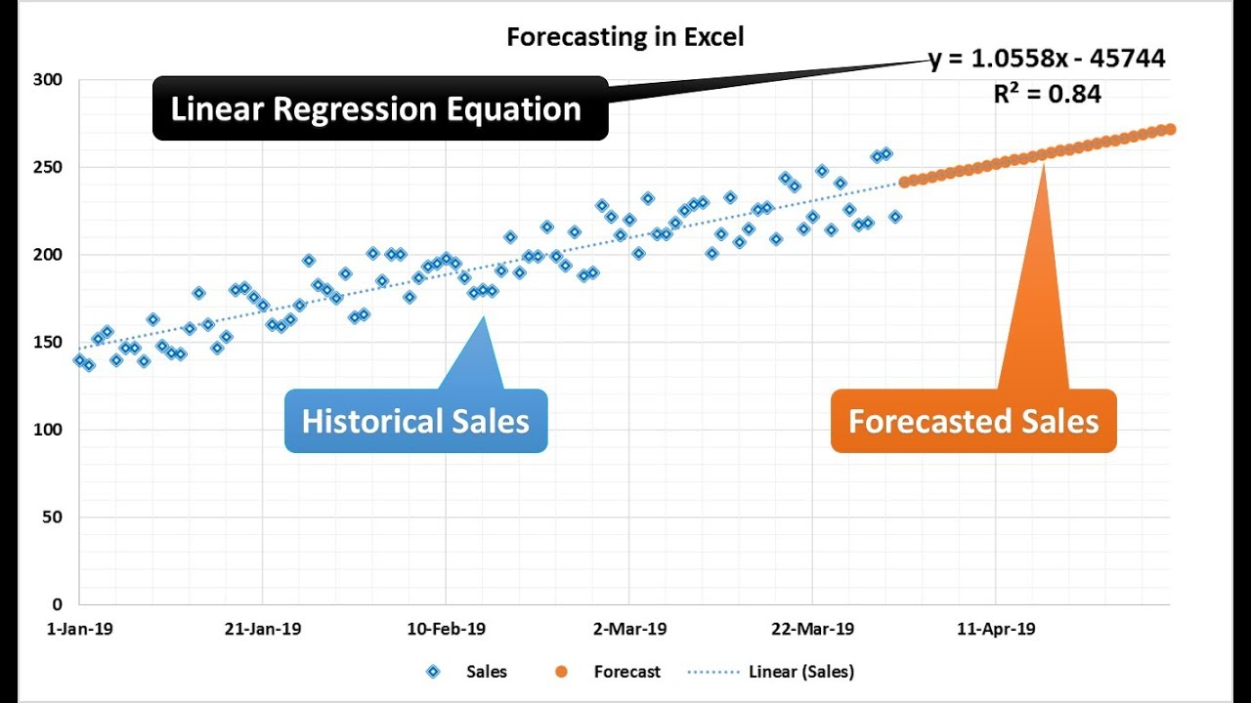

Linear regression for forecasting
$Y_{i}=X_{i}β+ε_{i}$
$\hat{y_{i}}=X_{i}\hat{β}+u_{i}$
$\hat{β}={\left(X^{′}X\right)}^{\left\{−1\right\}}X^{′}y$
$E\left(\hat{β}\right)=E\left({\left(X^{′}X\right)}^{\left\{−1\right\}}X^{′}y\right)=E\left({\left(X^{′}X\right)}^{\left\{−1\right\}}X^{′}(X_{i}β+ε_{i})\right)$
$E\left(\hat{β}\right)=E\left(β\right)+E\left({\left(X^{′}X\right)}^{\left\{−1\right\}}X^{′}ε\right)=β$
Put in a series of independent variables
Run model and put in new datapoint
Put in R’s predict function to get forecast
Will always be error and confidence interval

Slide 16
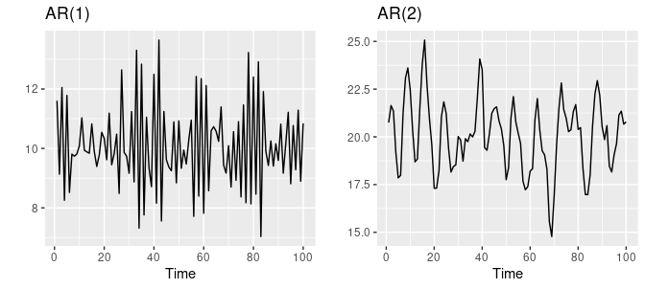

Autoregression
Next element in series dependent on last element
Can check for autoregression using correlogram
$y_{t}=α+β_{1}Y_{\left\{t−1\right)}+β_{2}Y_{\left\{t−2\right\}}+…β_{p}y_{\left\{t−p\right\}}+ε_t$

Slide 17
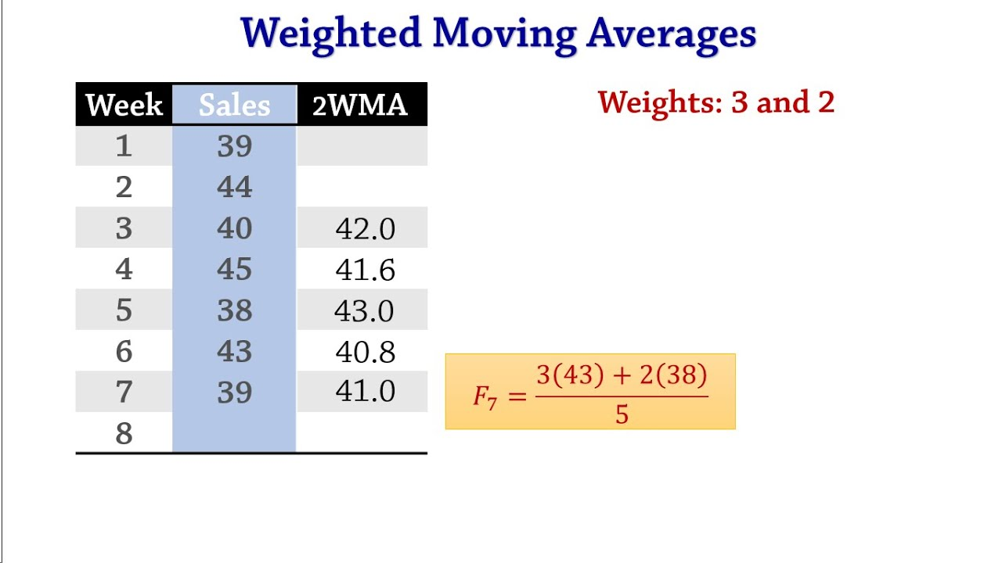
Moving Average
Next element weighted composition of previous elements
I

Slide 18
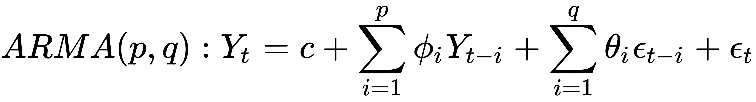
Forecasting a time series ARMA
Include AR terms and MA terms
Can be combined with linear regression
Helps accurately predict a decomposed forecast over time

Slide 19
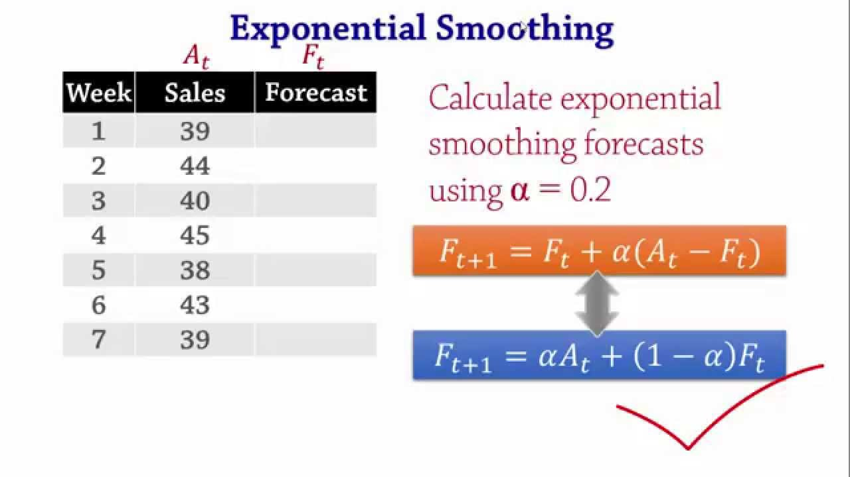
Exponential Smoothing
Next element partially based on error of prior element
Weight changed based on responsiveness to forecast error

Slide 20
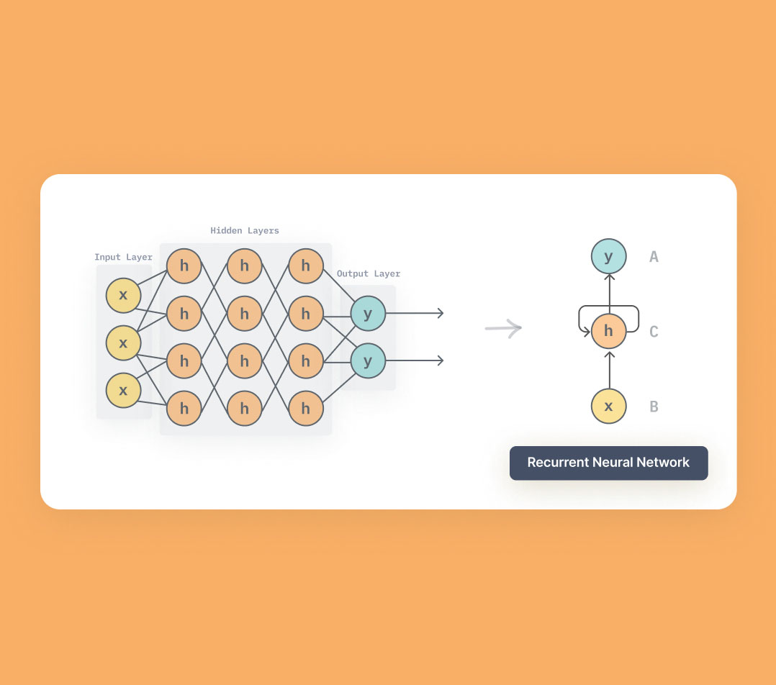
More complex time series forecasting mechanisms
Vector Autoregressions
Recurrent neural networks
Splines
Regression trees
Random forests
Bayesian structural time

Slide 21
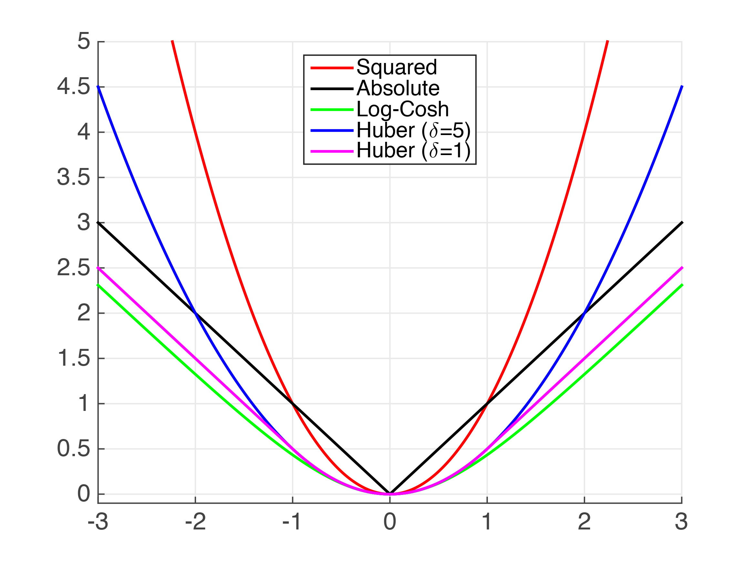
Measuring Forecast accuracy
RMSE: Root mean squared error
MSE: Mean squared error
MAE: Mean absolute error
Which one does linear regression minimize?
What statistical object do you get when you use MSE? MAE
Which one should you minimize?

Slide 22
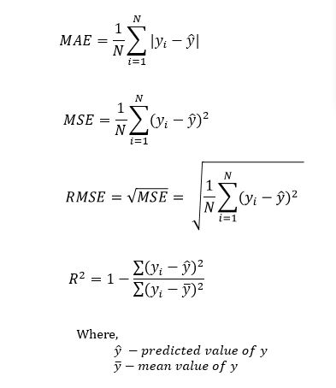
Measuring forecast error

Slide 23
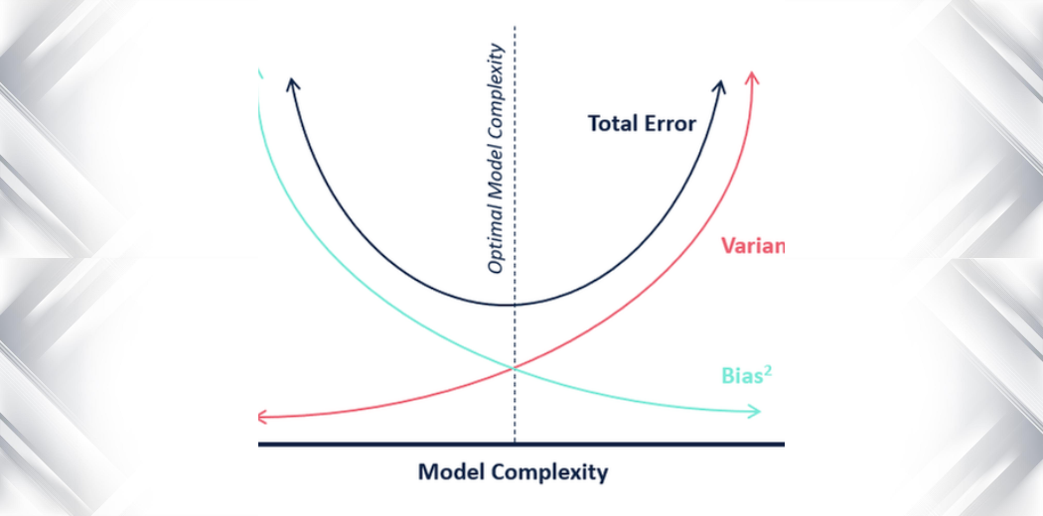
Bias-variance tradeoff

Slide 24
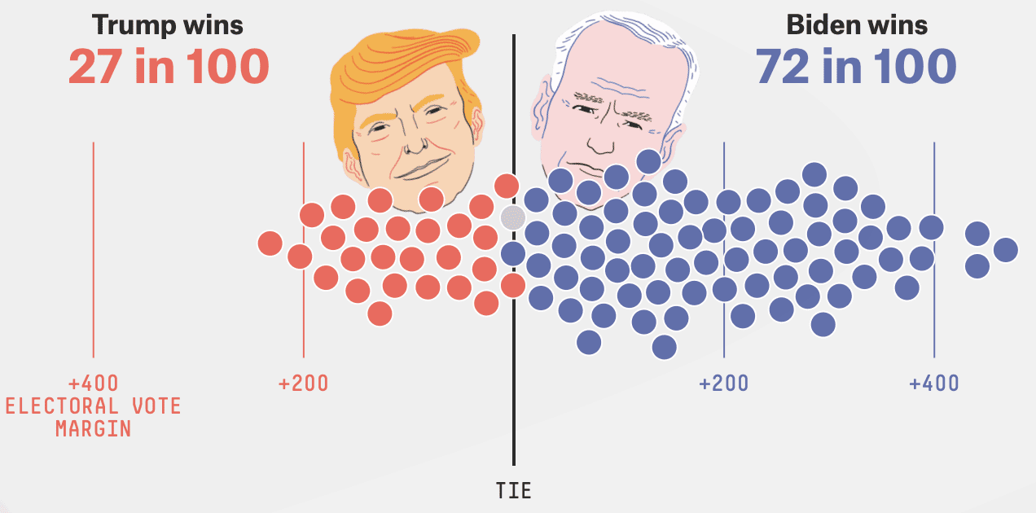
Probabilistic forecast

Slide 25
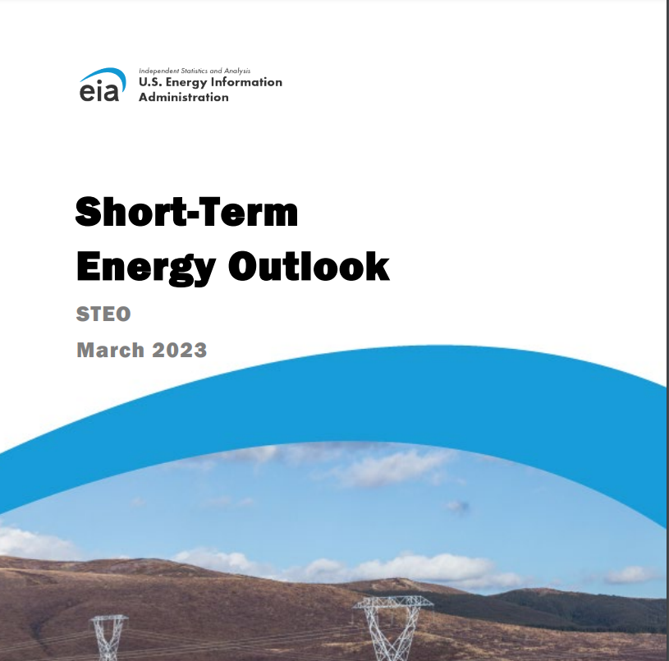
Outlook Reports
Regularly, government officials at statistical agencies produce reports
Forecast variables of interest
Provide discussion on what moved variables

Slide 26

Why outlook happens

Slide 27

How government commodity market forecasting works in practice
Once a year, baseline estimates of next year’s market variables are produced
Throughout the month, statistical agencies release reports related to commodity
Once a month, a committee meets to discuss what the forecast of market variables should be
Certain variables fixed, others move alongside
Committee members bring news, models, and analysis
Debate occurs until consensus forecast created

Slide 28

Interagency Commodities Estimates Committee Activity
Please do Homework 5 or read at least one article related to energy markets
I will have a “balance sheet” ready related to petroleum worldwide
We will discuss and debate the direction of oil prices and other balance sheet objects
We will make a forecast and create a short outlook report.

