Slide 1
Decision Tree
Implementation

Slide 2
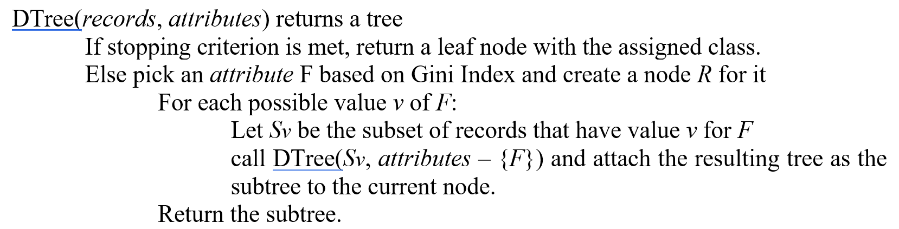
Decision Tree
Implement Decision Tree algorithm as follows:
the best feature to split

Slide 3
Example
Golf dataset
4 features
Label: yes/no
We use multi-way
Split in this assignment
Outlook | Temperature | Humidity | Windy | Label
Rainy | Hot | High | FALSE | No
Rainy | Hot | High | TRUE | No
Overcast | Hot | High | FALSE | Yes
Sunny | Mild | High | FALSE | Yes
Sunny | Cool | Normal | FALSE | Yes
Sunny | Cool | Normal | TRUE | No
Overcast | Cool | Normal | TRUE | Yes
Rainy | Mild | High | FALSE | No
Rainy | Cool | Normal | FALSE | Yes
Sunny | Mild | Normal | FALSE | Yes
Rainy | Mild | Normal | TRUE | Yes
Overcast | Mild | High | TRUE | Yes
Overcast | Hot | Normal | FALSE | Yes
Sunny | Mild | High | TRUE | No

Slide 4
Stopping criteria
stopCriteria(dataset)
assignedLabel = None
if all class labels are the same
assignedLabel = label
else if no more features to split
assignedLabel = majority(labels)
Input: dataset/split dataset
Output: assigned label
The original dataset does not satisfy the stopping criteria.
Then we find best split feature:
Check if it has only one feature by evaluating the number of columns in the current dataset

Slide 5
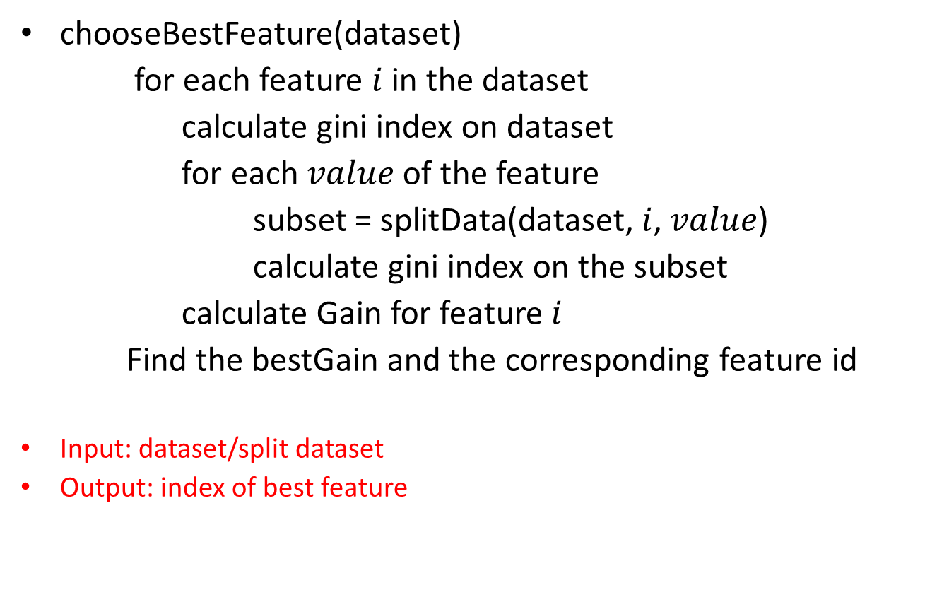
Find best split feature
chooseBestFeature(dataset)
for each feature $i$ in the dataset
calculate gini index on dataset
for each $value$ of the feature
subset = splitData(dataset, $i$, $value$)
calculate gini index on the subset
calculate Gain for feature $i$
Find the bestGain and the corresponding feature id
Input: dataset/split dataset
Output: index of best feature

Slide 6

Find best split feature
Find best split feature
For each feature, calculate the gain of gini indexes
If Feature = Outlook
Gini=$1−{\left(\frac{5}{14}\right)}^{2}−{\left(\frac{9}{14}\right)}^{2}=0.46$
Outlook = Rainy
gini =$1−{\left(\frac{3}{5}\right)}^{2}−{\left(\frac{2}{5}\right)}^{2}=0.48$
Outlook | Temperature | Humidity | Windy | Label
Rainy | Hot | High | FALSE | No
Rainy | Hot | High | TRUE | No
Overcast | Hot | High | FALSE | Yes
Sunny | Mild | High | FALSE | Yes
Sunny | Cool | Normal | FALSE | Yes
Sunny | Cool | Normal | TRUE | No
Overcast | Cool | Normal | TRUE | Yes
Rainy | Mild | High | FALSE | No
Rainy | Cool | Normal | FALSE | Yes
Sunny | Mild | Normal | FALSE | Yes
Rainy | Mild | Normal | TRUE | Yes
Overcast | Mild | High | TRUE | Yes
Overcast | Hot | Normal | FALSE | Yes
Sunny | Mild | High | TRUE | No
Number of “No” in the last column
Number of rows
Number of “No” in the last column given Outlook = rainy
Number of rows given Outlook = rainy

Slide 7

Find best split feature
Find best split feature
For each feature, calculate the gain of gini indexes
If Feature = Outlook
Gini=$1−{\left(\frac{5}{14}\right)}^{2}−{\left(\frac{9}{14}\right)}^{2}=0.46$
Outlook = Rainy
gini =$1−{\left(\frac{3}{5}\right)}^{2}−{\left(\frac{2}{5}\right)}^{2}=0.48$
Outlook = overcast
gini=$1−{\left(\frac{4}{4}\right)}^{2}=$ 0
Outlook | Temperature | Humidity | Windy | Label
Rainy | Hot | High | FALSE | No
Rainy | Hot | High | TRUE | No
Overcast | Hot | High | FALSE | Yes
Sunny | Mild | High | FALSE | Yes
Sunny | Cool | Normal | FALSE | Yes
Sunny | Cool | Normal | TRUE | No
Overcast | Cool | Normal | TRUE | Yes
Rainy | Mild | High | FALSE | No
Rainy | Cool | Normal | FALSE | Yes
Sunny | Mild | Normal | FALSE | Yes
Rainy | Mild | Normal | TRUE | Yes
Overcast | Mild | High | TRUE | Yes
Overcast | Hot | Normal | FALSE | Yes
Sunny | Mild | High | TRUE | No

Slide 8


Find best split feature
Find best split feature
For each feature, calculate the gain of gini
If Feature = Outlook
Gini=$1−{\left(\frac{5}{14}\right)}^{2}−{\left(\frac{9}{14}\right)}^{2}=0.46$
Outlook = Rainy
gini =$1−{\left(\frac{3}{5}\right)}^{2}−{\left(\frac{2}{5}\right)}^{2}=0.48$
Outlook = overcast
gini=$1−{\left(\frac{4}{4}\right)}^{2}=$ 0
Outlook = sunny
gini= $1−{\left(\frac{3}{5}\right)}^{2}−{\left(\frac{2}{5}\right)}^{2}=0.48$
Outlook | Temperature | Humidity | Windy | Label
Rainy | Hot | High | FALSE | No
Rainy | Hot | High | TRUE | No
Overcast | Hot | High | FALSE | Yes
Sunny | Mild | High | FALSE | Yes
Sunny | Cool | Normal | FALSE | Yes
Sunny | Cool | Normal | TRUE | No
Overcast | Cool | Normal | TRUE | Yes
Rainy | Mild | High | FALSE | No
Rainy | Cool | Normal | FALSE | Yes
Sunny | Mild | Normal | FALSE | Yes
Rainy | Mild | Normal | TRUE | Yes
Overcast | Mild | High | TRUE | Yes
Overcast | Hot | Normal | FALSE | Yes
Sunny | Mild | High | TRUE | No
Gain = $0.46−(\frac{5}{14}∗0.48+\frac{4}{14}∗0$
$$+\frac{5}{14}∗0.48)=0.117$$

Slide 9
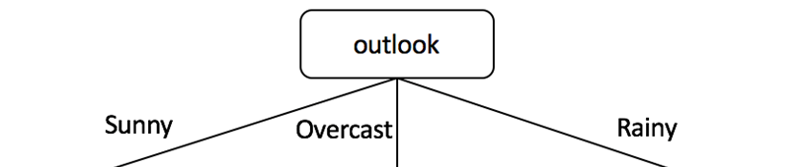
Find best split feature
Find best split feature
For each feature, calculate the gain
If Feature = Temperature, follow the same procedure to obtain the gain value
After the calculation for each feature on the dataset, we obtain
Gain(outlook) = 0.117
Gain(temperature)=0.018
Gain(humidity)=0.092
Gain(windy)=0.031
So Outlook is the best feature to split;
Then we split the data set:

Slide 10
Split the dataset
For each value in Outlook, split the dataset
splitData function has been provided.
Delete the Outlook column
Outlook | Temperature | Humidity | Windy | Label
Rainy | Hot | High | FALSE | No
Rainy | Hot | High | TRUE | No
Overcast | Hot | High | FALSE | Yes
Sunny | Mild | High | FALSE | Yes
Sunny | Cool | Normal | FALSE | Yes
Sunny | Cool | Normal | TRUE | No
Overcast | Cool | Normal | TRUE | Yes
Rainy | Mild | High | FALSE | No
Rainy | Cool | Normal | FALSE | Yes
Sunny | Mild | Normal | FALSE | Yes
Rainy | Mild | Normal | TRUE | Yes
Overcast | Mild | High | TRUE | Yes
Overcast | Hot | Normal | FALSE | Yes
Sunny | Mild | High | TRUE | No
Temperature | Humidity | Windy | Label
Mild | High | FALSE | Yes
Cool | Normal | FALSE | Yes
Cool | Normal | TRUE | No
Mild | Normal | FALSE | Yes
Mild | High | TRUE | No
Choose subset: Outlook = sunny;

Slide 11
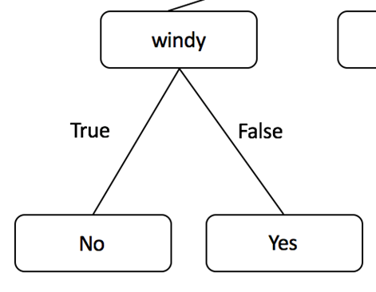
Repeat on sub-dataset
Repeat the same procedure for the sub-dataset
This is done by calling Dtree again for each value of the best split feature (Outlook in our example).
It is already implemented in the template
Sub-dataset doesn’t satisfy stopping criteria
Find best split on sub-dataset
(outlook=sunny)
Gain(temperature)=0.0133
Gain(Humidity)=0.0133
Gain(windy)=0.48
So windy is the best feature to split on
the sub-dataset (when outlook=‘sunny’)
Temperature | Humidity | Windy | Label
Mild | High | FALSE | Yes
Cool | Normal | FALSE | Yes
Cool | Normal | TRUE | No
Mild | Normal | FALSE | Yes
Mild | High | TRUE | No

Slide 12
Repeat on sub-dataset
Iterate until stopping criteria satisfied
Windy = False → Yes
Windy = True → No
(outlook=sunny)
Temperature | Humidity | Windy | Label
Mild | High | FALSE | Yes
Cool | Normal | FALSE | Yes
Cool | Normal | TRUE | No
Mild | Normal | FALSE | Yes
Mild | High | TRUE | No

Slide 13
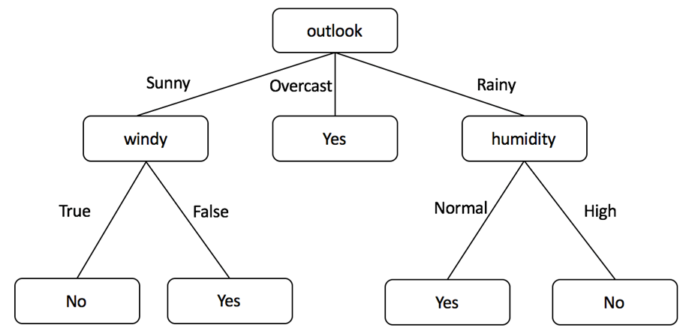
Repeat on sub-dataset
Follow the same procedure for overcast and Rainy
Outlook = overcast → label=yes
(outlook=Overcast)
Outlook | Temperature | Humidity | Windy | Label
Overcast | Hot | High | FALSE | Yes
Overcast | Cool | Normal | TRUE | Yes
Overcast | Mild | High | TRUE | Yes
Overcast | Hot | Normal | FALSE | Yes

Slide 14
Repeat on sub-dataset
Follow the same procedure for overcast and Rainy
Outlook = Rainy
(outlook=Rainy)
Outlook | Temperature | Humidity | Windy | Label
Rainy | Hot | High | FALSE | No
Rainy | Hot | High | TRUE | No
Rainy | Mild | High | FALSE | No
Rainy | Cool | Normal | FALSE | Yes
Rainy | Mild | Normal | TRUE | Yes
Gain(temperature)=0.28
Gain(Humidity)=0.48
Gain(windy)=0.013
Humidity = High → No
Humidity = Normal → Yes

