Slide 1
Exploring Borrowers’ Phone Data at Branch
Jacob Gollub
11/30/17

Slide 2
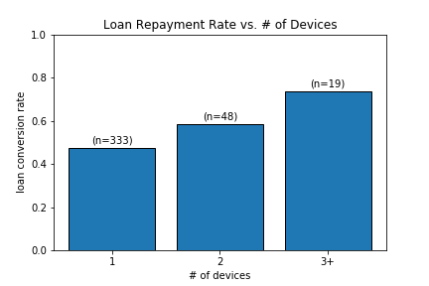
Device Count
Owning more devices appears to establish borrower reliability
(R = .1393, p =.005)

Slide 3
Contact Lists
Show hist. with tags (n= __)

Slide 4
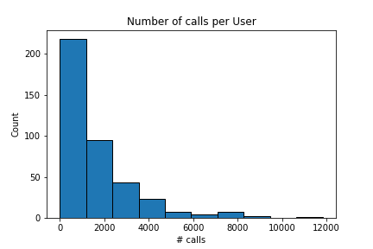
Call Logs
Put stats for cutoffs
User call count fairly predictive of loan repayment
(R = .4915, p < 1e-20)

Slide 5
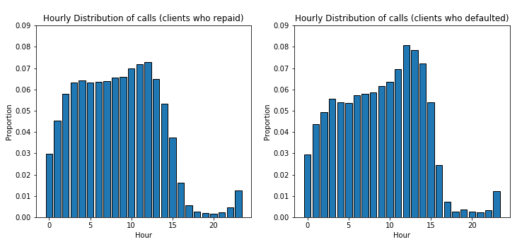
Distribution of Call times
-Distribution of the hour in which each call falls across the two populations
-Defaulted borrowers seem to call slightly more often in early afternoon, otherwise
similar

Slide 6
SMS Logs

Slide 8
Conclusion
Number of Devices
Number of Contacts
Number of Calls
Time at which calls took place

