Slide 1
Exploring Borrowers’ Phone Data at Branch
Jacob Gollub
2/12/17

Slide 2
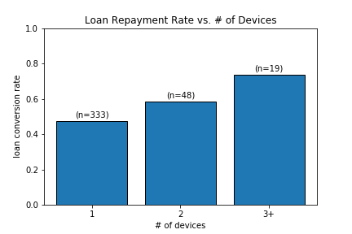
Device Count
Owning more devices establishes borrower reliability
(R = .1393, p =.005)

Slide 3
Contact Lists
Number of contacts a weak predictor (R=.1175, p=.0188)
Still, users with very few contacts much less likely to default
Future opportunities to assess a borrower based on reliability of contacts
# contacts | Payback Rate | n
< 350 | .4335 | 203
>= 350 | . 5685 | 197

Slide 4
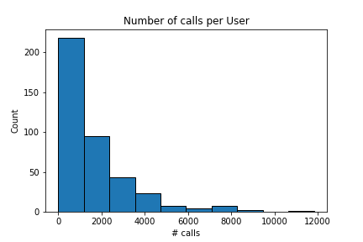
Call Logs
User call count fairly predictive of loan repayment
(R = .4915, p < 1e-20)
Average call duration a weaker predictor (R = .1643, p < 1e-3) but still noteworthy; no correlation between call count and duration
# calls | Payback Rate | n
< 1000 | .25 | 196
>= 1000 | . 7402 | 204

Slide 5
International Call Count
Number of international calls (listed as country other than “Kenya”) in a user’s history
Another predictor to consider (R=.1526, p=.002)
# calls | Payback Rate | n
0 | .4406 | 286
>= 1 | .6491 | 114

Slide 6
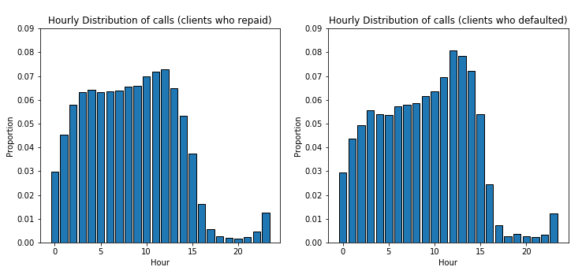
Distribution of Call times
-Distribution of the hour in which a call occurs across both populations
-Defaulted borrowers seem to call slightly more often in early afternoon, otherwise
similar
-also observed distribution weighted equally by users (‘hourly_dist_users.png’)

Slide 7
SMS Logs
Only observing sms from ‘MPESA’ and ‘Safaricom’; these account for >75% of text messages from named addresses
Ignore personal sms messages
Counts (R=.3318, p < 1e-10) and average length (R=.2392, p < 1.5e-6) of these messages provide more insightful predictors
We can dig further for ‘failure’ and ‘transaction’ messages
# Bank sms | Payback Rate | n
< 200 | .3 | 200
>= 200 | .7107 | 197

Slide 8
SMS Types
Two types: “confirmed” (n=71370), “failed” (n=2888)
“Confirmed” transaction messages covary most with repayment (more transactions → more credibility)
“failed” count also strongly covaries with status because implies more transaction messages and higher credibility
Since both types of messages covary strongly (R=.7601, p<1e-75), recommend tracking counts as single feature
Can search quantitatively for more types via K-means clustering
“Confirmed” Count: R = .3536, p < 1e-12
“Failed” Count: R = .2728, p < 1e-7

Slide 9
Conclusion
Many user-aggregated features within this dataset give us information about how likely a user is to repay their loan
We can assemble all the features examined and feed them into a model (random forest, logistic regression, etc.)
Perform PCA or get rid of highly collinear features
In the future, knowing a user’s contacts will be informative when we can access data on at least a small portion of those contacts

