Slide 1
Exploring Borrowers’ Phone Data at Branch
Jacob Gollub
11/30/17

Slide 2
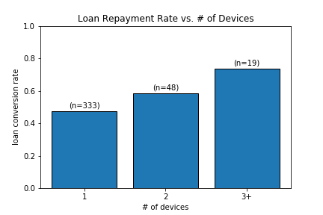
Device Count
Owning more devices establishes borrower reliability
(R = .1393, p =.005)

Slide 3
Contact Lists
Number of contacts a weak predictor (R=.1175, p=.0188)
Still, users with very few contacts much less likely to default
Future opportunities to assess a borrower based on reliability of contacts
# contacts | Payback Rate | n
>= 350 | .5685 | 197
< 350 | .4335 | 203

Slide 4
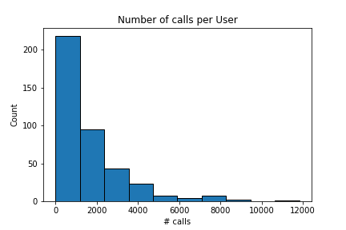
Call Logs
User call count fairly predictive of loan repayment
(R = .4915, p < 1e-20)
Average call duration a weaker predictor (R = .1643, p < 1e-3) but still worth looking into
# calls | Payback Rate | n
>= 1000 | .7402 | 204
< 1000 | .25 | 196

Slide 5
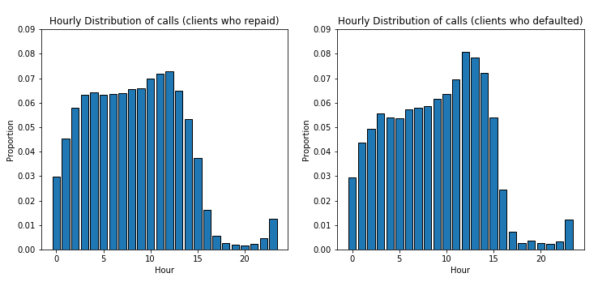
Distribution of Call times
-Distribution of the hour in which a call occurs across both populations
-Defaulted borrowers seem to call slightly more often in early afternoon, otherwise
similar
-also observed distribution weighted equally by users (‘hourly_dist_users.png’)

Slide 6
SMS Logs

Slide 8
Conclusion
Number of Devices
Number of Contacts
Number of Calls
Time at which calls took place

