Slide 1
W = 2.0 tf/m
0.50m
0.50m
4 m
Y
E = 2.0e⁶ tf/m²
X
0.50m
10 m
10 m

Slide 2
W = 2.0 tf/m
10.0 t
16.67 t-m
Y
Y
X
X
W = 2.0 tf/m

Slide 3
I_{z}
E
A
Nudo inicial
0.00521 2.0e6 0.25
Numero del elemento
Tipo de elemento
Tipo de material
Nudo final
0 0 0 0 1
1 0 0 1 0
1
1
2
0
Y
Coordenadas
Restricciones
Numero del nudo
X
0 0.00 0.00 -1 -1 -1
10.0 4.00 0 0 0
2 20.0 4.00 -1 -1 -1
0

Slide 4
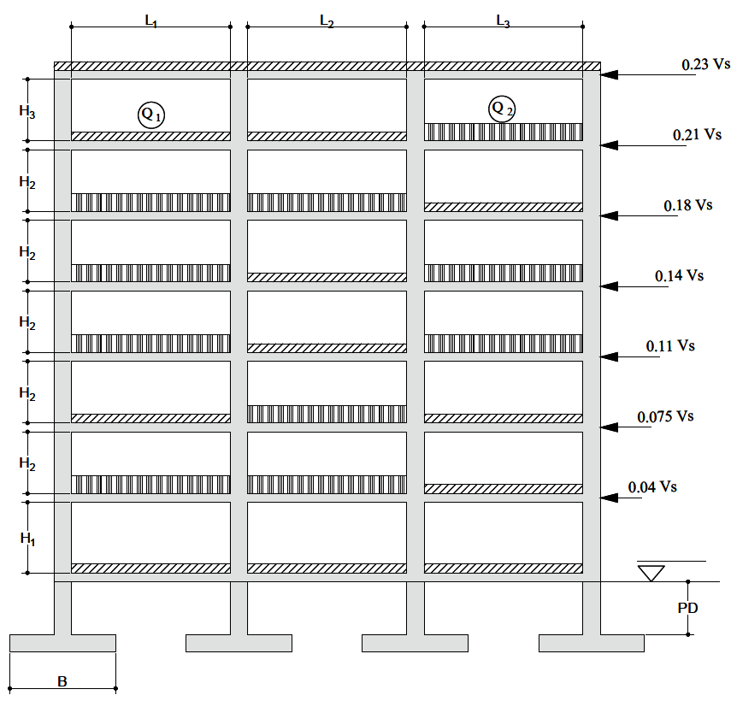

Slide 5
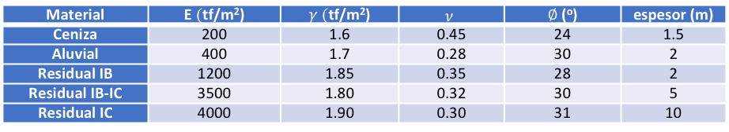
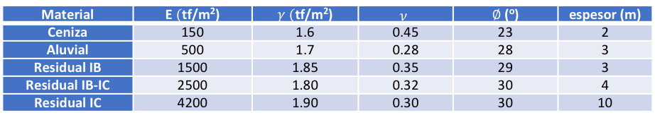
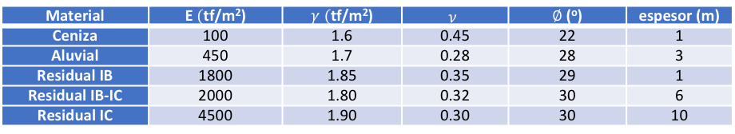
Material | E $($tf/m²) | $γ$ $($tf/m²) | $$ν$$ | $∅$ (º) | espesor (m)
Ceniza | 150 | 1.6 | 0.45 | 23 | 2
Aluvial | 500 | 1.7 | 0.28 | 28 | 3
Residual IB | 1500 | 1.85 | 0.35 | 29 | 3
Residual IB-IC | 2500 | 1.80 | 0.32 | 30 | 4
Residual IC | 4200 | 1.90 | 0.30 | 30 | 10
Material | E $($tf/m²) | $γ$ $($tf/m²) | $$ν$$ | $∅$ (º) | espesor (m)
Ceniza | 200 | 1.6 | 0.45 | 24 | 1.5
Aluvial | 400 | 1.7 | 0.28 | 30 | 2
Residual IB | 1200 | 1.85 | 0.35 | 28 | 2
Residual IB-IC | 3500 | 1.80 | 0.32 | 30 | 5
Residual IC | 4000 | 1.90 | 0.30 | 31 | 10
Material | E $($tf/m²) | $γ$ $($tf/m²) | $$ν$$ | $∅$ (º) | espesor (m)
Ceniza | 100 | 1.6 | 0.45 | 22 | 1
Aluvial | 450 | 1.7 | 0.28 | 28 | 3
Residual IB | 1800 | 1.85 | 0.35 | 29 | 1
Residual IB-IC | 2000 | 1.80 | 0.32 | 30 | 6
Residual IC | 4500 | 1.90 | 0.30 | 30 | 10

Slide 6
0.50m
0.50m
E = 2.0e⁶ tf/m²
Vig: 0.25 x 0.25 m
W = 2.0 tf/m
Col: 0.20 x 0.20 m
10 m
3.0 m
W = 1.0 tf/m
W = 1.0 tf/m
W = 2.0 tf/m
10 m
3.0 m
Y
X
4.0 m
4.0 m
6.0 m

Slide 7
W = 2.2 tf/m
2.0 tf
3.0 tf-m
0.30m
0.25m
2.4 m
Y
E = 188 tf/cm²
X
1.0 m
3.7 m
1.0 m

Slide 8
W = 4.0 tf/m
Vig: 0.25 x 0.25 m
Col: 0.20 x 0.20 m
3.0 m
E = 2.0e⁶ tf/m²
Y
X
4.0 m
4.0 m

