Slide 1
Geogg124: Data assimilation
P. Lewis

Slide 2
What is Data Assimilation?
Optimal merging of models and data
Models
Expression of current understanding about process
E.g. terrestrial C model
Data
Observations
E.g. EO
Notes:
Discuss a bit .. Also that its actually used for all sorts of ‘inversion’ problems which somewhat muddies the use of the term. Discuss what makes it different to ‘inversion’ … multiple constraints & uncertainty framework mainly … IMHO

Slide 3

Some basic stats
Gaussian PDF:
Notes:
Explain terms. X is the state vector here. T is transpose. Explain what a PDF is. Discuss the normalisation term & how the bit in the exp is basically a squared Z score (discuss what a Z score is?)

Slide 4
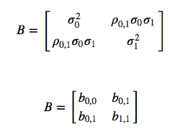
The uncertainty matrix
Notes:
Discuss what these terms are … rho is correln coefficient .. Ie normalised covariance. The bij terms are covariance.

Slide 5
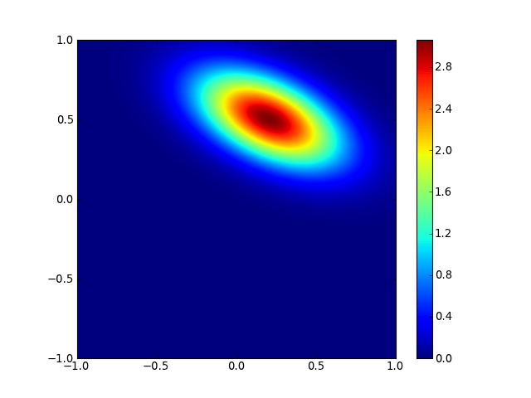
X=(0.2,0.5) sigma=(0.3,0.2), rho=-0.5

Slide 6
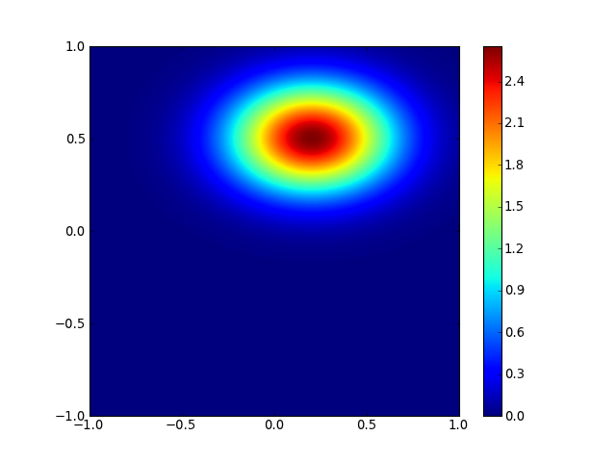
X=(0.2,0.5) sigma=(0.3,0.2), rho=0.0
Notes:
Discuss: the probability at the point (0,0) is only 0.86 of that when there is -0.5 correlation, so considering correlation is important (think of some egs?)

Slide 7

Combining probabilities
Bayes theorum
Notes:
Explain the conditional probabilities. The denominator is essentially a normalisation term so that the integral of the numerator is 1.

Slide 8
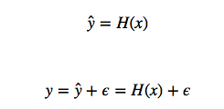

Observation operator
Model of y:
The PDF of the observations is the PDF of the observations given x
The observation PDF
Notes:
Where R is the uncertainty in the observations and the operator

Slide 9



Using Bayes theorum
So … we can improve on a prior estimate (x_{b}) by multiplying by the observation PDF
Notes:
Xb: prior estimate, B is prior uincertainty
X’ is the new (improved) estimate
This all falls out of Bayes theorum. We drop the denominator because its just a normalisation term

Slide 10
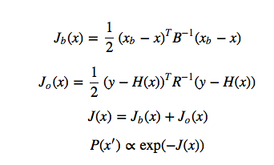
Using Bayes theorum
Notes:
Same info as previous slide, but broken down into parts to follow through …
Basically, you can multiply the probabilities, so the maximum likelihood (max of P) is the same as minimising the J term (because iof the negative exponential), so the maximum likelihood solution involves the minimum of the J terms, where the J terms are essentially *cost functions*

Slide 11
Differentials of J
Minimisation:
Need to know the derivatives
J’ : Jacobian
Uncertainty:
Posterior uncertainty:
Curvature of cost function
Inverse of 2nd O derivative of J, J’’
Hessian

Slide 12
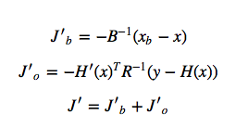
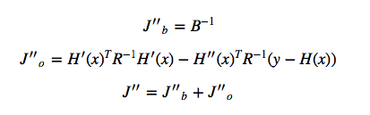
Differentials of J
Notes:
The derivatives for the prior and observation operator terms. Note how J’’B is just B-1 (which makes sense of course).
Show how its simpler if H is linear (H’’ = 0; H’(x) = Hx)

Slide 13

Posterior uncertainty
Follows from previous that (for linear case)

Slide 14



Univariate example
If H=I (identity operator)
Univariate:
Equal variances:
Notes:
Follow thro’ from top to bottom … some of them might know this univariate ‘adding of uncertainties’ in the middle line, if not, then the bottom one is easy to understand … 2 samples, so reduce uncertainty by 1/sqrt(2) (if independent)

Slide 15

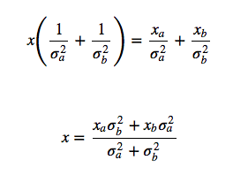
Optimal estimate
Solve for univariate case:
Samples (x_{a}, x_{b}) (sigma_{a}, sigma_{b}):
Notes:
So, given 2 samples, the ‘best’ estimate is a variance weighted mean … or, if the variances are equal, its simply the mean ;-) as youd expect.

Slide 16
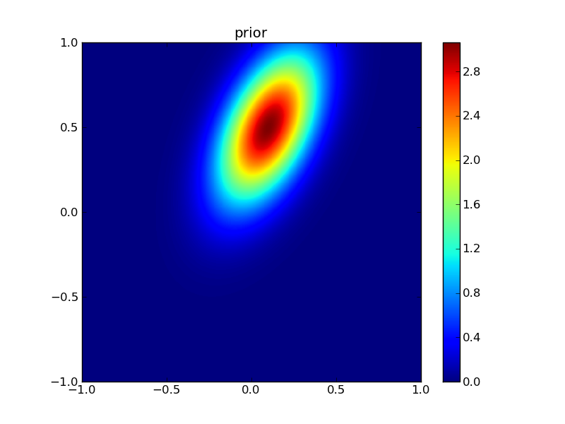
prior

Slide 17
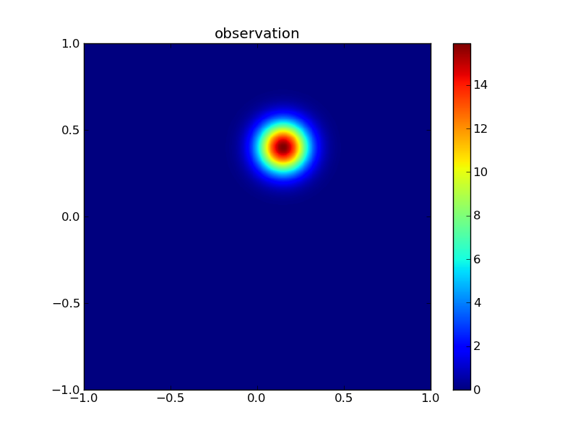
observation

Slide 18

posterior
Notes:
Go through & explain/discuss why you get this result … the posterior is quite close to the observation *because* the uncertainty in the observation is lower than that of the prior, but really its somewhere between the prior and the observation … essentially a variance weighted mean as shown above, but for 2D here. Also note that the posterior uncertainty is lower than either of the other 2 (relate to that sqrt 2 thing)

Slide 19
Finding solutions
DA methods
Variational (strong, weak constraint)
Sequential
MCMC (briefly)

Slide 20

Variational data assimilation: strong constraint
Cost function minimisation
Multiple obs constraints
Plus prior
Strong constraint:
Prediction must be a valid model state
‘trust the model’

Slide 21
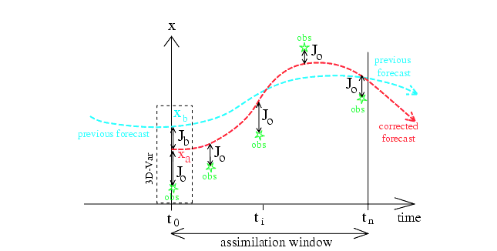
Variational data assimilation: strong constraint
Notes:
Figure from Bouttier and Courtier (1999) … should be self evident, but discuss with students. Mention 4D VAR … ie lots of these things happening over 3D space. Note that *normally* what is done is to adjust the initial conditions, eg in NWP. The ‘prior’ here is from a previous model run, or sometimes a climatology (average). Discuss advantages/disadvantages of strong constraint (trust the model … can correct for short term differences)

Slide 22


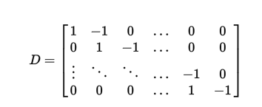
Variational data assimilation: weak constraint
Sometime want model as a ‘guide’ but don’t trust it.
So define model uncertainty
Use appropriate cost function for model
E.g. model

Slide 23
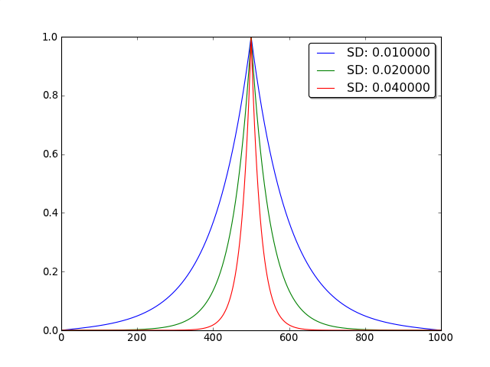
Dx: ~equivalent to convolution with Laplace function: smoother
Notes:
Well, equivalent if you have an identity operator for the observations …
Here, the relative uncertainty between the differential model (ie that Dx =0) and the observations (phrased as sd here) controls the effective width of the filter (ie the degree of smoothing), so sd = 0.04 -> high uncertainty in the Dx model, so trust the observations more (ie less smoothing)

Slide 24
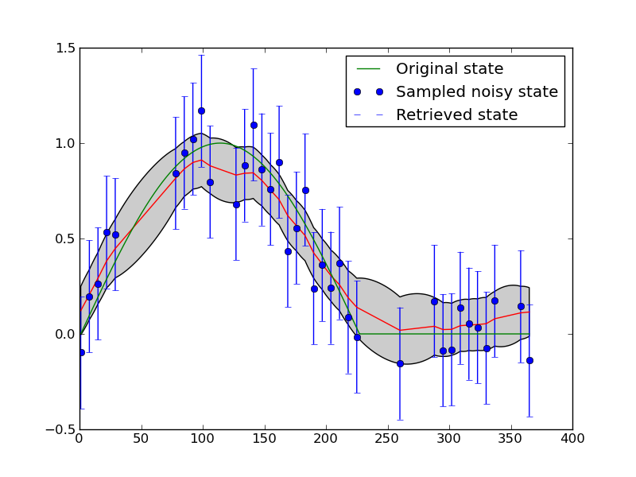
Dx constraint as a smoother
Notes:
The blue dots are sythnthetic NDVI data. The green line is the truth. The red/grey is what is recovered by the smoother. Note: reduced uncertainty, interpolation is done, uncertainty bounds contain the truth (but actually rather over-smooths at the breakpoint, as youd expect it to d)

Slide 25
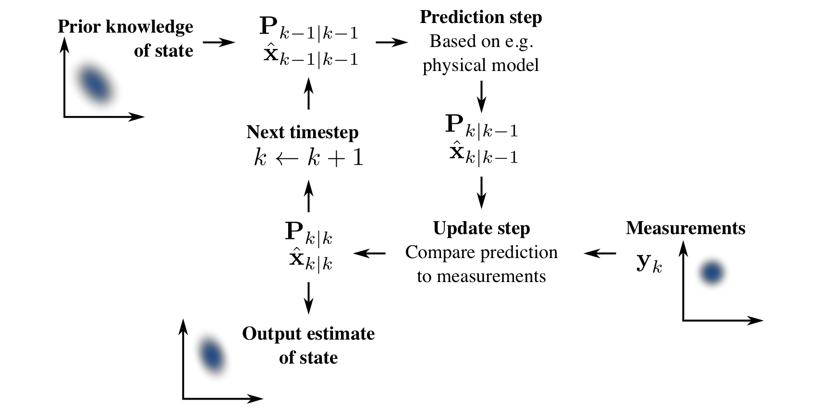
Sequential methods: Kalman Filter
Notes:
This is a fun one to go through .. I presume you know it well enough, if not there is text in the notes.

Slide 26

Prediction step
Notes:
M is the model here … ie what moves you from xk-1 to xk
The 2nd line is just adding uncertainties as we learned earlier (the MT P M just deals with model propagation in the prior uncertainty) .. Qk is the process model uncertaiunty. Nice eg to think of is the Dx model … zero order process model, so M=I and Q is a statement of the uncertainty increase per step

Slide 27



Update step: 1
Calculate the residual (‘innovation’)
Innovation uncertainty

Slide 28



Update step: 2
Optimal Kalman gain
Notes:
Essentially, K is the ratio of the current state uncertainty to the innovation uncertainty (mapped through H) .. So, sort of, how much you trust the current estrimate relative to what the innovation (the residual) is telling you, so this is used to scale the residual.
The posterior has a part (I – KH) that is essentially the reduction in uncertainty. Its interesting to note that the Kalman gain is *only* a function of uncertainties

Slide 29
Variants
Extended Kalman filter
deal with non-linearity by linearsing the operators
Particle filter
Instead of linearising the operators, sample the distributions using Monte Carlo methods
Ensemble Kalman filter
Deal with non-linearities by running an ensemble of sample trajectories through the model.
MCMC
Use Markov chains to sample space. Clever rules such as MH.
MH: propose update of x->x’. Measure improvment a
Accept is a>1 or use a as probability of acceptance else

Slide 30
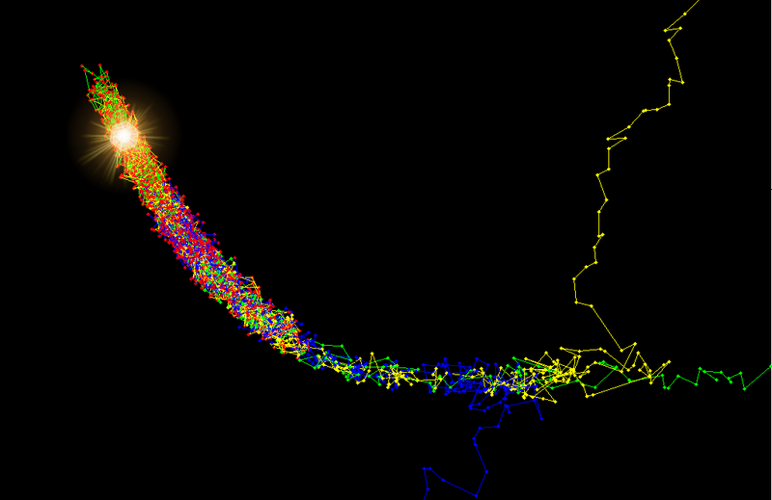
Metropolis Hastings
Notes:
From v. good wikipedia page: The result of three Markov chains running on the 3D Rosenbrock function using the Metropolis-Hastings algorithm. The algorithm samples from regions where the posterior probability is high and the chains begin to mix in these regions. The approximate position of the maximum has been illuminated. Note that the red points are the ones that remain after the burn-in process. The earlier ones have been discarded.

Slide 31
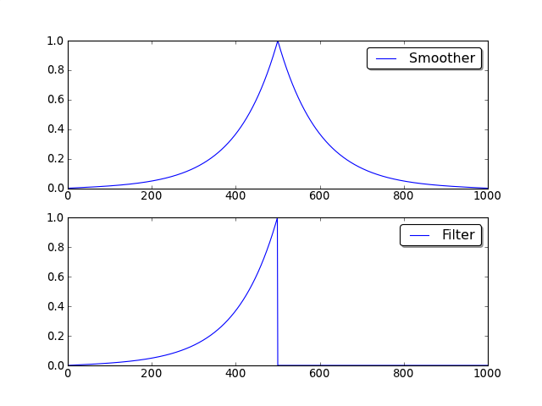
Smoothers and filters
Notes:
This expresses the essential difference between smoothers (eg K smoother) (2 way … all data) & filters (eg KF). You can run a filter in real time, but you need to be able to run the model backwards if you use a smoother & a sequential method.

Slide 32
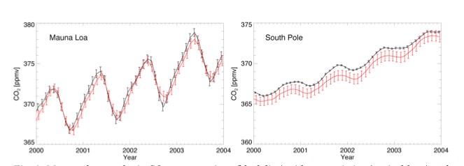
Applications
Carbon Cycle Data Assimilation System
DA system around BETHY model (+adjoint)
Deal with e.g. atmospheric conc. data. Through coupled atmospheric tracer model
Notes:
Figure from Scholze et al., 2009

Slide 33
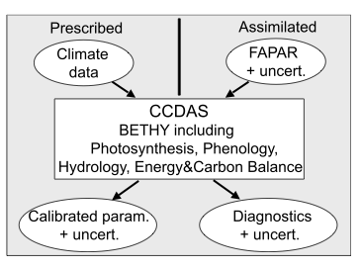
CCDAS
Notes:
Assimilate fapar … calibrate phenology & water parameters … diagnostics then eg CO2 fluxes at surface.
Figure from Scholze et al., 2007

Slide 34
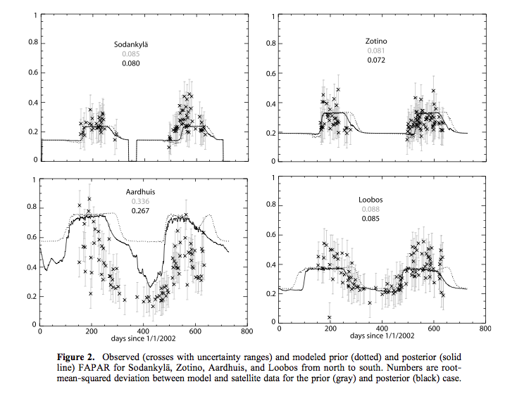
fAPAR assimilation
Notes:
Discuss quality of this … note v large uncertainties of the fapar
Figure from Scholze et al., 2007

Slide 35
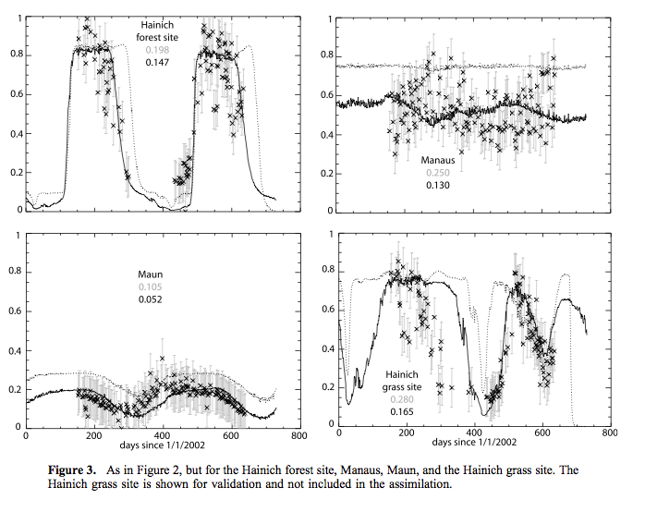
fAPAR assimilation
Notes:
Figure from Scholze et al., 2007

Slide 36
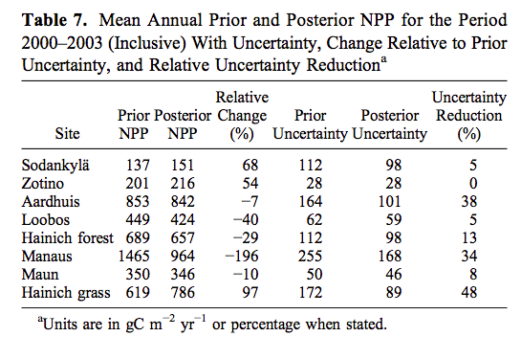
Impact of DA on NPP
Notes:
Figure from Scholze et al., 2007
Discuss & refer back to images … large improvement where model (params) poor.

Slide 37
EnKF of surface reflectance data into an ecosystem model
CCDAS has simple interface to observations
But difficult to make products (fAPAR) & use in model consistent
Difficult to track noise in satellite product
So, Quaife et al. (2008) attempt to link model state (LAI) to EO surface reflectance
using NL obs. op.

Slide 38
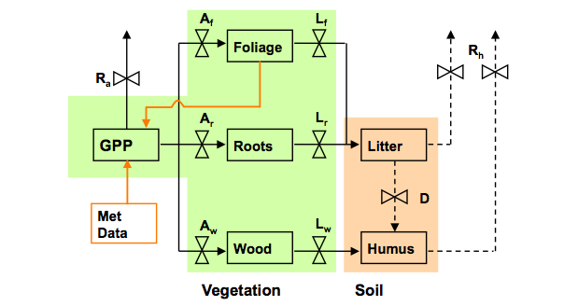
DALEC
Notes:
Figure from tristan probably …

Slide 39
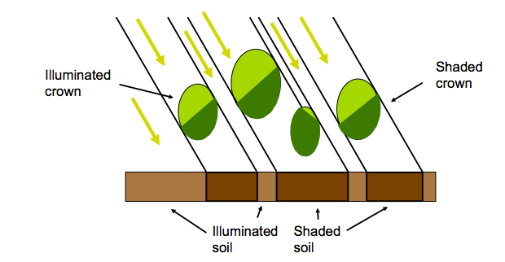
Observation operator

Slide 40
DA
EnKF
Used to affect leaf C (LAI)
EO data fn of ‘ancillary’ terms
Leaf chl., water etc.
Assumed constant (no uncertainty)

Slide 41
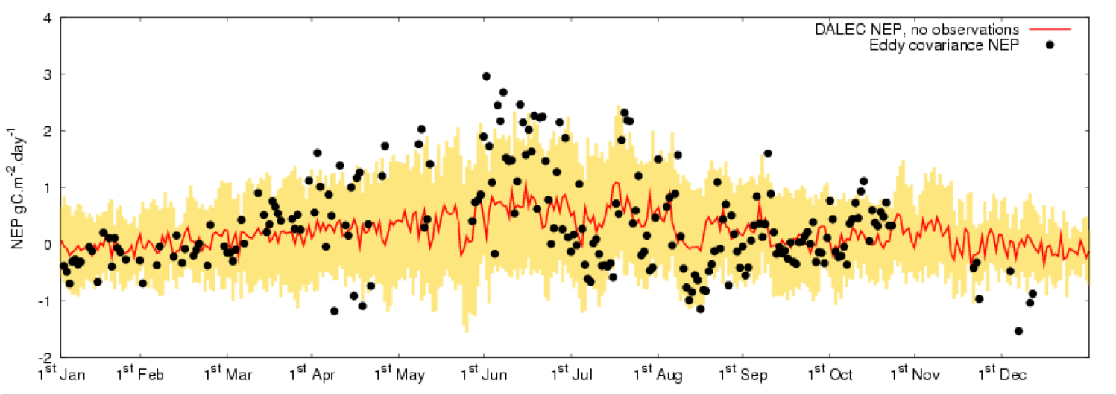
NPP

Slide 42
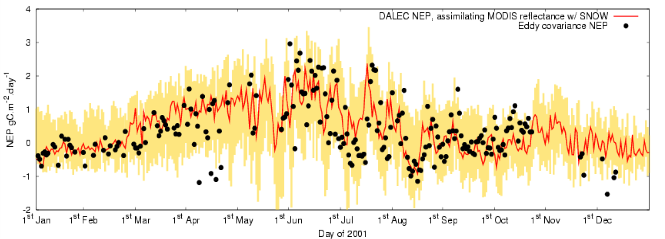
NPP
Notes:
Shows improvement in NPP with DA from MODIS (red & NIR) reflectance data

Slide 43
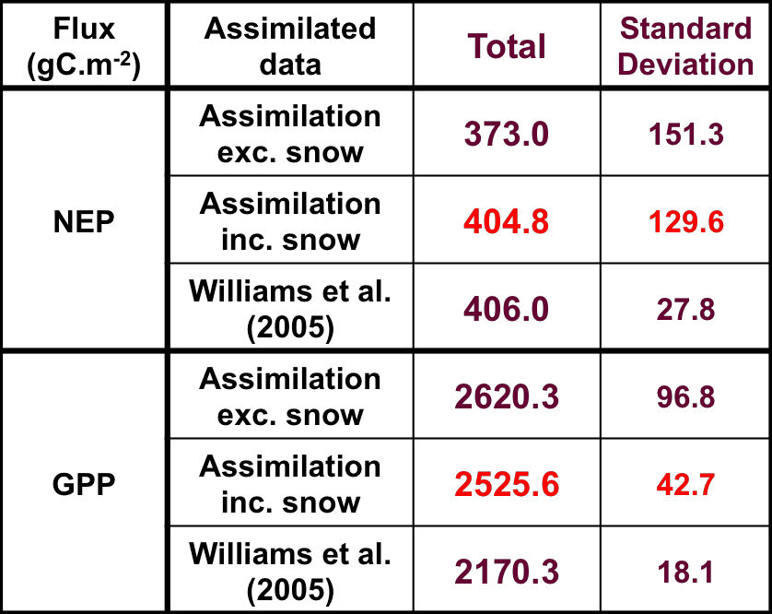
DA
Notes:
Improves NPP … but obviously cant constrain the soil parts of NPP. Note constraint from EO much less than williams et al using detailed data at flux tower, *but* eo can let you spatialise!

Slide 44

Mean NEP for 2000-2002
Flux Tower 1
4.5 km
Spatial average = 50.9
Std. dev. = 9.7
(gC/m²/year)
15
65
gC/m²/year

Slide 45
EO-LDAS
Earth Observation Land Data Assimilation
Focus on EO
Simple models only (regularisers, Dx, D²x …)
Observation operator
Semi-discrete (Gobron) + soil + ~PROSPECT
+ adjoint!

Slide 46
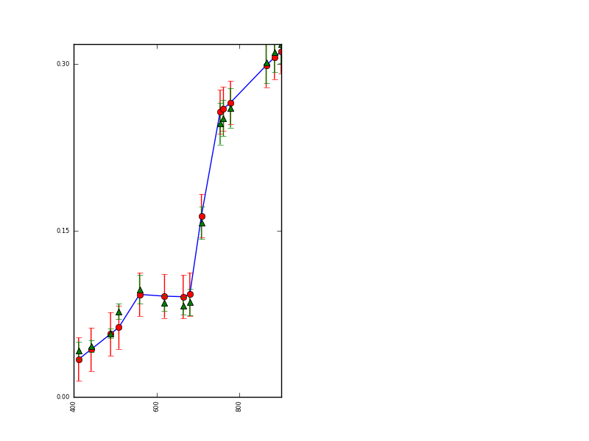
Simple DA: weak prior + MERIS observation
Reduces uncertainty
Models observation well
Solve for 7 biophysical parameters here
Uncertainty on most are high
From single meris observation
Notes:
Weak prior + observations. Red = observations (I think …)

Slide 47
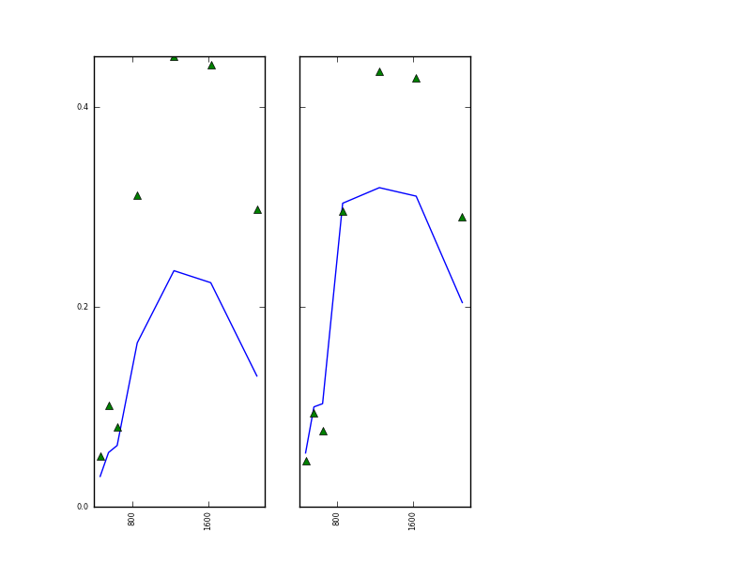
Predict MODIS
from MERIS parameters
Poor performance in extrapolation
Due to correlations and large uncertainties
Notes:
Green triangles = MODIS obs on same day same place as meris
Blue = prediction from params got from meris DA

Slide 48
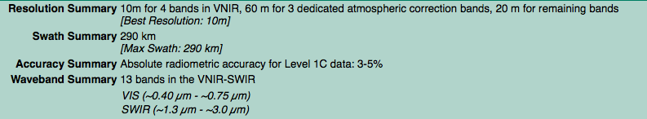
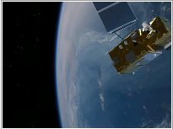
Sentinel-2 MSI

Slide 49
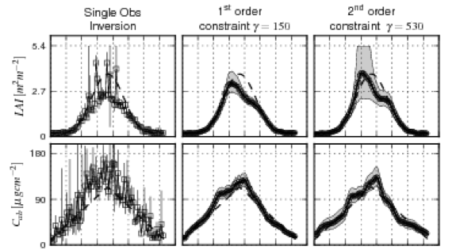
Use Dx, D²x to constrain
Notes:
Retrieve biophysical params using synthetic sentinel data. 2 shown here, but in total 6 retrieved for each day using Dx D2x regularidsation.
The left column show what you get from solving for each day separately.
If anyone asks, you get the degree of smoothness from cross validation (see notes & the paper)

Slide 50
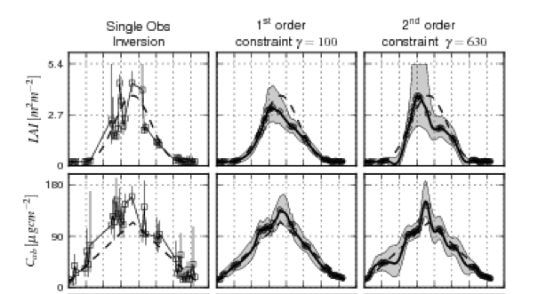
Cloudy case
Notes:
Same as previous, but with 50% of samples. Does a v good job of reconstructing temporal trajectories, even though given no information other than D1 D2 constraint.

Slide 51
Discussion
Outlined what DA is
Presented basic stats
How to combine uncertainties
Leads to how to combine constraints
Reviewed some major DA approaches
Variational / sequential
Weak constraint / strong constraint
Filters / smoothers

Slide 52
Discussion
Applications
CCDAS
Simple obs. Op.,
concentrates more on model (& atmos. transport)
Quaife et al
Connected refl. data to ecological model
Try to make canopy assumptions in M and H consistent
But only partially achieved this
EO-LDAS
Concentrate more on EO (H)
Variational system
Demonstrates use of regularisation

Slide 53
Discussion
State of the art in combining models/data
Really quite basic
NDVI to calibrate phenology
DA (CCDAS) shows that can be achieved in much more consistent / scientific manner
Incorporate uncertainty … DA
DA (Quaife/EO-LDAS) show potential for bypassing ‘products’ from EO
Directly link observations
Many advantages (multiple constraints)
But a bit slow/complex now
“In the future” this is how EO data will be used … (I hope!!)

