Slide 1

Music is Universal. Or is it not?
Jonathan Gomez Martinez and Ragip Gurlek

Slide 2
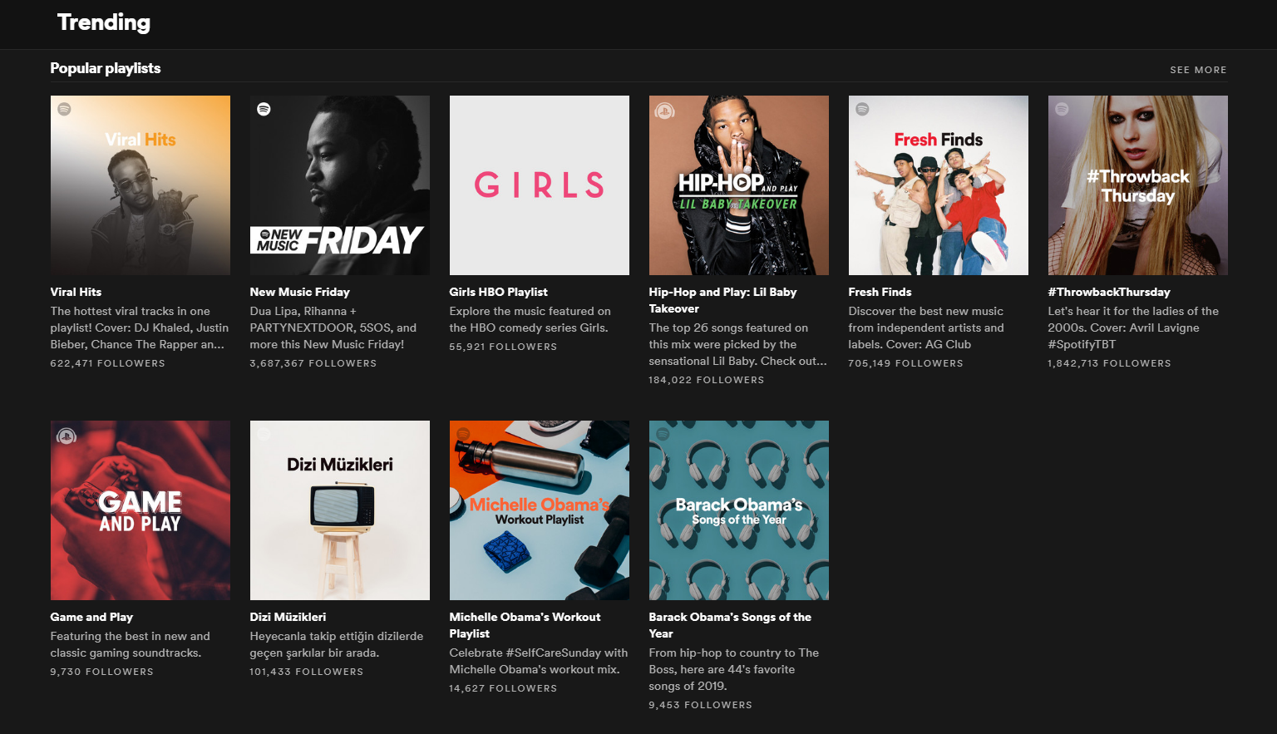
Goal
Identifying which country a song is popular in
Using only the musical properties and their relations over segments of the song
Without contextual information such as artist, label, or year

Slide 3
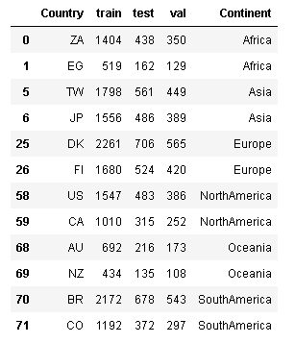
Dataset
Most popular playlists in Spotify¹ for 12 countries in a month in the last 19 years.
Songs appearing in playlists of multiple countries are discarded.
Songs are divided into segments that are musically different than each other. Each segment is represented with two musical properties, pitch and timbre.
Limitation: Some playlists are generated by Spotify and it is likely that they use the same features to curate the lists.

Slide 4
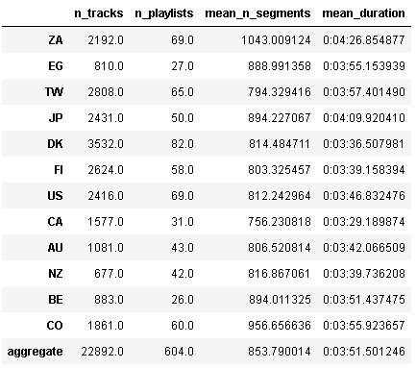
Descriptive Statistics

Slide 5
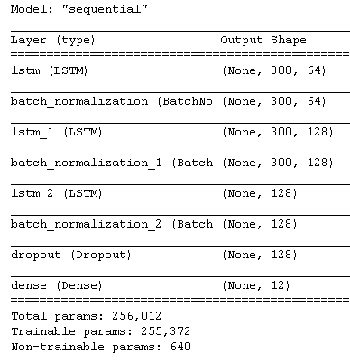
Sequential Learning
Architecture
Input: 30 seconds, sampled 10 times per second, for a sequence of length 300
LSTM 1: Vanilla
LSTM 2: Input Dropout: .5, Process sequence backwards
LSTM 3: Input Dropout: .5
Dropout: Drop prob = .5
Sampling
Pick n = 5000 tracks per country with replacement
For each track
randomly select a starting position
construct a 30 second sequence from initial position

Slide 6
Training
Tf.keras • 8 cores clocked at 3.00Ghz • 32 GB RAM
80% Training, 20% Testing, 20% Validation
Iterating over training attempting to get 20% accuracy across 12 categories on validation
Train on 5000 samples from each class for 25 epochs
Half learning rate
Train on 5000 samples from each class for 25 epochs
Half learning rate …

Slide 7
Evaluation
Validation accuracy across 12 categories
Pooled voting over tracks with final model
Subsample 30 second segments of test tracks and classify each.
Add softmax over all subsamples
Prediction = argmax over added softmax output

Slide 8
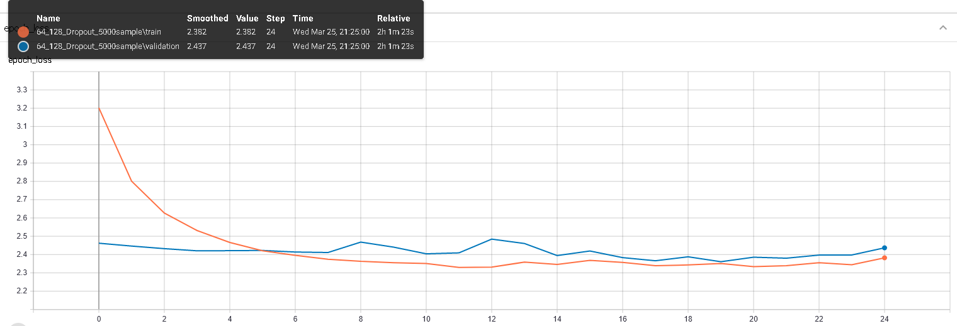
Loss in the current training

Slide 9
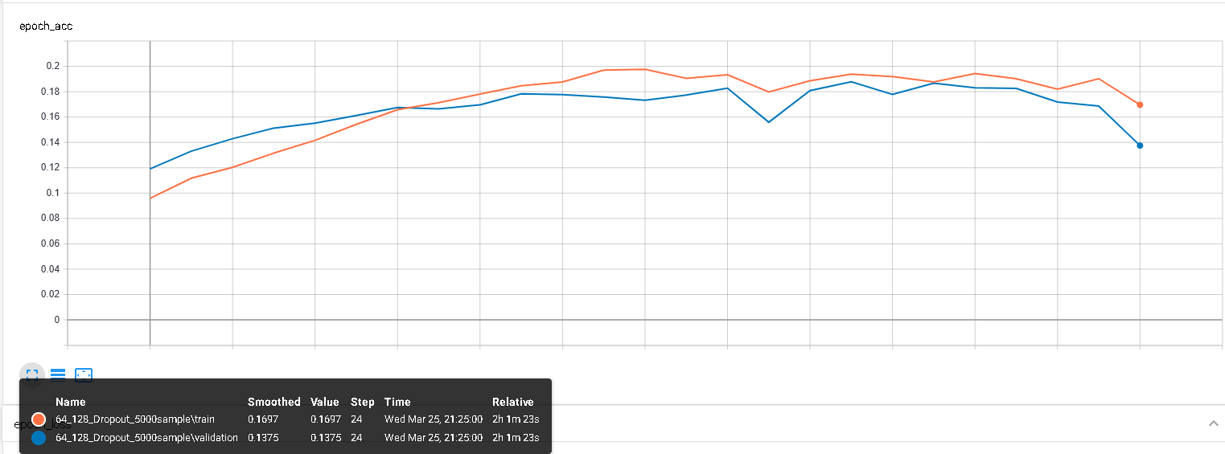
Accuracy in the current training

Slide 10
Appendix
“Timbre is the quality of a musical note or sound that distinguishes different types of musical instruments, or voices. …The first dimension represents the average loudness of the segment; second emphasizes brightness; third is more closely correlated to the flatness of a sound; fourth to sounds with a stronger attack; etc.” https://developer.spotify.com/documentation/web-api/reference/tracks/get-audio-analysis/
Pitch: Represented by a vector of 12. It represents the dominance of 12 pitches in Chromatic Scale in the segment.

