Slide 1

Music is Universal. Or is it not?
Jonathan Gomez Martinez and Ragip Gurlek

Slide 2

Goal
Identifying which country a song is popular in
Using only the musical properties and their relations over segments of the song
Without contextual information such as artist, label, or year

Slide 3
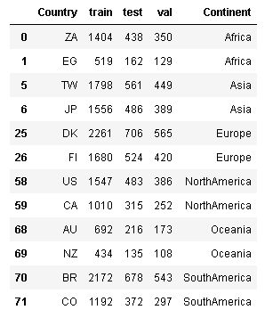
Dataset
Songs in featured Spotify¹ playlists
12 countries
2 countries with most unique tracks on each continent
Sampled monthly over 19 years
Songs appearing in playlists of multiple countries are discarded
Songs are divided into segments that are musically different than each other. Each segment is represented with two musical properties, pitch and timbre.
Limitation: Some playlists are generated by Spotify and it is likely that they use the same features to curate the lists.

Slide 4
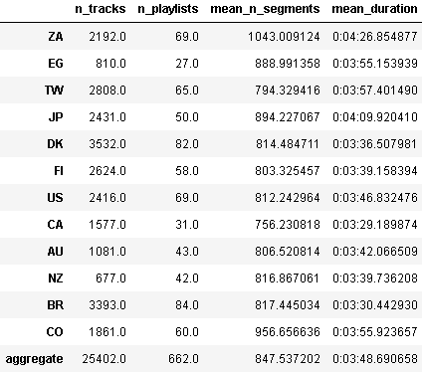
Descriptive Statistics

Slide 5
Sampling
Features in song
“Sample” tracks at 10 samples per seconds by expanding segments
From dataset
For each country
Select 5000 tracks (with replacement) for training
Select 1000 tracks (with replacement) for validation
For each track
Randomly select a starting position
Construct a 30 second sequence (length 300)
50,000 – 60,000 training samples
10,000 - 12,000 validation samples

Slide 6
Training
Tf.keras • 8 cores clocked at 3.00Ghz • 32 GB RAM
Batch size of 1024
Attempting to get 20% accuracy across 12 categories on validation
2.4x chance on balanced (by construction) classes
Half learning rate and resample every 25 epochs

Slide 7
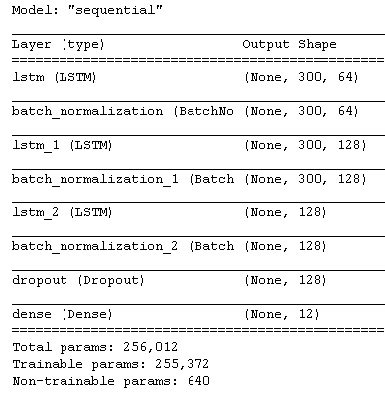
Architecture
Work in progress
General architecture
Input: 30 seconds, sampled 10 times per second, for a sequence of length 300
LSTM 1: Vanilla
LSTM 2: Input Dropout: .5, Process sequence backwards
LSTM 3: Input Dropout: .5
Dropout: Drop prob = .5

Slide 8
Evaluation
Validation accuracy across 12 categories
Pooled voting over tracks with final model
Subsample 30 second segments of test tracks and classify each.
Add softmax over all subsamples
Prediction = argmax over added softmax output

Slide 9
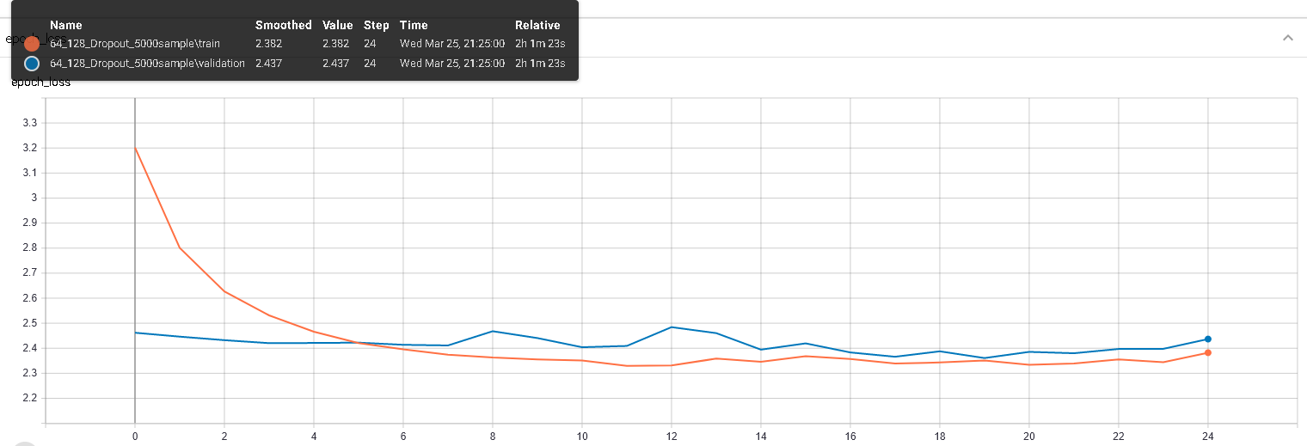
Loss in the current training

Slide 10
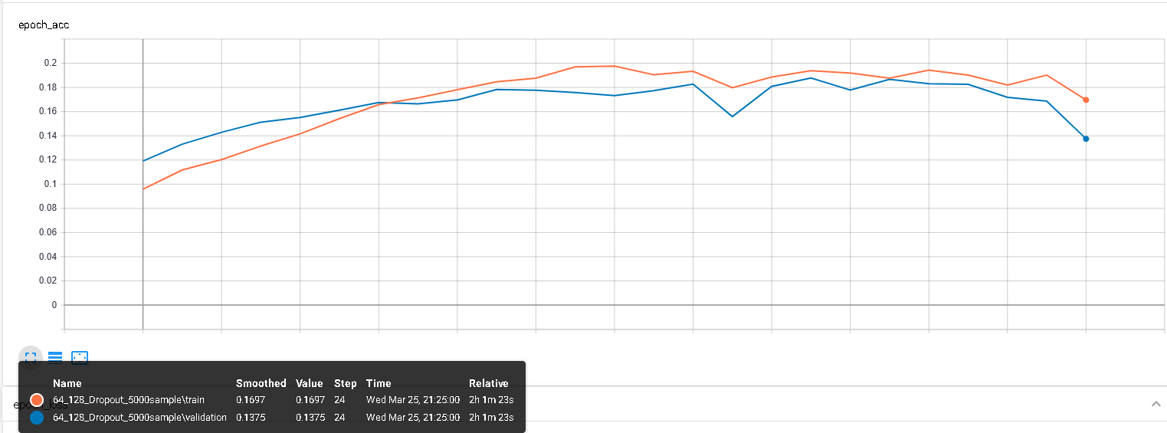
Accuracy in the current training

Slide 11
Appendix
“Timbre is the quality of a musical note or sound that distinguishes different types of musical instruments, or voices. …The first dimension represents the average loudness of the segment; second emphasizes brightness; third is more closely correlated to the flatness of a sound; fourth to sounds with a stronger attack; etc.” https://developer.spotify.com/documentation/web-api/reference/tracks/get-audio-analysis/
Pitch: Represented by a vector of 12. It represents the dominance of 12 pitches in Chromatic Scale in the segment.

