Slide 1
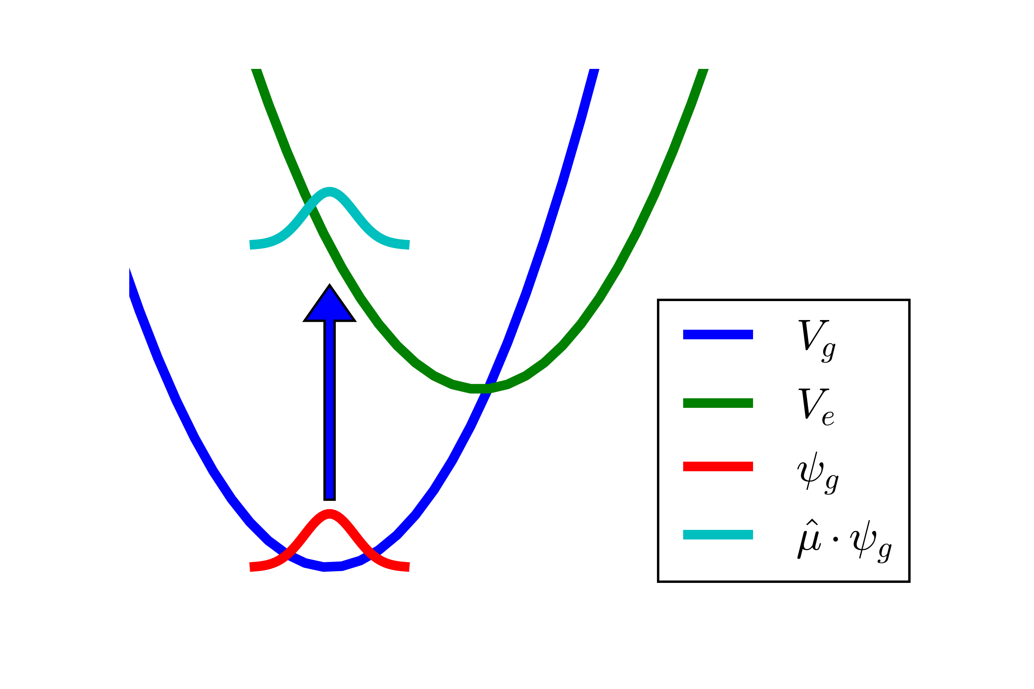
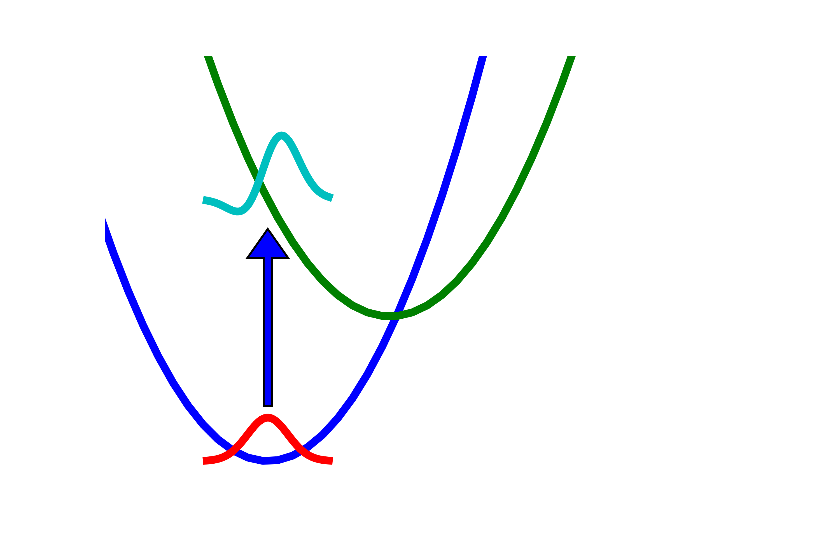
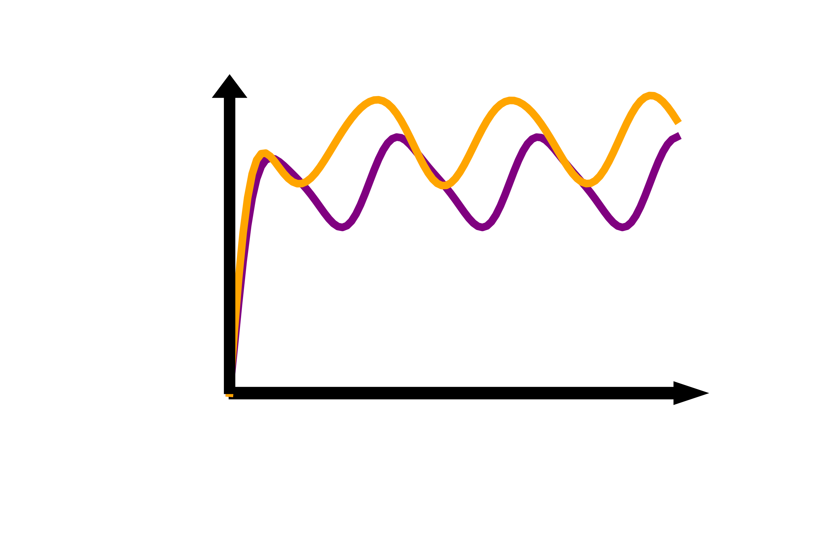






a.
Condon
b.
Non-Condon
$$\hat{μ}=$$
$$\hat{μ}=$$
$$\hat{μ}⋅$$
$$\hat{μ}⋅$$
c.
$$S_{PP}\left(T\right)$$
$$T$$

