Slide 2

Computing Reach Sets for Hybrid Systems
modes
1
2
3
K
1
2
iterations
3
n
initial reach set
unsafe
Notes:
Beginning with the general framework, the goal of reachability algorithms is to partition the state space into those states that may be reached from some initial set of states, and those that may not. In many cases this initial set is the initial conditions for the system being studied, but an alternative is to start with the set of unsafe states and run the system’s dynamics backwards.

Slide 3
Reach Sets: Initialize
modes
1
2
3
K
1
2
iterations
3
n
safe
unsafe
unsafe
Notes:
Beginning with the general framework, the goal of reachability algorithms is to partition the state space into those states that may be reached from some initial set of states, and those that may not. In many cases this initial set is the initial conditions for the system being studied, but an alternative is to start with the set of unsafe states and run the system’s dynamics backwards.

Slide 4
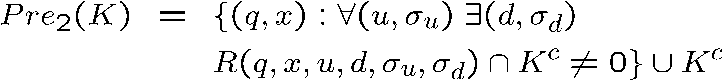

Reach Sets: uncontrollable predecessor
modes
1
2
3
K
1
“safe”
2
iterations
3
n
uncontrolled
transition
unsafe
Notes:
Beginning with the general framework, the goal of reachability algorithms is to partition the state space into those states that may be reached from some initial set of states, and those that may not. In many cases this initial set is the initial conditions for the system being studied, but an alternative is to start with the set of unsafe states and run the system’s dynamics backwards.

Slide 5
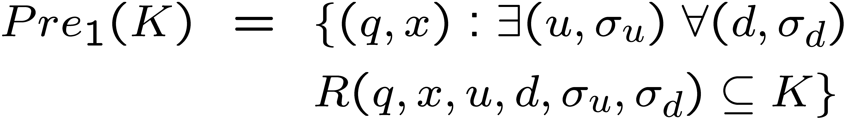
Reach Sets: controllable predecessor
modes
1
2
3
K
1
“safe”
2
iterations
3
n
controlled
transition
safe
Notes:
Beginning with the general framework, the goal of reachability algorithms is to partition the state space into those states that may be reached from some initial set of states, and those that may not. In many cases this initial set is the initial conditions for the system being studied, but an alternative is to start with the set of unsafe states and run the system’s dynamics backwards.

Slide 6
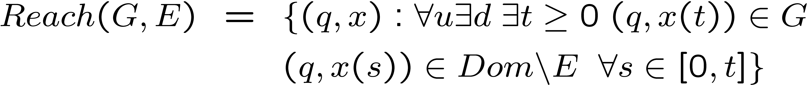
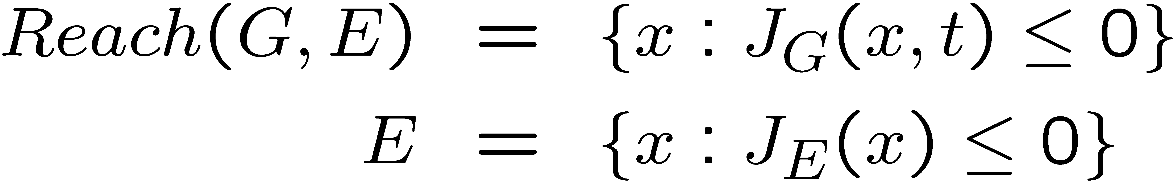

Reach Sets: Variational Inequality
modes
States which reach G without hitting E first:
1
2
3
K
1
2
iterations
3
where
n
subject to
Notes:
Beginning with the general framework, the goal of reachability algorithms is to partition the state space into those states that may be reached from some initial set of states, and those that may not. In many cases this initial set is the initial conditions for the system being studied, but an alternative is to start with the set of unsafe states and run the system’s dynamics backwards.

Slide 7
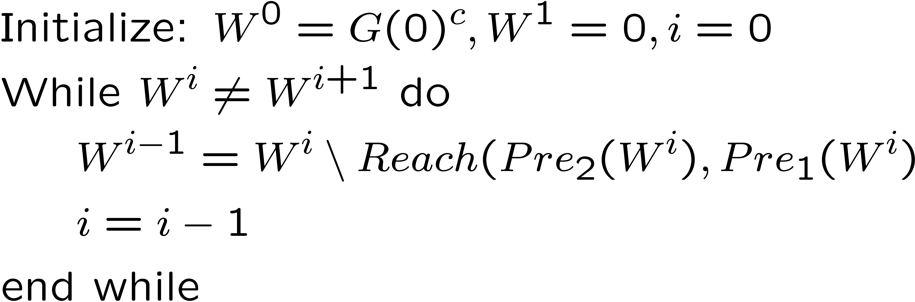
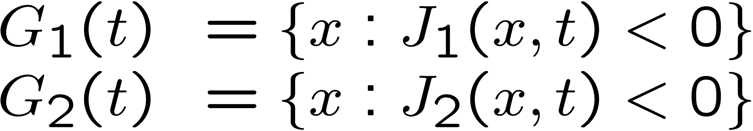
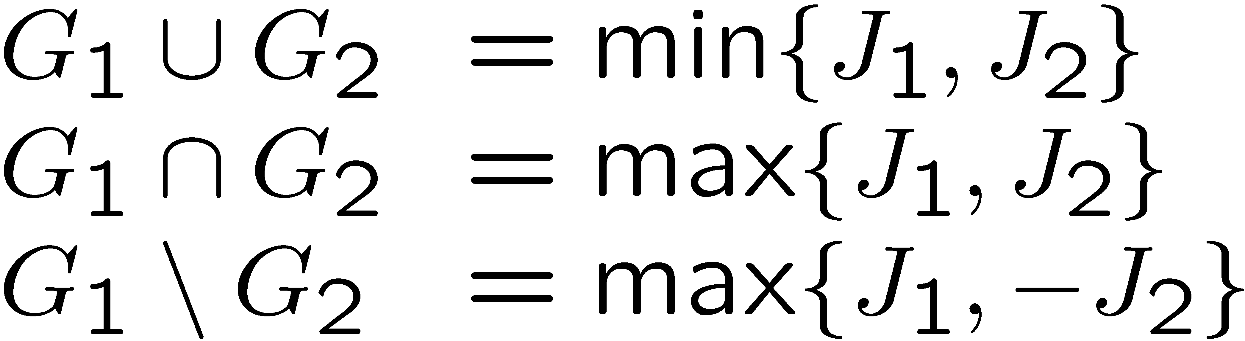
Reach Sets: Iterate
modes
1
2
3
K
1
2
iterations
3
n
Notes:
Beginning with the general framework, the goal of reachability algorithms is to partition the state space into those states that may be reached from some initial set of states, and those that may not. In many cases this initial set is the initial conditions for the system being studied, but an alternative is to start with the set of unsafe states and run the system’s dynamics backwards.

Slide 8






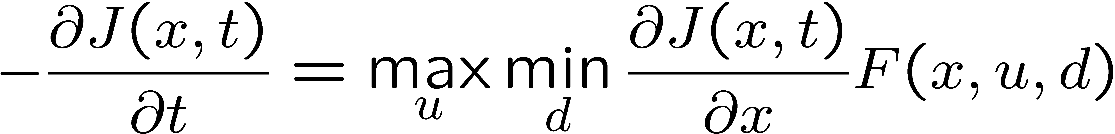
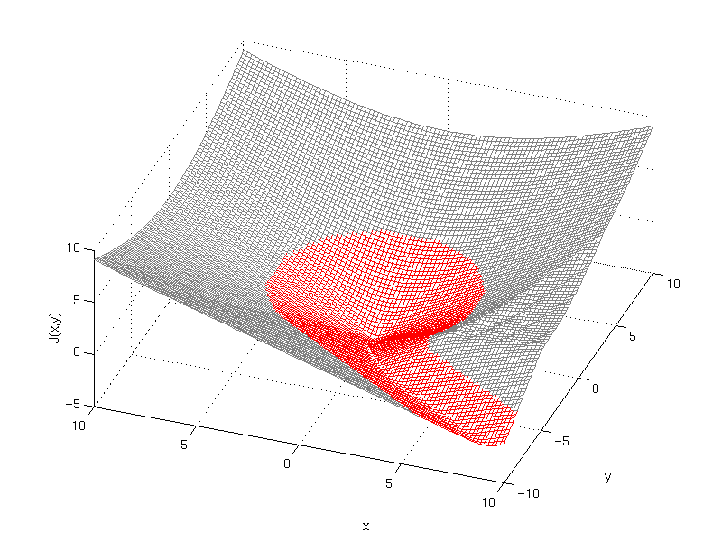
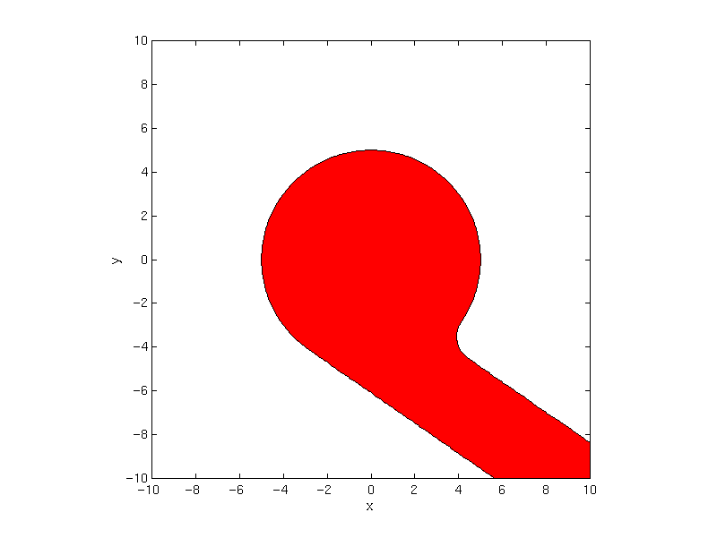
Numerical computation of reach sets
Create a level set function such that:
Propagating regions with level sets:
Boundary of region is defined implicitly by
is the distance from to the boundary at time
is negative inside region and positive outside
In our problem, the evolution of is governed by:

Slide 9
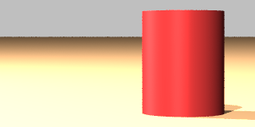
Numerical computation of reach sets
Level set methods:
  Convergent numerical algorithms to compute viscosity solution
  Non-oscillatory, high accuracy spatial derivative approximation
  Stable, consistent numerical Hamiltonian
  Variation diminishing, high order, explicit time integration
Example (2 player zero sum game):
ψ
v
ψ
x
y
d
u
v
5
[http://www.cs.ubc.ca/~mitchell/ToolboxLS/index.html]
Notes:
I will start with the toughest part, that of reachable sets for continuous systems. This problem has garnered significant attention in the past five years, and a number of techniques have been developed. The two key questions that any technique must address are how to represent continuous sets and how to evolve them. In discrete systems we can simply enumerate the states and evolve individual trajectories. Those strategies don’t work on the infinite number of states present in the reachable set of a continuous system.
In discussing the various techniques, I have identified two major philosophies, which are differentiated by how they treat the inevitable errors that accumulate when working with continuous systems on a computer. I’ll come back to my method after I discuss the alternative schemes.

Slide 10
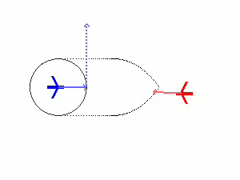
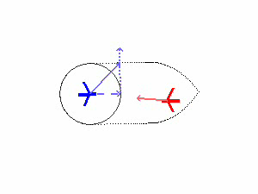
Collision Avoidance Control
[Mitchell, Tomlin ‘01]

Slide 11





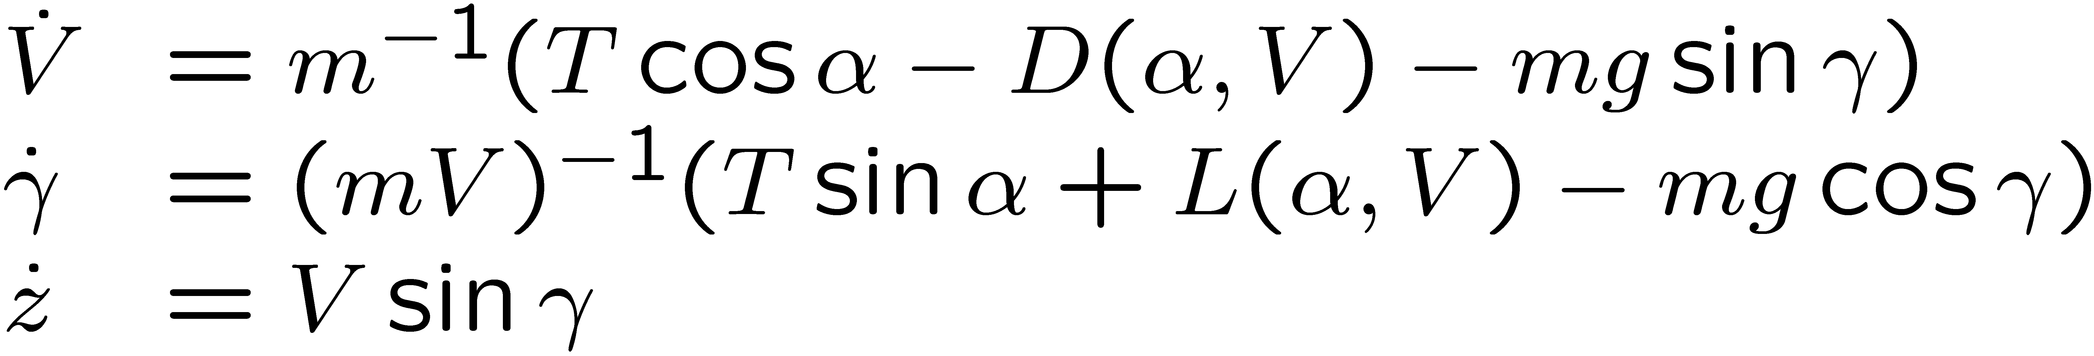



Example: Aircraft Autolander
Aircraft must stay within safe flight envelope during landing:
  Bounds on velocity ( ), flight path angle ( ), height ( )
  Control over engine thrust ( ), angle of attack ( ), flap settings
  Model flap settings as discrete modes of hybrid automata
  Terms in continuous dynamics may depend on flap setting
body frame
wind frame
inertial frame
[Mitchell, Bayen, Tomlin ’01]

Slide 12
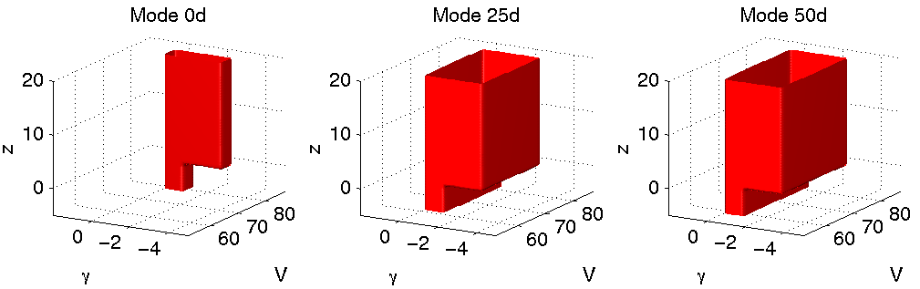
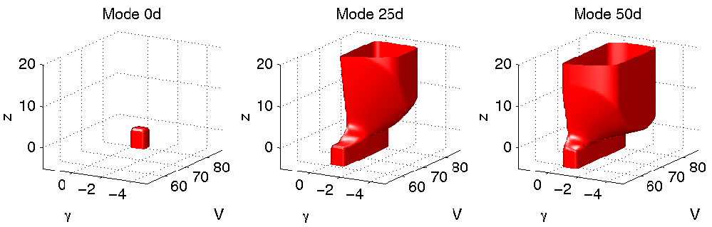
Landing Example: No Mode Switches
Envelopes
Safe sets

Slide 13
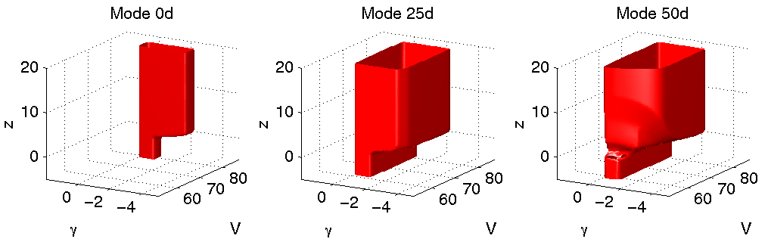
Landing Example: Mode Switches
Envelopes
Safe sets

Slide 14
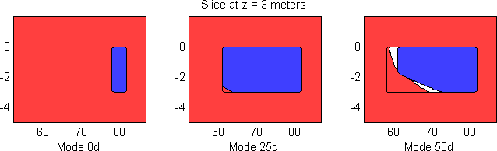
Landing Example: Synthesizing Control
For states at the boundary of the safe set, results of reach-avoid computation determine
  What continuous inputs (if any) maintain safety
  What discrete jumps (if any) are safe to perform
  Level set values and gradients provide all relevant data

Slide 15
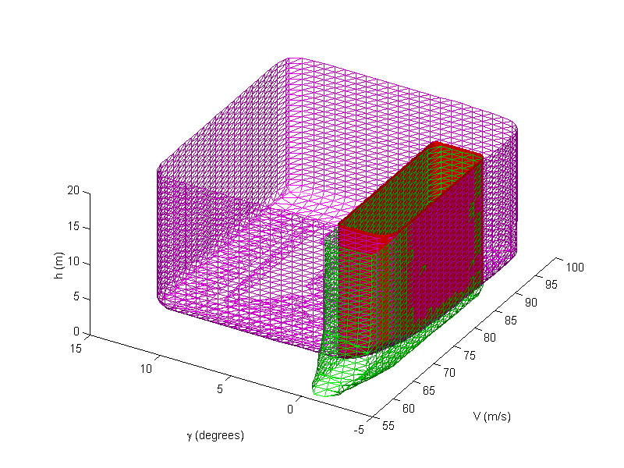
Application to Autoland Interface
Controllable flight envelopes for landing and Take Off / Go Around (TOGA) maneuvers may not be the same
Pilot’s cockpit display may not contain sufficient information to distinguish whether TOGA can be initiated
controllable TOGA envelope
existing interface
intersection
flare
TOGA
flaps extended
minimum thrust
flaps retracted
maximum thrust
rollout
flaps extended
reverse thrust
revised interface
flare
TOGA
flaps extended
minimum thrust
flaps retracted
maximum thrust
rollout
slow TOGA
controllable flare envelope
flaps extended
reverse thrust
flaps extended
maximum thrust
Notes:
As a more concrete example of this application, I have been working with Meeko Oishi (another of Claire’s students) to analyze the discrete interface presented to pilots as they land a particular recently developed and highly computerized commercial jetliner. In the final stages of landing a plane, the pilot normally executes a flare, touchdown and then rollout along the runway. In the event of an emergency, the pilot can execute a take-off / go-around (frequently abbreviated as TOGA) and climb back up to a missed approach altitude. The pilot interface reflects these options.
However, the flight envelopes for flare and TOGA don’t entirely overlap, because the aircraft’s stall speed increases when the wing flaps are retracted for TOGA. In practice, an attempt to follow TOGA procedures when in this low speed regime causes the stall warning stick shaker to go off, and the fly-by-wire flaps will not fully retract. Using the discrete abstraction that my tools provided and a discrete automata analysis algorithm developed by our coauthor Asaf Degani, Meeko was able to show that the pilot cannot determine whether a regular TOGA can be executed given the current interface design. One possible fix is shown in the lower right, where an additional state has been added to keep the flaps extended when TOGA is initiated in the low speed regime.

Slide 16
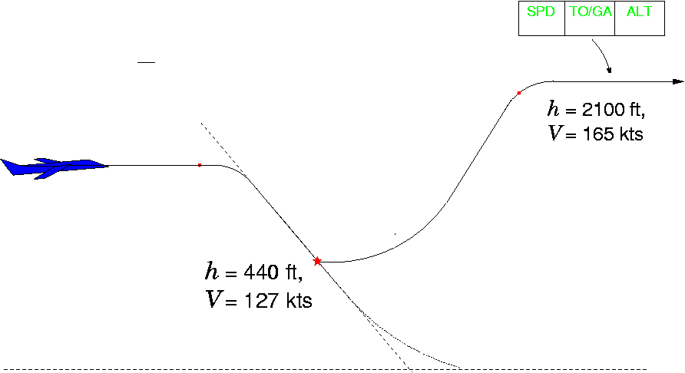
Aircraft Simulator Tests
Setup
  Commercial flight simulator, B767 pilot
  Digital video of primary flight display
Maneuver
  Go-around at low speed, high descent rate
Goal
  Determine whether problematic behavior predicted by our model is possible in aircraft flight simulator
(movie)

Slide 17
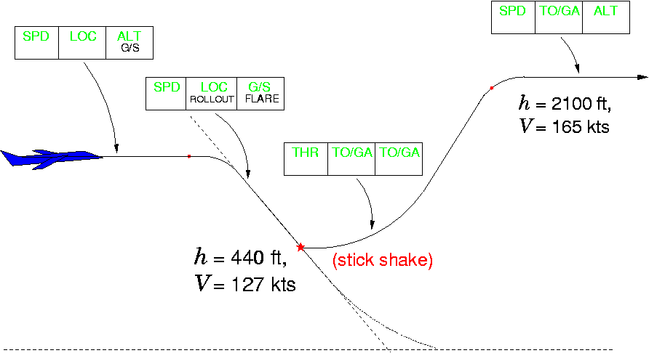
Aircraft Simulator Results
Produced unexpected behavior
  Non-standard procedure; Unable to duplicate
Validated types of problems addressed by this method

Slide 18
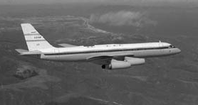
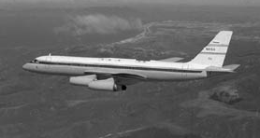
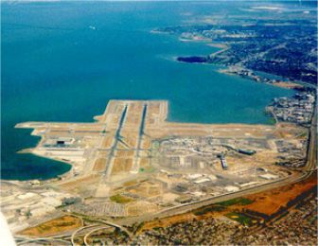
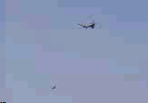
Example: Closely Spaced Parallel Approaches
San Mateo Bridge
750 ft separation
San Francisco Airport
CSPA to SFO video
Restrictions in Instrument Meteorological Conditions (IMC)
Notes:
First, what are closely spaced parallel approaches? Closely Spaced Parallel Approaches refer to the approach by pairs of commercial aircraft to airports with runways that parallel and spaced closed to each other.
Here is a picture of SFO with its closely space runways that are 750ft apart.
And, here is a video of the a csPA at into SFO.
By the way, I took this video at Coyote point which is over here in the picture, I think.
The controller pairs up aircraft to perform the approach simultaneously.
The pilot of the trail aircraft is given the responsibility of maintaining separation visually.
Because separation is ensured visually, this is permitted only when visibility is clear.
When visibility is poor (i.e. In IMC or instrument meteorological conditions), only one airplane is permitted to land at one time.
This reduces the arrival rate by half.
What runway spacing does this limitation apply to?
Notes:
VMC = visibility > 3 nm; cloud ceiling > 1000 ft (most airports); 3deg glideslope = 3.5 nm out
VMC = visibility > 5nm; cloud ceiling > 2100 ft ( at SFO, because of missed approach conditions) 3 deg glideslope = 7nm out

Slide 19
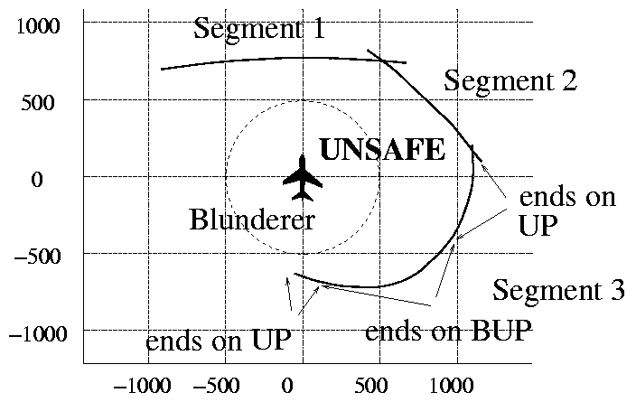
Example: Closely Spaced Parallel Approaches
evader
Three emergency escape maneuvers (EEMs):
Evader accelerates straight ahead
Evader accelerates, turns to the right 45 deg
Evader turns to the right 60 deg

Slide 20
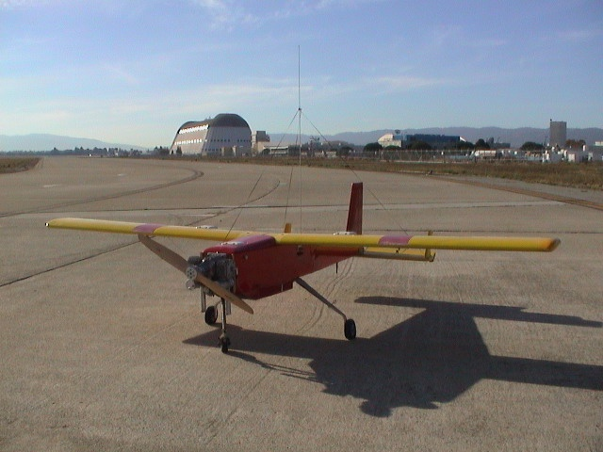
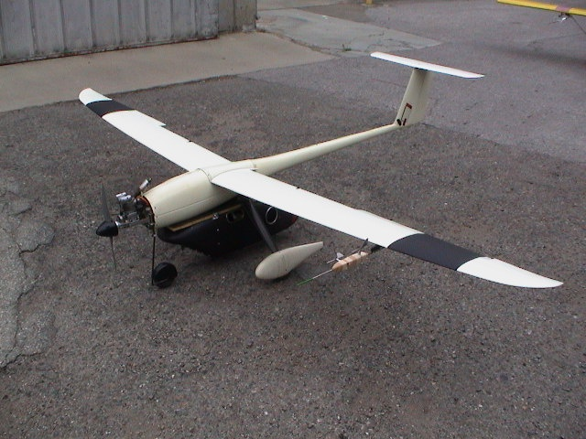
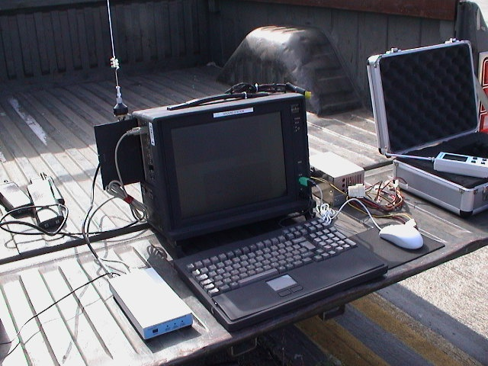
Tested on the Stanford DragonFly UAVs
Dragonfly 2
Dragonfly 3
Ground Station
[Jang, Teo, Tomlin]
Notes:
The overall test bed very broadly speaking includes two UAVs equipped with sensors, computer and communications capabilities that enable autonomous capabilities and a ground station for ground commands
We call our UAVs dragonfly 2 and 3. Dragonfly 1 was the unfortunately lost in a crash.

Slide 21
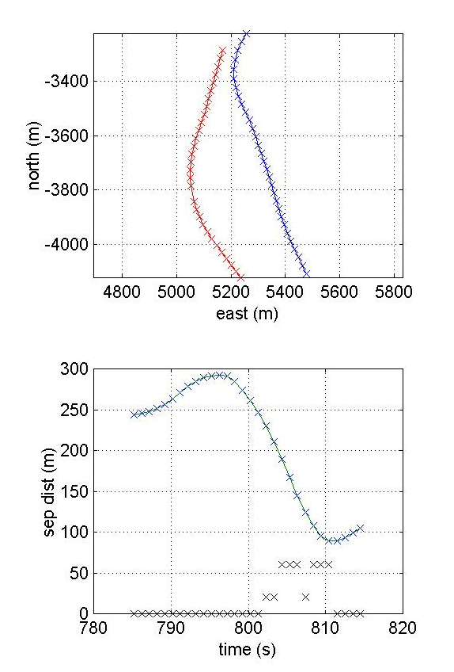


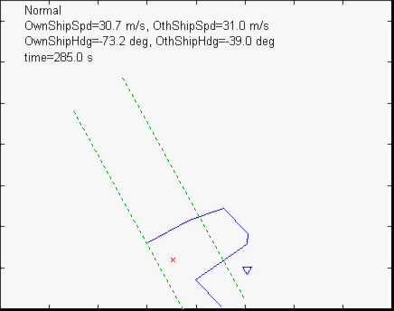
Flight Demo 1 -- Sept 2003
Accelerate and turn EEM
DF 2, the evader, is the larger blob
Evader, DF 2 (red and yellow aircraft)
North (m)
Put video here
East (m)
Separation distance (m)
EEM alert
Above threshold
time (s)
Notes:
Here is a flt demo result for independent approach type of scenario. The runway spacing is wider than the danger zone
In this case, the accelerate and turn to 45 deg eem is initiated
The separation distance at the closest pt of approach is above the threshold
Incidentally, there is no cross here because comms was lost for that one sec there.

Slide 22
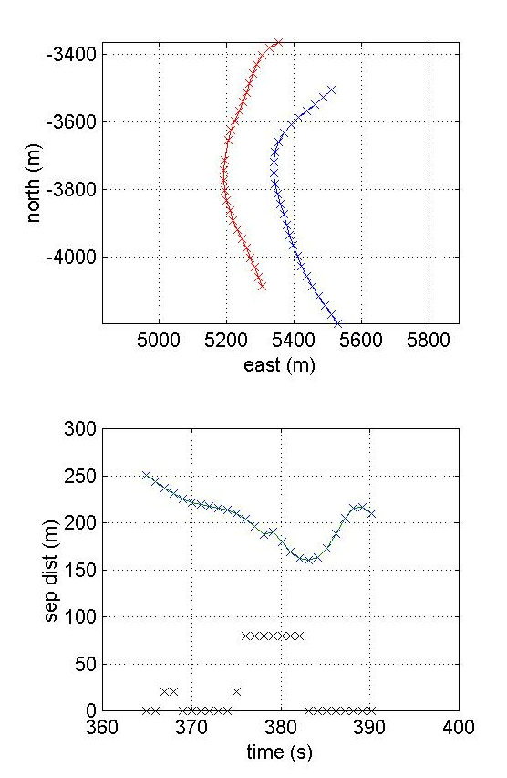

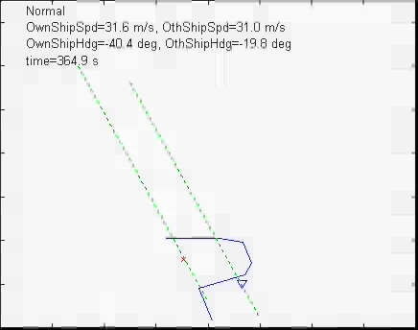
Flight Demo 2 – Sept 2003
DF 2, the evader, is the larger blob
Coast and turn EEM
Evader, DF 2 (red and yellow aircraft)
North (m)
Put video here
East (m)
Separation distance (m)
EEM alert
Above threshold
time (s)
Notes:
Here is another flt demo result. This time it is for a dependent approach scenario, the danger zone crosses into the evader’s approach path so in a normal approach, a minimum longitudinal separation is required.
This time it is the cruise and turn to 60 deg eem that is initiated. Again the threshold is not violated.

