Slide 1
FINAL PROJECT REVIEW
ForearmSense AI
EMG and motion-based grip activity
and stability analysis
AECD · 25EC1302E
KL University, Hyderabad
A Jaswant Goud 2510040007 G Abhishek 2510040015
O GopiChand 2510040023 C Meghasyam 2510040072
Notes:
Sources: README.md and project.json. Current deliverable is a synthetic laboratory. The available-hardware design uses Uno, one BioAmp EXG Pill, MPU-6050 and a hand gripper.

Slide 2
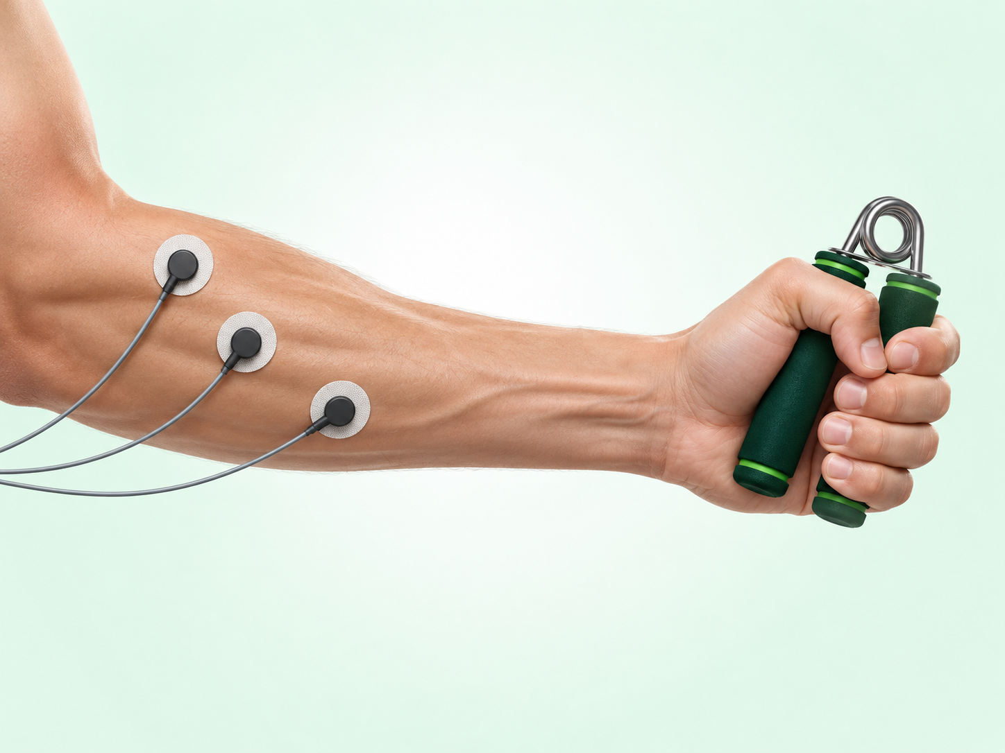
Problem and project objectives
Muscle activity needs
movement context
EMG describes electrical activation. Motion sensing distinguishes a steady grip from a grip with movement.
Activity analysis
Activation timing and repetition consistency
Movement stability
Concept illustration, not the built prototype
Acceleration and angular rate
ForearmSense AI
02
Notes:
Project sources: docs/ForearmSense_AI_AECD_PBL_REVISED_UNO.md, sections 1.1–1.5
Illustration: built-in image generation. Prompt: scientific editorial forearm and hand squeezing a spring gripper, three surface electrodes, white and mint background, forest green accents, no text or clinical claims. Concept only, no validated electrode placement or wiring.

Slide 3
Project scope and evidence
Evidence | What the project establishes
Confirmed inventory | Uno, one BioAmp channel, MPU-6050 and hand gripper
Implemented software | Synthetic signals, analog/DSP analysis and grouped ML
Saved engineering studies | Analytical noise/tolerances and partial SPICE checks
Planned implementation | Live serial input, calibration, recording and replay
Unavailable measurements | Grip force, SpO₂, blood flow and absolute yaw
ForearmSense AI
03
Notes:
Sources: project.json; docs/report-alignment.md

Slide 4
Available hardware and its role
Component | Role | Measurement boundary
BioAmp EXG Pill | One analog EMG channel | Gain and filtering unverified
Arduino Uno | ADC and serial transport | Revision and rate unverified
MPU-6050 | Acceleration and gyro | Ranges and mounting unverified
Hand gripper | Repeatable grip/release task | No force measurement
Confirmed inventory. Live acquisition and calibration remain planned.
ForearmSense AI
04
Notes:
Project sources: project.json; docs/fixed-hardware-project-map.md

Slide 5
Planned hardware data path
Analog EMG
Forearm
electrodes
BioAmp
EXG Pill
Arduino Uno
ADC + serial
Laptop
FastAPI + React
MPU-6050
Accel + gyro
Motion data
The gripper provides the task. It does not measure force.
Functional design only. Verify the board, firmware, sampling and calibration before live use.
ForearmSense AI
05
Notes:
Sources: project.json; docs/fixed-hardware-project-map.md. Functional diagram only. Live serial ingestion and calibration remain planned. No pin-level wiring or electrode placement is prescribed.

Slide 6
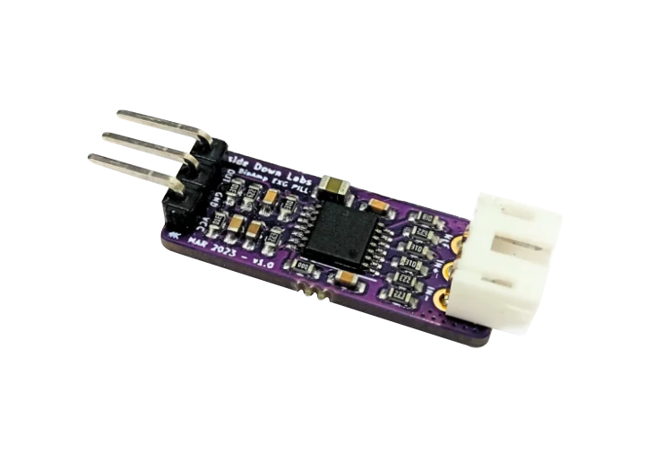
BioAmp EXG Pill: EMG front end
One analog biopotential channel
Conditions a small electrode-voltage difference for the controller ADC.
Configurable gain and bandpass. Manufacturer documents 2- or 3-electrode operation.
Module size: 25.4 × 10 mm.
Manufacturer reference image. Actual revision, gain and filter configuration remain unverified.
ForearmSense AI
06
Notes:
Source: https://docs.upsidedownlabs.tech/hardware/bioamp/bioamp-exg-pill/index.html; project.json

Slide 7
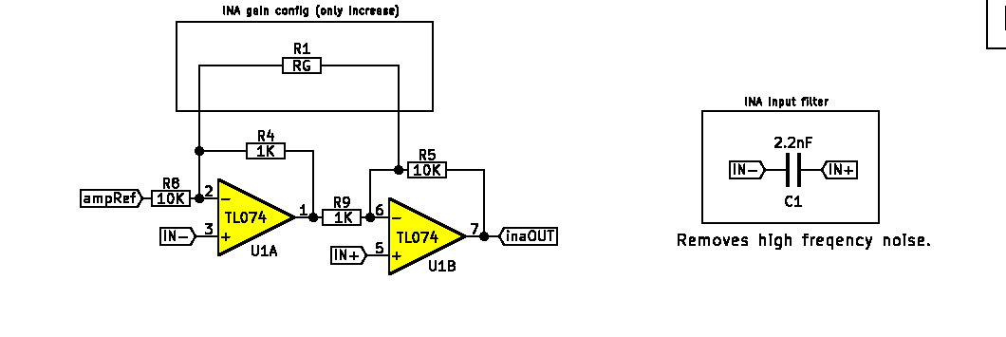
BioAmp published circuit reference
Published v1.0b instrumentation-amplifier excerpt. Reference only, not a verified schematic of the user’s module.
ForearmSense AI
07
Notes:
Published schematic v1.0b: https://raw.githubusercontent.com/upsidedownlabs/BioAmp-EXG-Pill/main/graphics/docs/BioAmp-EXG-Pill-v1.0b-schematic.png; the actual module revision is unverified. The published schematic and current documentation may refer to different configurations. No component values are adopted as calibration.

Slide 8
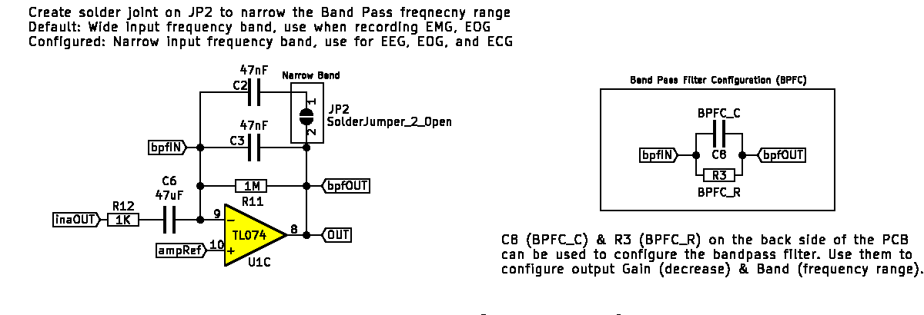
BioAmp published bandpass stage
Published v1.0b filter/gain configuration. Actual module revision and assembled settings require inspection.
ForearmSense AI
08
Notes:
Published v1.0b schematic excerpt: https://raw.githubusercontent.com/upsidedownlabs/BioAmp-EXG-Pill/main/graphics/docs/BioAmp-EXG-Pill-v1.0b-schematic.png. This is an older published reference. Do not infer installed gain or bandpass settings from it.

Slide 9
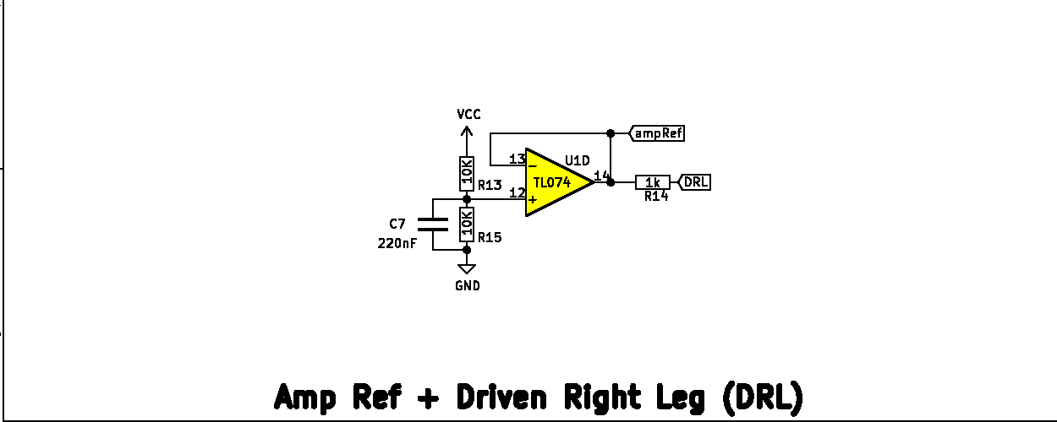
BioAmp published reference and bias circuit
Published amp-reference / driven-reference stage. This diagram does not establish body-connected safety.
ForearmSense AI
09
Notes:
Published v1.0b schematic excerpt: https://raw.githubusercontent.com/upsidedownlabs/BioAmp-EXG-Pill/main/graphics/docs/BioAmp-EXG-Pill-v1.0b-schematic.png. Amp-reference and driven-reference circuit shown as manufacturer educational documentation, not a verified human-use installation.

Slide 10
MPU-6050: six-axis motion sensing
3-axis accel
+ 3-axis gyro
On-chip ADCs
and registers
I²C digital
readout
Sensor capability | Meaning in this project
Acceleration: ±2 / 4 / 8 / 16 g | Movement context and gravity-based tilt
Gyro: ±250 / 500 / 1000 / 2000 °/s | Angular motion and steadiness
16-bit outputs; no magnetometer | Scale follows configured range; no compass heading
Datasheet ranges are selectable capabilities. Actual module settings and electrical compatibility need verification.
ForearmSense AI
10
Notes:
Source: https://product.tdk.com/system/files/dam/doc/product/sensor/mortion-inertial/imu/data_sheet/mpu-6000-datasheet1.pdf sections 3, 5 and 7; project.json

Slide 11
Motion processing and orientation
Acceleration
Gravity-based tilt
Complementary filter
α = 0.98 in simulation
Pitch + roll
Gyroscope
Integrated rotation
Tilt estimate = 0.98 × (previous estimate + gyro × Δt) + 0.02 × accelerometer tilt
Synthetic IMU runs at 200 Hz. Linear acceleration can bias tilt; gyro integration drifts. Absolute yaw is unavailable.
ForearmSense AI
11
Notes:
Sources: backend/app/simulation.py imu(); docs/engineering-analysis.md

Slide 12
Arduino Uno and ADC interpretation
Quantity | Classic Uno R3 example | Current project status
Controller | ATmega328P, 16 MHz | Actual Uno revision unverified
Analog conversion | 10-bit: codes 0–1023 | Firmware/reference unverified
Endpoint conversion | V ≈ code × Vref / 1023 | Keep raw counts until verified
If Vref = 5.000 V | 4.8876 mV per count | Conditional calculation only
Educational simulator | 12-bit, 3.3 V, 4 kHz default | Separate from physical Uno
ForearmSense AI
12
Notes:
Sources: https://docs.arduino.cc/hardware/uno-rev3/; https://support.arduino.cc/hc/en-us/articles/9350551575964-What-s-the-difference-between-UNO-R3-and-UNO-R4-boards; project.json

Slide 13
Sensor and controller interfaces
Analog voltage
BioAmp
Analog OUT
Uno
ADC + firmware
Laptop
Serial ingestion planned
MPU-6050
SDA + SCL
I²C motion data
Shared signal reference, compatible power and logic levels require board-specific verification.
Interface diagram only. Exact pins, power and installed firmware require verification.
ForearmSense AI
13
Notes:
Sources: docs/fixed-hardware-project-map.md; https://docs.upsidedownlabs.tech/hardware/bioamp/bioamp-exg-pill/index.html; https://product.tdk.com/system/files/dam/doc/product/sensor/mortion-inertial/imu/data_sheet/mpu-6000-datasheet1.pdf

Slide 14
Planned 35-second grip protocol
Three 5-second squeezes separated by rest
Rest
Squeeze
Rest
Squeeze
Rest
Squeeze
Rest
0-5 s
5-10 s
10-15 s
15-20 s
20-25 s
25-30 s
30-35 s
Rest phases
Squeeze phases
Baseline and relaxation
Activation timing, envelope consistency
and movement steadiness
ForearmSense AI
14
Notes:
Project sources: project.json task_protocol; docs/ForearmSense_AI_AECD_PBL_REVISED_UNO.md

Slide 15
Sampling and serial bandwidth
Condition | Consequence
250 raw samples/s | Nyquist = 125 Hz. Cannot preserve a 450 Hz band.
500 internal samples/s | Nyquist = 250 Hz. Still below the proposed full band.
115200 baud, 8N1 | Nominal transport capacity: 11,520 bytes/s.
70-byte packet at 200 packets/s | 14,000 bytes/s exceeds that capacity.
UI refresh versus sampling | Redraw rate must not determine recorded sample count.
Legacy rates are unverified descriptions. Measure the actual sketch, packet length and device timing.
ForearmSense AI
15
Notes:
Sources: docs/fixed-hardware-project-map.md section 5; revised report section 2.4.2

Slide 16
Planned calibration and session workflow
Verify firmware
and sensor ranges
Record a quiet
rest baseline
Record a reference
contraction
Run the 35 s
grip protocol
EMG checks
Motion checks
Confirm ADC bounds, reference, bias, clipping and usable acquisition bandwidth.
Check gyro offset, mounting orientation, rate and timestamp continuity.
Normalize only within the recorded session. A comfortable reference contraction is not a validated MVC.
ForearmSense AI
16
Notes:
Sources: docs/fixed-hardware-project-map.md sections 5–6; project.json

Slide 17
Local software architecture
Browser
React + TypeScript
REST API
FastAPI + Pydantic
Numerical engine
NumPy + SciPy + sklearn
Local files
JSON / CSV / joblib
Recharts renders plots. Vite serves the frontend and proxies API calls.
Loopback application: frontend 5173, backend 8000. No MongoDB, cloud service or database is implemented.
ForearmSense AI
17
Notes:
Sources: docs/architecture.md; frontend/package.json; backend/requirements.txt

Slide 18
Backend module responsibilities
Module | Responsibility
schemas.py + main.py | Bounded configuration, routes and numerical responses
simulation.py | Seeded EMG, motion and educational PPG scenarios
analog.py + engineering.py | Conditioning, R/C topology, noise and tolerance study
dsp.py | Spectrum, features, windows and FIR decimation
ml.py + artifacts.py | Grouped benchmark, inference and complete-run publication
spice.py | Fixed netlists, solver execution and numerical acceptance
ForearmSense AI
18
Notes:
Sources: backend/app/*.py; docs/architecture.md

Slide 19
Simulation and engineering APIs
Route | Purpose
POST /api/simulation/multimodal | One synchronized synthetic trial with EMG, IMU and PPG
POST /api/simulation/emg | Same complete trial response
POST /api/simulation/imu or /ppg | Standalone secondary modality arrays
POST /api/dsp/analyze | Analyze a generated trial, not uploaded samples
POST /api/analog/analyze | Analytical response, noise and tolerances
POST /api/analog/spice | Execute a separate local circuit verification
ForearmSense AI
19
Notes:
Source: backend/app/main.py; README.md API table

Slide 20
Project and machine learning APIs
Route | Behavior
GET /api/health, /project, /config | Status, inventory and bounded defaults/schema
GET /api/project/report | Serve revised PDF, or 404 if missing
POST /api/ml/train | Five models, 6–12 trials per class, grouped metrics
GET /api/ml/metrics | Completed benchmark in current server process
POST /api/ml/predict | Predict a generated trial using a trained fusion model
Error handling | 422 invalid input; 409 unavailable/concurrent training
ForearmSense AI
20
Notes:
Source: backend/app/main.py; backend/app/schemas.py

Slide 21
Frontend state and interaction flow
Change a
configuration value
Cancel stale
request
Request a new
seeded trial
Render completed
response
Simulation controls
Consistent results
Start advances seeds. Pause holds the last completed trial. Reset restores defaults.
AbortController and generation checks reject late replies. Export uses the completed response.
Project overview, EMG, analog, motion/pulse, machine learning and experiment-details views share the typed API.
ForearmSense AI
21
Notes:
Sources: frontend/src/main.tsx, api.ts, EngineeringPanel.tsx, MLPanel.tsx, ProjectOverview.tsx

Slide 22
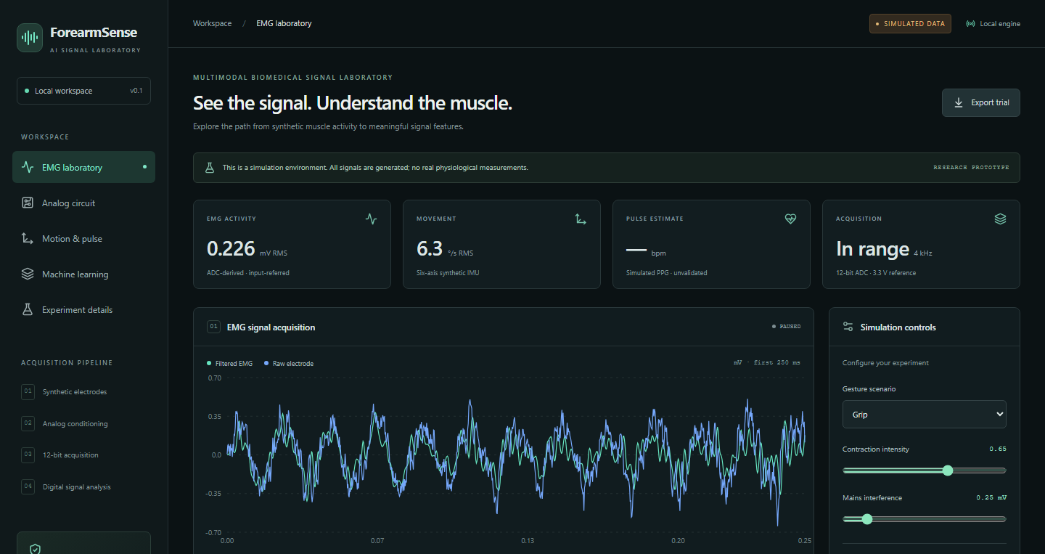
Interactive simulation dashboard
Adjust scenarios, inspect waveforms and export the full numerical trial.
Saved simulation view. Navigation predates report alignment.
ForearmSense AI
22
Notes:
Project sources: results/figures/dashboard-desktop.png, historical saved screenshot; README.md

Slide 23
Numerical outputs and artifact storage
Location | Saved evidence
datasets/synthetic/ | EMG/IMU/PPG samples and feature datasets
results/metrics/ | Seeded trial response and feature/filter summary
results/engineering/ + results/spice/ | Scenarios, component studies, netlists and solver output
results/ml/runs/run-<id>/ | Metrics, dataset, held-out predictions and fusion models
results/ml/current.json | Atomic pointer to the last successfully saved run
results/figures/ | Executed experiment plots and dashboard screenshots
New runs preserve earlier results. The server trains in-process and does not auto-load saved joblib models.
ForearmSense AI
23
Notes:
Sources: README.md; backend/app/artifacts.py; docs/ml-methodology.md

Slide 24
Input validation and run integrity
Boundary | Current protection
Simulation configuration | Finite values, unknown-field rejection, bounded settings
Compute size | 1–10 s trials; fixed 2/4/8 kHz simulation rates
Training and prediction | Single training lock; require a trained in-process model
SPICE execution | Fixed generated netlists, run lock and 45 s solver timeout
Numerical acceptance | Validate finite data, gain and complete transient duration
Artifact publication | Write a complete run before replacing the current pointer
Local prototype protections do not constitute multi-user deployment hardening or an authentication system.
ForearmSense AI
24
Notes:
Sources: backend/app/schemas.py; main.py; ml.py; spice.py; artifacts.py; docs/verification.md

Slide 25
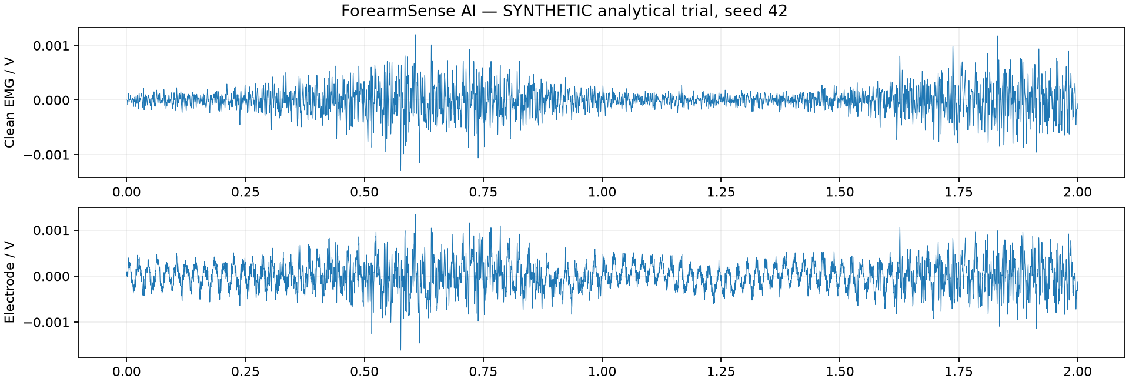
Software workflow
Generate
a seeded trial
Model analog
conditioning
Extract EMG
and IMU features
Review results
and export
Saved synthetic signal example
FastAPI backend + React/TypeScript frontend
ForearmSense AI
25
Notes:
Project sources: README.md; docs/architecture.md; docs/dsp-pipeline.md

Slide 26
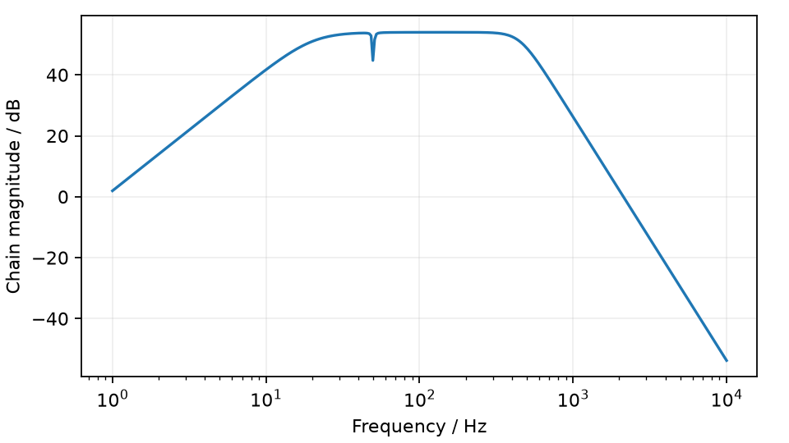
Analog conditioning and digital processing
High-pass
20 Hz
Notch
50 Hz, optional
Low-pass
450 Hz
ADC model
12-bit, 4 kHz
Educational filter model
Digital analysis
200 ms windows
100 ms hop
RMS and spectral features
FIR output at 1 kHz
A 250 Hz raw stream cannot preserve a 450 Hz EMG band.
ForearmSense AI
26
Notes:
Project sources: docs/dsp-pipeline.md; docs/analog-design.md; results/metrics/trial-seed42.json
Image source: results/figures/frequency-analysis.png, magnitude panel. This chain is educational and does not describe verified BioAmp hardware settings. FIR output guarantees a passband through 400 Hz.

Slide 27
Educational INA826 gain stage
3.3 V model supply
IN+
INA826
Differential instrumentation amplifier
Vout
IN−
REF = 1.65 V
RG = 5.49 kΩ
G = 1 + 49.4 kΩ / RG ≈ 9.998
Model/solver compatibility fails its expected-gain check. This does not describe a measured INA826 or BioAmp.
ForearmSense AI
27
Notes:
Sources: backend/app/analog.py; results/spice/devices.cir; https://www.ti.com/lit/ds/symlink/ina826.pdf . Functional device representation, not a verified body-connected circuit.

Slide 28
Educational high-pass circuit
R1 = 56.270 kΩ
Unity buffer
C1 = 100 nF
C2 = 100 nF
+
Vout
Vin
−
R2 = 112.540 kΩ
AC 0 V
High-pass: f₀ = 20 Hz, Q = 0.7071. Single-supply biasing and real amplifier behavior are outside this test.
ForearmSense AI
28
Notes:
Sources: backend/app/engineering.py components()/transfer(); results/spice/ideal.cir. Ideal unity-buffer Sallen-Key candidate, AC-ground reference. Not the physical BioAmp circuit.

Slide 29
Educational Sallen-Key low-pass circuit
C1 = 11.716 nF
Unity buffer
R1 = 32.676 kΩ
R2 = 32.676 kΩ
+
Vout
Vin
−
C2 = 10 nF
AC 0 V
LP1: 450 Hz, Q = 0.5412. LP2 uses R1 = R2 = 13.535 kΩ, C1 = 68.284 nF, C2 = 10 nF.
ForearmSense AI
29
Notes:
Sources: backend/app/engineering.py components()/transfer(); results/spice/ideal.cir. Ideal unity-buffer Sallen-Key candidate, AC-ground reference. Not the physical BioAmp circuit.

Slide 30
Filter equations and the notch boundary
Second-order high-pass
H(s) = s² / (s² + √2 ωh s + ωh²), ωh = 2π × 20
Optional 50 Hz notch
H(s) = (s² + ωn²) / (s² + (ωn / Q)s + ωn²), Q = 30
Fourth-order low-pass
Two 450 Hz sections: Q ≈ 0.5412 and 1.3066
No physical notch topology is selected. The ideal-buffer R/C SPICE check omits the notch stage.
ForearmSense AI
30
Notes:
Sources: docs/analog-design.md; backend/app/analog.py; engineering.py

Slide 31
Educational post-amplifier circuit
OPA2376 model
Vref + Vac
+
Vout
−
Rg = 1 kΩ
Rf = 49 kΩ
G = 1 + Rf / Rg = 50
Vref = 1.65 V
Feedback resistor values match the isolated SPICE netlist. Bias, supply and load matter in a physical circuit.
ForearmSense AI
31
Notes:
Sources: results/spice/devices.cir; docs/analog-design.md; https://www.ti.com/lit/ds/symlink/opa2376.pdf . Isolated OPA macro-model, 3.3 V supply, 1.65 V reference.

Slide 32
Gain, headroom and quantization
Educational quantity | Value and interpretation
First-stage gain × post gain | 9.99818 × 50 ≈ 499.909
5 mV peak-to-peak input example | Approximately 2.50 Vpp before filter attenuation
Model reference and supply | 1.65 V center within a 3.3 V supply
Assumed model output limits | 0.1–3.2 V, not guaranteed device headroom
12-bit endpoint ADC spacing | 3.3 / 4095 ≈ 0.806 mV per code
Digital baseline removal cannot recover analog saturation. These values do not calibrate the Uno/BioAmp setup.
ForearmSense AI
32
Notes:
Sources: docs/analog-design.md; backend/app/analog.py; results/metrics/trial-seed42.json

Slide 33
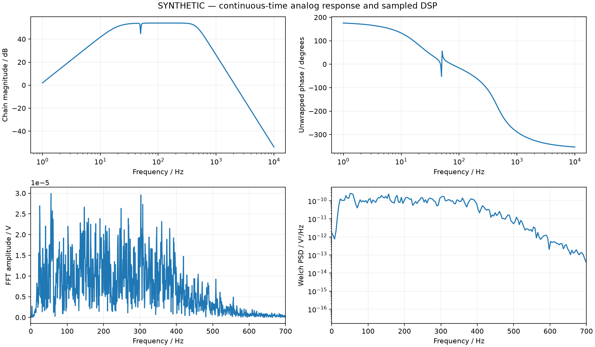
Frequency response and spectral evidence
Saved synthetic response: analog magnitude/phase, FFT amplitude and Welch power spectral density.
ForearmSense AI
33
Notes:
Sources: results/figures/frequency-analysis.png; docs/dsp-pipeline.md

Slide 34
EMG feature extraction
Feature | Calculation or interpretation
RMS | sqrt(mean(x²)) measures effective signal amplitude
MAV | mean(abs(x)) summarizes rectified amplitude
Waveform length | sum(abs(Δx)) reflects amplitude and variation
Zero crossings / slope changes | Thresholded sign changes, using a 10 µV difference gate
Mean / median frequency | Power-weighted mean and cumulative-power midpoint
Feature windows | 200 ms with a 100 ms hop; incomplete final windows dropped
Features use ADC-derived, input-referred samples and inherit the acquisition bandwidth and clipping limits.
ForearmSense AI
34
Notes:
Sources: backend/app/dsp.py; docs/dsp-pipeline.md

Slide 35
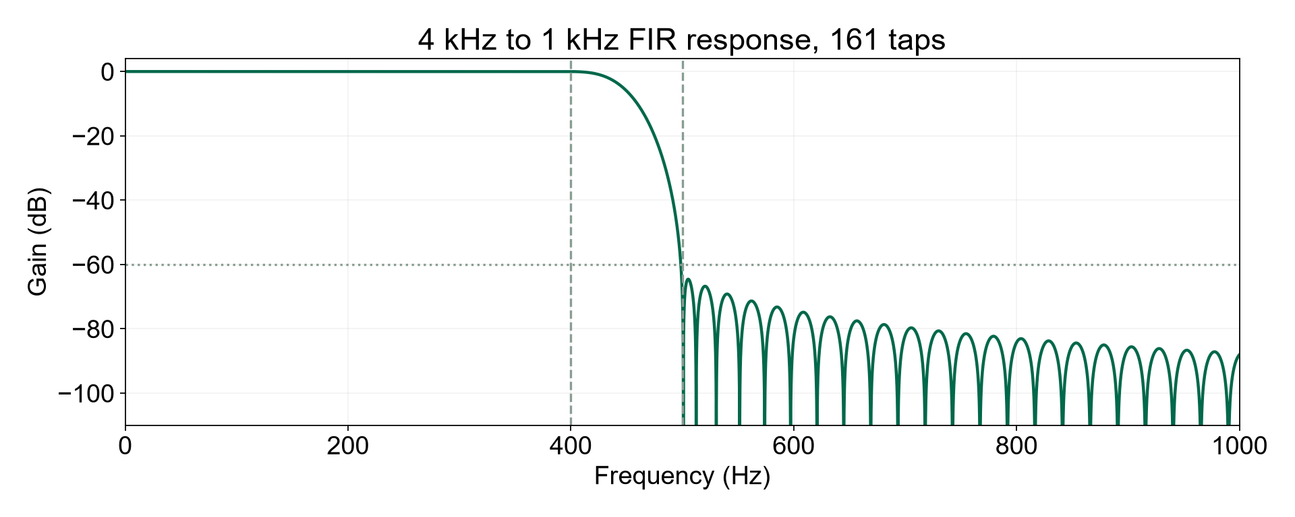
Anti-aliased FIR downsampling
161 taps
4 kHz to 1 kHz
Ripple: 0.0083 dB
Stopband: 64.56 dB
Passband: 0–400 Hz
Stopband: from 500 Hz
Offline delay-compensated filtering retains boundary transients. This is not a stateful streaming decimator.
ForearmSense AI
35
Notes:
Sources: backend/app/dsp.py decimator(); saved results/metrics/trial-seed42.json; plotted response regenerated from the same coefficients and checked against saved tap count/ripple.

Slide 36
Saved signal analysis results
Seed 42 · 2 seconds · 4 kHz · 8,000 samples
0.226 mV
Whole-trial RMS
211.7 Hz
Mean frequency
0 modeled clipping events
Synthetic ADC-derived signal, referred to the model input. No physiological measurement.
ForearmSense AI
36
Notes:
Project sources: results/metrics/summary.json; results/metrics/trial-seed42.json

Slide 37
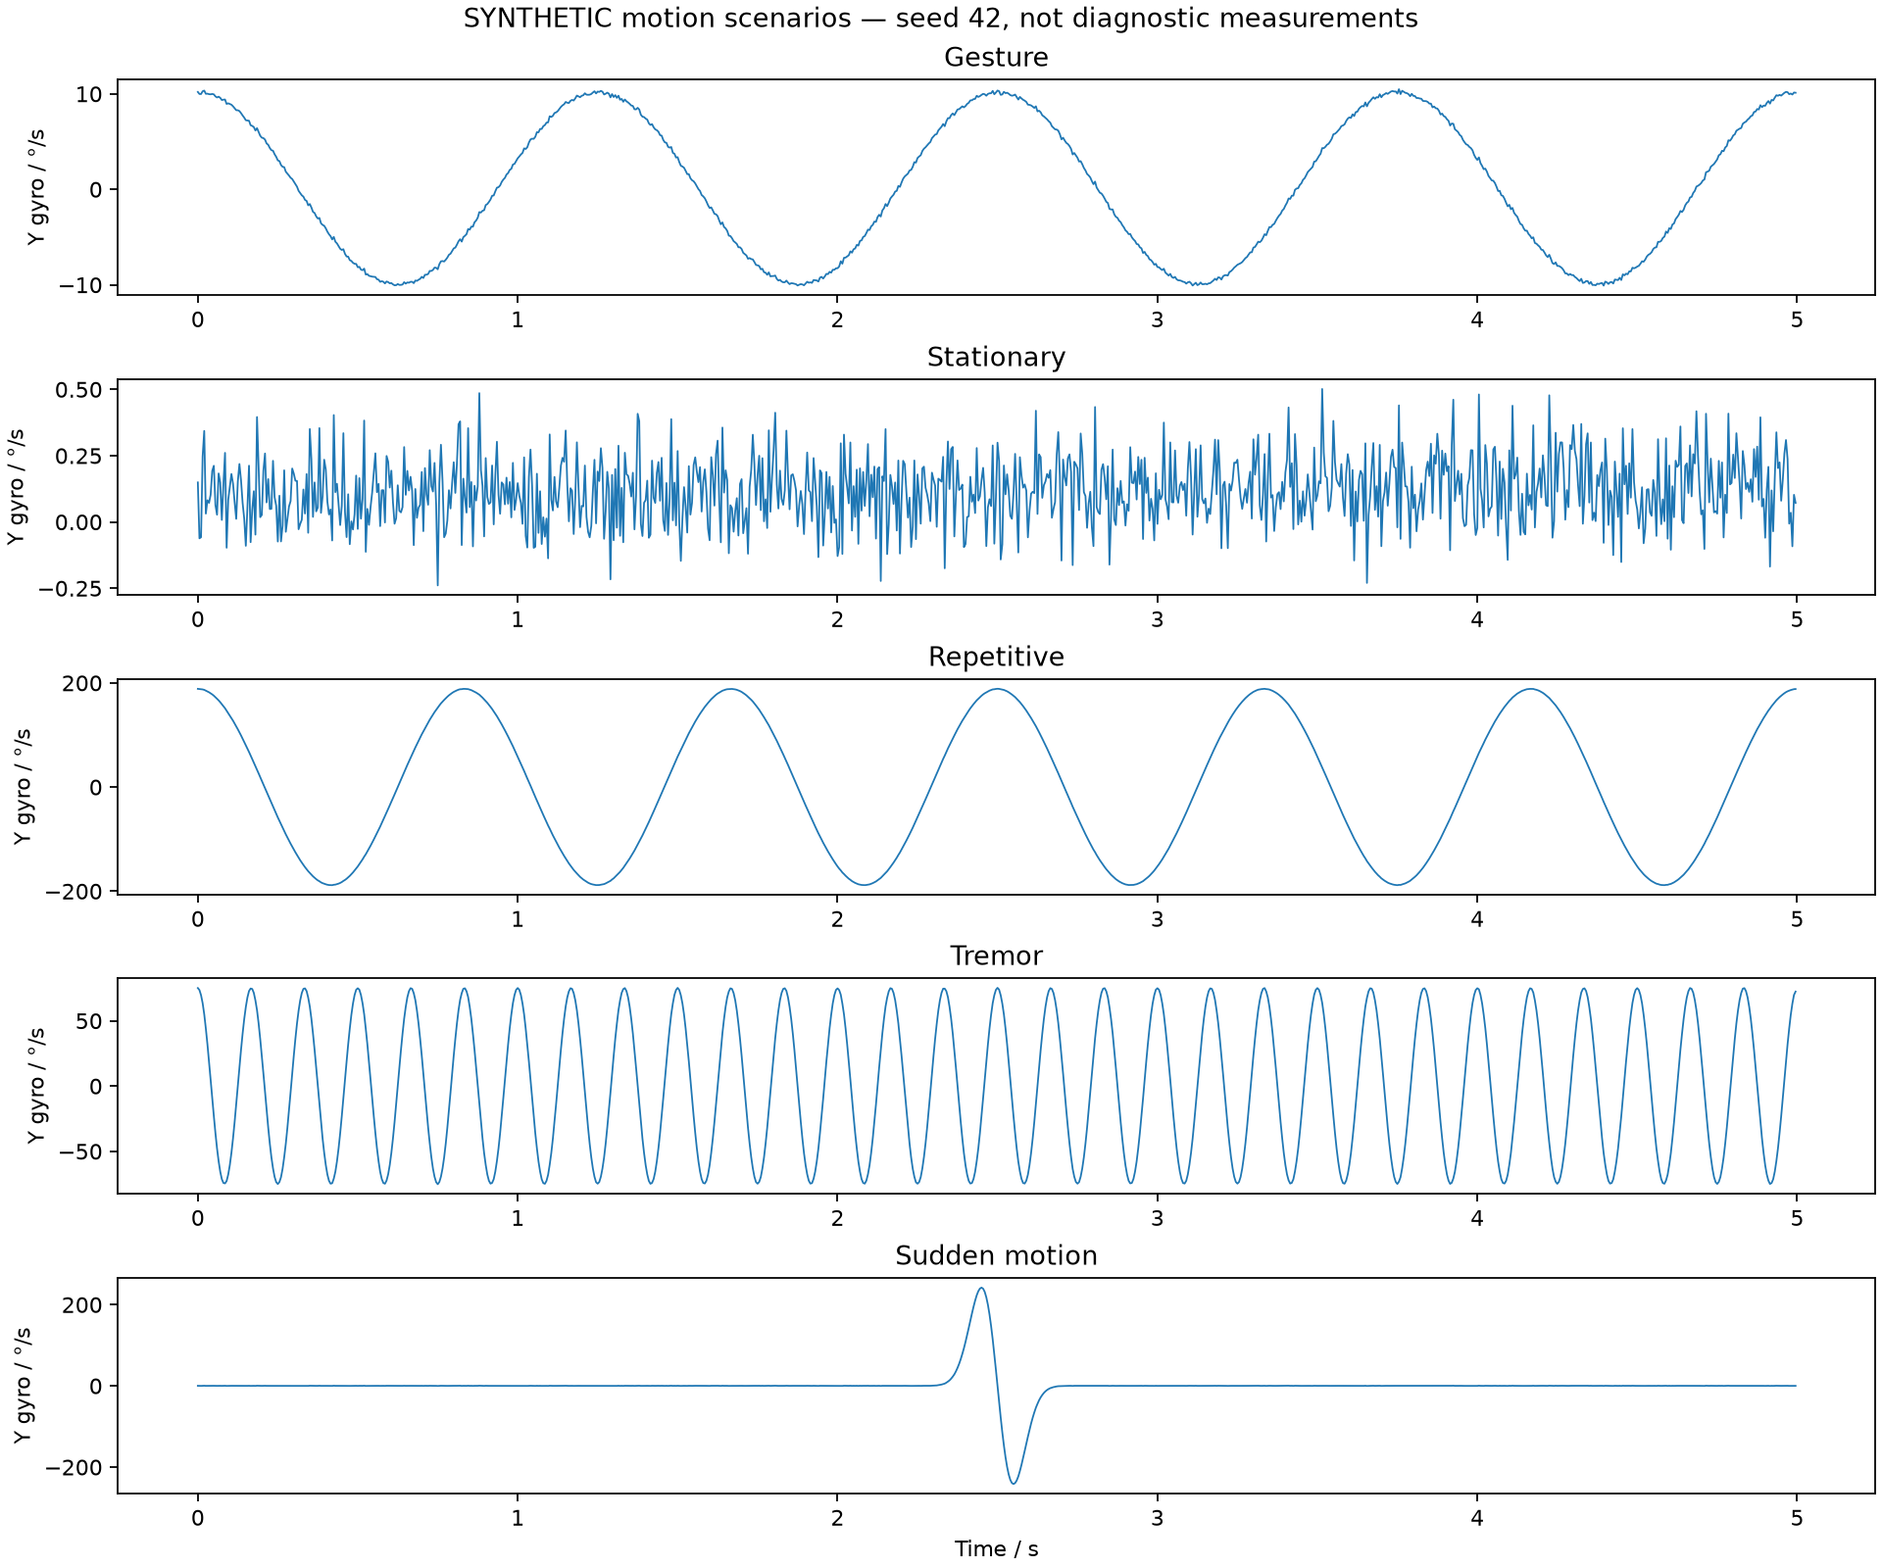
Synthetic motion scenarios
Stationary
Repetitive movement
Tremor
Sudden movement
Saved 6 Hz tremor scenario estimates 6.0 Hz.
All scenarios are generated. Expanded motion modes are outside the original gesture-training distribution.
ForearmSense AI
37
Notes:
Sources: results/figures/motion-scenarios.png; results/engineering/summary.json; docs/engineering-analysis.md

Slide 38
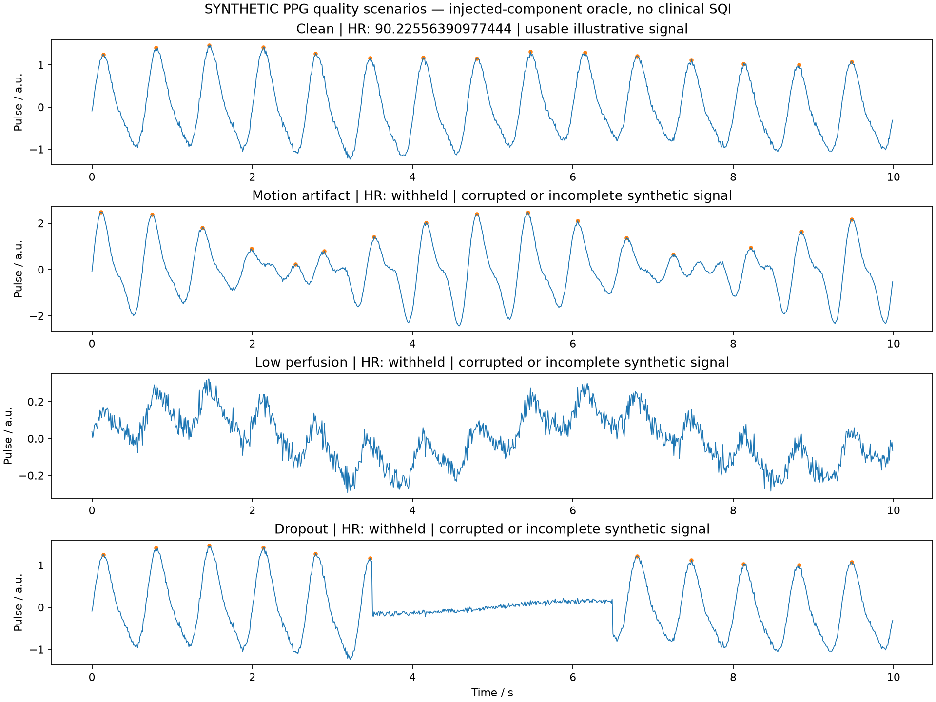
Optional PPG simulation and quality gating
Clean example
90 bpm generated
90.226 bpm estimated
HR withheld for
Motion artifact
Low perfusion
Dropout or short trials
No working optical sensor is confirmed. Quality uses injected signal components. No measured HR or SpO₂.
ForearmSense AI
38
Notes:
Sources: results/figures/ppg-scenarios.png; results/engineering/summary.json; backend/app/simulation.py ppg(); docs/engineering-analysis.md

Slide 39
Machine learning evaluation workflow
30 synthetic trials
5 gesture classes
200 ms windows
50% overlap
570 windows
EMG + IMU features
Three folds hold out complete trials
Training trials
Fit feature scaling + model
Held-out trials
Predict once per window
Logistic Regression, SVM, Decision Tree, Random Forest, Gradient Boosting
Windows from the same trial never appear in both training and test data.
ForearmSense AI
39
Notes:
Sources: docs/ml-methodology.md; results/ml/metrics.json. Three outer folds group windows by trial. StandardScaler stays inside training pipelines. SVM has nested grouped probability calibration. Five models and three modality comparisons.

Slide 40
Feature fusion and synthetic inference
7 EMG features
Amplitude + spectrum
15 aligned features
per 200 ms window
Fusion model
Probabilities
8 IMU features
Acceleration, gyro, tilt
IMU features: mean ax/ay/az, RMS gx/gy/gz, mean pitch and roll.
Demonstration prediction averages probabilities across a generated trial. No live grip-quality or health predictor.
ForearmSense AI
40
Notes:
Sources: docs/ml-methodology.md; backend/app/ml.py

Slide 41
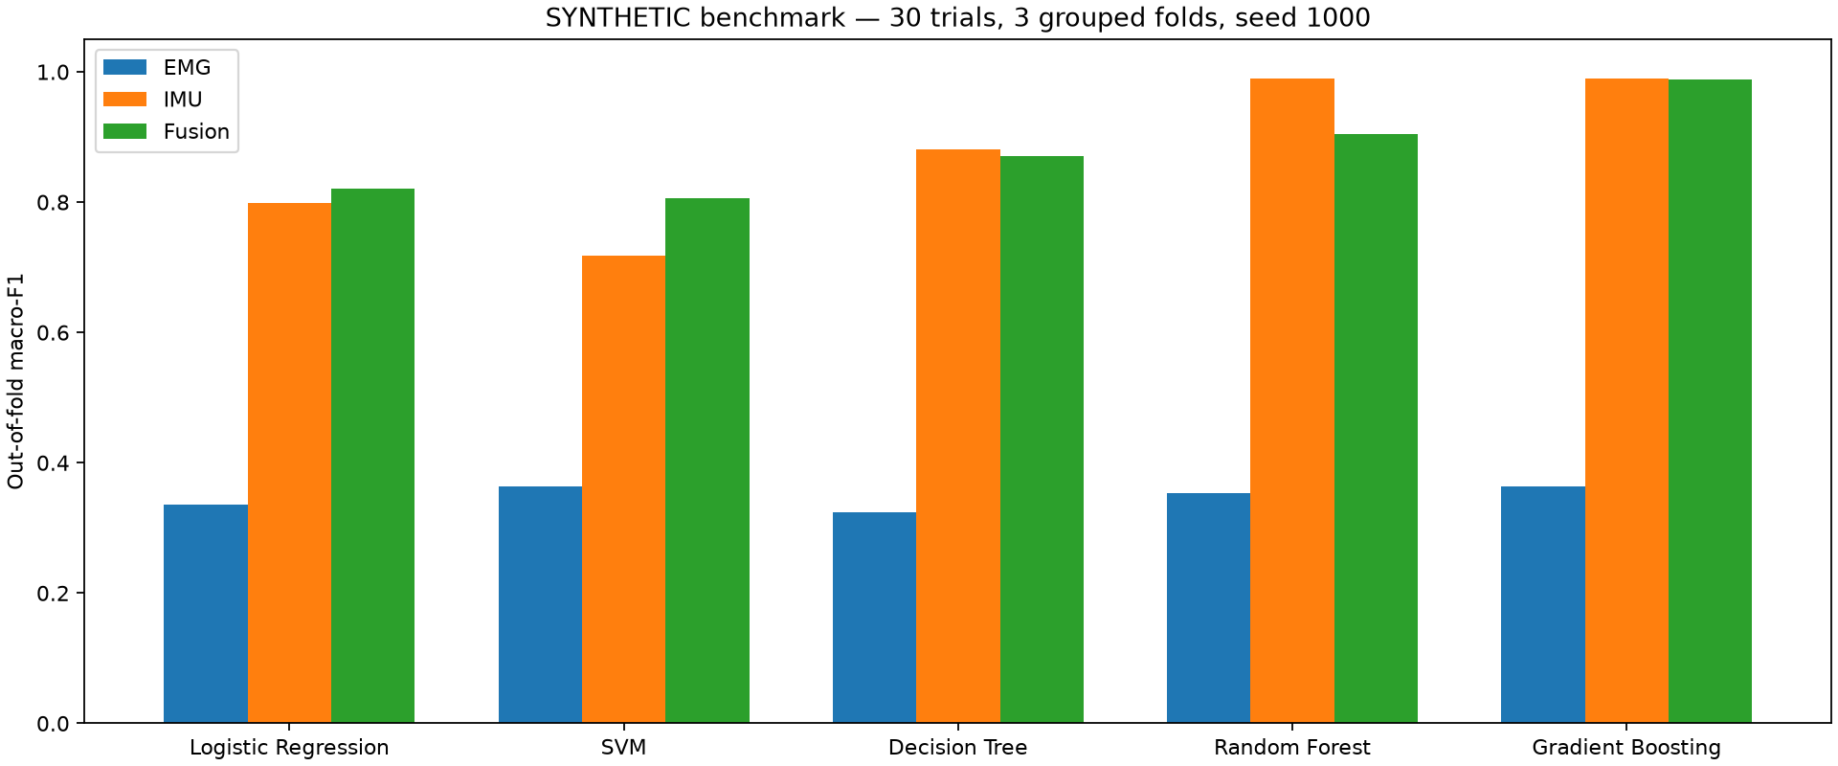
All model and modality comparisons
Out-of-fold macro-F1 on synthetic trials. Programmed motion makes high IMU scores easier to obtain.
ForearmSense AI
41
Notes:
Sources: results/figures/model-comparison.png; results/ml/metrics.json; seed 1000, 30 trials, 570 windows. Graph reports macro-F1, not accuracy.

Slide 42
Complete synthetic accuracy comparison
Model | EMG | IMU | Fusion
Logistic Regression | 35.61% | 79.82% | 82.11%
SVM | 40.00% | 71.75% | 80.70%
Decision Tree | 31.40% | 88.25% | 87.72%
Random Forest | 35.09% | 98.95% | 90.53%
Gradient Boosting | 36.49% | 98.95% | 98.77%
High IMU/fusion scores reflect programmed trajectories. These scores do not establish human performance.
ForearmSense AI
42
Notes:
Source: results/ml/metrics.json. Accuracy uses outer out-of-fold predictions, seed 1000, 30 trials, 570 windows.

Slide 43
Evaluation safeguards and limits
Method | Purpose or limit
Trial-grouped outer folds | All overlapping windows from a trial stay together
Training-only preprocessing | Fit scaling within each training pipeline
Nested grouped SVM calibration | Avoid using outer test trials for probability fitting
500 trial-bootstrap resamples | Accuracy intervals condition on fixed fits, without retraining
Macro-F1 and Brier score | Compare class balance and probability error
No independent selection holdout | Same-fold model comparison can be optimistic
ForearmSense AI
43
Notes:
Source: docs/ml-methodology.md; results/ml/metrics.json

Slide 44
Synthetic machine learning benchmark
Random Forest comparison
30 trials
570 windows
5 gesture classes
3-fold trial-grouped evaluation keeps overlapping windows from the same trial together.
IMU outperforms fusion here. Programmed movement patterns limit generalization.
Synthetic results only. No independent model-selection holdout or human validation.
ForearmSense AI
44
Notes:
Project sources: results/ml/metrics.json; results/ml/benchmark-report.md; docs/ml-methodology.md

Slide 45
Random Forest fusion confusion matrix
True / predicted | Rotation | Grip | Rest | Extension | Flexion
Rotation | 114 | 0 | 0 | 0 | 0
Grip | 0 | 110 | 4 | 0 | 0
Rest | 0 | 4 | 110 | 0 | 0
Extension | 0 | 0 | 0 | 84 | 30
Flexion | 0 | 0 | 0 | 16 | 98
Most errors occur between wrist extension and flexion. Counts sum to 570 held-out synthetic windows.
ForearmSense AI
45
Notes:
Source: results/ml/metrics.json record Random Forest / Fusion. Row = true class, column = predicted class. Counts are overlapping windows, not subjects.

Slide 46
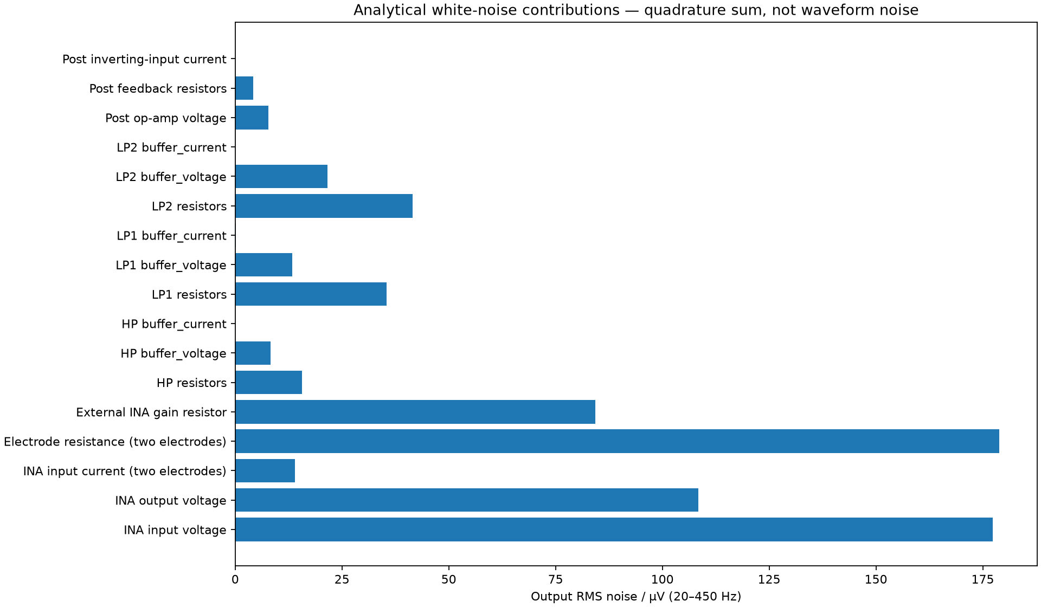
Analytical white-noise budget
294.170 µV
Output RMS, 20–450 Hz
0.588448 µV
Referred through nominal gain
Uncorrelated sources combine in quadrature. No 1/f, PCB, reference, supply, physical notch or ADC alias noise.
ForearmSense AI
46
Notes:
Sources: results/figures/noise-budget.png; results/engineering/summary.json; backend/app/engineering.py

Slide 47
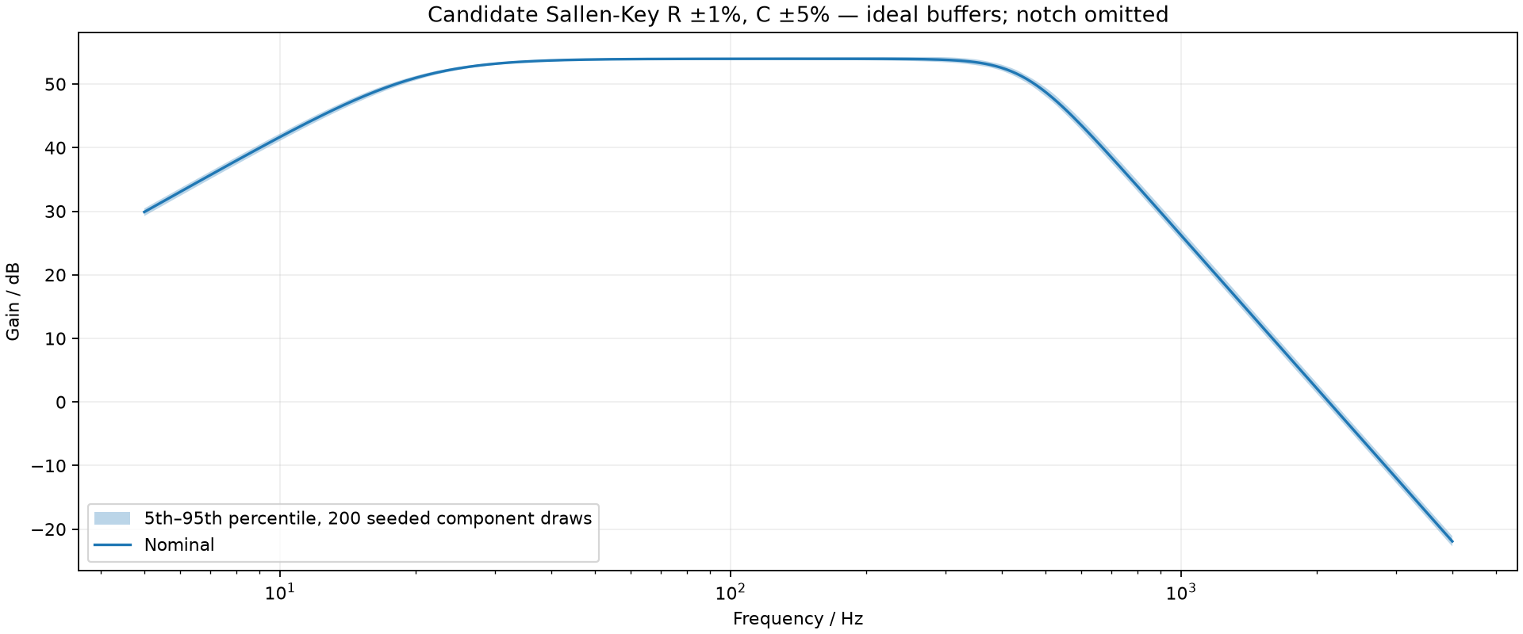
Engineering and software verification
SPICE: partial
Component tolerance study
Ideal R/C response agrees
within 1.45 x 10^-7 dB.
OPA2376 gain check passed.
INA826 gain check failed.
Recorded software checks
62 backend tests passed
Build and ESLint passed
7 browser cases across two runs
Saved analytical study. No physical hardware validation.
ForearmSense AI
47
Notes:
Project sources: results/spice/verification.json; docs/verification.md, report alignment record 2026-10-23
Image: results/figures/component-tolerances.png. Candidate Sallen-Key model, ideal buffers, R +/-1%, C +/-5%, notch omitted. Simulation ranges are not guarantees for physical modules.

Slide 48
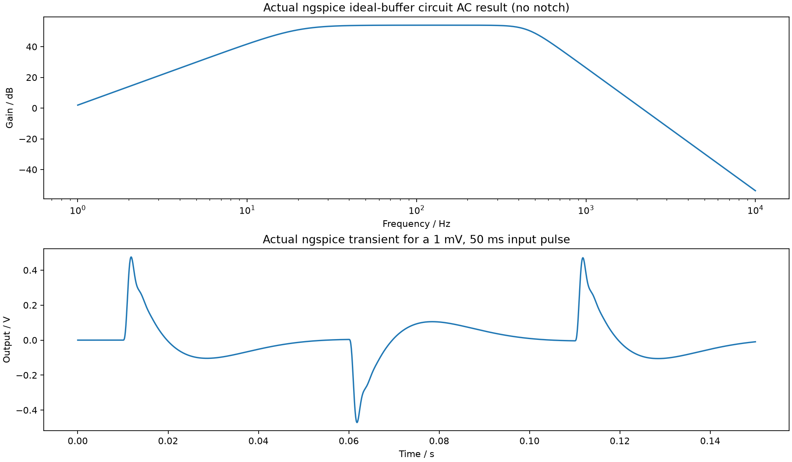
SPICE circuit outputs and acceptance
Ideal circuit passes
AC, transient and resistor-noise outputs are saved.
Device status: partial
OPA gain passes. INA compatibility fails.
The ideal-buffer netlist omits notch and rail limits. A solver exit code alone never establishes a passed result.
ForearmSense AI
48
Notes:
Sources: results/figures/spice-verification.png; results/spice/verification.json; results/spice/ideal.cir

Slide 49
Software verification and measured optimization
62 backend tests passed. Build and ESLint passed.
All 7 browser cases passed across a full run and a targeted rerun.
Computation | Before | After
200-draw tolerance sweep | 0.3440 s | 0.0295 s
Default full analysis | 1.6732 s | 1.4191 s
Prediction input preparation | 1.6732 s | 1.3171 s
Local warm-call medians. Excludes HTTP serialization, browser rendering and model probability evaluation.
ForearmSense AI
49
Notes:
Source: docs/verification.md, report-alignment and optimization records dated 2026-10-23. Historical local execution records, not rerun for this deck.

Slide 50
Demonstration sequence
01
Project overview
Confirm inventory, simulation source and unavailable channels.
02
EMG and analog analysis
Change gain, interference or notch and inspect regenerated data.
03
Motion and engineering
Select a motion scenario and run the separate SPICE checks.
04
Machine learning
Train the benchmark, inspect grouped results and predict a trial.
05
Export
Download the completed numerical response with its configuration.
ForearmSense AI
50
Notes:
Sources: README.md Demonstrate; docs/verification.md

Slide 51
Current completion and remaining work
Implemented | Next implementation phase
Synthetic EMG and motion generation | Verify firmware, ADC and actual sample timing
Analog/DSP analysis and JSON export | Validated serial ingestion with disconnect handling
Grouped ML training and prediction | Baseline calibration and 35-second acquisition
Engineering checks and local dashboard | Raw recording, replay and real-data evaluation
Unavailable measurements: grip force, SpO₂ and blood flow. No clinical claims.
ForearmSense AI
51
Notes:
Project sources: project.json; docs/report-alignment.md; README.md

Slide 52
Limitations and engineering risks
Risk or limitation | Engineering response
Unknown acquisition contract | Verify firmware, ranges, timestamps and ADC reference
Low-rate stream and aliasing | Restrict features to demonstrated bandwidth
Motion and electrode artifacts | Keep signal quality visible and invalid data unavailable
Synthetic model generalization | Use independent real labels and participant/session holdouts
Partial circuit compatibility | Retain failed checks and validate in a supported simulator
Human-connected operation | Review the actual hardware setup before acquisition
ForearmSense AI
52
Notes:
Sources: docs/fixed-hardware-project-map.md; docs/ml-methodology.md; docs/engineering-analysis.md

Slide 53
Implementation roadmap and acceptance
1
Verify acquisition
Board revision, sketch, sample timing, packet format and module settings
2
Add serial ingestion
Finite fields, valid units, visible disconnects and no silent simulation
3
Record and replay
Complete raw packets, task events and timestamp-based playback
4
Analyze real sessions
Baseline-aware activation, repetitions and motion stability
5
Evaluate with real data
Repeated sessions and held-out participants for new-person claims
ForearmSense AI
53
Notes:
Source: docs/fixed-hardware-project-map.md section 10; project.json

Slide 54
Conclusion and next milestone
A reproducible laboratory for
EMG and movement analysis
The project connects analog signal conditioning, digital analysis and grouped ML evaluation in one local application.
Next milestone
Verify the Uno/BioAmp/MPU-6050 stream, then complete one calibrated, recorded grip session.
ForearmSense AI
54
Notes:
Project sources: README.md; project.json; revised report conclusion

Slide 55
References: sensors and circuit design
Upside Down Labs
BioAmp EXG Pill documentation and v1.0b schematic
Arduino
UNO R3 documentation and R3/R4 ADC comparison
TDK InvenSense
MPU-6000/MPU-6050 Product Specification, Rev. 3.4
Texas Instruments
INA826 SBOS562G and OPAx376 SBOS406G
Manufacturer diagrams describe their published designs. They do not confirm the user’s exact board revision.
ForearmSense AI
55
Notes:
Primary source URLs listed on this slide and in relevant speaker notes. Accessed 23 October 2026.
https://docs.upsidedownlabs.tech/hardware/bioamp/bioamp-exg-pill/index.html
https://docs.arduino.cc/hardware/uno-rev3/
https://product.tdk.com/system/files/dam/doc/product/sensor/mortion-inertial/imu/data_sheet/mpu-6000-datasheet1.pdf
https://www.ti.com/lit/ds/symlink/ina826.pdf

Slide 56
References: project implementation and results
Area | Primary project sources
Scope and hardware | project.json; revised report; fixed-hardware-project-map.md
Analog and DSP | analog-design.md; dsp-pipeline.md; backend/app/
Engineering and SPICE | engineering-analysis.md; results/engineering/; results/spice/
Machine learning | ml-methodology.md; results/ml/metrics.json and benchmark report
Software and verification | architecture.md; verification.md; frontend/src/
Saved visual evidence | results/figures/; seeded trial and summary JSON files
ForearmSense AI
56
Notes:
Repository source index. All results retain their original synthetic/model provenance.

