Slide 1
FINAL PROJECT REVIEW
ForearmSense AI
EMG and motion-based grip activity
and stability analysis
AECD · 25EC1302E
KL University, Hyderabad
A Jaswant Goud 2510040007 G Abhishek 2510040015
O GopiChand 2510040023 C Meghasyam 2510040072
Notes:
Sources: README.md and project.json. Current deliverable is a synthetic laboratory. The available-hardware design uses Uno, one BioAmp EXG Pill, MPU-6050 and a hand gripper.

Slide 2
Problem and project objectives
Muscle activity needs movement context
EMG describes electrical activation. Motion sensing helps distinguish a steady grip from a grip with hand movement.
Activity analysis
Movement stability
Identify rest and contraction, then compare activation timing and repetition consistency.
Use acceleration and angular rate to describe movement during the task.
ForearmSense AI
02
Notes:
Project sources: docs/ForearmSense_AI_AECD_PBL_REVISED_UNO.md, sections 1.1–1.5

Slide 3
Available hardware and its role
Component | Role | Measurement boundary
BioAmp EXG Pill | One analog EMG channel | Gain and filtering unverified
Arduino Uno | ADC and serial transport | Revision and rate unverified
MPU-6050 | Acceleration and gyro | Ranges and mounting unverified
Hand gripper | Repeatable grip/release task | No force measurement
Confirmed inventory. Live acquisition and calibration remain planned.
ForearmSense AI
03
Notes:
Project sources: project.json; docs/fixed-hardware-project-map.md

Slide 4
Software workflow
01
Generate a trial
Seeded EMG and motion scenarios provide repeatable inputs.
02
Model conditioning
Analog gain, filters and ADC simulation expose signal limits.
03
Extract features
RMS and spectral features summarize EMG. IMU features add context.
04
Review and compare
React dashboard, JSON export and grouped ML benchmarks.
FastAPI backend + React/TypeScript frontend
ForearmSense AI
04
Notes:
Project sources: README.md; docs/architecture.md; docs/dsp-pipeline.md

Slide 5
Analog conditioning and digital processing
Educational analog model
Digital analysis
20 Hz high-pass
Optional 50 Hz notch
450 Hz low-pass
Modeled gain and 12-bit ADC
4 kHz default simulation rate
200 ms windows, 100 ms hop
RMS, MAV and spectral features
FIR decimation for a 1 kHz output
Sampling constraint
A 250 Hz raw stream has a 125 Hz Nyquist limit. It cannot preserve a 450 Hz EMG band.
ForearmSense AI
05
Notes:
Project sources: docs/dsp-pipeline.md; docs/analog-design.md; results/metrics/trial-seed42.json

Slide 6
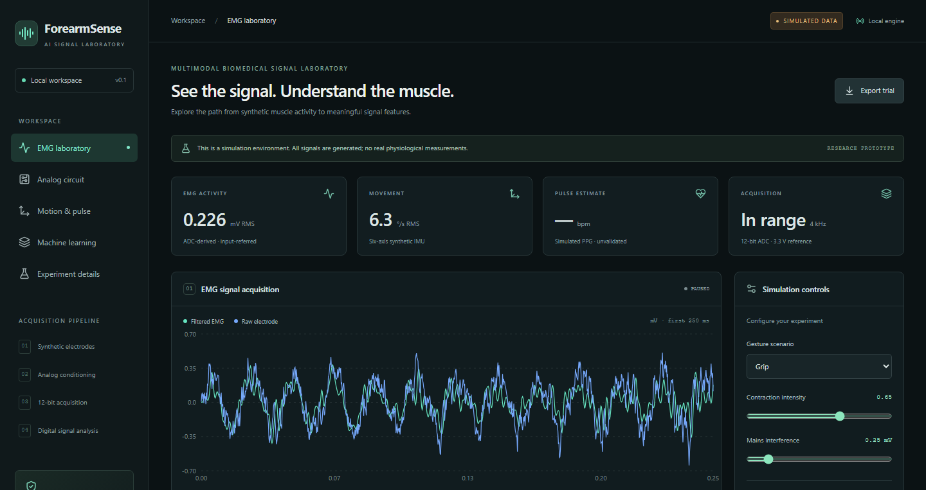
Interactive simulation dashboard
Adjust scenarios, inspect waveforms and export the full numerical trial.
Saved simulation view. Navigation predates report alignment.
ForearmSense AI
06
Notes:
Project sources: results/figures/dashboard-desktop.png, historical saved screenshot; README.md

Slide 7
Saved signal analysis results
Seed 42 · 2 seconds · 4 kHz · 8,000 samples
0.226 mV
Whole-trial RMS
211.7 Hz
Mean frequency
0 modeled clipping events
Synthetic ADC-derived signal, referred to the model input. No physiological measurement.
ForearmSense AI
07
Notes:
Project sources: results/metrics/summary.json; results/metrics/trial-seed42.json

Slide 8
Synthetic machine learning benchmark
Random Forest comparison
30 trials
570 windows
5 gesture classes
3-fold trial-grouped evaluation keeps overlapping windows from the same trial together.
IMU outperforms fusion here. Programmed movement patterns limit generalization.
Synthetic results only. No independent model-selection holdout or human validation.
ForearmSense AI
08
Notes:
Project sources: results/ml/metrics.json; results/ml/benchmark-report.md; docs/ml-methodology.md

Slide 9
Engineering and software verification
Analog model checks
SPICE status: partial
Ideal R/C response matched the analytical model within 1.45 × 10⁻⁷ dB.
OPA2376 gain check passed. INA826 compatibility failed the expected-gain check.
Recorded software checks
Browser coverage
62 backend tests passed. Production build and ESLint passed.
All 7 cases passed across a full run and a targeted rerun.
These records verify software and simulation behavior. Physical hardware remains unvalidated.
ForearmSense AI
09
Notes:
Project sources: results/spice/verification.json; docs/verification.md, report alignment record 2026-10-23

Slide 10
Planned 35-second grip protocol
Three 5-second squeezes, each separated by rest
Phase | Time intervals | Planned observation
Rest | 0–5, 10–15, 20–25, 30–35 s | Baseline and relaxation
Squeeze | 5–10, 15–20, 25–30 s | Activation and movement
Compare within a session
Activation timing, envelope consistency and movement steadiness.
ForearmSense AI
10
Notes:
Project sources: project.json task_protocol; docs/ForearmSense_AI_AECD_PBL_REVISED_UNO.md

Slide 11
Current completion and remaining work
Implemented | Next implementation phase
Synthetic EMG and motion generation | Verify firmware, ADC and actual sample timing
Analog/DSP analysis and JSON export | Validated serial ingestion with disconnect handling
Grouped ML training and prediction | Baseline calibration and 35-second acquisition
Engineering checks and local dashboard | Raw recording, replay and real-data evaluation
Unavailable measurements: grip force, SpO₂ and blood flow. No clinical claims.
ForearmSense AI
11
Notes:
Project sources: project.json; docs/report-alignment.md; README.md

Slide 12
Conclusion and next milestone
A reproducible laboratory for
EMG and movement analysis
The project connects analog signal conditioning, digital analysis and grouped ML evaluation in one local application.
Next milestone
Verify the Uno/BioAmp/MPU-6050 stream, then complete one calibrated, recorded grip session.
ForearmSense AI
12
Notes:
Project sources: README.md; project.json; revised report conclusion

