Slide 1
FINAL PROJECT REVIEW
ForearmSense AI
EMG and motion-based grip activity
and stability analysis
AECD · 25EC1302E
KL University, Hyderabad
A Jaswant Goud 2510040007 G Abhishek 2510040015
O GopiChand 2510040023 C Meghasyam 2510040072
Notes:
Sources: README.md and project.json. Current deliverable is a synthetic laboratory. The available-hardware design uses Uno, one BioAmp EXG Pill, MPU-6050 and a hand gripper.

Slide 2
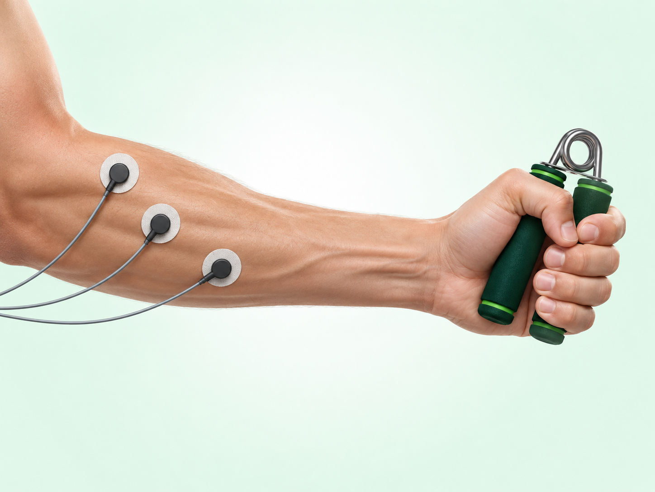
Problem and project objectives
Muscle activity needs
movement context
EMG describes electrical activation. Motion sensing distinguishes a steady grip from a grip with movement.
Activity analysis
Activation timing and repetition consistency
Movement stability
Concept illustration, not the built prototype
Acceleration and angular rate
ForearmSense AI
02
Notes:
Project sources: docs/ForearmSense_AI_AECD_PBL_REVISED_UNO.md, sections 1.1–1.5
Illustration: built-in image generation. Prompt: scientific editorial forearm and hand squeezing a spring gripper, three surface electrodes, white and mint background, forest green accents, no text or clinical claims. Concept only, no validated electrode placement or wiring.

Slide 3
Available hardware and its role
Component | Role | Measurement boundary
BioAmp EXG Pill | One analog EMG channel | Gain and filtering unverified
Arduino Uno | ADC and serial transport | Revision and rate unverified
MPU-6050 | Acceleration and gyro | Ranges and mounting unverified
Hand gripper | Repeatable grip/release task | No force measurement
Confirmed inventory. Live acquisition and calibration remain planned.
ForearmSense AI
03
Notes:
Project sources: project.json; docs/fixed-hardware-project-map.md

Slide 4
Planned hardware data path
Analog EMG
Forearm
electrodes
BioAmp
EXG Pill
Arduino Uno
ADC + serial
Laptop
FastAPI + React
MPU-6050
Accel + gyro
Motion data
The gripper provides the task. It does not measure force.
Functional design only. Verify the board, firmware, sampling and calibration before live use.
ForearmSense AI
04
Notes:
Sources: project.json; docs/fixed-hardware-project-map.md. Functional diagram only. Live serial ingestion and calibration remain planned. No pin-level wiring or electrode placement is prescribed.

Slide 5
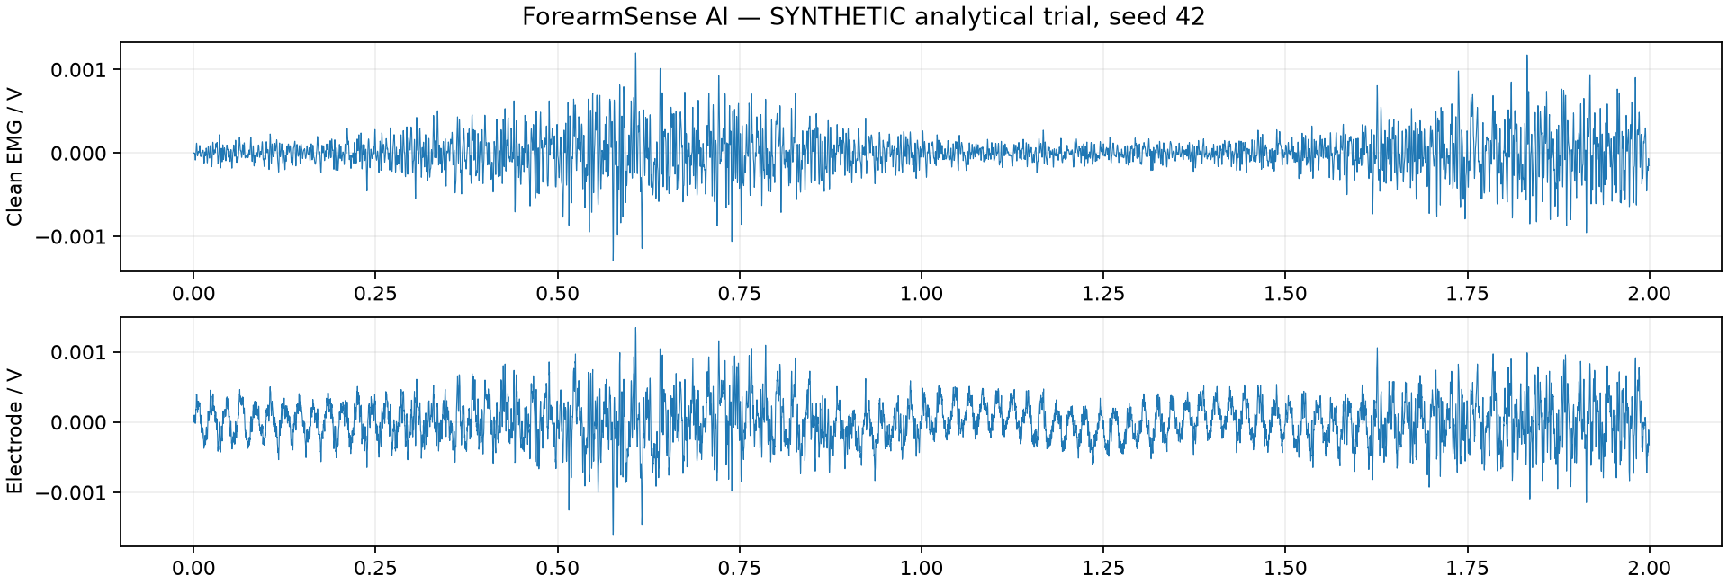
Software workflow
Generate
a seeded trial
Model analog
conditioning
Extract EMG
and IMU features
Review results
and export
Saved synthetic signal example
FastAPI backend + React/TypeScript frontend
ForearmSense AI
05
Notes:
Project sources: README.md; docs/architecture.md; docs/dsp-pipeline.md

Slide 6
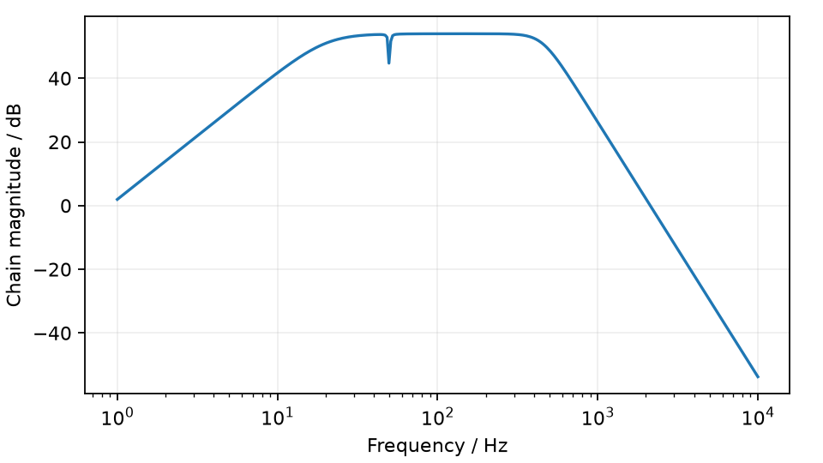
Analog conditioning and digital processing
High-pass
20 Hz
Notch
50 Hz, optional
Low-pass
450 Hz
ADC model
12-bit, 4 kHz
Educational filter model
Digital analysis
200 ms windows
100 ms hop
RMS and spectral features
FIR output at 1 kHz
A 250 Hz raw stream cannot preserve a 450 Hz EMG band.
ForearmSense AI
06
Notes:
Project sources: docs/dsp-pipeline.md; docs/analog-design.md; results/metrics/trial-seed42.json
Image source: results/figures/frequency-analysis.png, magnitude panel. This chain is educational and does not describe verified BioAmp hardware settings. FIR output guarantees a passband through 400 Hz.

Slide 7
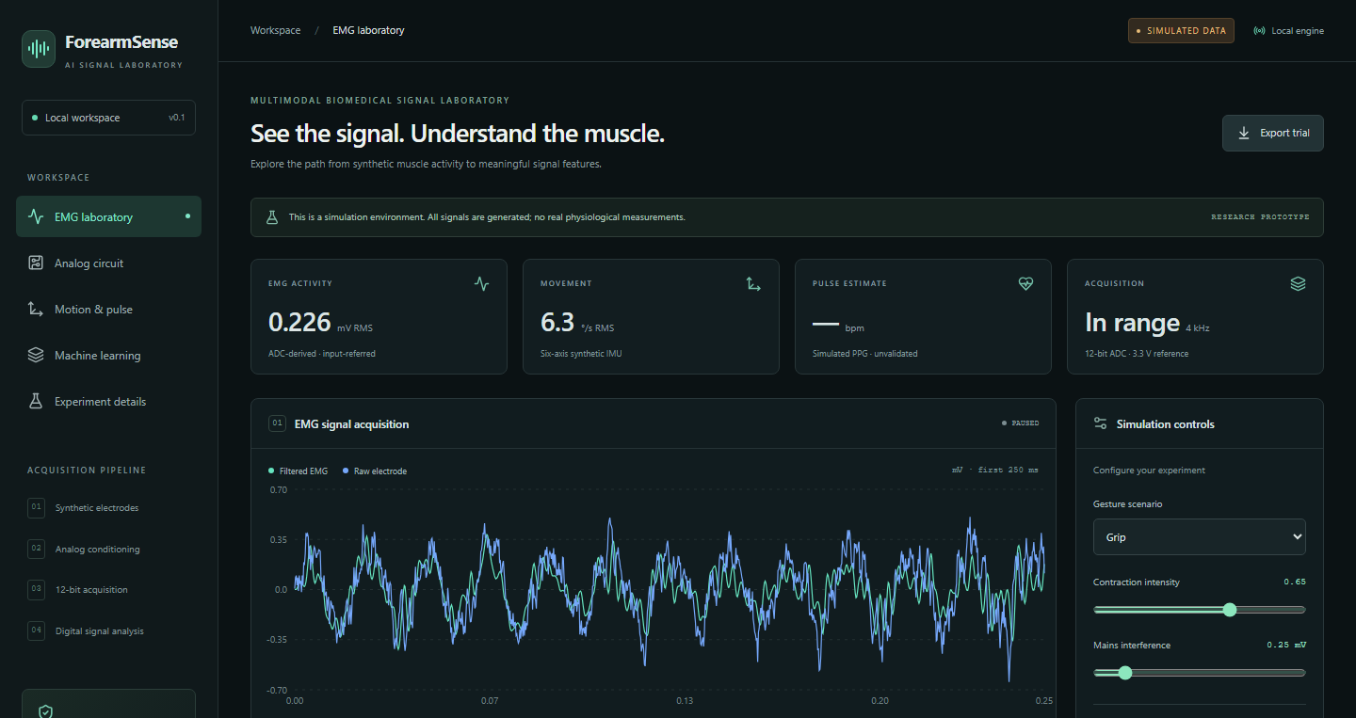
Interactive simulation dashboard
Adjust scenarios, inspect waveforms and export the full numerical trial.
Saved simulation view. Navigation predates report alignment.
ForearmSense AI
07
Notes:
Project sources: results/figures/dashboard-desktop.png, historical saved screenshot; README.md

Slide 8
Saved signal analysis results
Seed 42 · 2 seconds · 4 kHz · 8,000 samples
0.226 mV
Whole-trial RMS
211.7 Hz
Mean frequency
0 modeled clipping events
Synthetic ADC-derived signal, referred to the model input. No physiological measurement.
ForearmSense AI
08
Notes:
Project sources: results/metrics/summary.json; results/metrics/trial-seed42.json

Slide 9
Machine learning evaluation workflow
30 synthetic trials
5 gesture classes
200 ms windows
50% overlap
570 windows
EMG + IMU features
Three folds hold out complete trials
Training trials
Fit feature scaling + model
Held-out trials
Predict once per window
Logistic Regression, SVM, Decision Tree, Random Forest, Gradient Boosting
Windows from the same trial never appear in both training and test data.
ForearmSense AI
09
Notes:
Sources: docs/ml-methodology.md; results/ml/metrics.json. Three outer folds group windows by trial. StandardScaler stays inside training pipelines. SVM has nested grouped probability calibration. Five models and three modality comparisons.

Slide 10
Synthetic machine learning benchmark
Random Forest comparison
30 trials
570 windows
5 gesture classes
3-fold trial-grouped evaluation keeps overlapping windows from the same trial together.
IMU outperforms fusion here. Programmed movement patterns limit generalization.
Synthetic results only. No independent model-selection holdout or human validation.
ForearmSense AI
10
Notes:
Project sources: results/ml/metrics.json; results/ml/benchmark-report.md; docs/ml-methodology.md

Slide 11
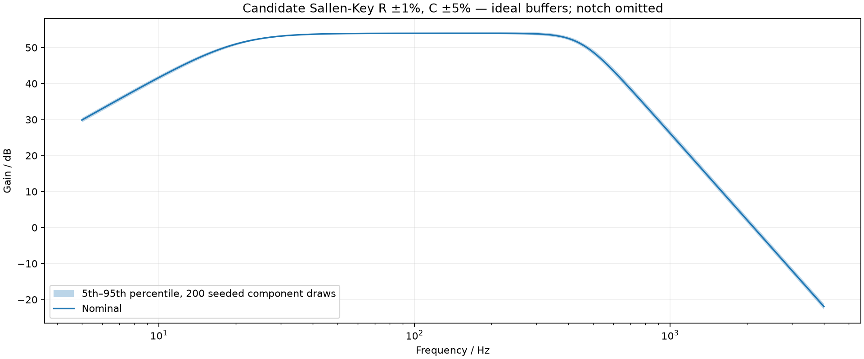
Engineering and software verification
SPICE: partial
Component tolerance study
Ideal R/C response agrees
within 1.45 x 10^-7 dB.
OPA2376 gain check passed.
INA826 gain check failed.
Recorded software checks
62 backend tests passed
Build and ESLint passed
7 browser cases across two runs
Saved analytical study. No physical hardware validation.
ForearmSense AI
11
Notes:
Project sources: results/spice/verification.json; docs/verification.md, report alignment record 2026-10-23
Image: results/figures/component-tolerances.png. Candidate Sallen-Key model, ideal buffers, R +/-1%, C +/-5%, notch omitted. Simulation ranges are not guarantees for physical modules.

Slide 12
Planned 35-second grip protocol
Three 5-second squeezes separated by rest
Rest
Squeeze
Rest
Squeeze
Rest
Squeeze
Rest
0-5 s
5-10 s
10-15 s
15-20 s
20-25 s
25-30 s
30-35 s
Rest phases
Squeeze phases
Baseline and relaxation
Activation timing, envelope consistency
and movement steadiness
ForearmSense AI
12
Notes:
Project sources: project.json task_protocol; docs/ForearmSense_AI_AECD_PBL_REVISED_UNO.md

Slide 13
Current completion and remaining work
Implemented | Next implementation phase
Synthetic EMG and motion generation | Verify firmware, ADC and actual sample timing
Analog/DSP analysis and JSON export | Validated serial ingestion with disconnect handling
Grouped ML training and prediction | Baseline calibration and 35-second acquisition
Engineering checks and local dashboard | Raw recording, replay and real-data evaluation
Unavailable measurements: grip force, SpO₂ and blood flow. No clinical claims.
ForearmSense AI
13
Notes:
Project sources: project.json; docs/report-alignment.md; README.md

Slide 14
Conclusion and next milestone
A reproducible laboratory for
EMG and movement analysis
The project connects analog signal conditioning, digital analysis and grouped ML evaluation in one local application.
Next milestone
Verify the Uno/BioAmp/MPU-6050 stream, then complete one calibrated, recorded grip session.
ForearmSense AI
14
Notes:
Project sources: README.md; project.json; revised report conclusion

