Slide 1
Overview of the framework of MP 1

Slide 2
Create Connection
Node A
k₁,k₂.._{kn}
Node B
k₁,k₂.._{kn}
Node C
k₁,k₂.._{kn}
Node D
k₁,k₂.._{kn}

Slide 3
Channel Delay
Node A
Node B
Max Delay Max
Server/Client
Thread
Message
Thread
Server/Client
Thread
Message
Thread
Send M to B
Display
Send M B system time is t
M
Select a random no. D
sleep till D time units
M
Display
Received M from A,
Max delay is Max s,
System time is at time t’

Slide 4
Channel Delay
M₁
Node A ---------- > Node B
Node A ---------- > Node B
t₁
t₁+r₁
Selects random number r₁
M₂
t₁+t’
Max( t₁+t’+r_{2,} t₁+r₁)
Selects random number r₂

Slide 5
Key-Value Store and Consistency Models
Operations
delete Key
get Key Model
insert Key Value Model
update Key Value Model

Slide 6
Implement Linearizability
Totally
Ordered
Broadcast
Node A
Write (k₁=x,t)
Central Server
Write (k₁=x,t)
Write (k₁=x,t)
Write (k₁=x,t)
Write (k₁=x,t)
Node A
Node B
Node C
Node D

Slide 7
Implement Linearizability
Node A
ack
Central Server
ack
ack
ack
ack
Node A
Node B
Node C
Node D

Slide 8
Implement Sequential consistency
Totally
Ordered
Broadcast
Node A
Write (k₁=x,t)
Central Server
Write (k₁=x,t)
Write (k₁=x,t)
Write (k₁=x,t)
Write (k₁=x,t)
Node A
Node B
Node C
Node D

Slide 9
Implement Sequential consistency
Node A
ack
Central Server
ack
ack
ack
ack
Node A
Node B
Node C
Node D

Slide 10
Implement Sequential consistency
Node A
Read (k₁)

Slide 11
Implement Eventual consistency W=2
Node A
Write (k₁=x,t)
Node B
Write (k₁=x,t)
Node C

Slide 12
Implement Eventual consistency W=2, R = 2
Node A
ack
Node B
ack
Node C

Slide 13
Implement Eventual consistency R = 2
Node A
Read k₁
Node B
Read k₁
Node C

Slide 14
Implement Eventual consistency W=2, R = 2
Node A
Node B
k₁=(x₁,t₁)
If t₁>t₂ return x₁
Else return x₂
k₁=(x₂,t₂)
Node C

Slide 15
Python Sockets

Slide 16
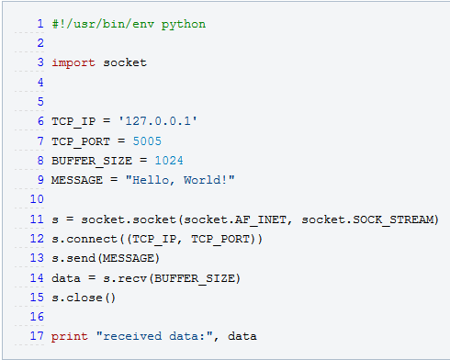
Send a Message over TCP

Slide 17
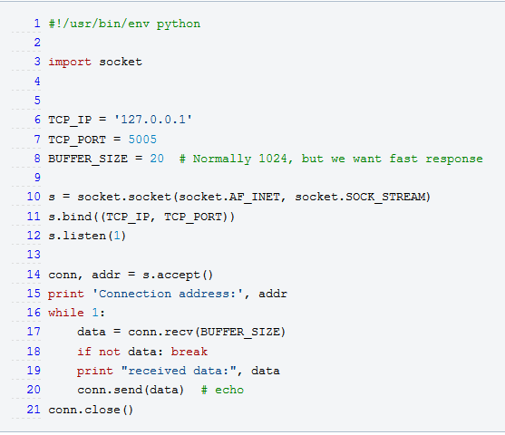
Simple TCP Server

Slide 18
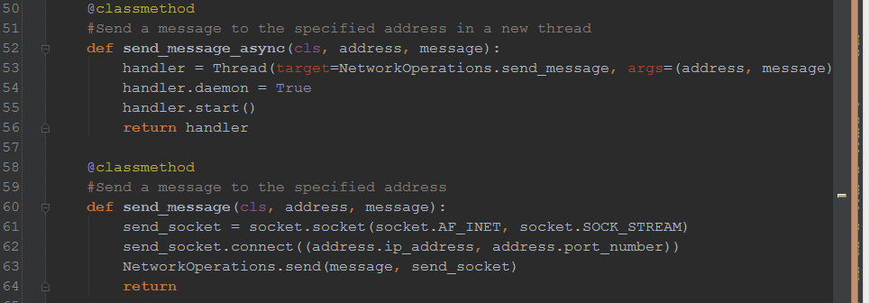
Multithreaded Messaging

Slide 19
References
https://wiki.python.org/moin/TcpCommunication

Slide 21
Multi threading
http://www.tutorialspoint.com/java/java_multithreading.htm

Slide 22
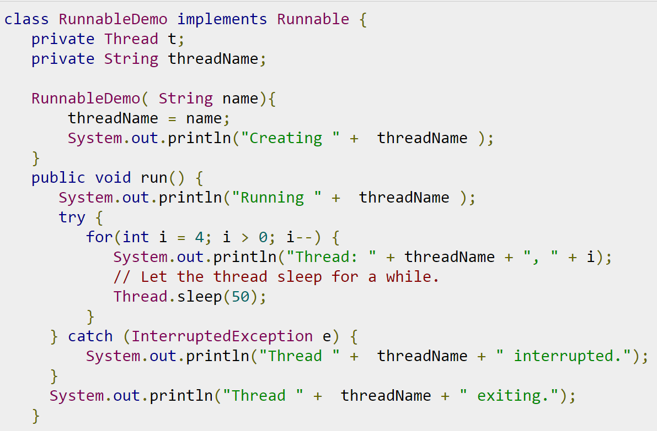

Slide 23
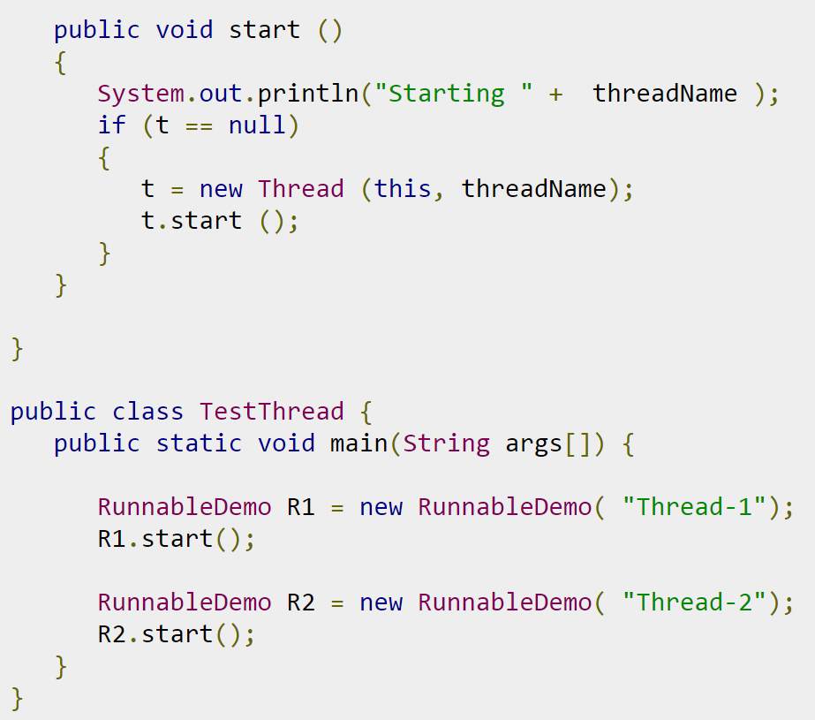

Slide 24
Sockets
http://cs.lmu.edu/~ray/notes/javanetexamples/

Slide 25
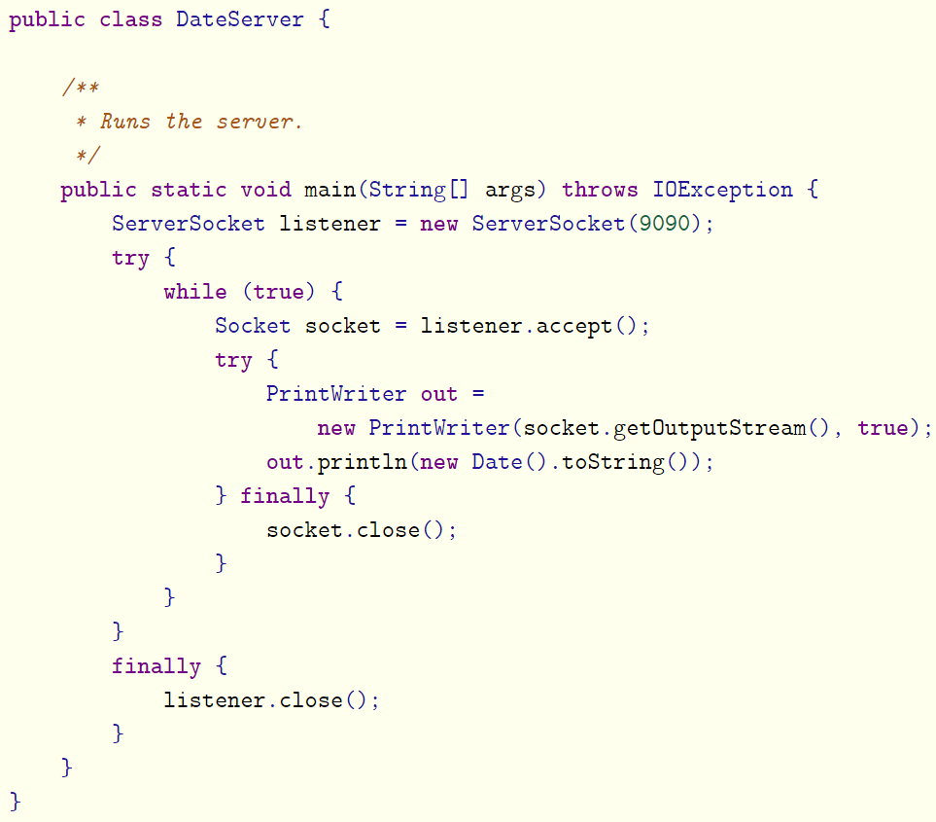

Slide 26
