Slide 1
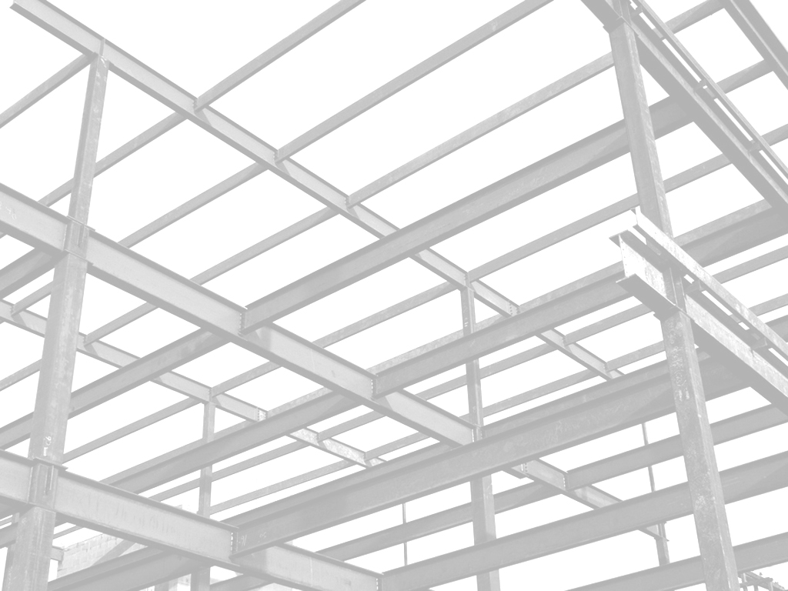

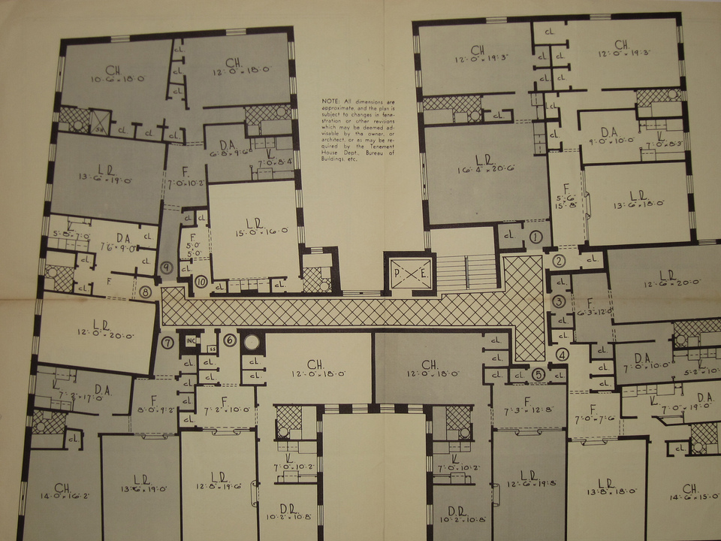
Improving Variability of Applications using Adaptive Object-Models
http://www.flickr.com/photos/8095451@N08/
João Gradim
Supervisor: Ademar Aguiar (Ph.D.)
Supervisor: Hugo Ferreira (Ph.D. AbD)
Faculdade de Engenharia da Universidade do Porto
February 11th, 2011

Slide 2

Introduction
http://www.flickr.com/photos/seb-o/

Slide 3
Context
Many software projects exist in an ever-changing environment

Slide 4
Context
Requirements change to reflect changes in the enviroment, the industry, the client and end-users

Slide 5
Context
Modifying a system is costly

Slide 6
Motivation & Objectives
Adapting ideas and methodologies associated with meta-architectures and “incomplete by design” systems, making Rails development even more agile and adaptable to change

Slide 7
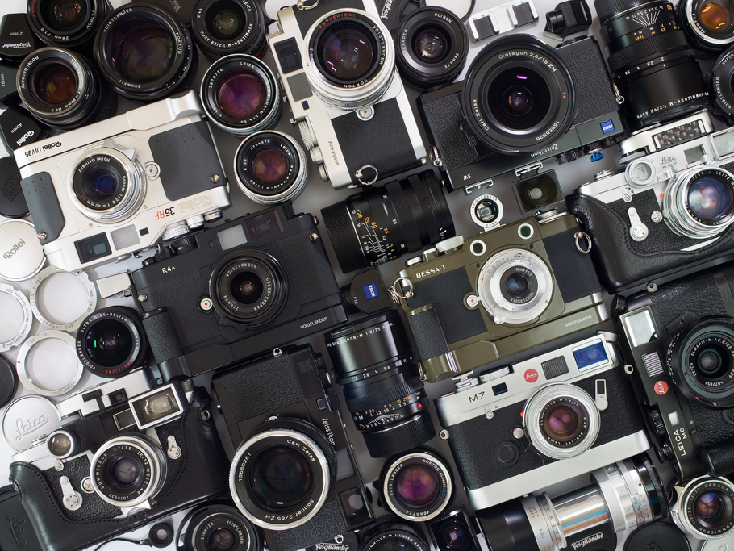

Related Work
http://www.flickr.com/photos/minieng/

Slide 8
Methodologies
Domain-Driven Design

Slide 9
Generative Programming
Software Product Lines
Model-Driven Engineering
Frameworks (e.g. Rails scaffolding)

Slide 10
Programming Paradigms
Metaprogramming
Aspect-Oriented Programming

Slide 11
Design
Architectural Patterns
Design Patterns

Slide 12
Adaptive Object-Models

Slide 13

Approach & Results
http://www.flickr.com/photos/ 33646230@N03 /

Slide 14
Research Design
Current Design Analysis
Variability Analysis
Implementation & Impact Analysis

Slide 15
User Roles
Provide authorization
Declarative authorization (CanCan)
Not very flexible...

Slide 16
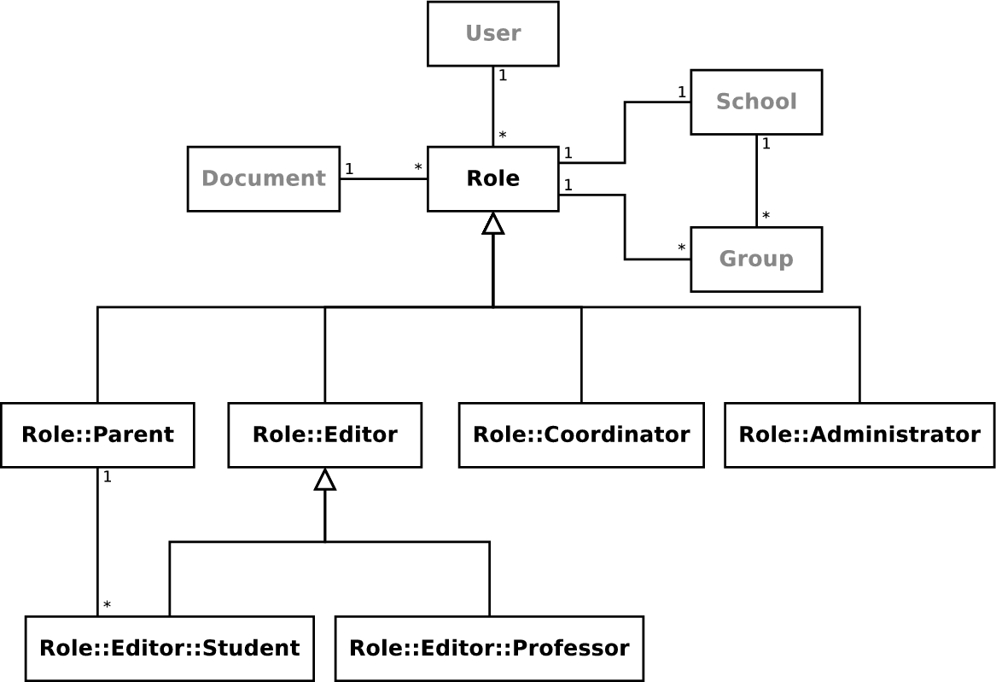
User Roles

Slide 17
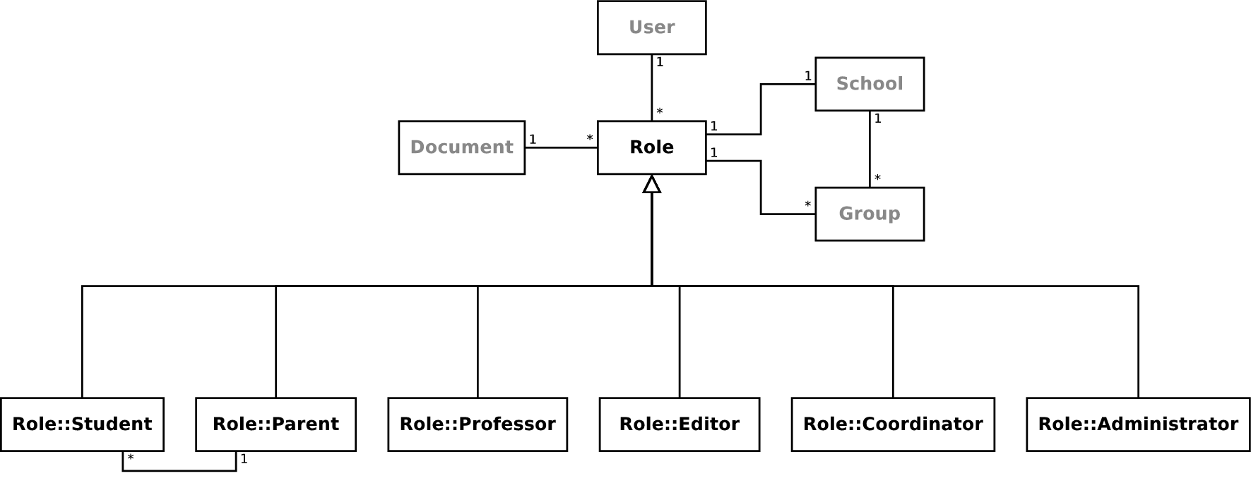
User Roles

Slide 18
Social Network
Completely dynamic
Built upon request, on runtime
Not very flexible...

Slide 19
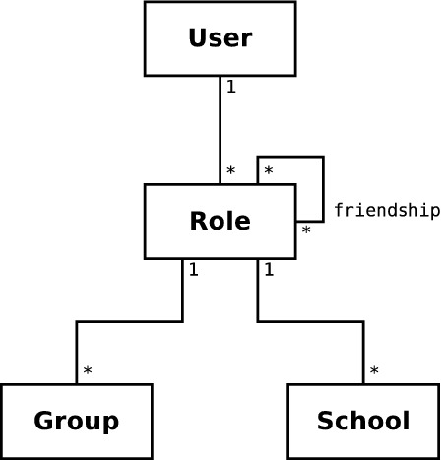
Social Network

Slide 20
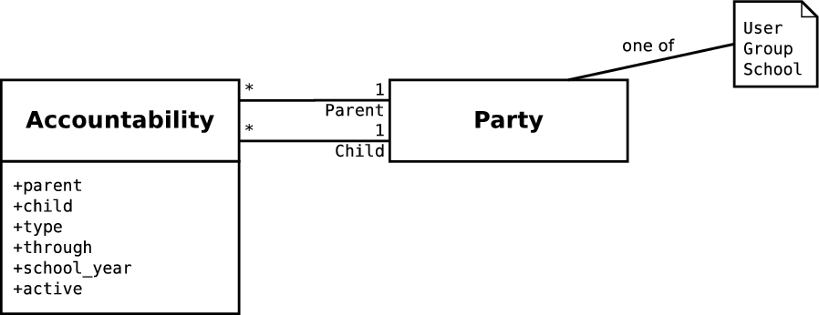
Social Network

Slide 21
Document Editor
One of the most used features
Many different types of content
Flexible, but too complex...

Slide 22
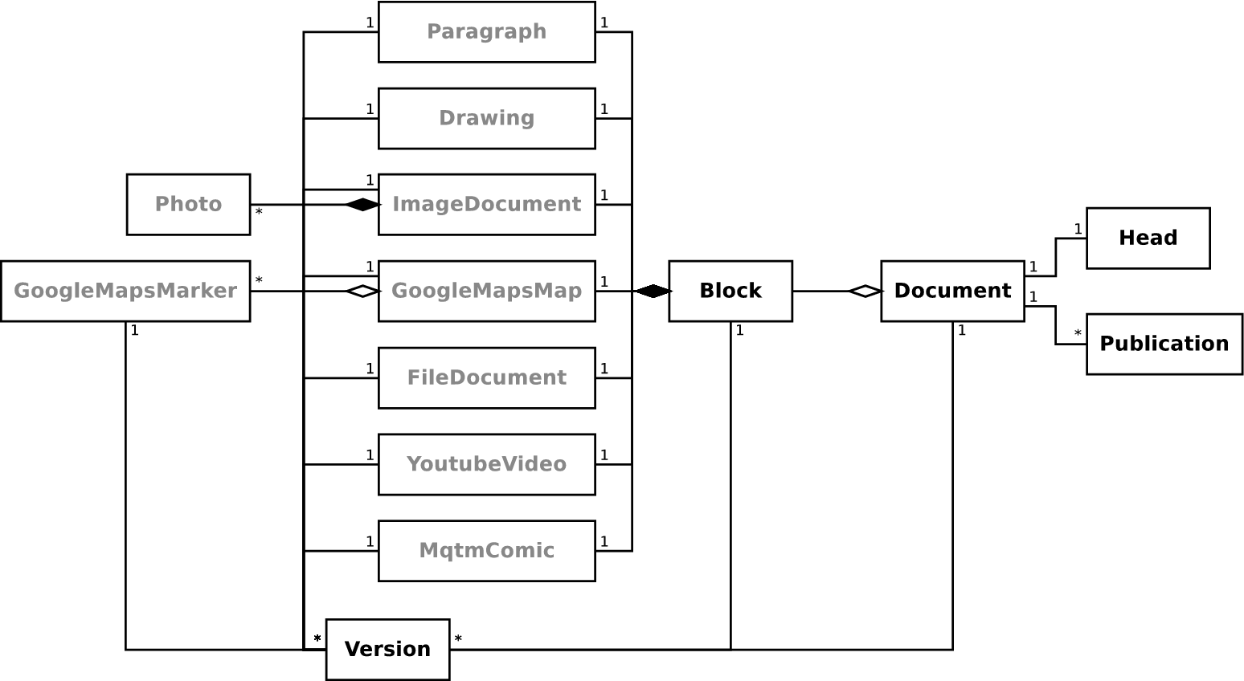
Document Editor

Slide 23
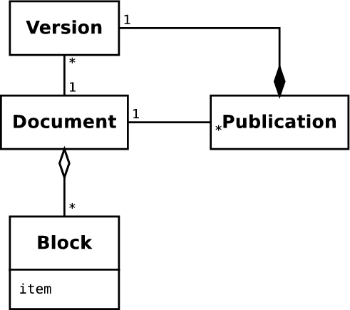
Document Editor

Slide 24

Conclusions
http://www.flickr.com/photos/ dklimke /

Slide 25
AOMs
AOM architectures provide the best framework for building adaptable software systems

Slide 26
Rails & MVC
MVC architecture used by Rails can coexist harmoniously with AOM design patterns, especially with the AR engine

Slide 27
Variability

Slide 28
Performance
Performance can be increased

Slide 29

Further Work

Slide 30
Implementation

Slide 31
Performance

