Slide 1
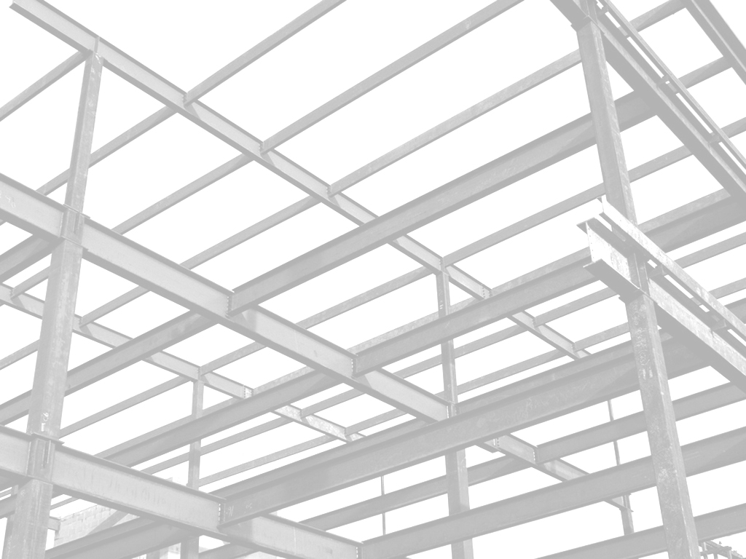

Improving Variability of Applications using Adaptive Object-Models
João Gradim
Supervisor: Ademar Aguiar (Ph.D.)
Supervisor: Hugo Ferreira (Ph.D. AbD)
Faculdade de Engenharia da Universidade do Porto
February 11th, 2011

Slide 2

Introduction

Slide 3
Context
Many software projects exist in an ever-changing environment

Slide 4
Context
Requirements change to reflect changes in the enviroment, the industry, the client and end-users

Slide 5
Context
Modifying a system is costly

Slide 6


Related Work

Slide 7
Methodologies
Domain-Driven Design

Slide 8
Generative Programming
Software Product Lines
Model-Driven Engineering
Frameworks (e.g. Rails scaffolding)

Slide 9
Metaprogramming
Metaprogramming
Aspect-Oriented Programming

Slide 10
Design
Design Patterns
Architectural Patterns

Slide 11

Approach & Results

Slide 12

Conclusions

Slide 13
AOMs
AOM architectures provide the best framework for building adaptable software systems

Slide 14
Rails & MVC
MVC architecture used by Rails can coexist harmoniously with AOM design patterns, especially with the AR engine

Slide 15
Variability

Slide 16
Performance
Performance can be increased

Slide 17

Further Work

Slide 18
Implementation

Slide 19
Performance

