Slide 1


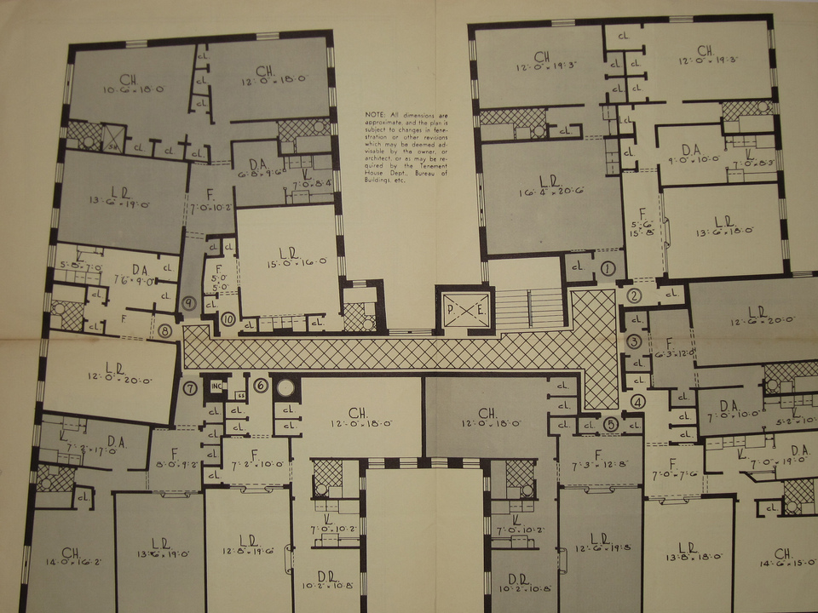
Improving Variability of Applications using Adaptive Object-Models
http://www.flickr.com/photos/8095451@N08/
João Gradim
Supervisor: Ademar Aguiar (Ph.D.)
Supervisor: Hugo Ferreira (Ph.D. AbD)
Faculdade de Engenharia da Universidade do Porto
February 11th, 2011

Slide 2

Introduction
http://www.flickr.com/photos/seb-o/

Slide 3
Context
Many software projects exist in an ever-changing environment

Slide 4
Context
Requirements change to reflect changes in the enviroment, the industry, the client and end-users

Slide 5
Context
Modifying a system is costly

Slide 6
Motivation & Objectives
Adapting ideas and methodologies associated with meta-architectures and “incomplete by design” systems, making Rails development even more agile and adaptable to change

Slide 7


Related Work
http://www.flickr.com/photos/minieng/

Slide 8
Methodologies
Domain-Driven Design

Slide 9
Generative Programming
Software Product Lines
Model-Driven Engineering
Frameworks (e.g. Rails scaffolding)

Slide 10
Programming Paradigms
Aspect-Oriented Programming
Metaprogramming

Slide 11
Design
Architectural Patterns
Design Patterns

Slide 12
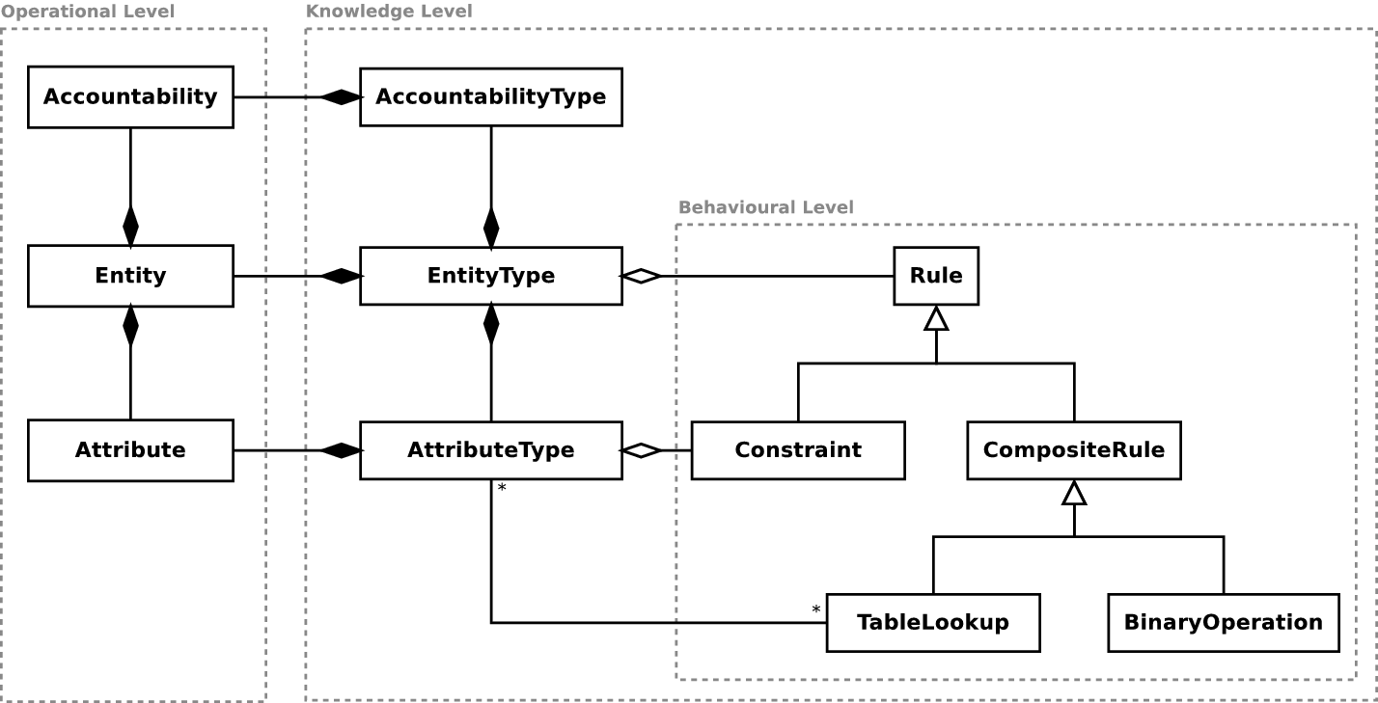
Adaptive Object-Models

Slide 13

Approach & Results
http://www.flickr.com/photos/ 33646230@N03 /

Slide 14
Research Design
Current Design Analysis
Variability Analysis
Implementation & Impact Analysis

Slide 15
User Roles
Provide authorization
Multi-level hierarchy
Not very flexible...

Slide 16
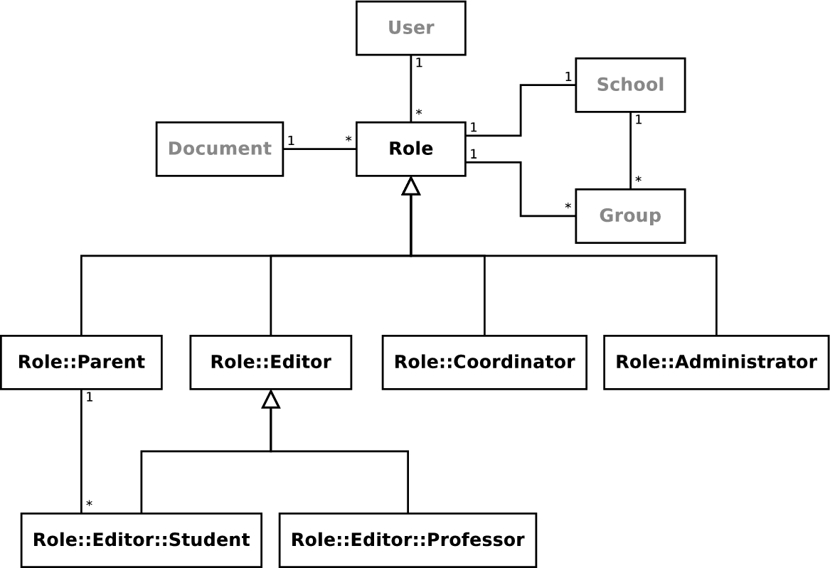
User Roles – Before

Slide 17
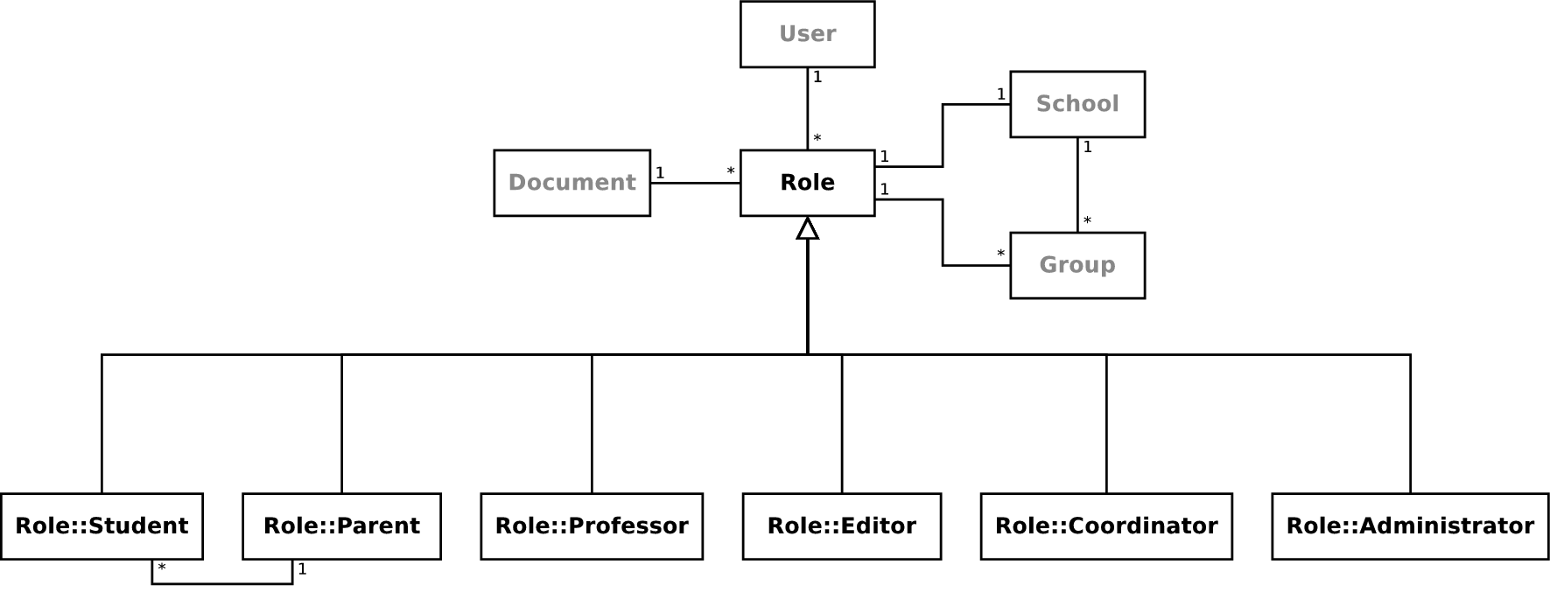
User Roles – After

Slide 18
User Roles – Results
Flexible design
Rulesets are based on role composition instead of subclassing
Independent roles

Slide 19
Social Network
Completely dynamic
Built upon request, on runtime
Not very flexible...

Slide 20
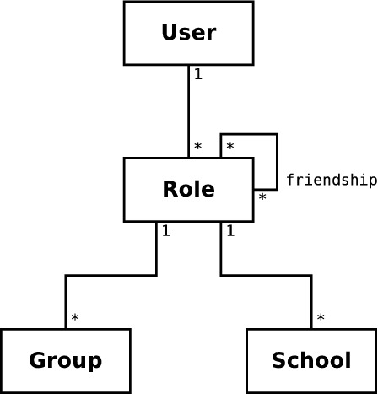
Social Network – Before

Slide 21
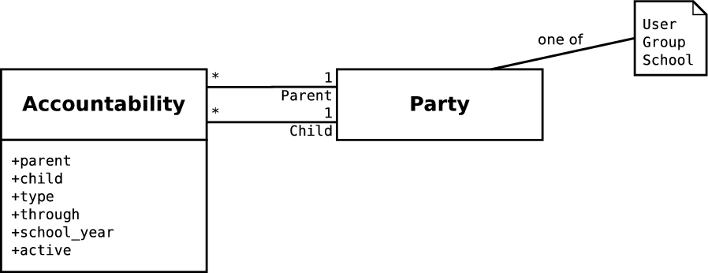
Social Network – After

Slide 22
Social Network – Results
User network can be manually edited
Possibility to create connections between any two entities
Huge performance increase
Notes:
1 – without any effort and without polluting the codebase with hardcoded exceptions

Slide 23
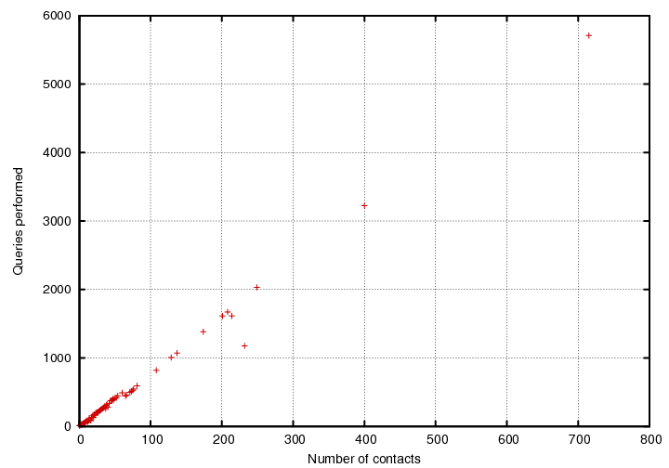
Social Network – Results
11
(not to scale)

Slide 24
Document Editor
One of the most used features
Many different types of content
Flexible, but too complex...

Slide 25
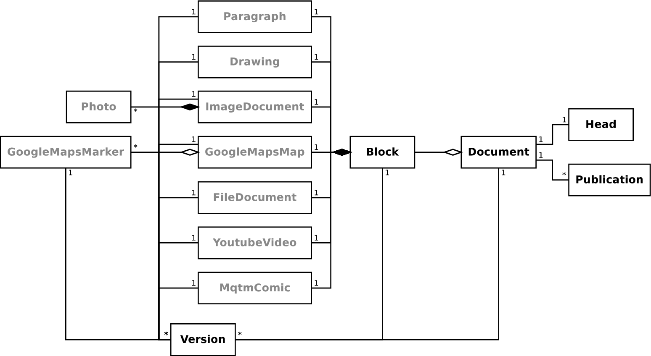
Document Editor – Before

Slide 26
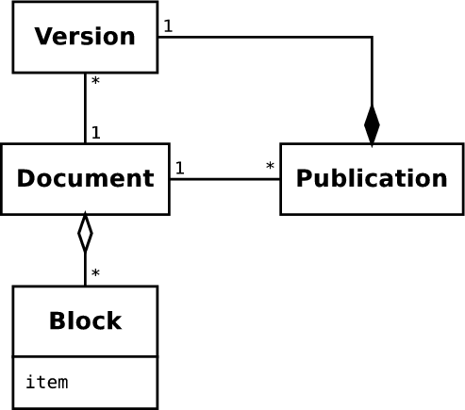
Document Editor – After

Slide 27
Document Editor – Results
Much simpler infrastructure, no more migrations
No code repetition
Performance increase
Notes:
Much simpler infrastructure: focus on model description instead of versioning and association logic – increased variability
No code repetition: unique handler for user input, less errors

Slide 28
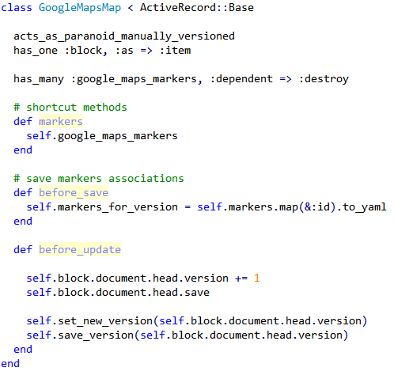
Document Editor – Results

Slide 29
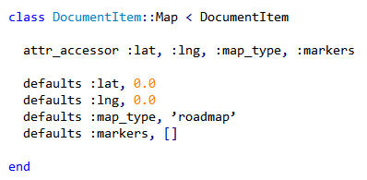
Document Editor – Results

Slide 30
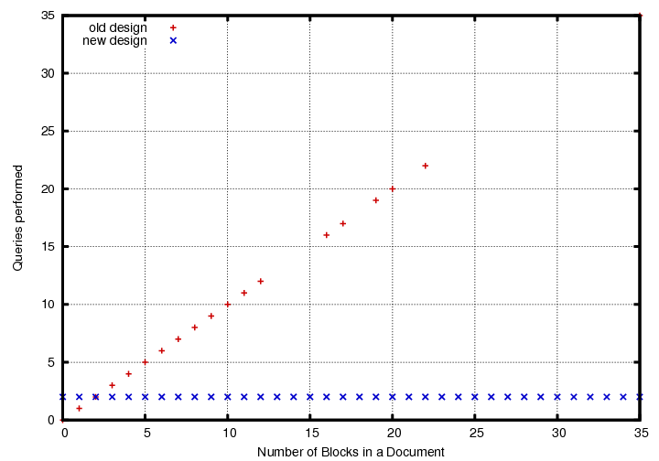
Document Editor – Results

Slide 31

Conclusions
http://www.flickr.com/photos/ dklimke /

Slide 32
AOMs
AOM architectures provide the best framework for building adaptable software systems

Slide 33
Variability
Different degrees of variability achieved
Rails MVC architecture and conventions can be an obstacle to highly-variable systems

Slide 34
Rails & MVC
MVC architecture used by Rails can coexist harmoniously with AOM design patterns, especially with the AR engine

Slide 35
Performance
Performance can be increased – depending on previous design
Notes:
Performance increase is dependant on the previous design

Slide 36

Further Work

Slide 37
Implementation
Finish prototypes
Implement everything in the platform

Slide 38
Performance
Keep all accountabilities in memory
Optimize queries used to retrieve connections between entities (SQL)

