Slide 1


Improving Variability of Applications using Adaptive Object-Models
João Gradim
Supervisor: Ademar Aguiar (Ph.D.)
Supervisor: Hugo Ferreira (Ph.D. AbD)
Faculdade de Engenharia da Universidade do Porto
February 11th, 2011

Slide 2

Introduction

Slide 3
Context
Many software projects exist in an ever-changing environment
Requirements change to reflect changes in the enviroment, the industry, the client and end-users
Modifying a system is costly

Slide 4
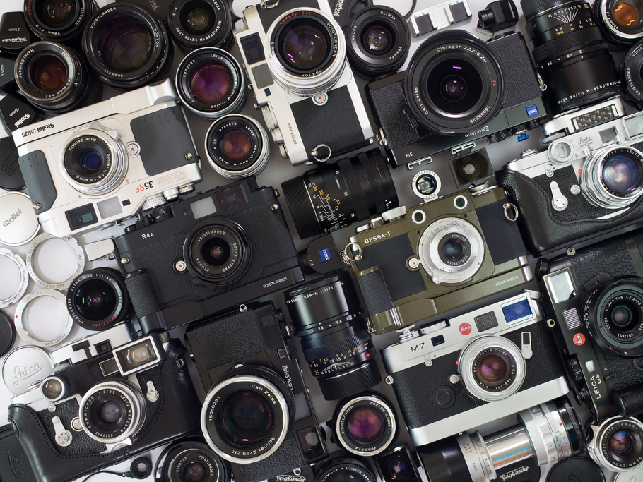

Related Work

Slide 5

Approach & Results

Slide 6

Conclusions

Slide 7
AOMs
AOM architectures provide the best framework for building adaptable software systems

Slide 8
Rails & MVC
MVC architecture used by Rails can coexist harmoniously with AOM design patterns, especially with the AR engine

Slide 9
Variability

Slide 10
Performance
Performance can be increased

Slide 11

Further Work

Slide 12
Implementation

Slide 13
Performance

