Slide 1

Causes of Death: Our World In Data Tableau Project
Josh Graham

Slide 2
Project Process
Understand the Data
Choose my Data Story
Create Tableau Dashboards

Slide 3
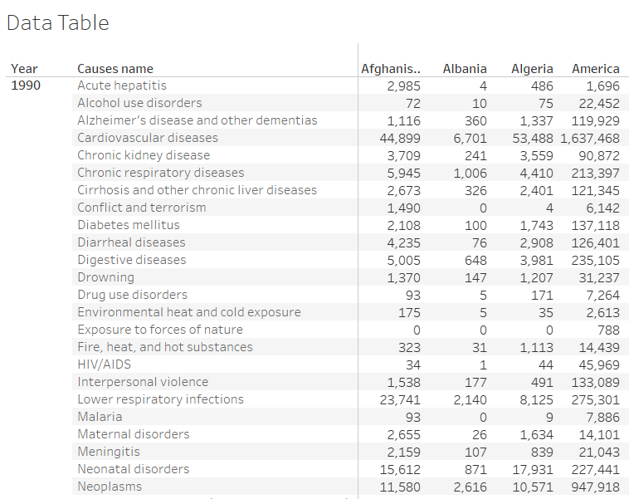
Understanding The Data
Column Data | Datatype
Causes name | String
Causes Full Description | String
Death Numbers | Number (whole)
Entity | String & Geographic Country Data
Code | String
Year | Number (whole)

Slide 4
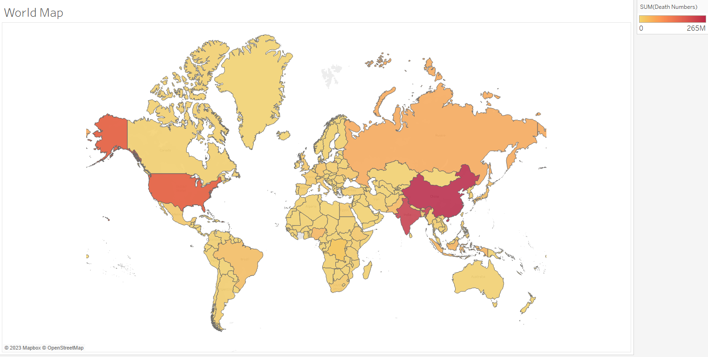

Slide 5
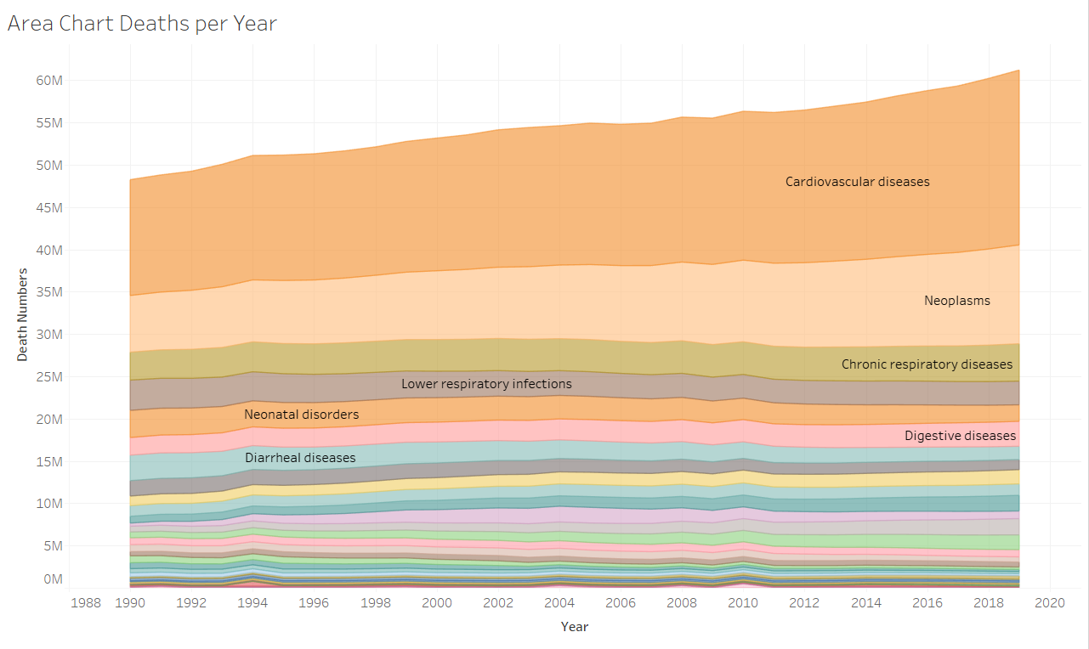

Slide 6
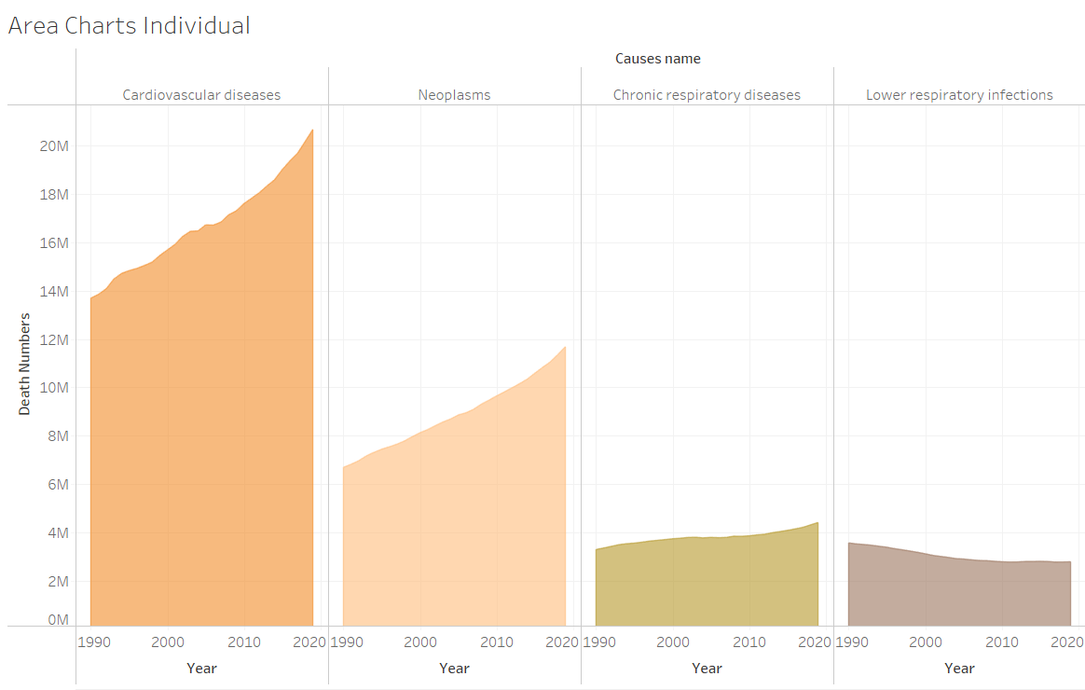

Slide 7
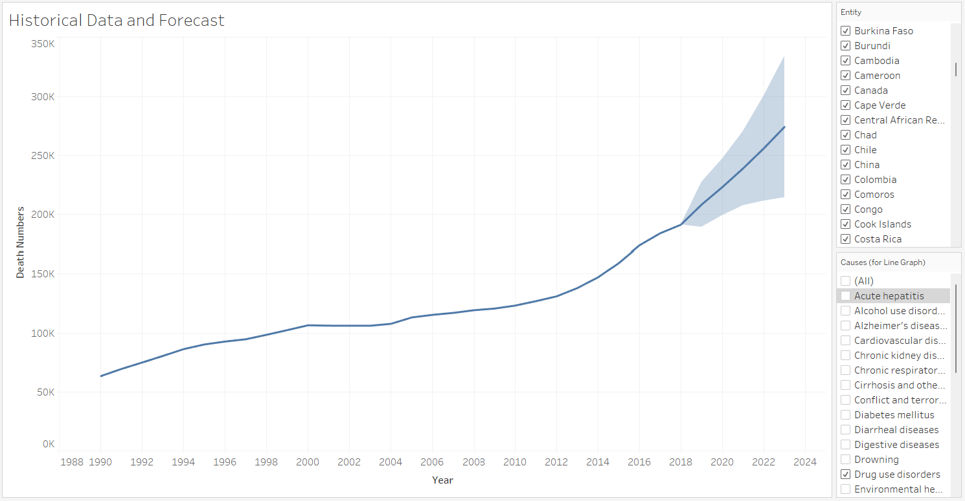

Slide 8
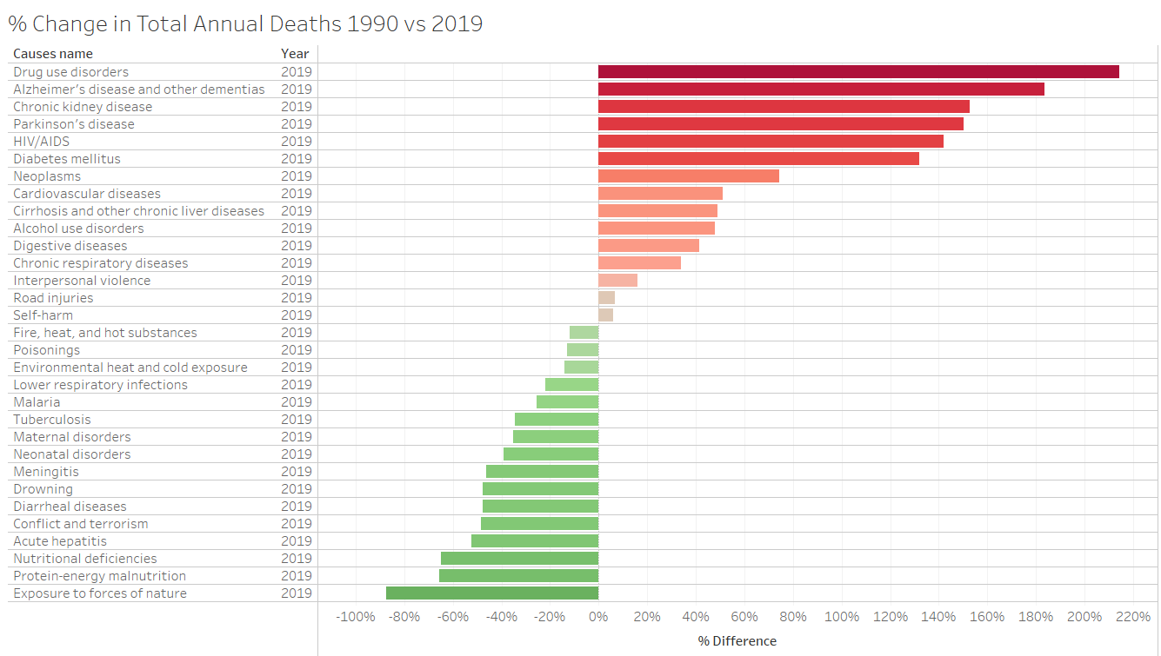
Choose my Data Story

Slide 9
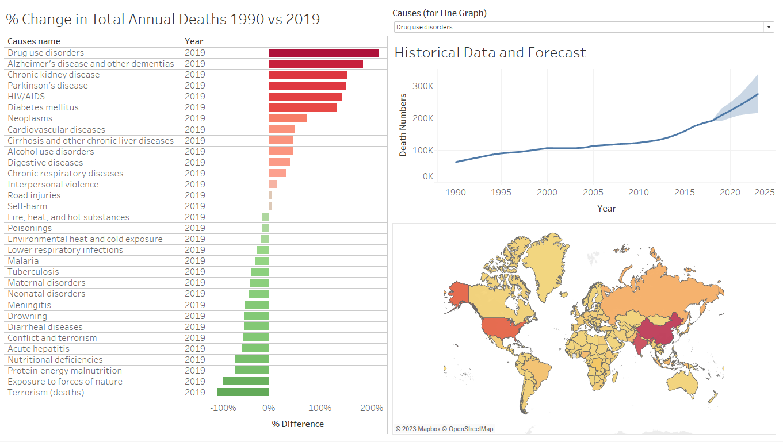
Create Tableau Dashboard

