Slide 1
Quora Questions
Josh Graham

Slide 2

Project Work Flow
Data Exploration
Data Cleaning
Feature Engineering
Model Creation

Slide 3
Data Exploration
Not duplicate:
What is the step by step guide to invest in share market in india?
What is the step by step guide to invest in share market?
Not duplicate:
What is the story of Kohinoor (Koh-i-Noor) Diamond?
What would happen if the Indian government stole the Kohinoor (Koh-i-Noor) diamond back?
Not duplicate:
Motorola (company): Can I hack my Charter Motorolla DCX3400?
How do I hack Motorola DCX3400 for free internet?

Slide 4
Data Exploration
Is duplicate:
Astrology: I am a Capricorn Sun Cap moon and cap rising...what does that say about me?
I'm a triple Capricorn (Sun, Moon and ascendant in Capricorn) What does this say about me?
Is duplicate:
What would a Trump presidency mean for current international master’s students on an F1 visa?
How will a Trump presidency affect the students presently in US or planning to study in US?
Is duplicate:
What does manipulation mean?
What does manipulation mean?

Slide 5
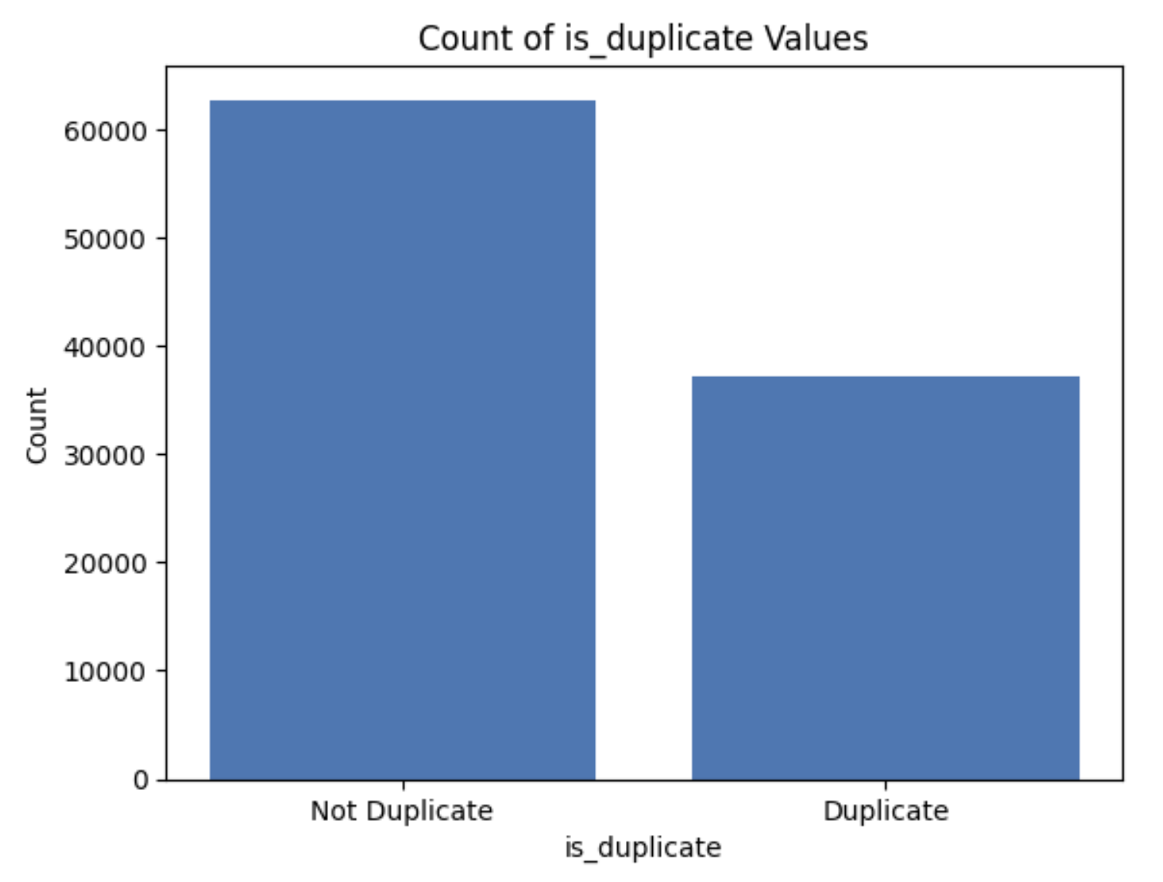
Data Exploration
Value counts for ‘is_duplicate’ :
0 62746
1 37254
62.7% will be our baseline for accuracy. Any accuracy score we achieve above this baseline would indicate that our model is performing better than simply predicting the majority class for all samples.

Slide 6
Data Cleaning
To clean the data I created a function that:
Tokenized Text
Removed Punctuation
Removed Upper Case
Removed Stop Words
Stemmed Words
Pre Function:
Astrology: I am a Capricorn Sun Cap moon and cap rising...what does that say about me?
Post Function:
astrolog capricorn sun cap moon cap rise say

Slide 7
Feature Engineering
To do feature engineering on the data I create a function that:
Instantiated the TFIDF Vectorizer
Vectorized the clean question 1 and 2 for a given row
Turned the vectorizer matrix to an array
Calculated the Cosine Similarity of the 2 vectorized questions

Slide 8


Feature Engineering
Non Duplicate:
What is the step by step guide to invest in share market in india?
What is the step by step guide to invest in share market?
Cosine Similarity = 0.90
Non Duplicate:
What is the story of Kohinoor (Koh-i-Noor) Diamond?
What would happen if the Indian government stole the Kohinoor (Koh-i-Noor) diamond back?
Cosine Similarity = 0.46

Slide 9
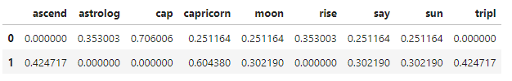

Feature Engineering
Duplicate:
Astrology: I am a Capricorn Sun Cap moon and cap rising...what does that say about me?
I'm a triple Capricorn (Sun, Moon and ascendant in Capricorn) What does this say about me?
Cosine Similarity = 0.38
Duplicate:
Who would win: Black Panther or Batman?
Who would win in a fight between Black Panther and Batman?
Cosine Similarity = 0.85

Slide 10
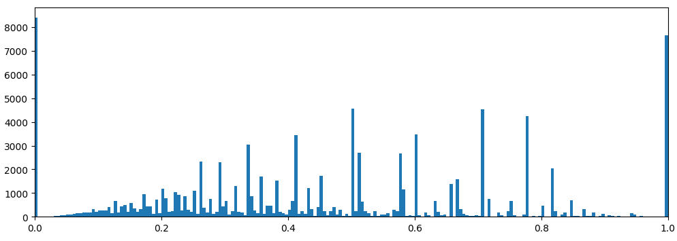
Feature Engineering
Here is a histogram of the cosine similarity of the dataset.

Slide 11


Model Creation
I created 2 classification models to predict whether 2 questions were a duplicate or not.
The X value input was the cosine similarity and the y value output was the 0 or 1 ‘is_duplicate’ parameter
XGBoost
Logistic Regressor

Slide 12
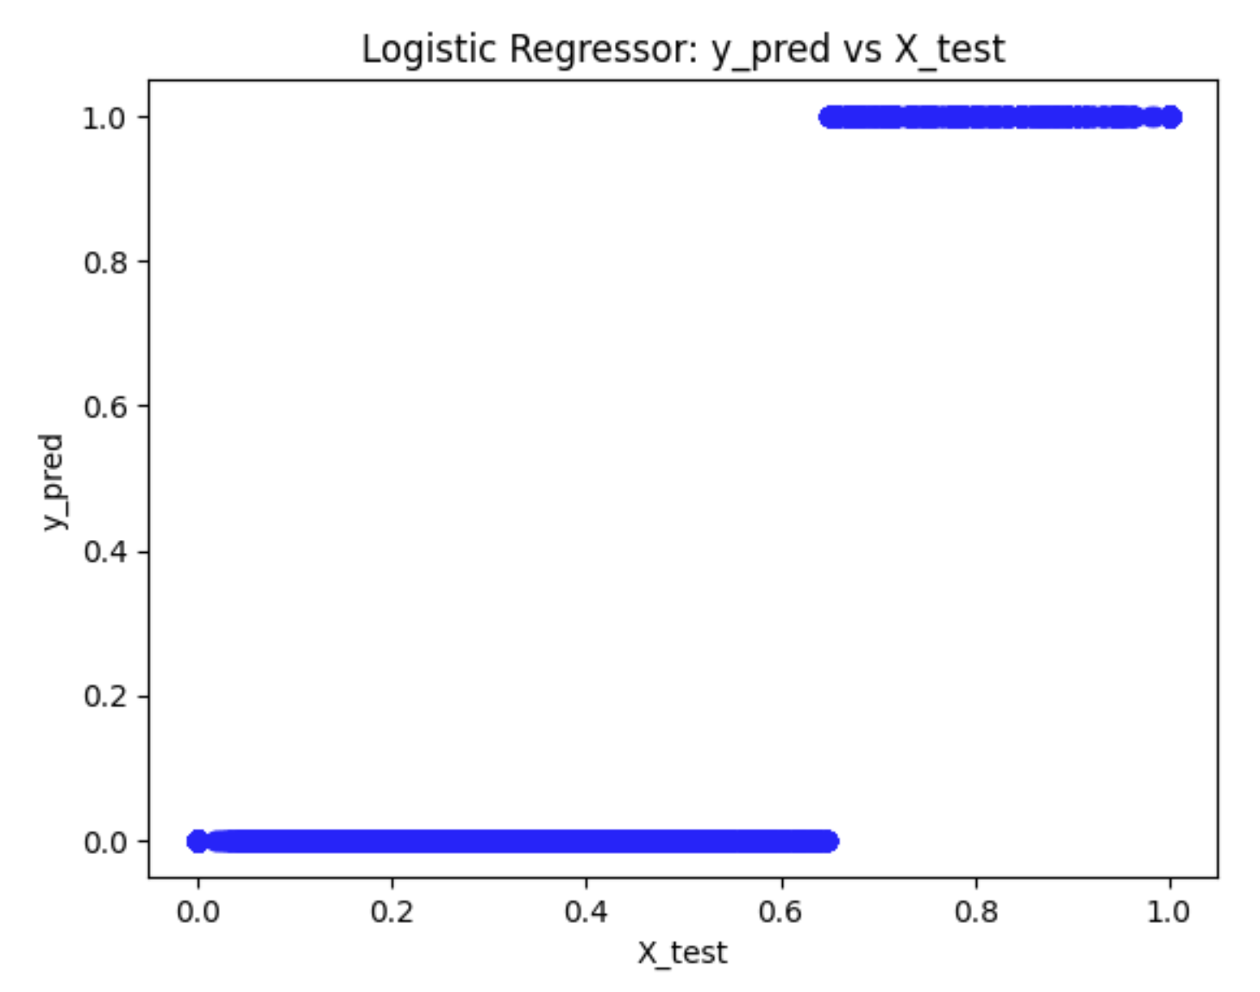
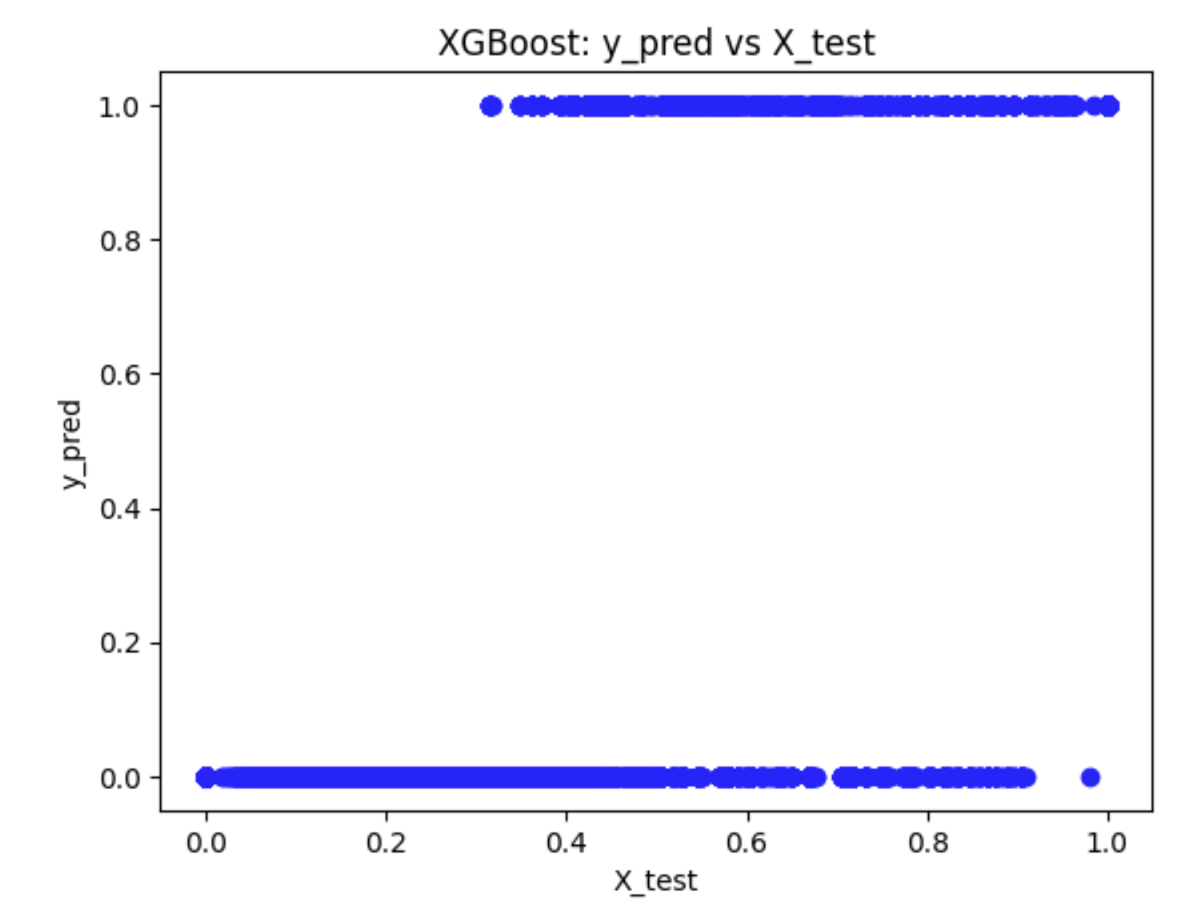
Model Creation

