Slide 1


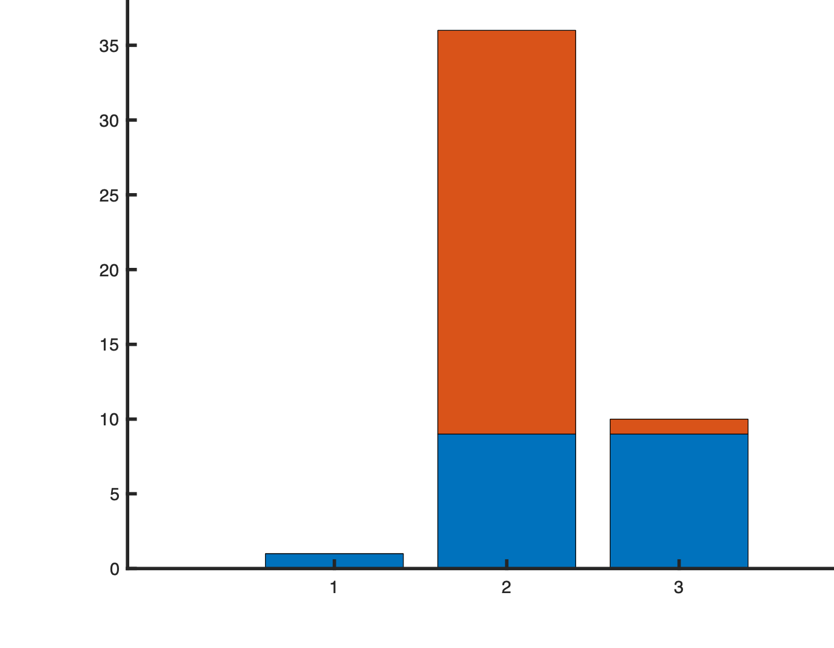
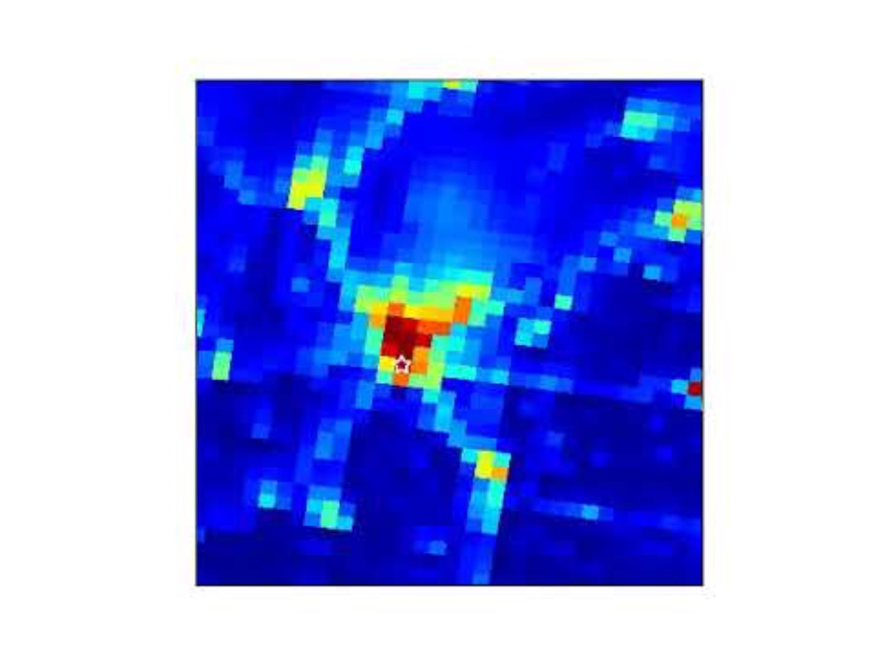

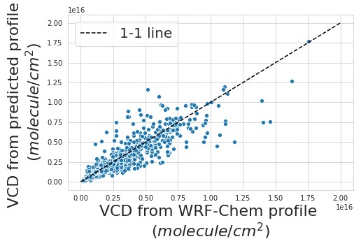
Headshot of yourself
Grant–Efficient generation of native resolution NO₂ a priori profiles for TEMPO retrievals using machine learning Jennifer Grant, Qindan Zhu, Hannah Kenagy, Ron Cohen
University of California, Berkeley
Hourly a priori NO₂ profiles at
2 km x 2 km
Wall time of 1-day simulation
Chemical transport model (CTM)
Machining Learning (ML)
12kmx12km
CTM
2kmx2km
CTM
2kmx2km
ML
Chemistry
Meteorology
Emissions
3. Machine learning is a computationally efficient method, and the predictions yield a good agreement.
1. Accurately interpreting satellite NO₂ observations requires a priori profiles at both high spatial and high temporal resolution.
2. NO₂ a priori profiles are typically generated using computationally expensive chemistry transport model. Here we propose using machine learning on high-resolution meteorological forecast/analysis and emissions inventory.

