Slide 1
Intel Core i9 14900K
Josh Green and Akhil Sankar

Slide 2
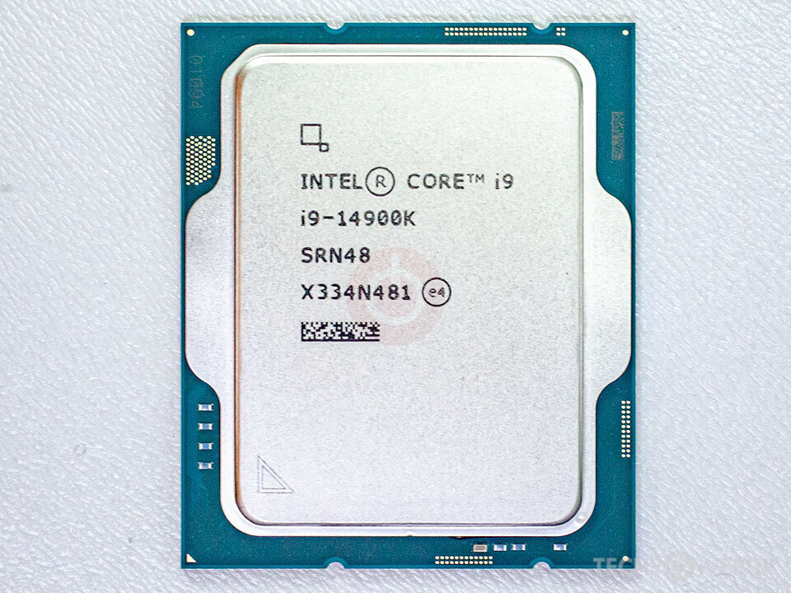
Processor Core Count
The 14900K was Intel’s previous flagship processor
24 Cores
8 Performance and 16 Efficiency Cores
32 Total threads
Cores are connected using a ring bus interconnect
Each core is attached to the ring, with cores making requests through the ring to other parts of the system. The L3 cache appears shared due to this scheme

Slide 3
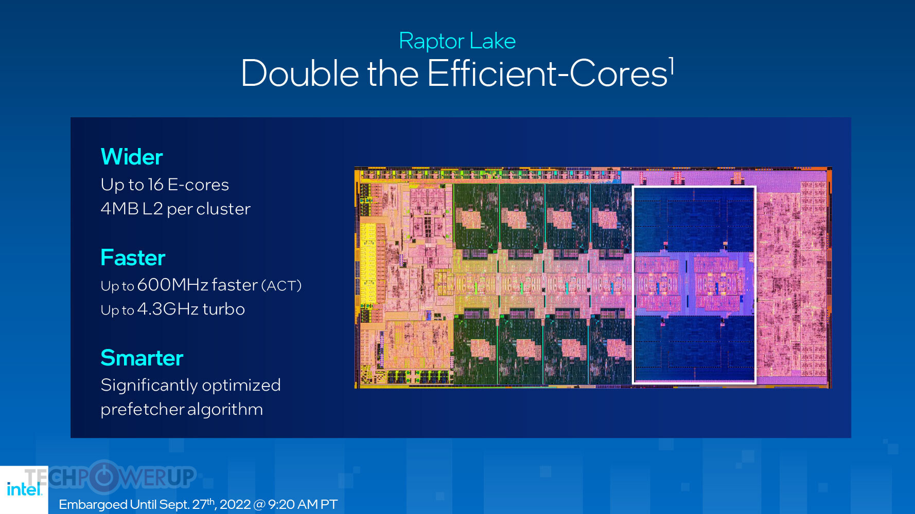
Memory Layout
The 14900K has 36 MB of Intel Smart Cache
L3 Cache shared between all cores
There are 32 MB of L2 cache.
Each P core gets 2 MB each, and E cores are grouped into clusters of 4, with each cluster having 16 MB
L1 Cache is 80 KB per core, Not shared amongst cores The cache line size for all cache levels is 64 bytes

Slide 4
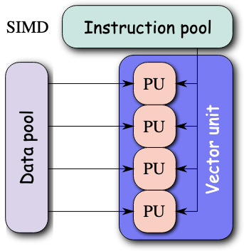
SIMD Capability and Width
The 14900K supports AVX2 with a width of 256 bits.
Other intel processors support AVX-512, but Intel has been phasing this protocol out of their consumer chips, so the 14900K is limited to only AVX2
The 14900K also supports Streaming SIMD Extensions version 4.1 and 4.1, but these are limited to 128 bit instructions and are mainly supported for backwards compatibility.

Slide 5
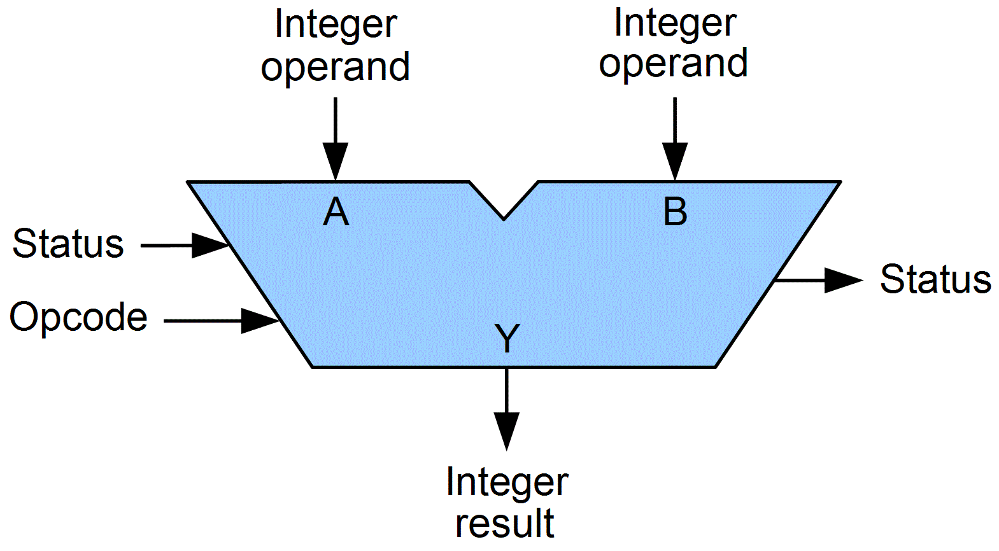
ILP Width and ALU layout
We have info about the previous generation layout from “Alder Lake”, but we have to infer for specifics about “Raptor Lake”
The 14900K has
12 execution ports
5 simple ALUs and 5 ALUs with LEA support
512 entries for a Reorder buffer size
32 bytes per cycle instruction fetch
Since this CPU is newer, some information isn’t publicly available, so we have to make some assumptions based on the previous generation of Intel CPUs

Slide 6
Divergent Execution for SIMD
Intel uses mask registers to enable specific lanes for operations.
The compiler is able to insert SIMD instructions in place of branches to reduce stalls.
This is done by inserting masks and flags for divergent conditions. End result is this still may have a cost on throughput

Slide 7
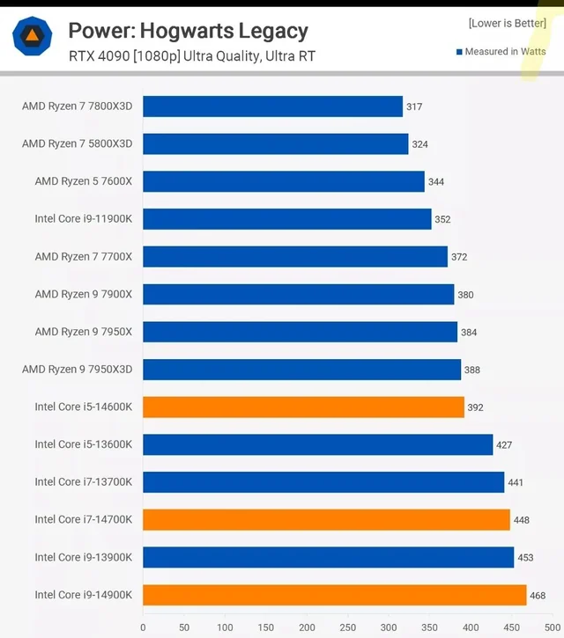
Power Consumption
The Intel 14900K hates your energy bill
Base TDP of 125W
Turbo Power up to 253 W
This is the higher end of TDP limits
High enough that these CPUs were frying themselves (microcode issue)

Slide 8
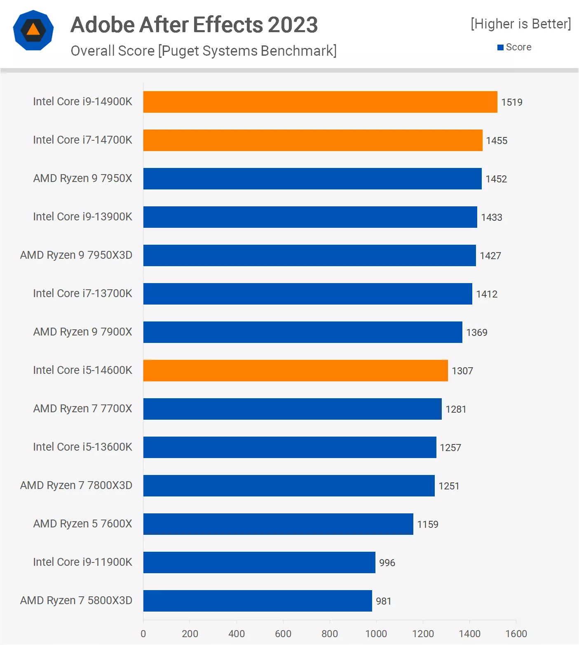
Peak/Average Achievable Performance from SPECs in FLOPs
With AVX2, 256 bit width vectors, 8 pcores at 6 GHz turbo max, a rough estimate for performance is 2 TFLOPs single-precision
When under real conditions with limiting factors (bandwidth, ILP, cache misses), we see about 70-80% of peak performance

Slide 9
Final Analysis
Strengths: High single-thread performance, lots of cores, large L3 cache, high turbo performance
Weaknesses: high power, complex scheduling, limited vector width (no AVX-512), less optimal interconnect for cores

