Slide 1

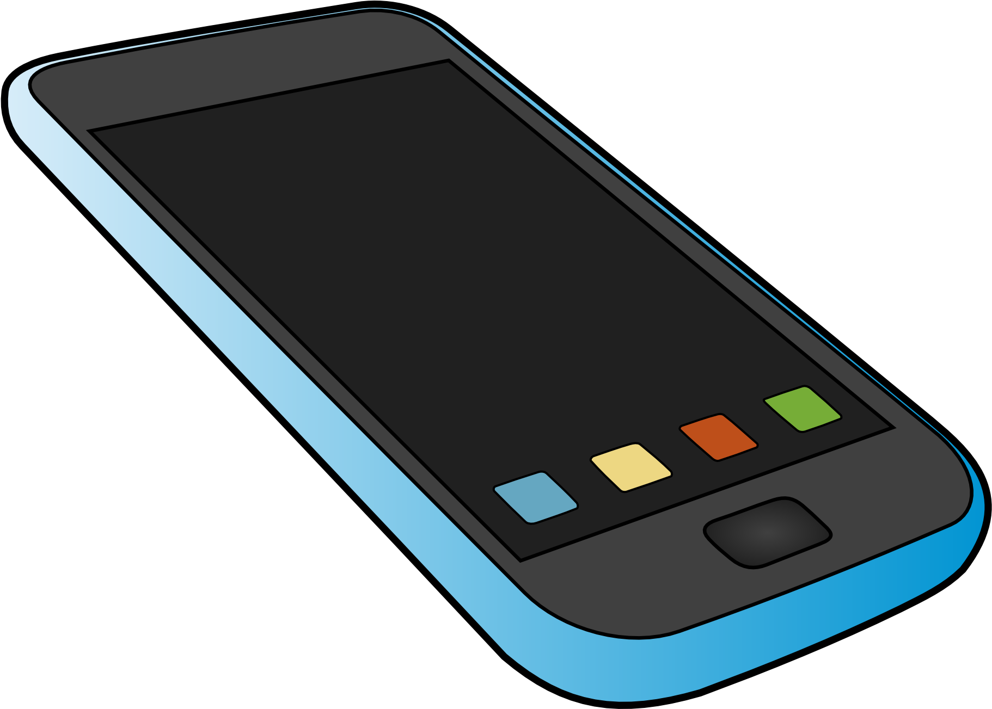
"Silence Your Phones": Smartphone Notifications Increase Inattention and Hyperactivity Symptoms
CEN5728 – Advanced Human Computer Interaction

Slide 2
General Background
While this is nothing new, technology is everywhere
This paper was published in 2016, nearly a decade after the iPhone was first introduced to the market
Accessibility to the internet is never more than a press of a button away, regardless of where you are

Slide 3

Why this topic?
Within the paper, they talked about why this topic is relevant. Across several surveys, they found that smartphone owners use their phones a lot:
95% - Social Gatherings
70% - While Working
10% - During Sex
Estimated that people reach for their phones more than 100 times per day, spending around two hours a day on their phone.
Image courtesy of incimages.com

Slide 4
Topic Background
Why would this be a problem?
Switching tasks takes a lot of effort, perhaps even more effort than it takes to complete a task
According to the “load theory of attention” the higher our cognitive load, the easier we are to distract
Digital interruptions have been associated with “feeling more distracted, stressed, and anxious”.

Slide 5
The Study
Recruited a sample of university students:
Assessed their individual differences relating to inattention and hyperactivity, while measuring how often they felt interrupted by their cellphones
Correlated cellphone interruptions with these symptoms
Since ADHD is associated with poorer performance and social anxiety, they also included measures of productivity and mental well-being.

Slide 6
The Study
Daily Surveys
How often did they feel interrupted?
Longer Weekly Survey
Contained main variables and measures

Slide 7
Measures
Smartphone interruptions
Ordinal (0-6)
14 Different Daily Activities
Inattention and Hyperactivity
Ordinal (1-4)
18 Symptoms
Productivity
Three question self-report based on previous research
Psychological Well-Being
Based on Ryff’s six components of psychological well-being
This measure alone is based on a ton of previous research, which could be an entire presentation in and of itself

Slide 8
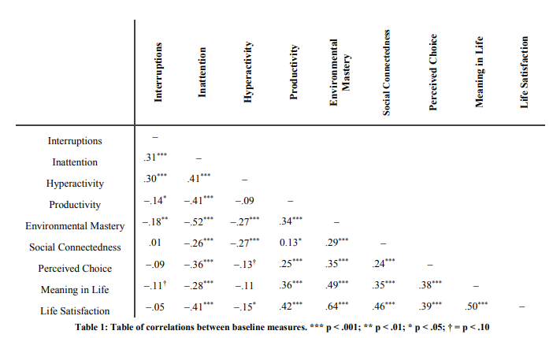
Correlations between baseline measures

Slide 9
Analysis
In order to analyze results, they had participants:
Give a baseline of inattention and hyperactivity
Spend time both maximizing and minimizing their interruptions
At baseline, participants who reported more interruptions had a higher level of both inattention and hyperactivity

Slide 10
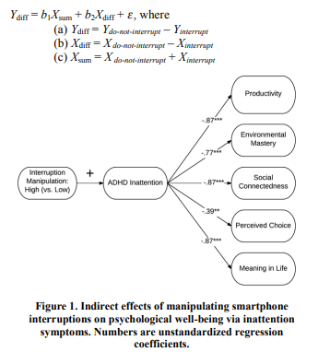
Regression Diagram – Indirect Effects
We can see that all dependent variables listed here have an extremely high level of significance, with all but one having a p-value of less than 0.001

Slide 11

Questions?

Slide 12
Work Cited
Kostadin Kushlev, Jason Proulx, and Elizabeth W. Dunn. 2016. "Silence Your Phones": Smartphone Notifications Increase Inattention and Hyperactivity Symptoms. In Proceedings of the 2016 CHI Conference on Human Factors in Computing Systems (CHI '16). Association for Computing Machinery, New York, NY, USA, 1011–1020.
DOI: https://doi-org.flpoly-proxy.flvc.org/10.1145/2858036.2858359
Accessed from the Florida Poly Library

