Slide 1

System Requirements,
Organizational Contexts, and
Information Infrastructure
Christine L. Borgman
Phil Agre
IS 282, Information Systems Analysis & Design
Winter, 2007

Slide 2
Background reading
Syllabus:
  Stewart Brand, How Buildings Learn: What Happens after They're Built, New York: Viking, 1994. Chapter 10: Function Melts Form: Satisficing Home and Office.
  Batya Friedman and Helen Nissenbaum, Bias in computer systems, ACM Transactions on Information Systems 14(3), 1996, pages 330-347.
  Roger Montgomery, Architecture invents new people, in Russell Ellis and Dana Cuff, eds, Architects' People, New York: Oxford University Press, 1989.
  Donald A. Schon, The Reflective Practitioner: How Professionals Think in Action, New York: Basic Books, 1983. Chapter 3: Design as a Reflective Conversation with the Situation.
  Pelle Ehn on Participatory Design
Requirements documents:
  UCLA Library Request for Proposals
  UCLA Taskforce Report on Common Collaboration and Learning Environment Initiative
Notes:
Requirements documents:UCLA Library Request for Proposals-read the requirements and priorities closely
http://staff.library.ucla.edu/groups/otng/RFP.doc
UCLA Taskforce Report on Common Collaboration and Learning Environment Initiative:- Joint report to the FCET (33 pages)- Assessment task force report (96 pages) - look closely at the discriminating and non-discriminating factors between Moodle and Sakai, the method, and the executive summary (a UCLA signon is required for access to this report - that's your BOL account that you use for URSA/MY.UCLA).http://www.oit.ucla.edu/ccle/

Slide 3
Overview
Requirements
  Definitions
  Approaches
Organizational Issues
  Context
  Scope, definitions
  Technology and strategy
  Stakeholders
  Information gathering
Information infrastructure

Slide 4
Requirements:
What’s in a name?
Requirements
Needs
Preferences
Priorities
Essential features
Goals

Slide 5
Requirements Analysis
Systems Development Life Cycle
Participatory Design
Notes:
Discuss as complementary / competing approaches

Slide 6
Systems Development Life Cycle
Problem statement
Analysis
Requirements
Design
Develop
Test
Validate
Implement
Notes:
Discuss straight sequencing of this approach; problems with it, lack of iteration
Why still used? Often to purchase systems. Look at first part of RFP

Slide 7
RFP: formal bids-1
Develop RFP
  Detailed set of requirements
  Specify what the system must do, not how it must do it
  Consider data requirements and interoperability
Issue request for proposal (legally binding)
Determine evaluation plan
Notes:
Extremely over simplified process…
add lots of detail in the discussion

Slide 8
UCLA Library
Request for Proposals
General Conditions
Technical and service requirements
  Functional specifications
  Technology and database specifications
  Vendor specifications
Cost proposal
Notes:
Discuss how this works, how binding

Slide 9
UCLA Library
Request for Proposals
As information for the bidder, the checklist includes a priority for each selected characteristic, using the following terms:
  Crucial Will have a significant and broad impact on user service and staff productivity. Bidders should provide as much information as possible about crucial items
  Highly desirable Will have an important impact on user service and/or staff productivity, for a large number of users or staff
  Desirable Will have a noticeable impact on user service or staff productivity for at least a subset of users or staff
In the checklist, bidders are asked to identify the status of each element in the list according to the following codes:
    ﾘWK (Working) indicates a working implementation that is in use by existing customers
    ﾘTS (In Test) indicates a feature that has been developed and is in test prior to production release.
    ﾘDV (In Development) indicates a feature that is in the development queue, with an expected implementation date.
    ﾘWIC (Willing to Include in Contract) indicates a feature that is not yet in development but is something the Bidder is willing to include in the contract as a deliverable.
    For anything coded as TS or DV, an expected release date should be entered in the "Date" column.
Notes:
Discuss how this works, how binding

Slide 10
RFP: formal bids-2
Receive proposals
Evaluate proposals
  Points awarded
  Demos by vendors (if major contract)
Select vendor
  Negotiate terms and conditions
  Award contract
Notes:
Extremely over simplified process…
add lots of detail in the discussion

Slide 11
UCLA Common Collaboration and Learning Environment
Minimum computing, communications, equipment, and software needs
Capabilities
Tools
Services and assistance
Notes:
Discuss from paper copies -- having difficulty copying into ppt

Slide 12
Moodle and Sakai Assessment for CCLE
Overall impressions of each
Pros/benefits
Cons/risks
To select Moodle, we should believe…
To select Sakai, we should believe…

Slide 13
Moodle and Sakai Assessment for CCLE
Technical discriminators between systems
  Maturity
  Sharing course content
  Large research university community
  Admistrative statistics
  Time to develop new functionality
  Framework for campus integration

Slide 14
Moodle and Sakai Assessment for CCLE
Functional discriminators between systems
  Ease of use
  Accessibilty
  Quiz tool
  Gradebook
  Discussion board
  Documentation
  Customizing site page
  Direct link to site
  Roles and permissions
  Extended language support
  Email from outside the site

Slide 15
Moodle and Sakai Assessment for CCLE
Non-discriminators between systems
  Technical
  Functional
Detailed technical analysis of each system
Detailed functional analysis of each system

Slide 16

Designing for Usability
Gould & Lewis, 1983
Four principles
  Understand who the users will be
  A panel of users should work closely with the design team in early stages
  Real users should test simulations with real work, early in the design process
  Design must be iterative, with user testing that leads to corrections and improvements

Slide 17
Designing for Usability
Gould & Lewis, 1983
Survey of designers
  Number of these 4 principles mentioned in interviews:
    None: 26%
    One: 35%
    Two: 24%
    Three: 14%
    Four: 2%
  Features mentioned:
    Understand who the users will be: 62%
    Interactive design: 9%
    Early tests with users: 40%
    Iterative design: 20%
Notes:
Roll out

Slide 18
Organizational Issues
Context
Scope, definitions
Technology and strategy
Stakeholders
Information gathering
Notes:
Phil’s notes here; discuss Pelle Ehn in this context; participatory design

Slide 19

Infrastructure
Social construct
Policy construct
Technology construct
Integrated social, policy, technology construct

Slide 20
Social definition of infrastructure-1
(Star & Ruhleder, 1996)
An infrastructure is embedded in other structures, social arrangements, and technologies.
It is transparent, in that it invisibly supports tasks.
Its reach or scope may be spatial or temporal, in that it reaches beyond a single event or a single site of practice.
Infrastructure is learned as part of membership of an organization or group.
Notes:
First use trains and train stations (david lee conversation etc), then
Use CCLE environments and changing nature as example -- draw out from them.

Slide 21
Social definition of infrastructure-2
(Star & Ruhleder, 1996)
It is linked with conventions of practice of day to day work.
Infrastructure is the embodiment of standards, so that other tools and infrastructures can interconnect in a standardized way.
It builds upon an installed base, inheriting both strengths and limitations from that base.
Infrastructure becomes visible upon breakdown, in that we are most aware of it when it fails to work -- when the server is down, the electrical power grid fails, or the highway bridge collapses.
Notes:
Linked with conventions of practice - mtgs in London vs washington dc
Embodiment of stds - railtracks, luggage sizes for planes and trains
Installed base - extensive network, but hard to chaange - esp track gauge
Visible upon breakdown - floods took out UK trains;
sept 11 - suddenly nothing worked.

Slide 22
Infrastructure: distributions along technical/social & global/local axes
diagram courtesy of Florence Millerand & Geoffrey Bowker

Slide 23
Information infrastructure: technical framework
U.S. National Research Council, 1994:
  Information infrastructure is “a framework in which communications networks support higher-level services for human communication and access to information. Such an infrastructure has an architectural aspect -- a structure and design -- that is manifested in standard interfaces and in standard objects (voice, video, files, e-mail, and so on) transmitted over the interfaces.”
Notes:
Segue to INFORMATION infra
At least 3 types of info infra

Slide 24
Cyberinfrastructure
IT-based infrastructure: “a set of functions, capabilities, and/or services that make it easier, quicker, and less expensive to develop, provision, and operate a relatively broad range of applications. This can include facilities, software, tools, documentation, and associated human support organizations.”
U.S. National Science Foundation, Blue Ribbon Panel on Cyberinfrastructure
Notes:
Second issue -- think about the infra for delivering and using DLS. First, infra, new models. Then DL infra (next slide).
Infrastructure is another of those fuzzy terms; more discussion in the paper
Framework that supports systems and services. This is a good simple definition for the present purposes. Particular given goal of report to redefine US infra for higher education

Slide 25
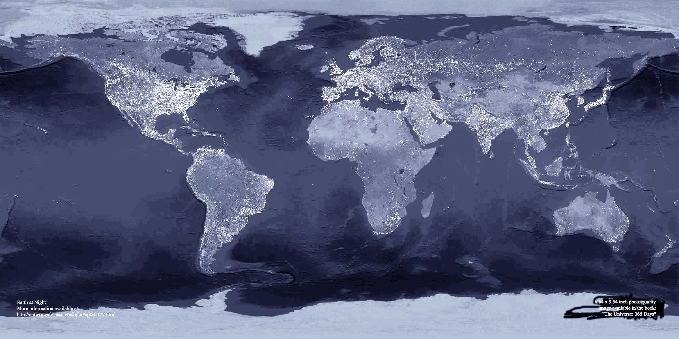
e-Science infrastructure: Layered Model
Applications
Space
Content
Digital Libraries
User
Interfaces &
Tools
Scientific DBs
Information & knowledge layer
Middleware
services layer
ITC Infrastructure
Processors, memory, network
Slide courtesy of Stephen Griffin, NSF, and Norman Wiseman, JISC

Slide 26
Information infrastructure:
Public policy
National Information Infrastructure
  Intelligent network of telecommunications
  Funding and policy framework
    Public support for research and education
    Encourage private sector investment
Global Information Infrastructure (Group of 7 Nations)
  Promoting competition
  Providing open access to networks
  Promoting interconnectivity and interoperability
Notes:
Commercial nature of NII/GII
Emphasis on service providins
Open access - any one can provide services (does not mean free of cost)

Slide 27
Information infrastructure:
Technology, people, content
U.S. NII Agenda for Action, 1993:
    an NII encompasses the nation’s networks, computers, software, information resources, developers, and producers.
Notes:
This is one of few II stmts that mentions content
Doesn’t ‘say much about insitutions, certainly not about libs
But is a good summary of info infra - use this as summary and segue slide
ref Cyberinfra (and later)

Slide 28
Summary
Requirements
  Definitions
  Approaches
Organizational Issues
  Context
  Scope, definitions
  Technology and strategy
  Stakeholders
  Information gathering
Information infrastructure

Slide 29
Fieldwork assignment
Signups with Phil; cb schedule for Tuesday
Review of assignment
(1) Go someplace interesting. Bring a cell phone. Spend maybe a half-hour noting what information issues are going on there. Identify all of the information resources that people are using. Talk to the people if you can. What questions do they have? How do the information issues relate to the larger structure of their lives? What kinds of futuristic information services would be useful to them? It's okay to go someplace where you already know the people, but don't go to a place that is highly familiar to you.
(2) While you're still there in the place, call Phil or Christine on your cell phone. (We'll have a schedule to sign up for a time slot for this.) Try out your ideas. Maybe Phil or Christine has some ideas. Brainstorm.
(3) Resume your work in the place. Dream up more information services. Talk to people about them if you can. Document all of the important issues.
(4) In class on January 29th, we will divide the available time among everyone in class. Assuming that twenty people take the class, that will be ten minutes each. Spend exactly five minutes telling everyone where you went, what's going on with information there, what the people said, and what the important issues were. Then spend exactly one minute telling everyone your best idea for a futuristic information service. Use whatever media convey the ideas best. Phil or Christine will offer a two-minute (uncritical) commentary on your ideas, and then will lead a two-minute discussion.
(5) Write a 400-word summary of your ideas that we can include in a publication about "pervasive information services". Put it on a Web page in HTML format and e-mail the URL to Phil by February 5th.
The goal here is to build a culture of design thinking in the group. At this stage, therefore, creativity is more important than practicality. The best ideas will pioneer whole new dimensions of information services design.

Slide 30
Presentations next week
Ten minutes each
  Spend exactly five minutes telling everyone where you went, what's going on with information there, what the people said, and what the important issues were.
  Then spend exactly one minute telling everyone your best idea for a futuristic information service. Use whatever media convey the ideas best.
  Phil or Christine will offer a two-minute (uncritical) commentary on your ideas, and then will lead a two-minute discussion.
Use of computer for displays
  Macintosh available
  Load onto machine PRIOR TO START OF CLASS

