Slide 1
http://bar.utoronto.ca/efp_grape/cgi-bin/efpWeb.cgi

Slide 2
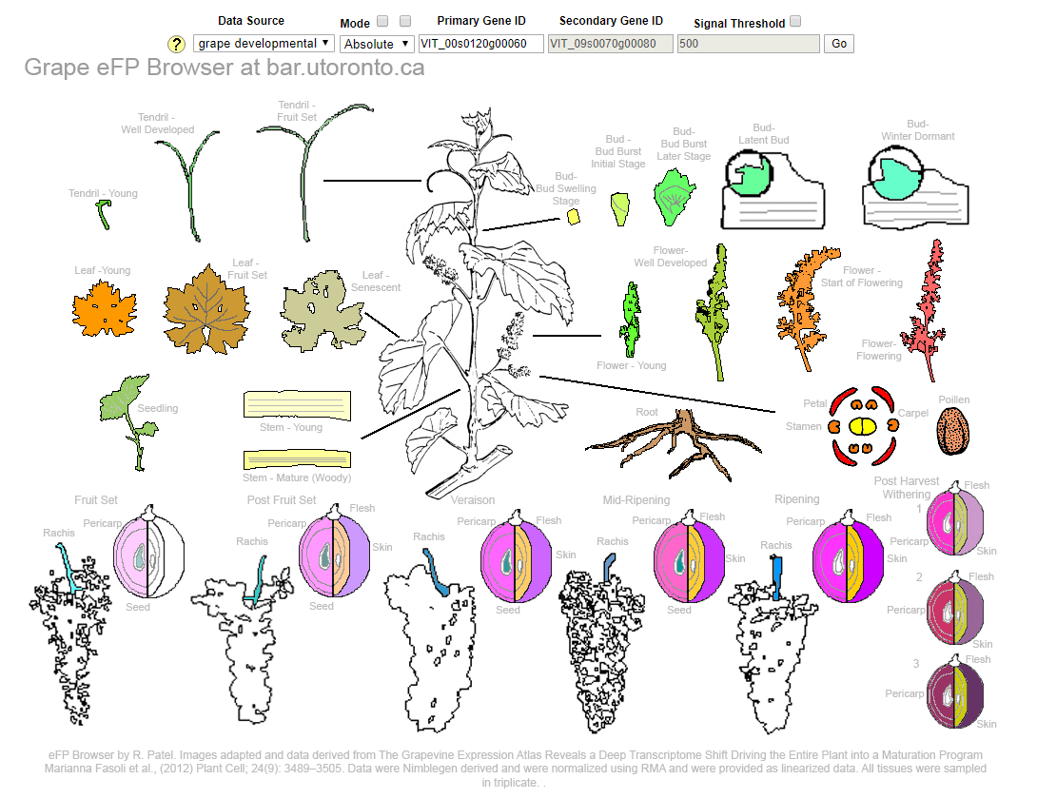

Slide 3
https://www.sdstate.edu/agronomy-horticulture-plant-science/functional-genomics-bud-endodormancy-induction-grapevines

Slide 4
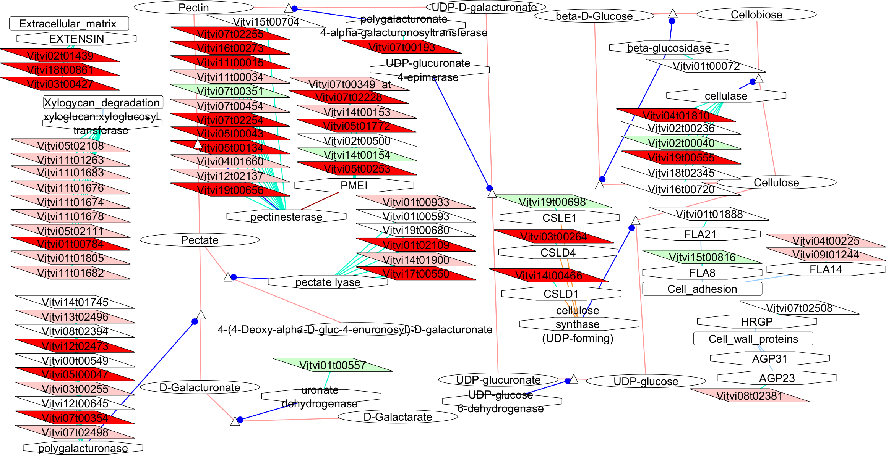

Slide 5
