Slide 1

What is Galaxy?
From Galaxy training
https://galaxyproject.github.io/training-material/

Slide 2

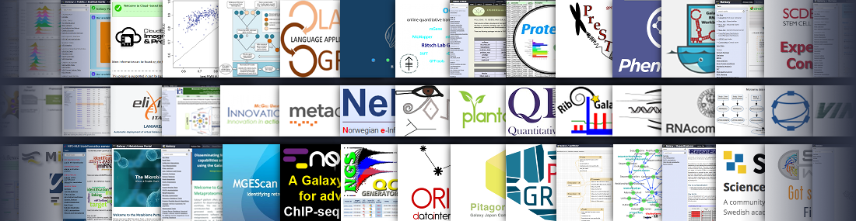
Data Intensive analysis for everyone
Versatile and reproducible workflows
Web platform
Open source under Academic Free License
Developed at Penn State, Johns Hopkins, OHSU and Cleveland Clinic with substantial outside contributions

Slide 3
Core values
Accessibility
Users without programming experience can easily upload/retrieve data, run complex tools and workflows, and visualize data
Reproducibility
Galaxy captures information so that any user can understand and repeat a complete computational analysis
Transparency
Users can share or publish their analyses (histories, workflows, visualizations)
Pages: online Methods for your paper

Slide 4
Galaxy growth
More than 7,000 ready to use tools for users
More than 7,500 citations
More than 350 public Galaxy resources
120+ public servers, many more non-public
Both general-purpose and domain-specific

Slide 5
User Interface

Slide 6
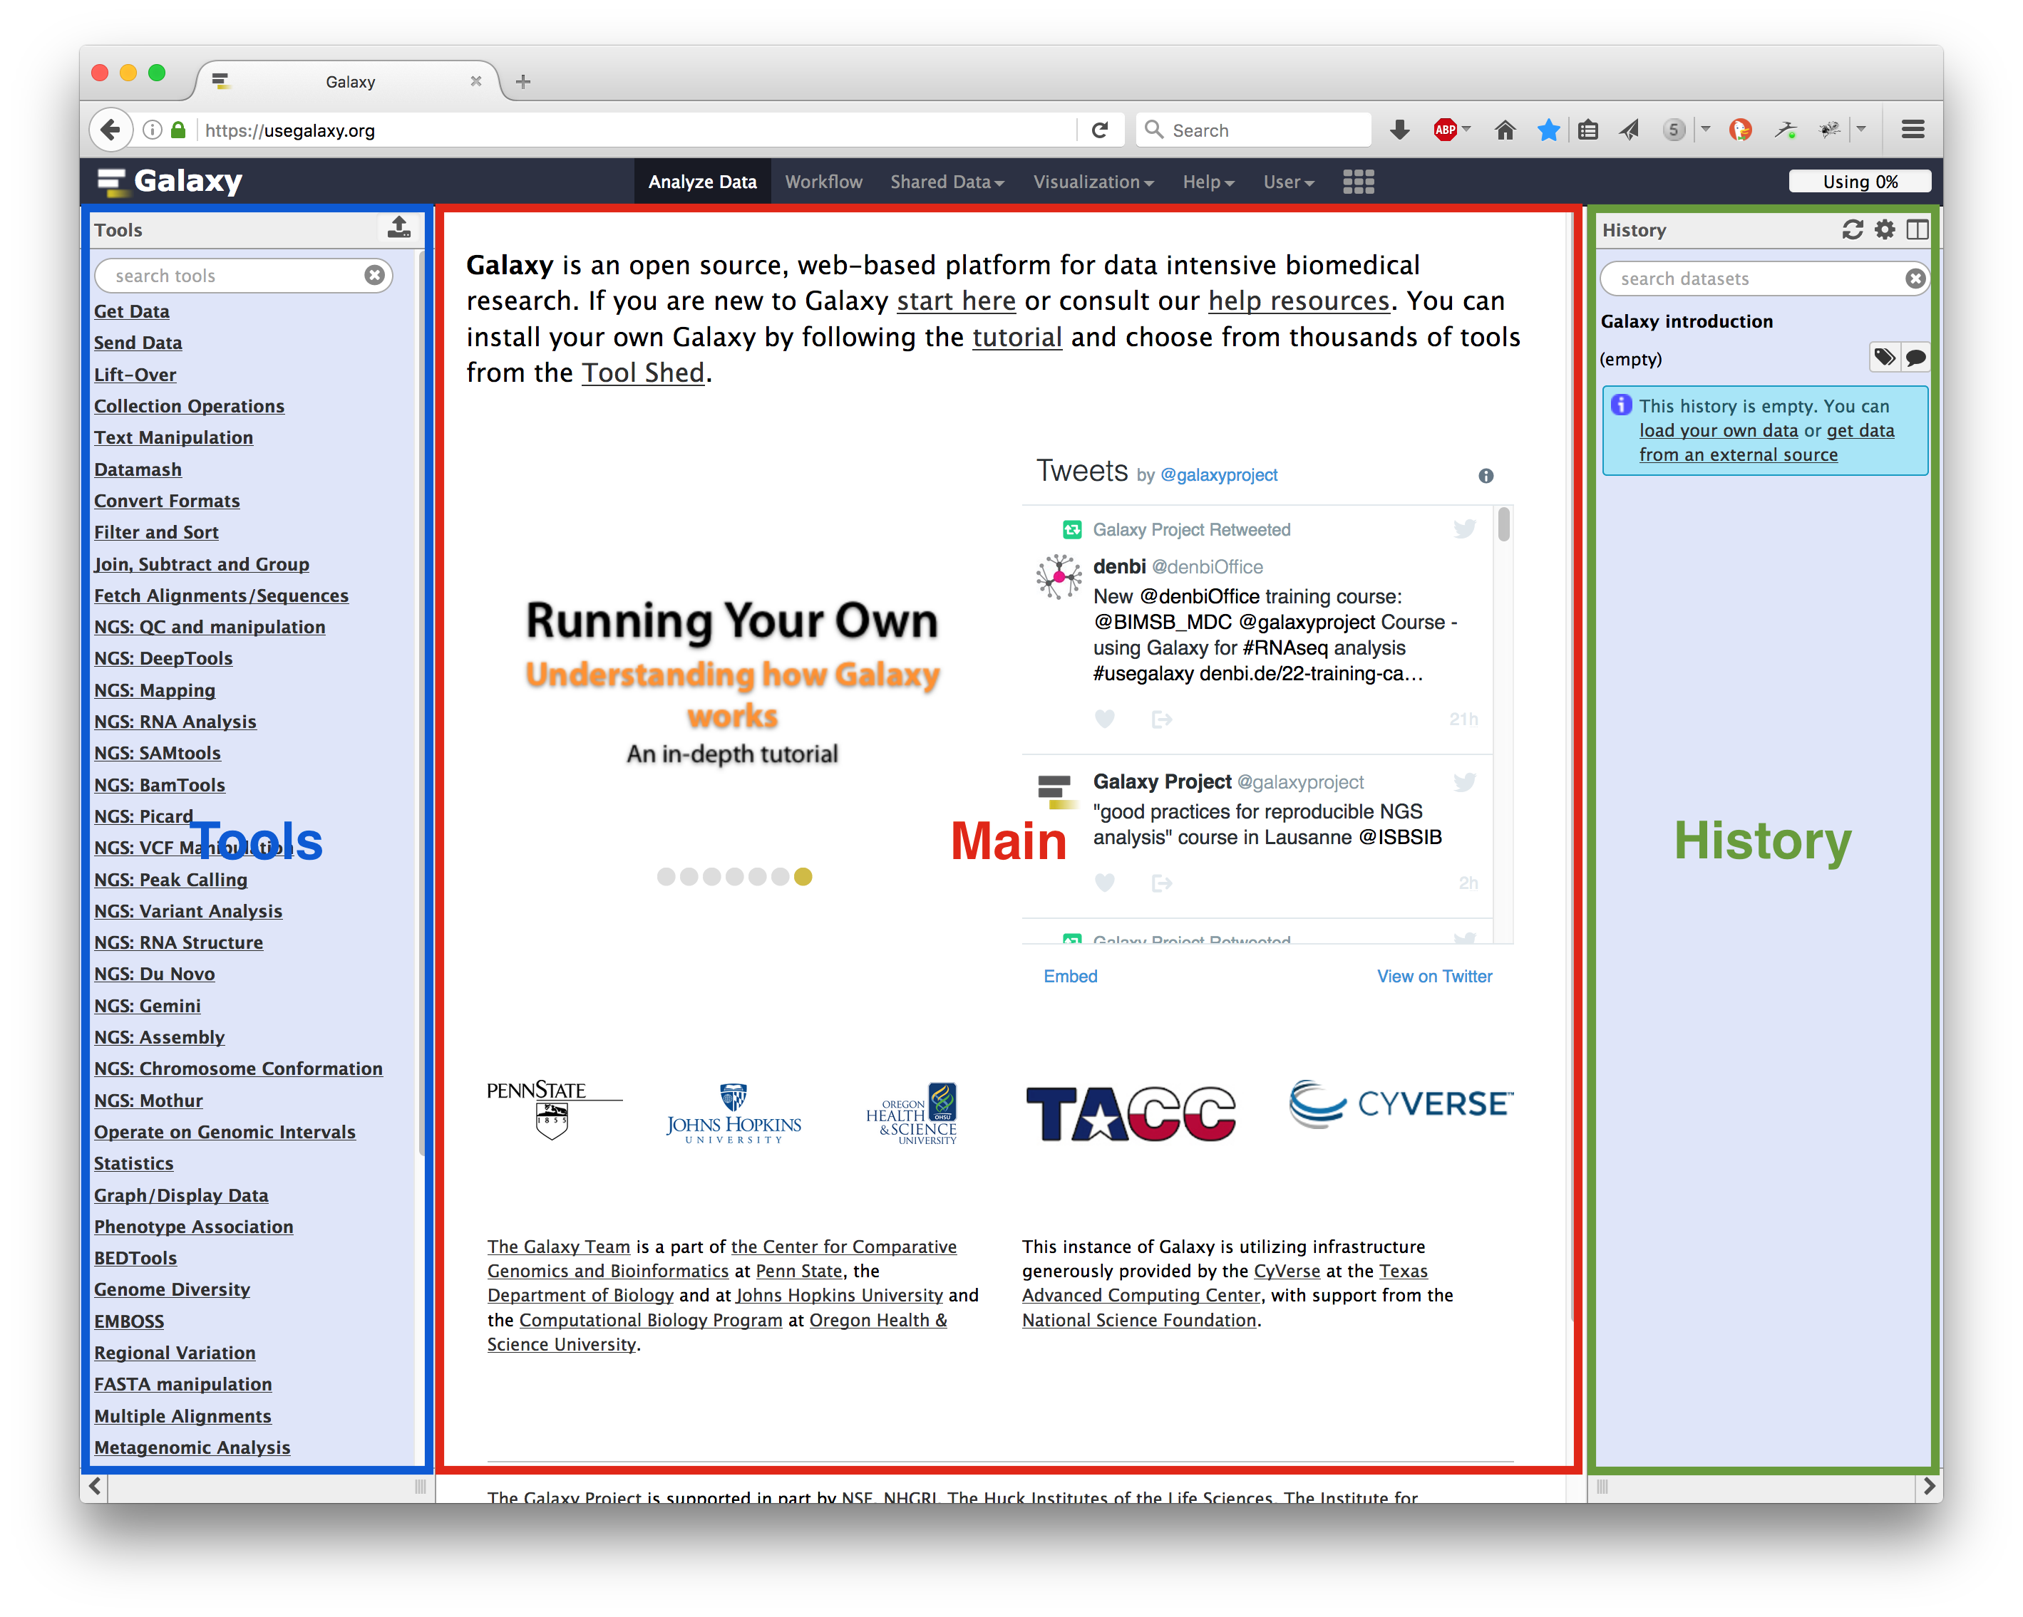
Main Galaxy interface
Home page divided into 3 panels

Slide 7
Top menu
Link | Usage
Analyze Data | go back to the homepage
Workflow | access existing workflows or create new one using the editable diagrammatic pipeline
Visualize | create new visualisations and launch Interactive Environments
Shared data | access data libraries, histories, workflows, visualizations and pages shared with you
Help | links to Galaxy Help Forum (Q&A), Galaxy Community Hub (Wiki), and Interactive Tours
User | your preferences and saved histories, datasets, pages and visualizations

Slide 8
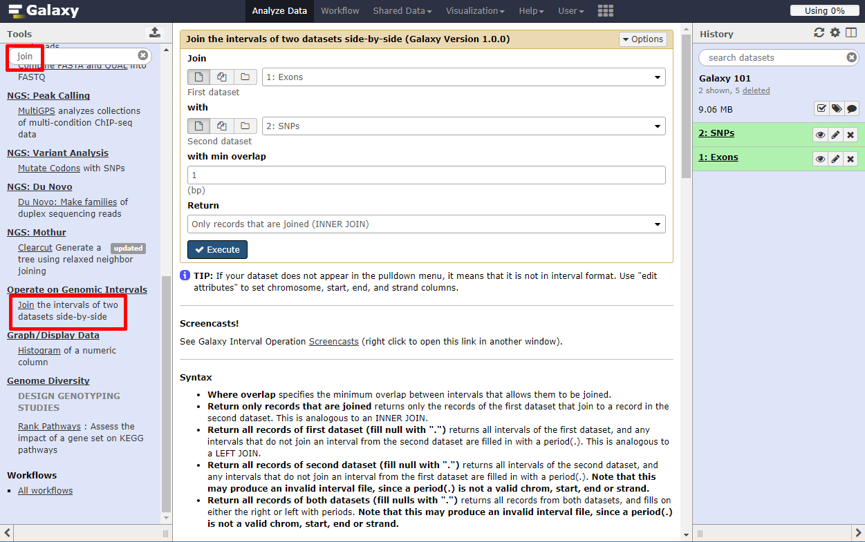
Tools
The tool search helps in finding a tool in a crowded toolbox

Slide 9
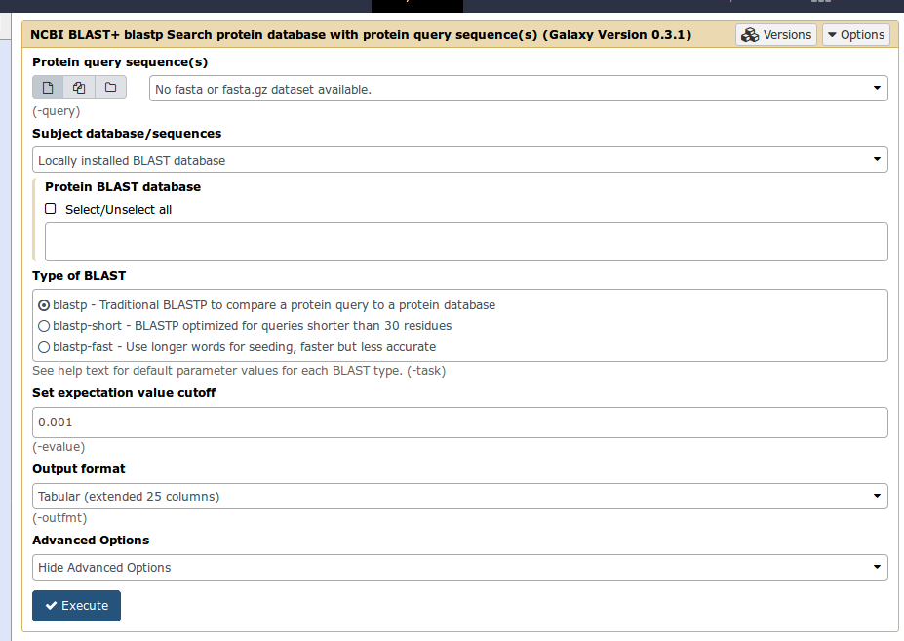
Tool interface
A tool form contains:
input datasets and parameters
help, citations, metadata
an Execute button to start a job, which will add some output datasets to the history
New tool versions can be installed without removing old ones to ensure reproducibility

Slide 10
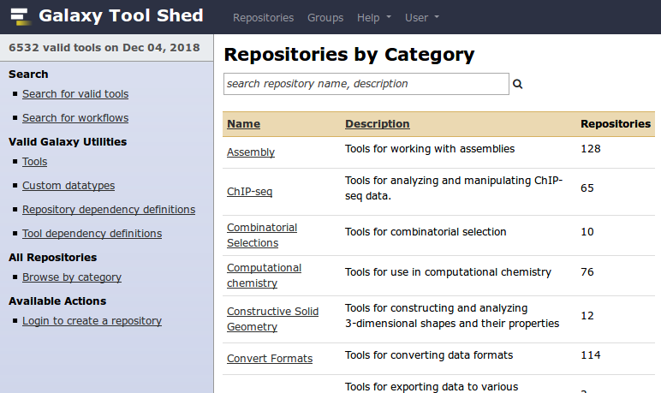
Tool Shed
Free "app" store: Galaxy Tool Shed
Thousands of tools already available
Most software can be integrated
If a tool is not available, ask the Galaxy community for help!
Only a Galaxy admin can install tools

Slide 11
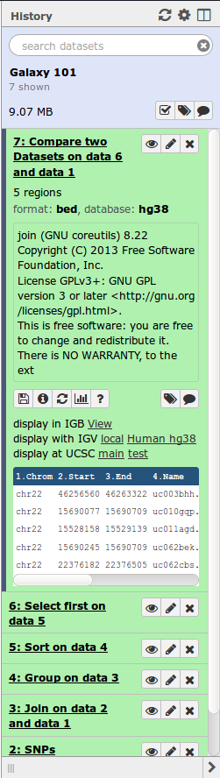
History
Location of all analyses
collects all datasets produced by tools
collects all operations performed on the data
For each dataset (the heart of Galaxy’s reproducibility), the history tracks
name, format, size, creation time, datatype-specific metadata
tool id, version, inputs, parameters
standard output (stdout) and error (stderr)
state (waiting, running, success, failed)
hidden, deleted, purged

Slide 12
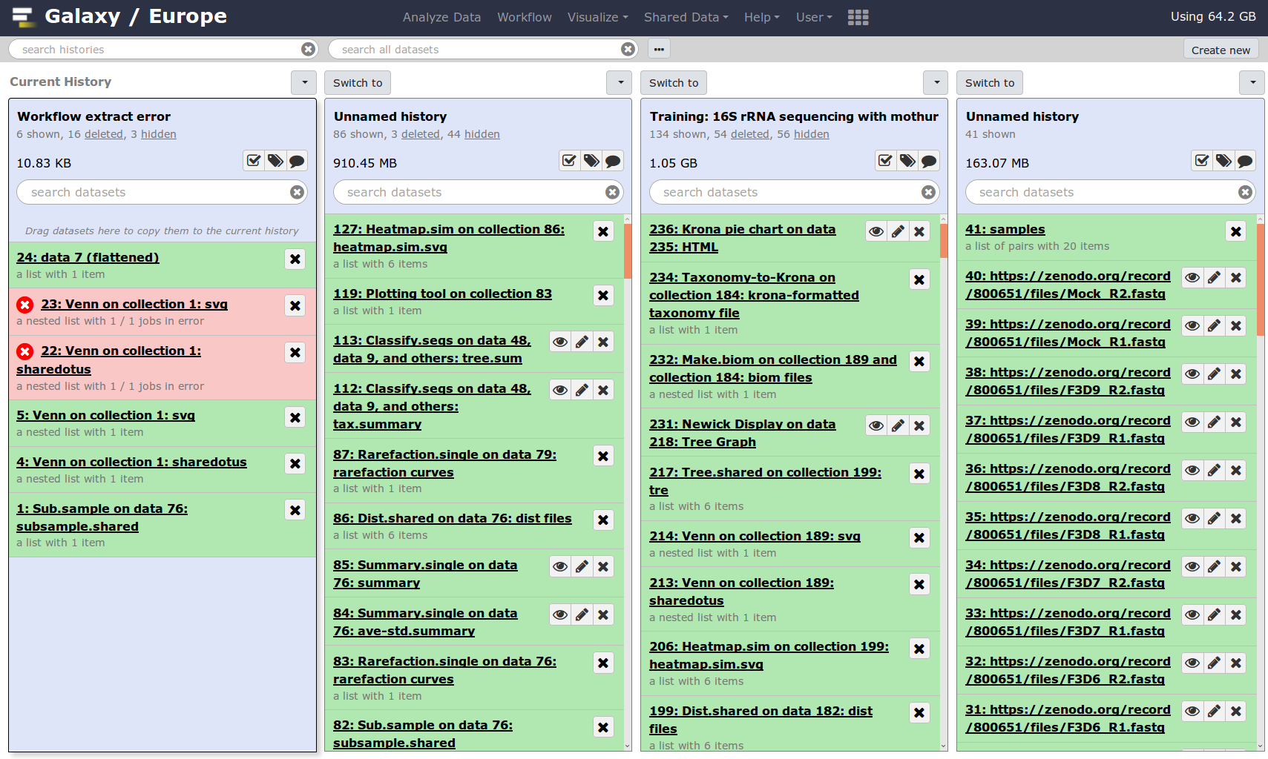
Multiple histories
You can have as many histories as you want
each history should correspond to a different analysis
and should have a meaningful name

Slide 13
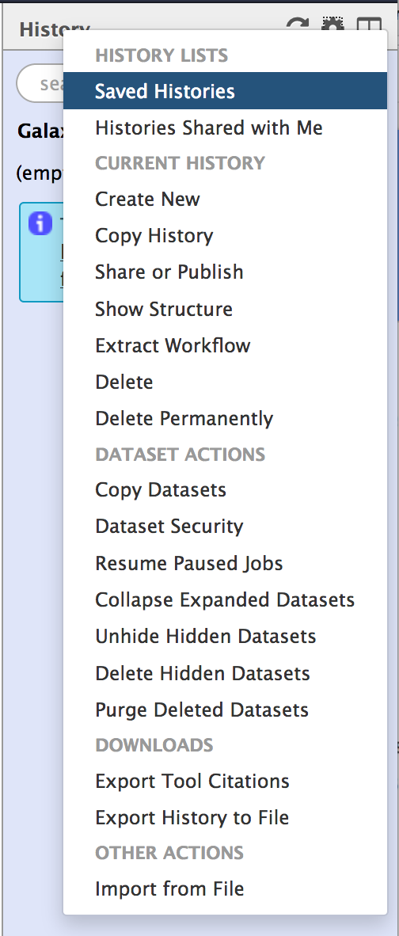
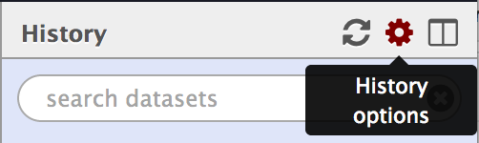
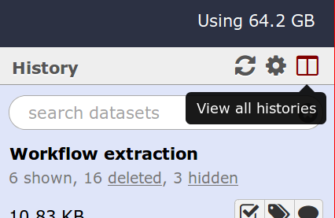
History options menu
History behavior is controlled by the History options (gear icon)
Create New history will not make your current history disappear
To see all of your histories, use the history switcher
Copy Datasets from one history to another and save disk space for your quota

Slide 14
Loading data

Slide 15
Importing data
Copy/paste from a file
Upload data from a local computer
Upload data from internet using URL
Upload data from online databases: UCSC, BioMart, ENCODE, modENCODE, Flymine etc.
Import from Shared Data (libraries, histories, pages)
Upload data from FTP
See Getting data into Galaxy

Slide 16
Datatypes
Tools only accept input datasets with the appropriate datatypes
When uploading a dataset, its datatype can be either:
automatically detected
assigned by user
Dataset produced by a tool: datatype assigned by the tool
To change the datatype of a dataset:
galaxy-pencil Edit Attributes and Datatype
galaxy-pencil Edit Attributes and Convert Formats

Slide 17
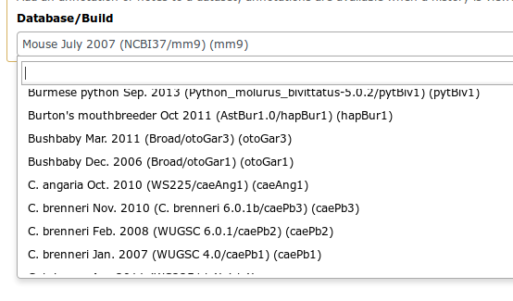
Reference datasets
Example: reference Genome
Genome build specifies which genome assembly a dataset is associated with
e.g. mm10, hg38...
Can be automatically detected or assigned by user
Users can create custom genome builds
New builds can be added by the admin

Slide 18
Workflows

Slide 19
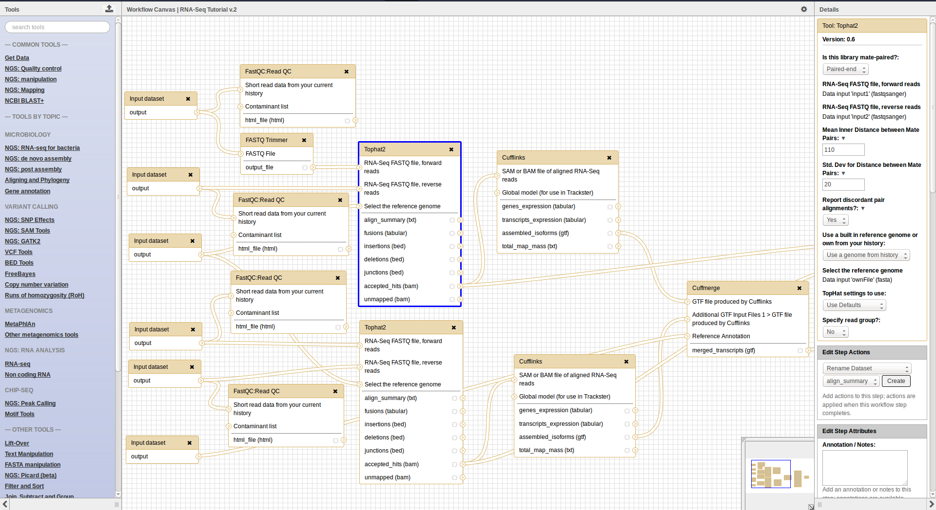
Workflow Editor
Extracted from a history
Built manually by adding and configuring tools using the canvas
Imported using an existing shared workflow

Slide 20
Why would you want to create workflows?
Re-run the same analysis on different input data sets
Change parameters before re-running a similar analysis
Make use of the workflow job scheduling
jobs are submitted as soon as their inputs are ready
Create sub-workflows: a workflow inside another workflow
Share workflows for publication and with the community

Slide 21
Sharing data
Share everything you do in Galaxy - histories, workflows, and visualizations
Directly using a Galaxy account's email addresses on the same instance
Using a web link, with anyone who knows the link
Using a web link and publishing it to make it accessible to everyone from the Shared Data menu

Slide 22
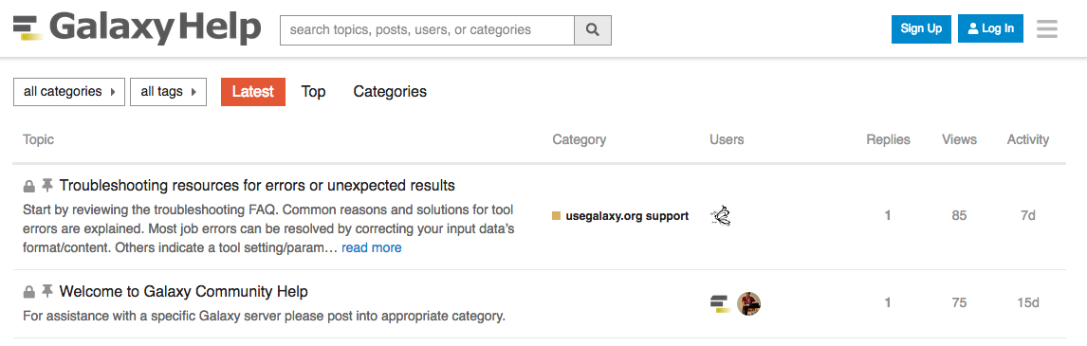
Community
Support forum: Galaxy Help
Community curated documentation: Galaxy Community Hub
Events all around the world
Galaxy Training for scientists, developers, admins, instructors: Galaxy Training Community
Training questions? Chat with us on Gitter

Slide 23
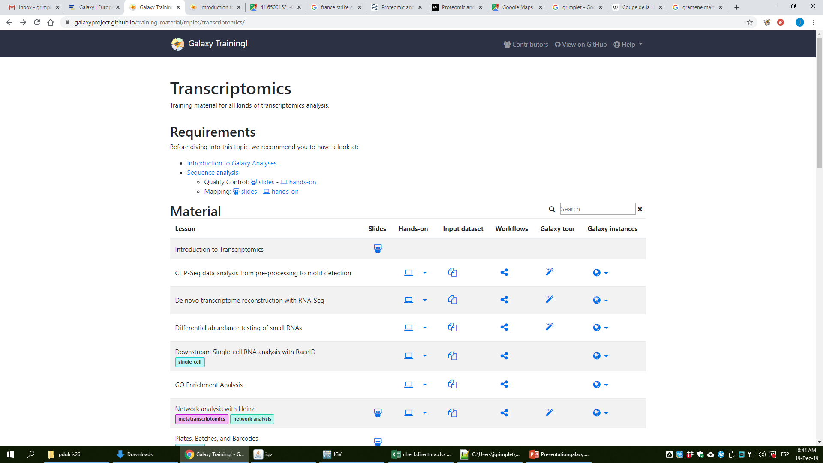

Slide 24
-creating an account
https://usegalaxy.eu/

