Slide 1

Protect your Future Publications: Reproducibility Through Data Management Plans - Compliance and Security

Slide 2
CCSS Research Support Code of Conduct
The Cornell Center for Social Sciences provides a welcoming environment for everyone embracing all backgrounds or identities. All instructors and attendees agree to abide by our community norms. We encourage the following behaviors in our workshops:
Respect differing viewpoints and ideas
Share your own perspectives and ask any questions
Accept constructive criticism
Use welcoming and inclusive language
Show courtesy and respect for all instructors and attendees
If you believe that an instructor or attendee has violated the code of conduct, please report the violation to CCSS-ResearchSupport@cornell.edu. We take all reported incidents seriously.

Slide 3
Land Acknowledgement
Cornell University is located on the traditional homelands of the Gayogo̱ hó꞉nǫ' (the Cayuga Nation). The Gayogo̱ hó꞉nǫ' are members of the Haudenosaunee Confederacy, an alliance of six sovereign Nations with a historic and contemporary presence on this land. The Confederacy precedes the establishment of Cornell University, New York state, and the United States of America. We acknowledge the painful history of Gayogo̱ hó꞉nǫ' dispossession, and honor the ongoing connection of Gayogo̱ hó꞉nǫ' people, past and present, to these lands and waters.
Here are additional links for more on the history of Cornell’s violent, colonial formation, the movement to return native lands, and about the AIISP program at Cornell.
Consider donating to the Gayogo̱ hó꞉nǫʼ sovereignty initiative here.

Slide 4
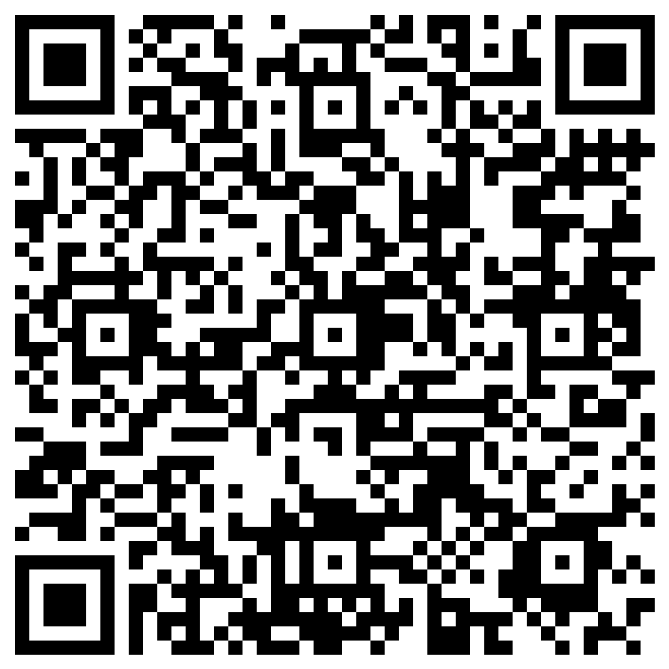
Attendance
Notes:
Before we begin, please scan the QR code above so we can record your attendance.

Slide 5
Outline
Provide an overview of what a DM(S)P is and why it is important
Advertise services provided by CCSS in support of DM(S)P and Reproducibility
Support provided by other units on campus such as the RDMSG
Notes:
Before I begin, let me acknowledge my Fellow Consultant at RDMSG, Sarah J. Wright, who created some of the slides I am using here today, which RDMSG uses for our outreach to the research community. Sarah is the Research Data and Life Sciences Librarian here at Cornell.

Slide 6
What data management IS:
(v.) Action that contributes to effective storage, preservation and use of data and documentation throughout the research lifecycle

Slide 7
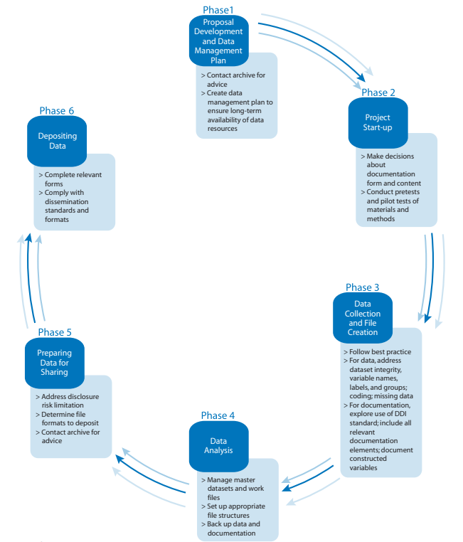
Source: https://www.icpsr.umich.edu/files/deposit/dataprep.pdf
Notes:
It means that you begin thinking about managing your research data during the proposal development stage, and applying best practices at various phases of the research and data lifecycle. Applying best practices at each phase of the research lifecycle will make it simple to prepare your data and relevant document for sharing later. Avoid organizing your data and documentation at a later stage. It will make the task so daunting.

Slide 8
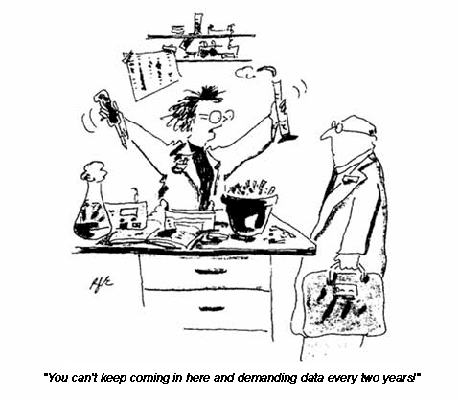
Why good data management practices are important
Reproducibility (Journals)
Recognition (Researchers)
Reuse (Funders)

Slide 9
What is a data management (and sharing) plan (DMSP/DMP)?
In the context of research funders, a DM(S)P is a document outlining a strategy for security, storage, preservation and sharing (reuse) of data related to a specific project.
Notes:
Formal document (but not fixed!)
Outlines what you will do with your data during and after you complete your research
Ensures your data is safe for the present and the future

Slide 10
Who requires a DMP-like document with a proposal?
Key Cornell Funders
Other Funders/More Information
NSF ☑ DMP
NIH ☑ Data Management and Sharing Plan
USDA/NIFA/ARS ☑ DMP
NOAA ☑ DMP
NASA ☑ DMP
USGS ☑ DMP
DOE ☑ DMP
CCSS
Gordon and Betty Moore Foundation
Gulf of Mexico Research Institute
IMLS
NEH/Office of Digital Humanities
Smithsonian Institute ☑ Digital Asset Management Plan
https://data.research.cornell.edu/content/funder-data-requirements
http://datasharing.sparcopen.org/data
Re-Use  Return on Investment
☑ DMP
Notes:
Willam T Grant Foundation: “Where appropriate, we value projects that: generate data useful to other researchers and make such data available for public” use.
NEH: The plan should describe how the project team will manage and disseminate data generated by the project. As noted earlier, NEH peer reviewers will consider the DMP when they evaluate proposals. If the project receives an award, NEH will also require the recipient to discuss compliance with the DMP in post-award reports.”

Slide 11

What goes into a DMP (generally)??
Expected data & research products
What types of data, samples, physical collections, code, software, curriculum, and other materials will be produced during the project?
Data & metadata formats & standards
What formats and standards will be used for your files and metadata?
Policies for access & sharing (dissemination)
For the data you are sharing, when will you make it available, and under what conditions?
What methods will be used for storing, securing, and sharing data and metadata during and after the award period?
Policies & provision for re-use, re-distribution & production of derivatives
How will you provide public access to the data while protecting privacy, confidentiality, security, and intellectual property rights?
Plan for archiving & preservation of access
How will you preserve the data over time? How long will the data be kept?
Roles & responsibilities
What are the roles and who has the responsibilities for managing data?

Slide 12
Limitations on Sharing
DMS Plans should maximize appropriate sharing
Justifiable ethical, legal, and technical factors for limiting sharing include:
Informed consent will not permit or limit scope of sharing or use
Privacy or safety of research participants would be compromised and available protections insufficient
Explicit federal, state, local, or Tribal law, regulation, or policy prohibits disclosure
Restrictions imposed by existing or anticipated agreements with other parties
See Protecting Privacy When Sharing Human Research Participant Data for additional details
Notes:
Sarah
The NIH recognizes that there will be limitations on what researchers are able to share. Those limitations should be explained in the DMS plan, and the NIH does want researchers to maximize appropriate sharing. Reasons to limit sharing include:
Reasons NOT generally justifiable to limit sharing:
Data are considered too small
Researchers anticipate data will not be widely used
Data are not thought to have a suitable repository

Slide 13
How to get help with DMPs
Agency guidance (see links provided throughout)
RDMSG guidance https://data.research.cornell.edu
Data management planning
Data storage finder tool
Data management best practices
DMPTool: Web-based tool to build and edit a customized plan according to select funder requirements. https://dmptool.org
Ask for help!
ccss-researchsupport@cornell.edu
rdmsg-help@cornell.edu

Slide 14
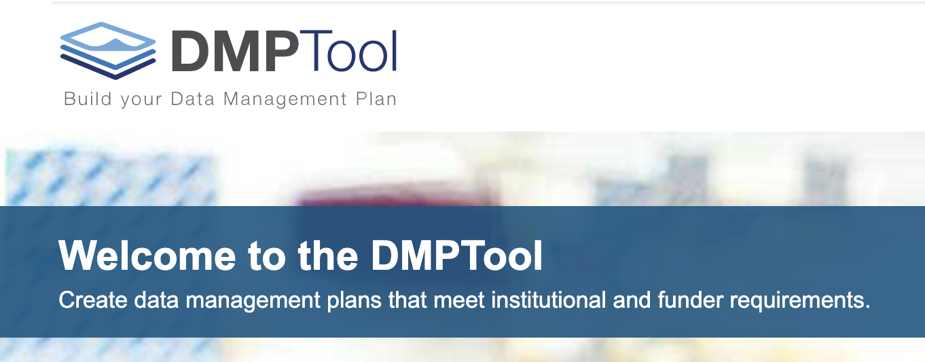
Creating a DMP
http://dmptool.org/
Notes:
operates as “wizard” and provides prompts for the user to fill out in order to create their data management plan. You can save your plan, print it, or export it to your computer.

Slide 15


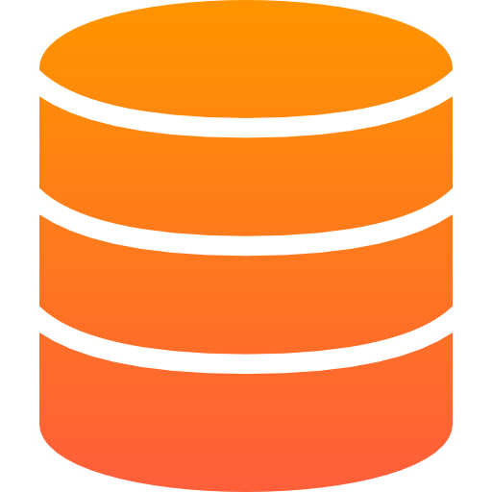


FAIR Data
“… as open as possible, as closed as necessary” - Horizon2020 Programme, Open Research Data pilot principle
DATA SHOULD BE
Findable
Use unique and persistent identifiers.
Accessible
Post datasets in open repositories.
Interoperable
Save data in open standard file formats.
Reusable
Document data provenance and file information in README.
BY HUMANS AND MACHINES
www.nature.com/articles/sdata201618
www.force11.org/fairprinciples
https://ec.europa.eu/research/participants/data/ref/h2020/grants_manual/hi/oa_pilot/h2020-hi-oa-data-mgt_en.pdf
Notes:
Insert DOI and ORCID logo

Slide 16
CCSS services in support of DM(S)P and Reproducibility

Slide 17

Data Quality Review
Peer, L., Green, A., & Stephenson, E. (2014). Committing to data quality review. International Journal of Digital Curation, 9(1). http://doi.org/10.2218/ijdc.v9i1.317
File Review
Doc Review
Data Review
Code Review
Notes:
Preparing high-quality reproduction materials require that you do a Data Quality Review which includes File Review, Documentation Review, Data Review and Code Review

Slide 18
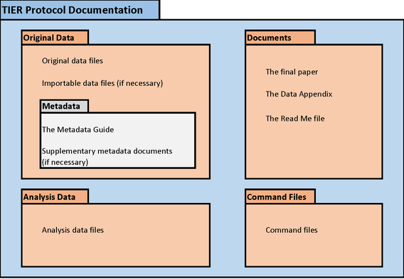
Data Quality Review
Peer, L., Green, A., & Stephenson, E. (2014). Committing to data quality review. International Journal of Digital Curation, 9(1). http://doi.org/10.2218/ijdc.v9i1.317
Check for presence of all (necessary) files
Files in one project folder
Project folder has sub-folders to group files by type e.g., code, original data, analytic data, output, etc.
Has Readme that describes content
(Optional) Make the project folder a git repository so changes can be tracked
File Review
Notes:
Check that all files needed to reproduce your study are included in the reproducibility package
Ideally all files are in one project folder and organized by type. For example, have a sub-folder for codes, for original data, for analytic data, outputs, etc.
The image on the right is an example of a protocol for organizing your files. It is actually called the TIER Protocol. TIER stands for Teaching Integrity in Empirical Research.
In the TIER Protocol

Slide 19
Data Quality Review
Confirm the presence of comprehensive descriptive information necessary for informed reuse
Data definitions
Variable construction
Methodology
Sampling information
Original data source citation
Analysis software version
Questionnaires, codebooks
Data Availability Statements
Link to related research products
Doc Review
Notes:
Next is review your documents.

Slide 20
Data Quality Review
Check for undocumented variable and value information
Examine data for inconsistencies and errors
Discrepancies in number of observations
Out-of-range or wild codes
Undefined null values
Review data for confidentiality/intellectual property issues, anonymization
Confirm data is cited in article (and Readme)
Data Review
Notes:
Data quality review

Slide 21
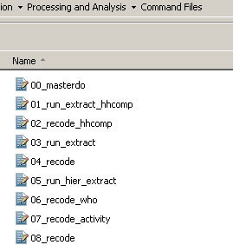
Research Code Management
Check file names of codes contain the order of execution, i.e., prefixed with a step ##.
Check for presence of master file that would execute all codes in sequence
Identify software, packages, and OS and their versions required to execute the code.
Code Review
Notes:
Review your code
File names of code are prefixed with the order of execution
Use a Master program file to call all programs used in the study
Note the software, packages, operating system used and their versions. And when the code was last executed These are needed should re-users need to rebuild your computing environment.

Slide 22
Convert absolute file paths to relative file paths
Check code for presence of non-executable comments that document analysis processes
Map code processes to paper sections using comments
Remove or comment out unnecessary codes
Label new variables and their values immediately after creation
Code Review
Notes:
Data quality review

Slide 23
Run the code from start to finish in one go, using a different computer (not the one you used to run your analysis). Rebuild the computing environment if necessary.
Address errors in the code. Repeat until no more errors are encountered.
Note in the code the date you last executed your code from start to finish.
Compare code output to findings presented in the article.
Code generates output in the same order as they appear on the manuscript (if possible)
Inspect code inefficiencies, hardcoded values, others
Code Review
Notes:
Data quality review

Slide 24
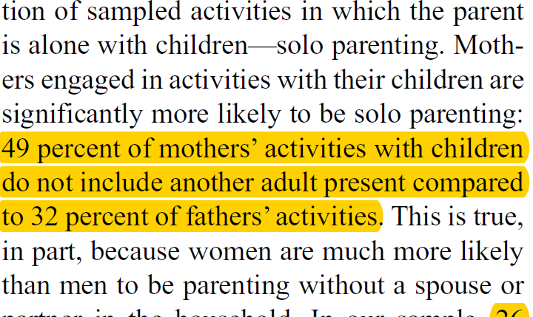
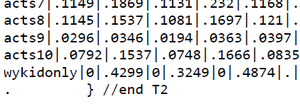
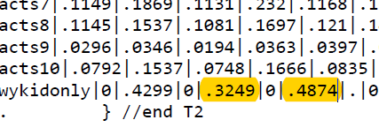
MANUSCRIPT AND OUTPUT REVIEW
Highlight on your manuscript all sections (e.g., paragraphs, sentences, tables, charts) and in-line text that reference output derived from your data.
In the output file, highlight the numbers,
tables, figures, charts used in your manuscript
Highlight sections stating that methodological assumptions were assessed
For example: “Normality was assessed for the distribution of all
continuous variables of interest” – show proof in your code
Highlight operationalization of variables
For example: “We defined obese as BMI > 28…”
– inspect your code
Highlight claims of additional analyses, but not shown, and promising to make them available upon request
For example: “In some additional analysis (not shown), but available upon request…”
-- reproduction materials for that should be inspected as well.
Notes:
Review the manuscript and output

Slide 25
Readme – Instructions to reproduce the study
Instructions to reproduce the study
Title of study
Author(s) and their ORCIDs
Article Citation (with DOI)
Primary author contact info and ORCID
Data Availability Statement for each Dataset
Data Citation (with DOI), license, and version
Code Citation (with DOI), license, software, version, and last updated
Code-output table – list of table, figure, in-text numbers in manuscript and which code produced them.
Errata (post-publication reproduction)

Slide 26
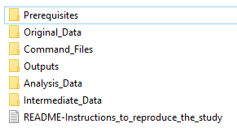
Organize and Package the Reproduction Materials
If files are unorganized within the project folder,
we use TIER Protocol (projectier.org).
2. If files are organized within project folder, retain
researcher’s existing structure
Add a Prerequisites folder to store the version of
the libraries, packages, ados that researchers used
to generate their results
In R, we use Checkpoint
In Stata, we redirect the PLUS folder to the
Prerequisites folder
Example of our expanded TIER structure

Slide 27
R-squared Workflow
Post-manuscript writing review of RM
2
Identify and apply quality improvement interventions
Client Deposits
R-Squared
Publication
Submission Stage
Check Submission: Complete?
Run Code:
Error-free?
Compare Results:
Identical?
Journal/
ProQuest
Pre-submission
1
No
Assemble Package
Archival Storage & Access
R&R
Yes
Yes
Yes
Client validates and signs off on the package
Yes
Accepted
Versioning
Journal-specified Repository
No
No
No
Optional:
(prep catalog, mint DOI, data availability statement)
Proof
Another package may be created with all or some data removed, but with instructions (data availability statements) on how to get and where to put them in the package, depending on who owns the data used by the author(s).
CISER Data Archive
Discuss with client and make necessary corrections
Post-publication
E-Commons
https://ciser.cornell.edu/research/results-reproduction-r-squared-service/reproduction-materials-review-recommendations/
Notes:
Let me introduce you now to our current workflow.
First, we instruct authors to do what we call a post-manuscript writing review of their reproduction materials.
What do I mean by that?
Soon after or immediately after finishing their manuscript, we recommend authors to run their code(s) from beginning to end in one go and compare the results produced with that of their manuscript. They will address all coding errors and inconsistencies encountered before submitting them to us. On the manuscript, they will highlight all tables, figures, charts, and in-text numbers derived from the data. These highlighted numbers are the results that our R-squared service will target for reproduction. We have detailed instructions on preparing reproduction materials for R-squared on our website below, and I’m also pasting it now on the chat window.
We prefer that authors come to us during the Accepted stage of the manuscript as the manuscript format is more or less final. Any errors and inconsistencies found can still be corrected when the proof arrives. While the proof stage is also okay, the turnaround to return the proof to the publisher is often short. One journal gave the authors 48 hours to verify the proof. We also do post-publication reproduction, i.e., we can help create a reproducibility package for an already published study.
Once the reproduction materials are ready, the authors will submit them to us via Cornell Box or SFT.
Next, we create a project folder for the files and check the submission for completeness. We make that folder a git repository. Git is a versioning software that we use to track changes that we make to the code. We can go back to the previous version of the code, including the original. Incidentally, I will teach a Git workshop on October 14, 2021.
Next, we run the code. If we find errors in the code, we will correct them if we can. If we cannot fix them, we will discuss them with the authors, and either they or we will make the necessary corrections. During this process, we may also suggest code improvements for either curation or future usability.
Once we get the code to run through, we compare the results with the manuscript. If we find inconsistencies or differences between the output and manuscript, we flag them and inform the authors.
When there are no more errors, and the output matches the manuscript, we assemble the reproducibility package. We update the instructions to reproduce the study in the Readme file. We also apply the appropriate licenses to the data and code in consultation with the authors, so re-users know their rights to the data and code shared by the authors.
Next, we ask the authors to validate and sign off on the package.
Once validated, we may create two versions of the reproducibility package. One reason is that some or all data used in the study may be from a third party, and authors do not have the rights to share the data.
So, there will be a version with data and one without data. The version with data will be for authors’ use only, and the version without the data will be made publicly available. Still, we will insert in the Readme or write in a separate document a data availability statement detailing how re-users can gain access to the data.
Another reason we may create two versions of the reproducibility package is when one is for public use, and the other is for restricted use requiring authors’ permission before being granted access.
Finally, suppose the authors decide for CCSS to host their reproducibility package. In that case, we will create a catalog for it on the CCSS Data and Reproduction Archive and provide them the DOI that they can give to the journal.

Slide 28
Demo of completed R-squared project
Reproducibility Package
http://doi.org/10.6077/80ph-y162 (Kim, et. al. – CISER Archive)
https://doi.org/10.7910/DVN/OARGFC (Karim – Dataverse)
To see more reproducibility packages, go to: https://archive.ciser.cornell.edu
Type R2 on the search box and hit Search
Notes:
Here are examples of Reproducibility packages

Slide 29
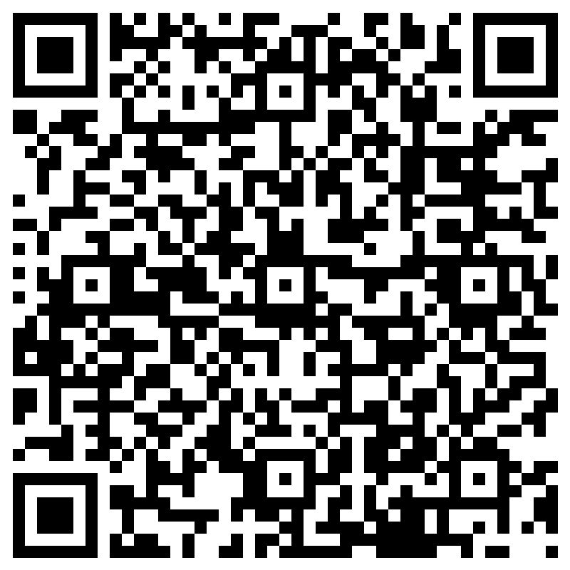
Evaluation

Slide 30
ccss-researchsupport@cornell.edu

Slide 31
References
Wright, Sarah J. “Data Management and Sharing Plans: Support at Cornell” Workshop. Cornell University, Ithaca, NY. 14 Feb 2023.

