Slide 1

Protect your Future Publications: Reproducibility Through Data Management Plans - Compliance and Security
Florio O. Arguillas, Jr. Ph.D.
Research Associate
CCSS

Slide 2
CCSS Research Support Code of Conduct
The Cornell Center for Social Sciences provides a welcoming environment for everyone embracing all backgrounds or identities. All instructors and attendees agree to abide by our community norms. We encourage the following behaviors in our workshops:
Respect differing viewpoints and ideas
Share your own perspectives and ask any questions
Accept constructive criticism
Use welcoming and inclusive language
Show courtesy and respect for all instructors and attendees
If you believe that an instructor or attendee has violated the code of conduct, please report the violation to CCSS-ResearchSupport@cornell.edu. We take all reported incidents seriously.

Slide 3
Land Acknowledgement
Cornell University is located on the traditional homelands of the Gayogo̱ hó꞉nǫ' (the Cayuga Nation). The Gayogo̱ hó꞉nǫ' are members of the Haudenosaunee Confederacy, an alliance of six sovereign Nations with a historic and contemporary presence on this land. The Confederacy precedes the establishment of Cornell University, New York state, and the United States of America. We acknowledge the painful history of Gayogo̱ hó꞉nǫ' dispossession, and honor the ongoing connection of Gayogo̱ hó꞉nǫ' people, past and present, to these lands and waters.
Here are additional links for more on the history of Cornell’s violent, colonial formation, the movement to return native lands, and about the AIISP program at Cornell.
Consider donating to the Gayogo̱ hó꞉nǫʼ sovereignty initiative here.

Slide 4
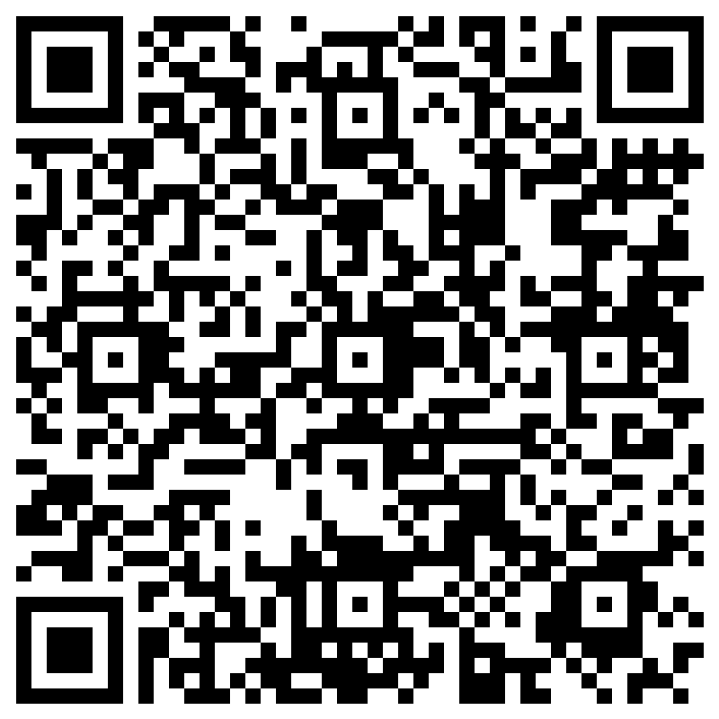
Attendance
Notes:
Before we begin, please scan the QR code above so we can record your attendance.

Slide 5
Outline
Provide an overview of what a DM(S)P is and why it is important
Support provided by other units on campus, such as the RDMSG
Services provided by CCSS in support of DM(S)P compliance and Reproducibility

Slide 6
What is a data management (and sharing) plan (DMSP/DMP)?
In the context of research funders, a DM(S)P is a document outlining a strategy for security, storage, preservation and sharing (reuse) of data related to a specific project.
Notes:
First, let’s briefly define what a data management plan is:
A data management plan is a formal document outlining what you will do with your data during and after you complete your research to ensure that your data is safe for the present and the future.
Basically it is a document where you detail your strategy for securing, storing, preserving, and sharing (or disseminating) data related to your project.

Slide 7
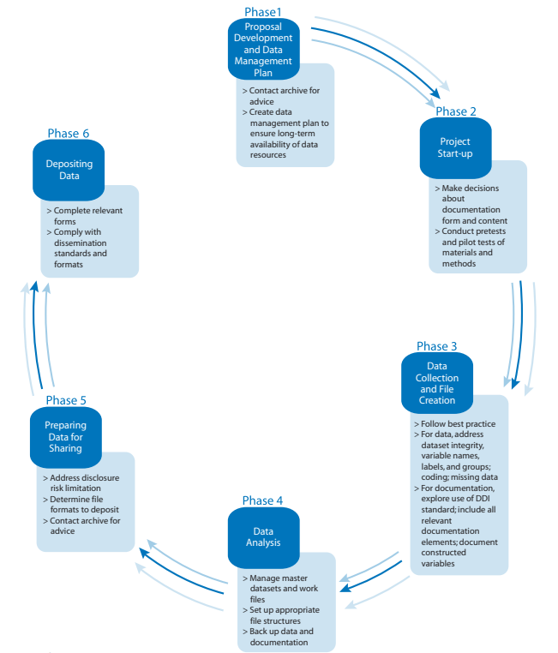
Data Life Cycle
Source: https://www.icpsr.umich.edu/files/deposit/dataprep.pdf
Notes:
Since a grant proposal is often the first phase of the research process, it means that you start planning about managing your research data during the proposal development stage, i.e., even before your data comes into existence, and applying best practices at various phases of the data lifecycle. Using best practices at each step of the data lifecycle will make it smoother later to prepare your data and associated documents for sharing. Avoid organizing your data and documentation at a later stage. It will make the task so daunting.

Slide 8
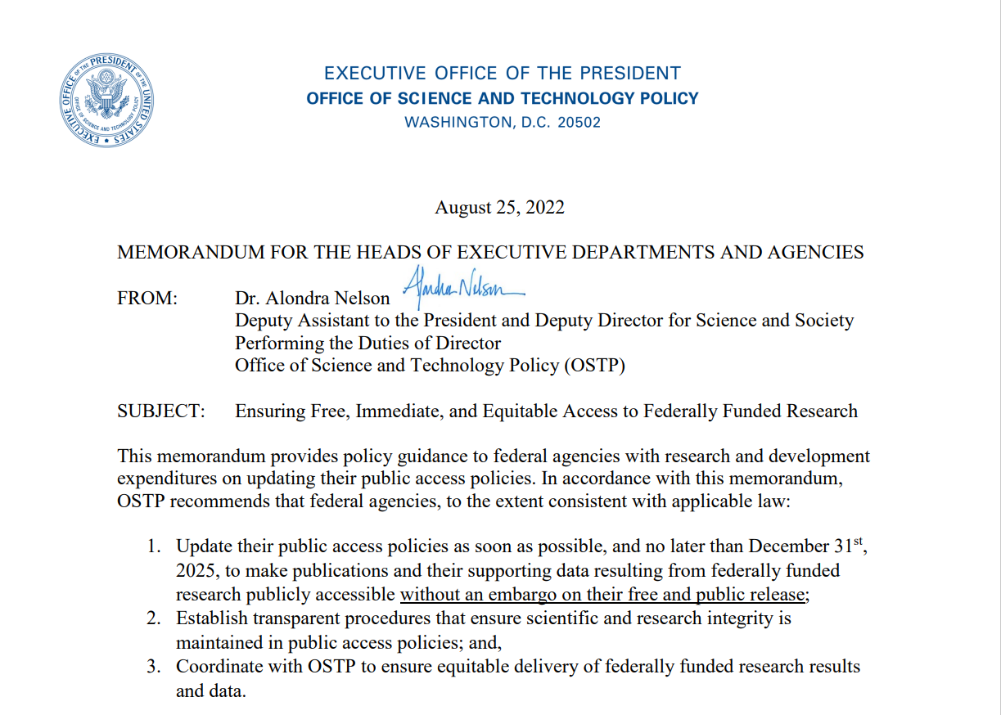
OSTP Memos of 2013 and 2022
February 22, 2013 - This 2022 memo builds upon the solid foundation of the 2013 OSTP memo - Increasing Access to the Results of Federally Funded Scientific Research
August 25th, 2022, the White House Office of Science and Technology Policy (OSTP) released a memo titled Ensuring Free, Immediate, and Equitable Access to Federally Funded Research.
The new guidance moves from a 12-month embargo to immediate, free access to publications; ensures that publications are machine readable; provides immediate access to data underlying publications; and empowers adoption of persistent identifiers for researchers, awards, organizations, and research outputs.
https://www.whitehouse.gov/wp-content/uploads/2022/08/08-2022-OSTP-Public-Access-Memo.pdf

Slide 9
Who requires a DMP-like document with a proposal?
Key Cornell Funders
Other Funders/More Information
NSF ☑ DMP
NIH ☑ Data Management and Sharing Plan
USDA/NIFA/ARS ☑ DMP
NOAA ☑ DMP
NASA ☑ DMP
USGS ☑ DMP
DOE ☑ DMP
CCSS
Gordon and Betty Moore Foundation
Gulf of Mexico Research Institute
IMLS
NEH/Office of Digital Humanities
Smithsonian Institute ☑ Digital Asset Management Plan
https://data.research.cornell.edu/content/funder-data-requirements
http://datasharing.sparcopen.org/data
Re-Use  Return on Investment
☑ DMP
Notes:
Who requires a DMP-like document with a proposal?

Slide 10
Scientific Data
The recorded factual material commonly accepted in the scientific community as of sufficient quality to validate and replicate research findings, regardless of whether the data are used to support scholarly publications.
Scientific data do not include laboratory notebooks, preliminary analyses, completed case report forms, drafts of scientific papers, plans for future research, peer reviews, communications with colleagues, or physical objects, such as laboratory specimens.
https://grants.nih.gov/grants/guide/notice-files/NOT-OD-21-013.html
Notes:
But what is meant by Scientific data? What can be shared? Scientific data has been defined as:
As defined in 2 CFR 200.315 (e) (3): “Research data means the recorded factual material commonly accepted in the scientific community as necessary to validate research findings, but not any of the following: preliminary analyses, drafts of scientific papers, plans for future research, peer reviews, or communications with colleagues. This ‘recorded’ material excludes physical objects (e.g., laboratory samples). Research data also do not include: (i) Trade secrets, commercial information, materials necessary to be held confidential by a researcher until they are published, or similar information which is protected under law; and (ii) Personnel and medical information and similar information the disclosure of which would constitute a clearly unwarranted invasion of personal privacy, such as information that could be used to identify a particular person in a research study.”

Slide 11
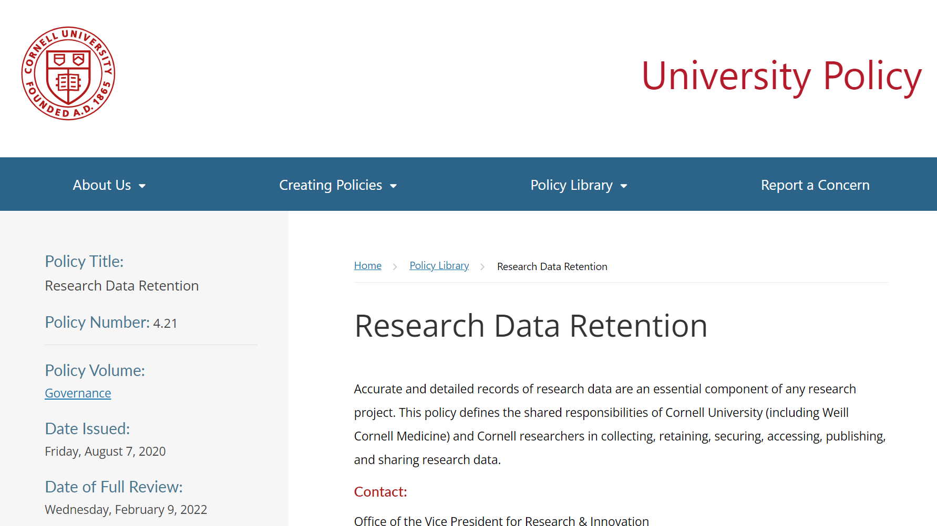
DMP and Cornell’s Research Data Retention Policy (4.21)
Requires research to be reproducible - access to relevant research data, materials, documents, protocols, methods, and procedures (1.3.2)
Publication - The PI must ensure that any figures, tables, images, data, or assertions included in the publication can be defended with raw data, and demonstrably are not deceptively manipulated. (1.3.11)
Safeguard private, confidential, proprietary, and restricted data (1.3.3 and 1.3.9)
Cornell (including Weill Cornell Medicine) asserts ownership of research data and related property rights (1.3.4)
Cornell has the right to access and take custody of research data (1.3.10)
Outlined the roles of the University, PI, Ithaca, and WCM faculty (1.3.5 to 1.3.8)
A must-read!!! Must-review!!!
https://policy.cornell.edu/policy-library/research-data-retention

Slide 12
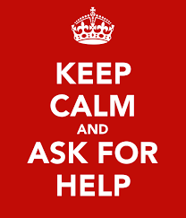
What goes into a DMP (generally)??
Expected data & research products
What types of data, samples, physical collections, code, software, curriculum, and other materials will be produced during the project?
Data & metadata formats & standards
What formats and standards will be used for your files and metadata?
Policies for access & sharing (dissemination)
For the data you are sharing, when will you make it available, and under what conditions?
What methods will be used for storing, securing, and sharing data and metadata during and after the award period?
Policies & provision for re-use, re-distribution & production of derivatives
How will you provide public access to the data while protecting privacy, confidentiality, security, and intellectual property rights?
Plan for archiving & preservation of access
How will you preserve the data over time? How long will the data be kept?
Roles & responsibilities
What are the roles and who has the responsibilities for managing data?
Notes:
So, what goes into a DMP generally?
CCSS has a boiler template for quantitative research
(show template)

Slide 13
Limitations on Sharing
DMS Plans should maximize appropriate sharing
Justifiable ethical, legal, and technical factors for limiting sharing include:
Informed consent will not permit or limit scope of sharing or use
Privacy or safety of research participants would be compromised and available protections insufficient
Explicit federal, state, local, or Tribal law, regulation, or policy prohibits disclosure
Restrictions imposed by existing or anticipated agreements with other parties
See Protecting Privacy When Sharing Human Research Participant Data for additional details
Notes:
There will be some limitations on what researchers are able to share. Those limitations should be explained in the DMS plan, and funders do want researchers to maximize appropriate sharing. Reasons to limit sharing include:
Informed consent will not permit or limit scope of sharing or use
Privacy or safety of research participants would be compromised and available protections insufficient
Explicit federal, state, local, or Tribal law, regulation, or policy prohibits disclosure
Restrictions imposed by existing or anticipated agreements with other parties
Reasons NOT generally justifiable to limit sharing:
Data are considered too small
Researchers anticipate data will not be widely used
Data are not thought to have a suitable repository

Slide 14
How to get help with DMPs
Agency guidance (see links provided throughout)
RDMSG guidance https://data.research.cornell.edu
Data management planning
Data storage finder tool
Data management best practices
DMPTool: Web-based tool to build and edit a customized plan according to select funder requirements. https://dmptool.org
Ask for help!
ccss-researchsupport@cornell.edu
rdmsg-help@cornell.edu

Slide 15
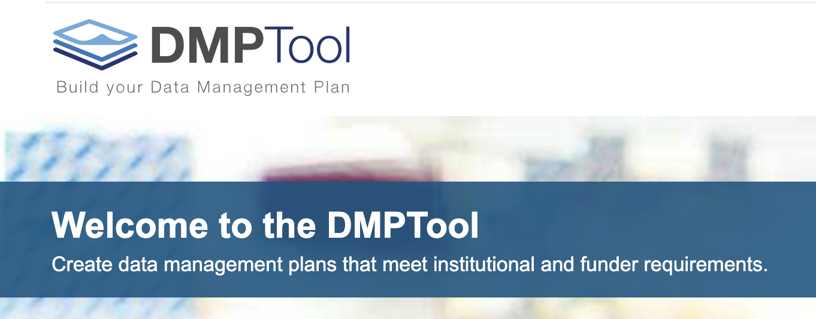
Creating a DMP
http://dmptool.org/
Notes:
operates as “wizard” and provides prompts for the user to fill out in order to create their data management plan. You can save your plan, print it, or export it to your computer.

Slide 16
CCSS services in support of DM(S)P and Reproducibility

Slide 17
CCSS DMP-related services
We help craft DMPs for social science researchers applying for external grants, CCSS Faculty Fellowships, or CCSS Grants.
We provide data storage and a computing environment to manage and process data
Research Servers (for non-restricted data)
Cornell Restricted Access Data Center
High-Capacity Computing Servers
Build-your-own-server (or we build it for you)
Your data resides in a Cornell University facility
Section 1.3.7 of Policy 4.21. Research records must be retained in university facilities, or facilities mandated by the sponsor, or other facilities commonly used for the purpose by peers in the same field of study so long as the data is maintained with appropriate oversight and reasonable means are available for access by Cornell faculty and administrative personnel when needed.

Slide 18
CCSS DMP-related services
We provide regular as well as customized workshops for individuals, project teams, or classes on data management and processing, and the use of statistical and qualitative software packages
To assist with DMP compliance and Cornell’s Data Retention Policy, we offer a Data Archiving and Replication Service.

Slide 19

Results Reproduction Service
Post-manuscript writing review of RM
2
Identify and apply quality improvement interventions
Client Deposits
R-Squared
Publication
Submission Stage
Check Submission: Complete?
Run Code:
Error-free?
Compare Results:
Identical?
Journal/
ProQuest
Pre-submission
1
No
Assemble Package
Archival Storage & Access
R&R
Yes
Yes
Yes
Client validates and signs off on the package
Yes
Accepted
Versioning
Journal-specified Repository
No
No
No
Optional:
(prep catalog, mint DOI, data availability statement)
Proof
Another package may be created with all or some data removed, but with instructions (data availability statements) on how to get and where to put them in the package, depending on who owns the data used by the author(s).
CISER Data Archive
Discuss with client and make necessary corrections
Post-publication
E-Commons
https://socialsciences.cornell.edu/research-support/R-squared
Notes:
CCSS Data and Reproduction Archive and provide them the DOI that they can give to the journal.

Slide 20
Data Quality Review
File Review
Doc Review
Data Review
Code Review
Notes:
Preparing high-quality reproduction materials require that you do a Data Quality Review which includes File Review, Documentation Review, Data Review and Code Review

Slide 21
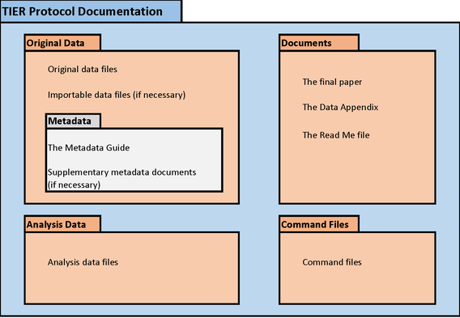
Data Quality Review
Check for presence of all (necessary) files
Files in one project folder
Project folder has sub-folders to group files by type e.g., code, original data, analytic data, output, etc.
Has Readme that describes content
File Review

Slide 22
Confirm the presence of comprehensive descriptive information necessary for informed reuse
Data definitions
Variable construction
Methodology
Sampling information
Original data source citation
Analysis software version
Questionnaires, codebooks
Data Availability Statements
Link to related research products
Doc Review

Slide 23
Check for undocumented variable and value information
Examine data for inconsistencies and errors
Discrepancies in number of observations
Out-of-range or wild codes
Undefined null values
Review data for confidentiality/intellectual property issues, anonymization
Confirm data is cited in article (and Readme)
Data Review

Slide 24
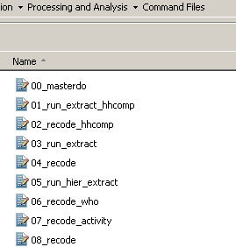
Check file names of codes contain the order of execution, i.e., prefixed with a step ##.
Check for presence of master file that would execute all codes in sequence
Identify software, packages, and OS and their versions required to execute the code.
Code Review
Notes:
Review your code
File names of code are prefixed with the order of execution
Use a Master program file to call all programs used in the study
Note the software, packages, operating system used and their versions. And when the code was last executed These are needed should re-users need to rebuild your computing environment.

Slide 25
Convert absolute file paths to relative file paths
Check code for presence of non-executable comments that document analysis processes
Ensure code processes are mapped to paper sections using comments
Unnecessary codes removed or commented out
New variables and their values labeled immediately after creation
Code Review

Slide 26
Run the code from start to finish in one go, using a different computer (not the one you used to run your analysis). Rebuild the computing environment if necessary.
Address errors in the code. Repeat until no more errors are encountered.
Note in the code the date code was last executed from start to finish.
Compare code output to findings presented in the article.
Suggest code to generate output in the same order as they appear on the manuscript (if possible)
Inspect code inefficiencies, hardcoded values, others
Code Review

Slide 27
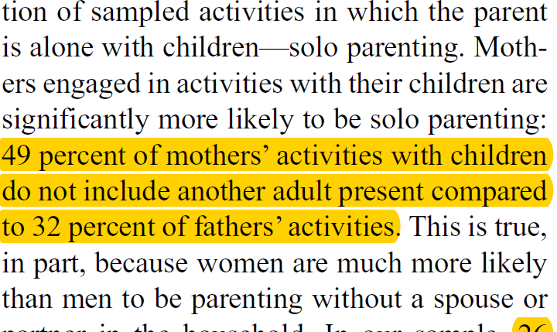
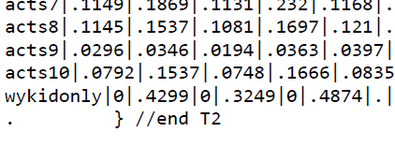
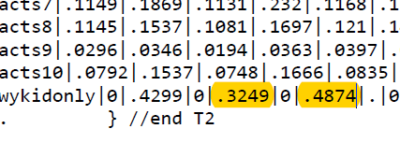
MANUSCRIPT AND OUTPUT REVIEW
Review all sections (e.g., paragraphs, sentences, tables, charts) and in-line text that reference output derived from your data.
In the output file, numbers, tables, figures, charts
used in the manuscript are highlighted
Review sections stating that methodological assumptions were assessed
For example: “Normality was assessed for the distribution of all
continuous variables of interest” – show proof in your code
Review operationalization of variables
For example: “We defined obese as BMI > 28…”
– inspect your code
Review claims of additional analyses, but not shown, and promising to make them available upon request
For example: “In some additional analysis (not shown), but available upon request…”
-- reproduction materials for that should be inspected as well.
Notes:
Review the manuscript and output

Slide 28
Review Readme – Instructions to reproduce the study
Instructions to reproduce the study
Title of study
Author(s) and their ORCIDs
Article Citation (with DOI)
Primary author contact info and ORCID
Data Availability Statement for each Dataset
Data Citation (with DOI), license, and version
Code Citation (with DOI), license, software, version, and last updated
Code-output table – list of table, figure, and in-text numbers in the manuscript and which code produced them.
Errata (post-publication reproduction)

Slide 29
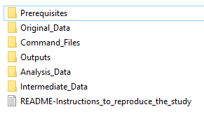
Organize and Package the Reproduction Materials
If files are unorganized within the project folder,
we use TIER Protocol (projectier.org).
2. If files are organized within project folder, retain
researcher’s existing structure
Suggest a Prerequisites folder to store the version of the libraries, packages, ados that researchers used to generate their results
In R, we use Checkpoint
In Stata, we redirect the PLUS folder to the
Prerequisites folder
Example of our expanded TIER structure

Slide 30


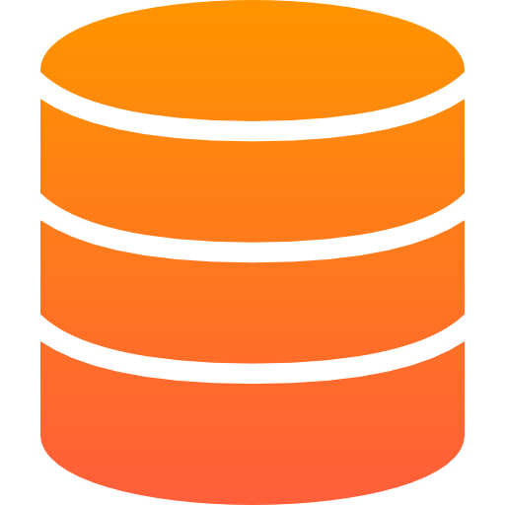


FAIR Data
“… as open as possible, as closed as necessary” - Horizon2020 Programme, Open Research Data pilot principle
DATA SHOULD BE
Findable
Use unique and persistent identifiers.
Accessible
Post datasets in open repositories.
Interoperable
Save data in open standard file formats.
Reusable
Document data provenance and file information in README.
BY HUMANS AND MACHINES
www.nature.com/articles/sdata201618
www.force11.org/fairprinciples
https://ec.europa.eu/research/participants/data/ref/h2020/grants_manual/hi/oa_pilot/h2020-hi-oa-data-mgt_en.pdf
Notes:
Make Data FAIR

Slide 31
Archive Data and Reproducibility Package
Archive meets Desirable characteristics of Data Repositories for Federally Funded Research (whitehouse.gov)
Reproducibility Package
http://doi.org/10.6077/80ph-y162 (Kim, et. al. – CISER Archive)
https://doi.org/10.7910/DVN/OARGFC (Karim – Dataverse)
To see more reproducibility packages, go to: https://archive.ciser.cornell.edu
Type R2 on the search box and hit Search
Notes:
Here are examples of Reproducibility packages

Slide 32
All-in-one service for Results Reproduction
Ensure:
The results reproduce… Peace of mind!
The code works and does not break!
Suggest code improvements
The process is transparent
Publication- and archival-ready, easy-to-use Reproducibility Package
Well-documented, easily-understandable package of Reproduction Materials
Host the Reproducibility Package in the CCSS Data and Reproduction Archive
Create a study catalog
Ease of access to data and code
Provide a DOI for the journal to use
Implement appropriate access settings
Provide alternative metrics

Slide 33
ccss-researchsupport@cornell.edu
Florio Arguillas (foa2@cornell.edu)

Slide 34
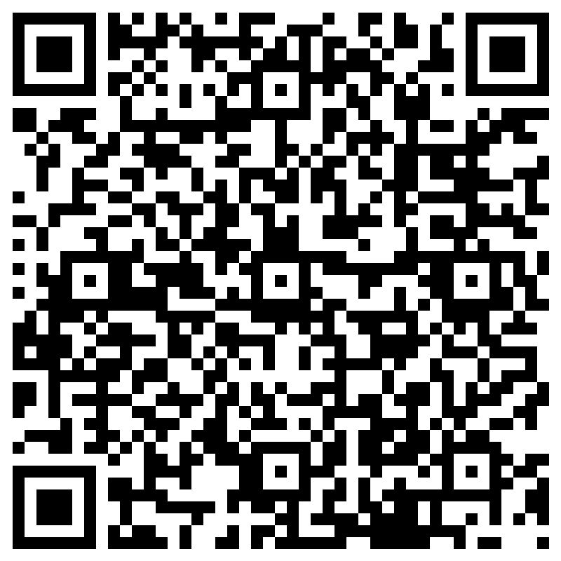
Evaluation

Slide 35
References
Wright, Sarah J. “Data Management and Sharing Plans: Support at Cornell” Workshop. Cornell University, Ithaca, NY. 14 Feb 2023.

