Slide 1


Web Scraping and APIs for extracting data through the web

Slide 2
Outline
Quick Introduction: Web Scraping and APIs
Comparing Web Scraping vs APIs
Sample Code

Slide 3
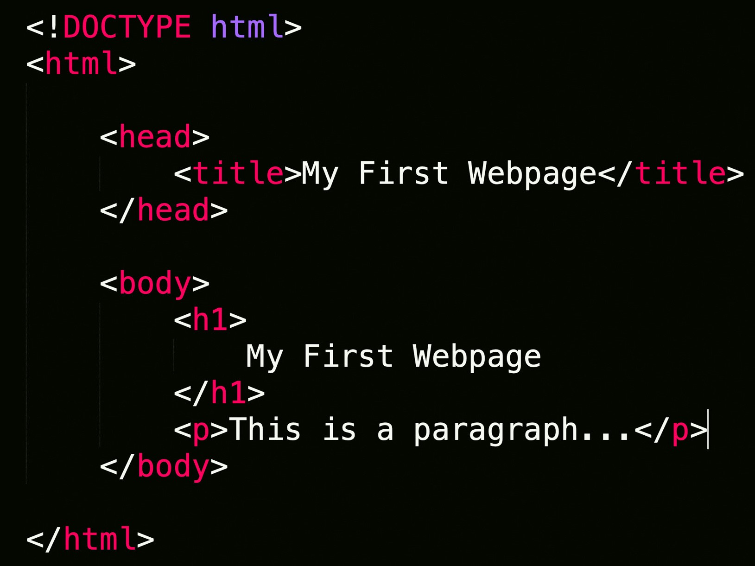
Web Scraping
Extraction of data from a website.
Loads HTML code from URL. User selects which content to keep

Slide 4
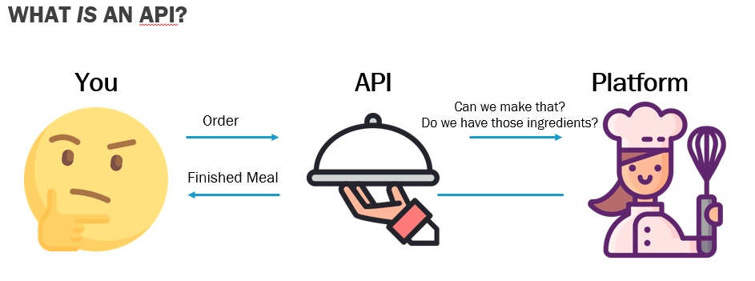
APIs
Allows communication and data exchange between 2 applications.
API Sample Data: https://jsonapi.org/examples/

Slide 5
API Sample Data
Free to access and use with no keys required.
API json data. https://api.covid19api.com/summary

Slide 6


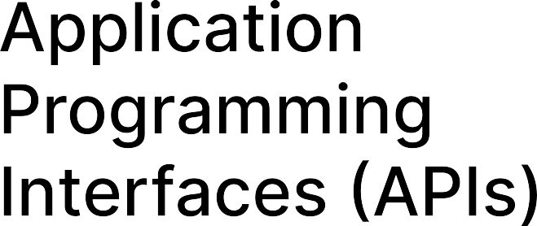
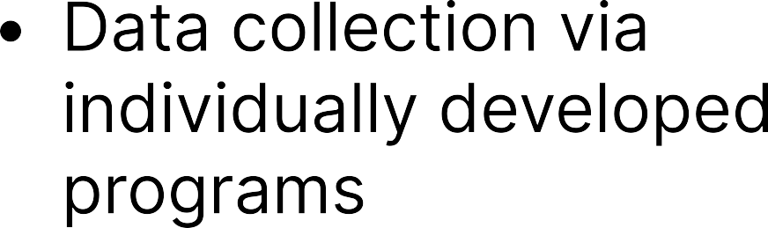

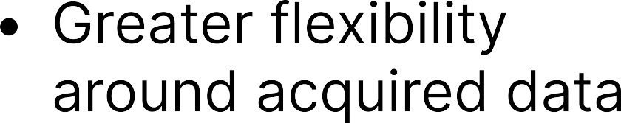




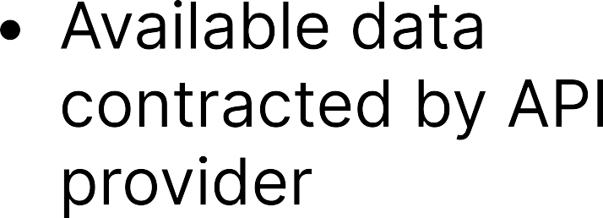
Web Scraping VS APIS

Slide 7
Sample Code
https://colab.research.google.com/drive/11AKQHgXu8pF-AcaAa0tk8WiGuUk3Zy05?usp=sharing

Slide 8
Thank you!
Contact us at CCSS-ResearchSupport@cornell.edu

