Slide 1
Embedded Networking Software Development Lab 1 – Networking Layer 4 (Transport Layer)
Version 0.1

Slide 2
Overview
Purpose
Study an implementation of the UDP protocol on an embedded networking stack.
Learning objectives
To become familiar with the internals of the UDP protocol
To learn how to use the Kinetis Design Studio (KDS) software development environment for the FRDM-K64F board.

Slide 3
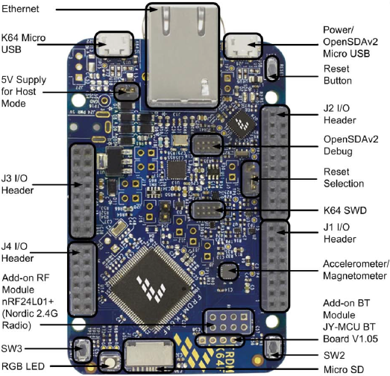
Overview (2)
The FRDM-K64F board
Ethernet RJ-45 port
Ethernet PHY
(Micrel KSZ8081RNA)
Micrcontroller
(Kinetis K64F)

Slide 4
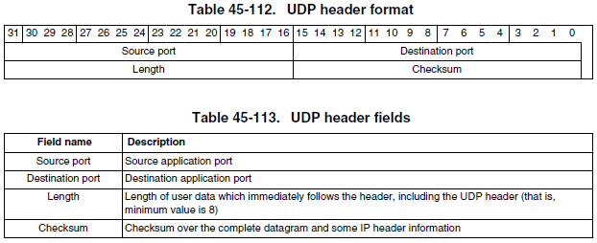
Background Information
UDP Protocol
UDP Header

Slide 5
Software Requirements
Complete the code that implements the support for the UDP protocol in the embedded networking stack for the FRDM-K64F board:
Complete the layer-4 function that binds a UDP end-point to a given UDP port number
Complete the layer-4 function that sends a UDP datagram over the network
Complete the layer-4 function that looks up the UDP end point corresponding to the destination UDP port of an incoming UDP datagram.

Slide 6
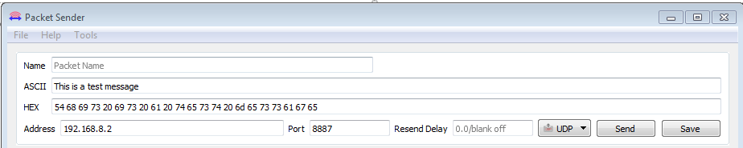
Test Plan
Test your completed embedded networking stack on the FRDM-K64F board, by using the “Packet Sender” tool from a PC, as follows:
Connect the Ethernet port of the board to the Ethernet port of your PC
Configure a static IPv4 address for the PC’s wired Ethernet interface that is in the 192.168.8.0/24 subnet (e.g., 192.168.8.1)
Configure “Packet Sender” on the PC to send UDP datagrams to port 8887, to the IPv4 address of the board (which by default is 192.168.8.2)

Slide 7
Test Plan (2)
Test case 1: Random messages
Send random text messages to the board:
The board should respond echoing your message, appending a capital letter (‘A’ .. ‘Z’) at the end of the original message:
2. Click Send button
1. Enter text message here
Sample reply from the board

Slide 8
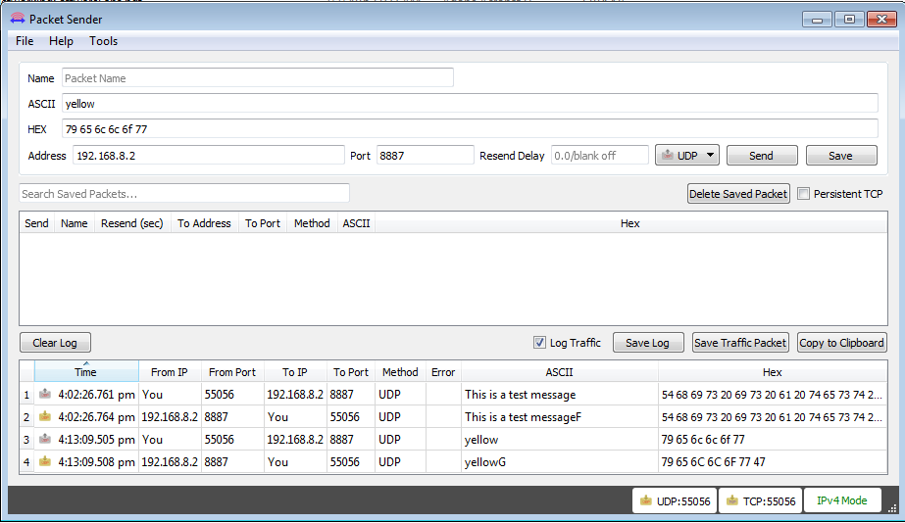
Test Plan (3)
Test Case 2: Command messages
Send “command” messages to the board to change the color of the blinking LED. Valid commands are the strings: “red”, “green”, “blue”, “yellow”, “cyan”, “magenta” and “white”.

Slide 9
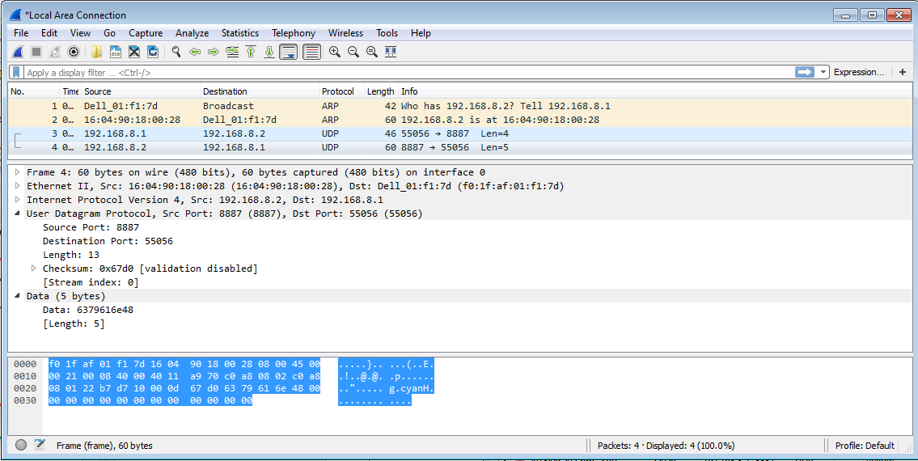
Test Plan (4)
Test Case 3: Wireshark Analysis
Use Wireshark to verify that UDP packets sent by the FRDM-K64F board are well-formed.

Slide 10
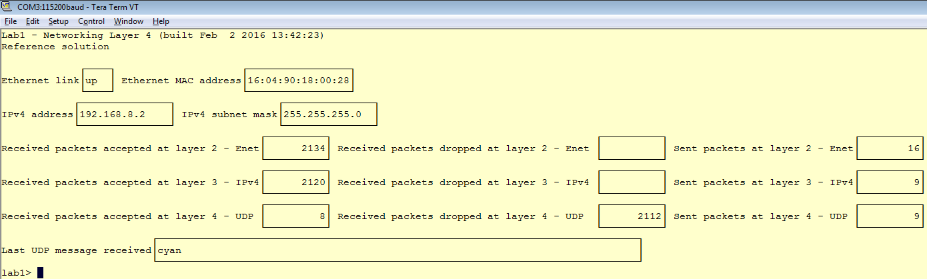
Test Plan (5)
Test Case 4: Board Network Stats Analysis
Start a TeraTerm session and connect it to the board’s serial console
While sending messages from “Packet Sender”, look at the Network stats dashboard on the board’s serial console. Verify the consistency of the stats (e.g., # of packets received at layer 4 cannot be greater than #r of packets received at layer 3, and # of packets received at layer 3 cannot be greater than # of packets received at layer 2)

Slide 11
Software Architecture Diagrams
Hardware/Software Topology

Slide 12
Software Architecture Diagrams (2)
Hardware Context Diagram

Slide 13
Software Architecture Diagrams (3)
Software Context Diagram

Slide 14
Software Architecture Diagrams (4)
Runtime Architecture

Slide 15
Software Architecture Diagrams (5)
Runtime Architecture (cont.)

