Slide 1
Embedded Networking Software Development Lab 2 – Networking Layer 3 (Network Layer)
Version 0.1

Slide 2
Overview
Purpose
Learn how the “ping” command is implemented in an IPv4-based networking stack.
Learning objectives
To become familiar with the packet formats of the IPv4 and ICMP protocols
To learn how the “ping” command is implemented in an embedded networking stack for the FRDM-K64F board.

Slide 3
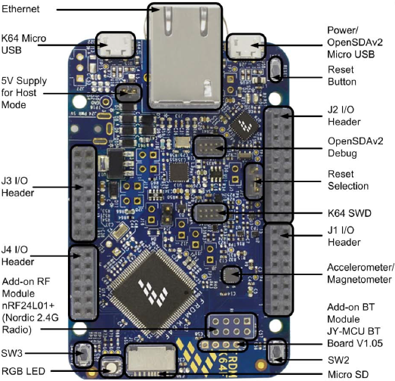
Overview (2)
The FRDM-K64F board
Ethernet RJ-45 port
Ethernet PHY
(Micrel KSZ8081RNA)
Micrcontroller
(Kinetis K64F)

Slide 4
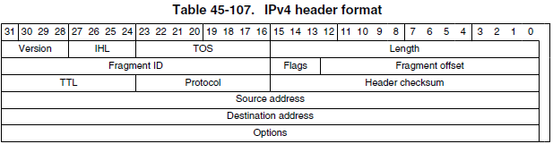
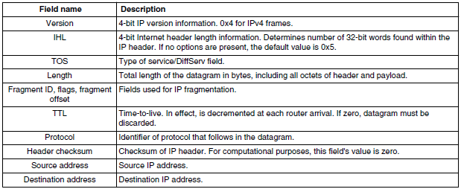
Background Information
The IPv4 protocol (Internet Protocol version 4)
Layer 3 protocol in the OSI model

Slide 5
Background Information
The IPv4 protocol (2)
Carries layer 4 packets
UDP datagrams
TCP segments
Carries layer 3 control packets
ICMP messages
IGMP messages
Carried in a layer 2 protocol such as Ethernet
An IPv4 packet is encapsulated in an Ethernet frame, using the value 0x0800 for the frame type field

Slide 6


Background Information (2)
The ICMP protocol
Internet Control Message Protocol
ICMPv4 messages are encapsulated in IPv4 packets
Protocol field of the IPv4 header is set to the value 0x01

Slide 7
Background Information (3)
The “ping” command
Ping uses ICMP messages
It sends an ICMP “echo request” message to the target host and waits for an ICMP “echo reply” message from the target host.
Ping request ICMP message
Type = 8, Code = 0
Ping reply ICMP message
Type = 0, Code = 0

Slide 8
Lab Overview
Networking Stack Architecture
Lab2: IPv4

Slide 9
Lab Overview (2)
Instructions:
Complete the code that implements the minimum support for the ICMP protocol in the embedded networking stack for the FRDM-K64F board, to be able to send and reply to “pings”:
Solve the 7 TODOs in the networking_layer3_ipv4.c source file.

Slide 10
Test Plan
Test your completed embedded networking stack on the FRDM-K64F board, by using the following test cases:
Test case 1: “ping” from the FRDM-K64F board to the PC
Test case 2: “ping” from the PC to the FRDM-K64F board
Run test cases from lab1 to verify that there are no regressions
Test Environment Configuration:
Connect the Ethernet port of the board to the Ethernet port of your PC
Configure a static IPv4 address for the PC’s wired Ethernet interface that is in the 192.168.8.0/24 subnet (e.g., 192.168.8.1)

Slide 11
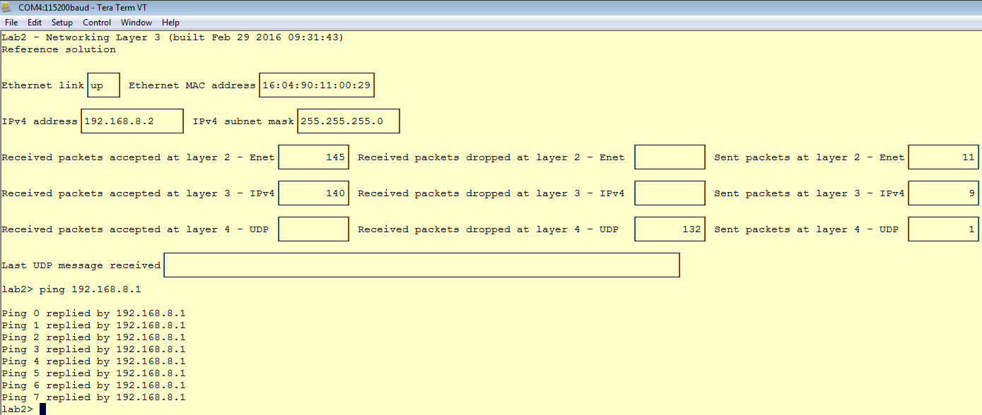
Test Plan (2)
Test Case 1: Ping from the FRDM-K64F board to the PC
Run the “ping” command from the FRDM-K64F board to the PC, from the TeraTerm window:

Slide 12
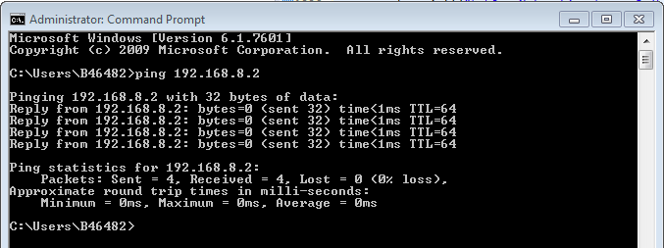
Test Plan (3)
Test Case 2: Ping from the PC to the FRDM-K64F board
Run the “ping” command from the PC to the FRDM-K64F board, from a Command prompt window or a PowerShell window:

Slide 13
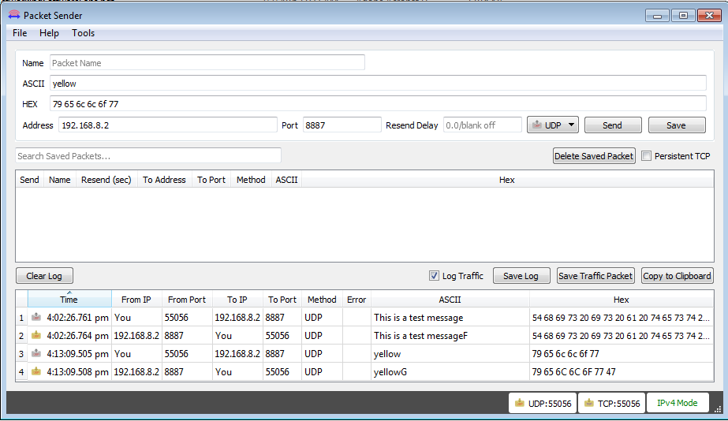
Test Plan (4)
Test Case 3: Command messages
Send “command” messages to the board to change the color of the blinking LED. Valid commands are the strings: “red”, “green”, “blue”, “yellow”, “cyan”, “magenta” and “white”.

Slide 14
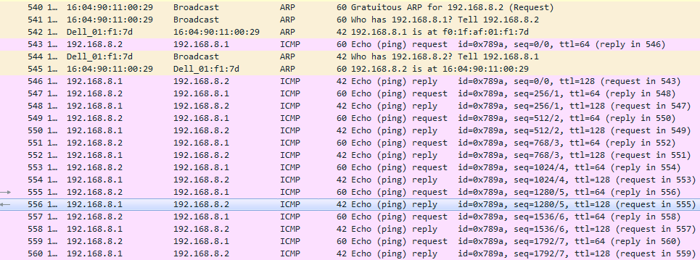
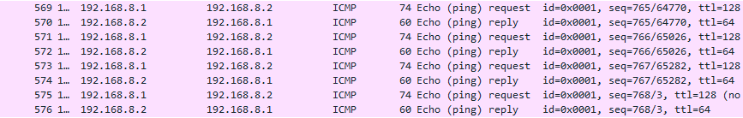
Test Plan (5)
Test Case 4: Wireshark Analysis
Use Wireshark to examine the “ping” ICMP packets:

Slide 15
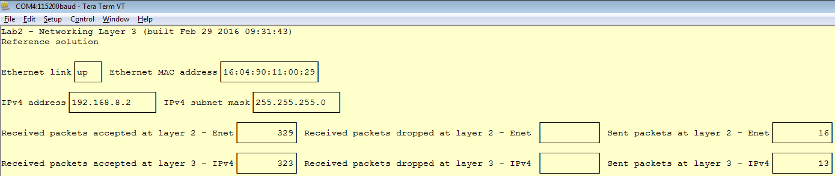
Test Plan (6)
Test Case 5: Board Network Stats Analysis
Start a TeraTerm session and connect it to the board’s serial console
While doing pings from the board to the PC and from the PC to the board, look at the Network stats dashboard on the board’s serial console. Verify the consistency of the stats (e.g., # of packets received at layer 3 cannot be greater than # of packets received at layer 2)

Slide 16
Software Architecture Diagrams
Hardware/Software Topology

Slide 17
Software Architecture Diagrams (2)
Hardware Context Diagram

Slide 18
Software Architecture Diagrams (3)
Software Context Diagram

Slide 19
Software Architecture Diagrams (4)
Runtime Architecture

Slide 20
Software Architecture Diagrams (5)
Runtime Architecture (cont.)

