Slide 1
Embedded Networking Software Development Lab 3 – Networking Layer 2 (Link Layer) and Layer 1 (Physical layer)
Version 0.1

Slide 2
Overview
Purpose
Learn how the ARP protocol works and to get exposed to Ethernet as a layer-2 networking technology.
Learning objectives
To become familiar with the packet format of the ARP protocol
To become familiar with the Ethernet frame format
To learn how to detect if there is physical Ethernet connectivity (physical Ethernet link is up or down)

Slide 3
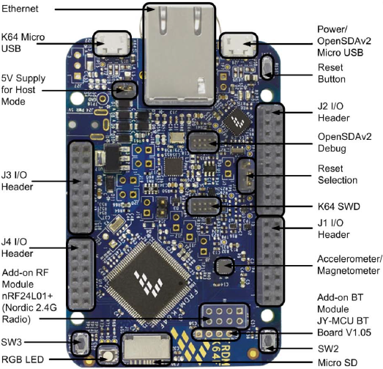
Overview (2)
The FRDM-K64F board
Ethernet RJ-45 port
Ethernet PHY
(Micrel KSZ8081RNA)
Micrcontroller
(Kinetis K64F)

Slide 4
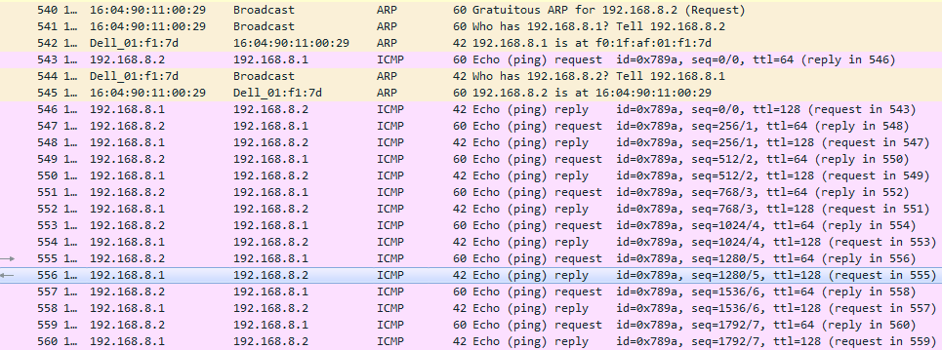
Overview (3)
In lab2, we used Wireshark to examine the “ping” ICMP packets (shown in pink below):
When a network interface is “turned on”, a gratuitous ARP request is sent for its local IPv4 address, to detect if someone else is using the same IPv4 address
When sending a packet for the first time to a new node, an ARP request is sent to all nodes in the same subnet, to see who has the target IP address
The target node replies with an “ARP reply” message to the requesting node. The ARP reply contains the local MAC address of the node sending the reply.

Slide 5
Background Information
To be transmitted over the network, IPv4 (and IPv6) packets are encapsulated in layer-2 packets.
In the case of Ethernet, layer-2 packets are known as Ethernet frames
Also, layer-3 node addresses need to be mapped to layer-2 node addresses.
In the case of Ethernet, layer-2 addresses are known as MAC (Media Access Control) addresses, and nodes as known as Ethernet stations.
The Address Resolution Protocol (ARP) maps IPv4 addresses to layer-2 addresses.
It is a layer 2.5 protocol, as it has “one foot on layer 3 and one foot on layer 2”.

Slide 6
Background Information (2)
The ARP Protocol has two basic message types:
ARP Request
Carried in a layer-2 broadcast packet
Its purpose is to ask other nodes in the same layer-2 network (layer-3 subnet) “who has a given IPv4” address.
There is a special ARP request known as a “Gratuitous ARP request”, used to detect duplicated IPv4 addresses in a subnet.
ARP Reply
Carried in a layer-2 unicast packet
Its purpose is to answer an ARP request to the requesting node, by providing the layer-2 address of the node that has the given IPv4 address (contained in the ARP request)

Slide 7
Background Information (3)
The ARP Protocol basic flow:
When an IPv4 node’s network interface is “turned on”, or its IP address is changed, the networking stack sends a gratuitous ARP request, to make sure that no other nodes (in the same subnet) have the same IP address.
No ARP reply should be received, unless there are two or more nodes with the same IPv4 address, which is a network configuration error.
When an IPv4 node sends an IPv4 packet to another node, for which its layer-2 address is not known, the networking stack sends an ARP request, to obtain the target node’s layer-2 address, before it can send the IPv4 packet.
When an IPv4 node receives an ARP request for its own IPv4 address, the networking stack sends an ARP reply to the requesting node.

Slide 8
Background Information (4)
The ARP Protocol basic flow (cont.):
When the node that sent the ARP request receives an ARP reply for the target IPv4 address, it saves it in a table known as the ARP cache, and sends the pending IPv4 packet(s).
Subsequent sends of IPv4 packets will get the target node’s layer-2 address from the ARP cache instead of sending ARP requests.
Entries in the ARP cache expire after 20 minutes, by default. After that, the next packet send will trigger a new ARP request.

Slide 9
Background Information (5)
Fields of an ARP message:
Link address type
0x1 for Ethernet MAC addresses
Network address type
0x800 for IPv4 addresses
Link address size (in bytes)
6 for Ethernet MAC addresses
Network address size (in bytes)
4 for IPv4 addresses
ARP operation (ARP_REQUEST or ARP_REPLY)
16-bit value in network byte order
0x0001 – ARP request
0x0002 – ARP reply

Slide 10
Background Information (6)
Fields of an ARP message (cont.):
Source (sender) link address
Sender’s MAC address in the case of Ethernet
Source (sender) network address
Sender’s IPv4 address
Destination (target) link address
Target’s MAC address in the case of Ethernet
Destination (target) network address
Target’s IPv4 address

Slide 11
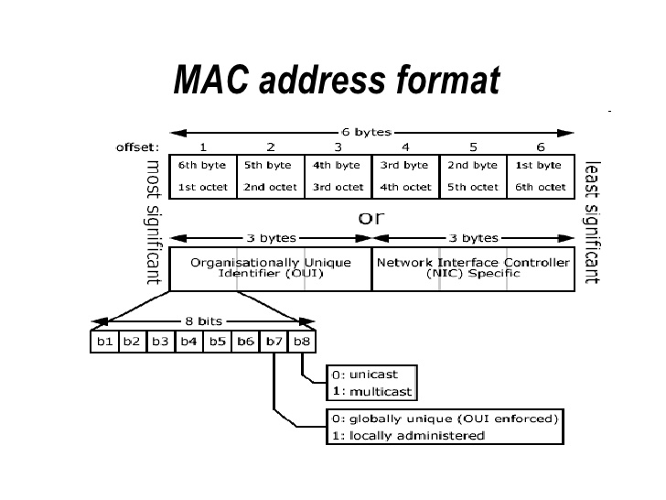
Background Information (7)
Ethernet MAC addresses
There are two special MAC addresses:
Broadcast MAC address:
ff:ff:ff:ff:ff:ff
Null MACV address:
00:00:00:00:00:00

Slide 12
Background Information (8)
Ethernet Frames
Both IPv4 packets and ARP messages are carried in Ethernet frames
Fields of an Ethernet frame
Destination MAC address
Source MAC address
Frame type
0x0800 – for IPv4 packets
0x0806 – for ARP messages
0x8100 – for VLAM tagged frame
0x86dd – for IPv6 packets
Data payload (e.g., IPv4 packet, ARP message, etc)
CRC

Slide 13
Background Information (9)
Ethernet MAC
Media Access Controller
Implements a data-link layer (layer 2 of the OSI model).
A hardware module inside a microcontroller chip such as the NXP Kinetis K64F
Ethernet PHY
Physical interface transceiver
Implements the physical layer (layer 1 of the OSI model)
A separate chip such as the Micrel KSZ8081RNA

Slide 14
Background Information (10)
MII
Media Independent Interface
Hardware protocol for chip-to-chip communication between the Ethernet MAC (in the microcontroller) and the Ethernet PHY
Consists of a parallel data interface and a serial management interface
Data interface is full duplex (separate signals for Rx and Tx) and requires 16 pins in total
Requires a 25MHz clock
Supports data transfer rates up to 100 Mbits/s
Serial Management Interface (SMI) also known as MDIO, requires two pins.
Multiple PHYs can be connected to the same MDIO bus.
Each PHY on a MDIO bus has its own address

Slide 15
Background Information (11)
RMII
Reduced pin-count MII
Data interface requires only 8 pins
Requires a 50MHz clock
SMII
Serial MII
Data interface requires only 4 pins
Requires a 125MHz clock

Slide 16
Background Information (12)
Higher speed MAC-to-PHY protocols
GMII - Gigabit MII: 1 Gbits/s
RGMII - Reduced pin-count GMII
SGMII - Serial GMII
QSGMII- Quad Serial GMII (4 SGMII lines combined): 5 Gbits/s
XGMII - 10 Gigabit MII: 10 Gbits/s

Slide 17
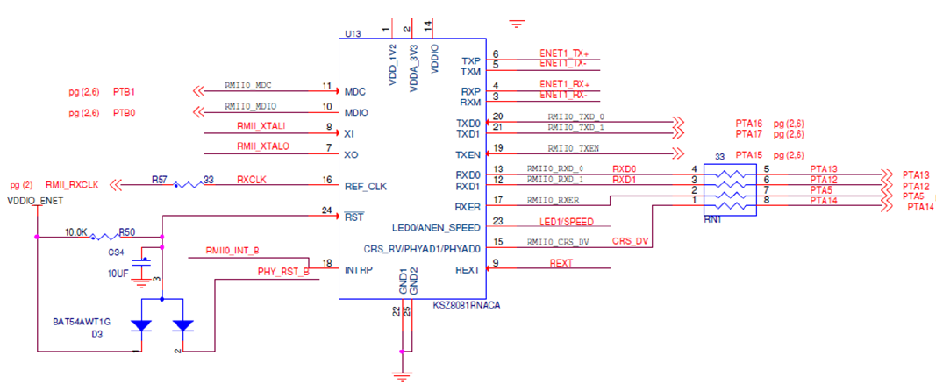
Background Information (13)
Pin connections between the MCU (K64F chip) and the Micrel Ethernet PHY (KSZ8081RNA chip)
MDIO serial bus signals
- PTB1 means: K64F GPIO Port B, Pin 1
RMII signals

Slide 18
Lab Overview
Networking Stack Architecture
Lab3:
Lab3
Lab3:

Slide 19
Lab Overview (2)
Instructions:
Implement the TODOs tagged with ‘TODO-lab3’ in the code of project lab3-layers2and1:
Complete function that send an ARP request
Complete function that sends an ARP reply
Complete function that sends an Ethernet frame
Configure the MDIO pins of the Ethernet PHY
Implement function to detect if the Ethernet physical link is up/down
Complete function that generates local MAC address for the FRDM-K64F’s Ethernet interface.
Answer question in the QUESTIONS.txt file

Slide 20
Test Plan
Test your completed embedded networking stack on the FRDM-K64F board, by using the following test cases:
Test case 1: “ping” from the FRDM-K64F board to the PC
Test case 2: “ping” from the PC to the FRDM-K64F board
Run test cases from lab1 to verify that there are no regressions
Test Environment Configuration:
Connect the Ethernet port of the board to the Ethernet port of your PC
Configure a static IPv4 address for the PC’s wired Ethernet interface that is in the 192.168.8.0/24 subnet (e.g., 192.168.8.1)

Slide 21
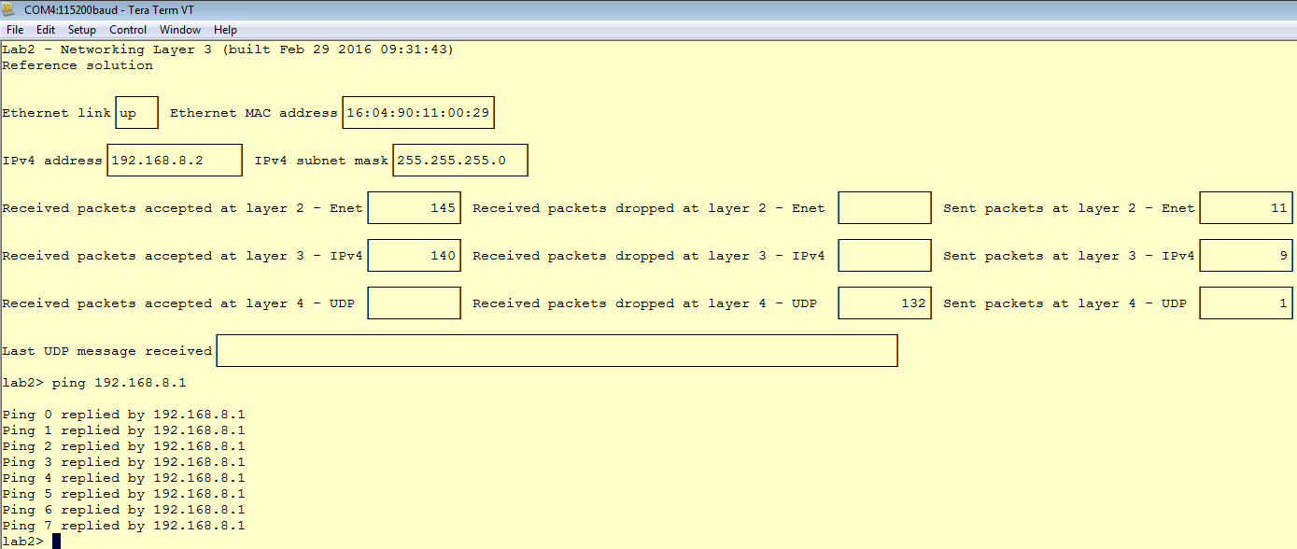
Test Plan (2)
Test Case 1: Ping from the FRDM-K64F board to the PC
Run the “ping” command from the FRDM-K64F board to the PC, from the TeraTerm window:

Slide 22
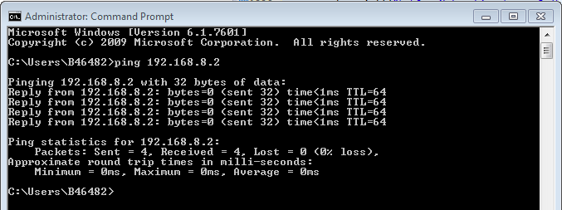
Test Plan (3)
Test Case 2: Ping from the PC to the FRDM-K64F board
Run the “ping” command from the PC to the FRDM-K64F board, from a Command prompt window or a PowerShell window:

Slide 23
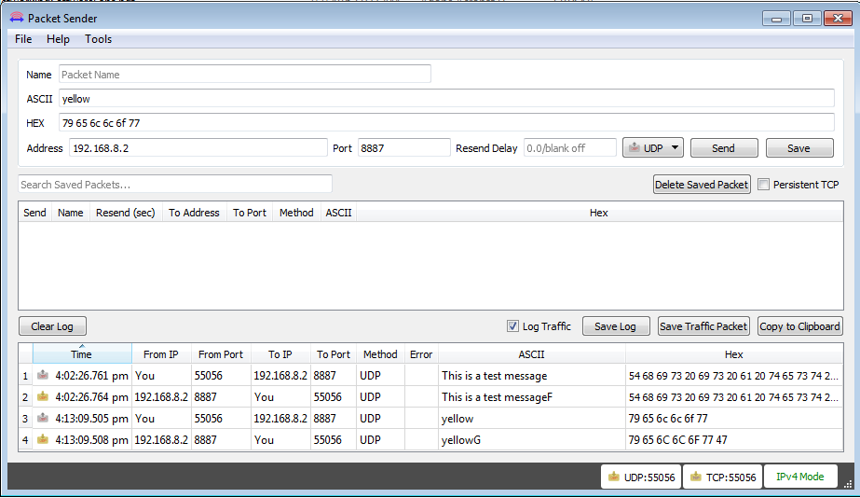
Test Plan (4)
Test Case 3: Command messages
Send “command” messages to the board to change the color of the blinking LED. Valid commands are the strings: “red”, “green”, “blue”, “yellow”, “cyan”, “magenta” and “white”.

Slide 24
Test Plan (5)
Test Case 4: Detection of Ethernet link up/down
Unplug the Ethernet cable that connects the FRDM-K64F board to the PC, from either end.
The board’s RGB LED should blink red
Re-plug the unplugged end of the Ethernet cable that connects the FRDM-K64F board to the PC
The board’s RGB LED should blink green

Slide 25
Software Architecture Diagrams
Hardware/Software Topology

Slide 26
Software Architecture Diagrams (2)
Hardware Context Diagram

Slide 27
Software Architecture Diagrams (3)
Software Context Diagram

Slide 28
Software Architecture Diagrams (4)
Runtime Architecture

Slide 29
Software Architecture Diagrams (5)
Runtime Architecture (cont.)

