Slide 1
HiRTOS: A Multi-Core RTOS written in SPARK Ada
J. Germán Rivera
(jgrivera67@gmail.com)

Slide 2
Topics
HiRTOS Design Overview
HiRTOS Thread Scheduler
HiRTOS Separation Kernel
Porting HiRTOS to a New Platform
Future Work

Slide 3
What is HiRTOS?
HiRTOS: High-Integrity RTOS
A small real-time operating system kernel and separation kernel written in
SPARK Ada
HiRTOS targets deeply embedded software applications that run in small single-core and multi-core embedded platforms
HiRTOS won the “2023 Alire Embedded Crate of the Year” award
HiRTOS is available for download as two Alire crates:
HiRTOS kernel at https://alire.ada.dev/crates/hirtos
HiRTOS separation kernel at https://alire.ada.dev/crates/hirtos_separation_kernel
HiRTOS code is available in GitHub at https://github.com/jgrivera67/HiRTOS

Slide 4
Why Writing an RTOS in Ada?
An RTOS can be seen as a safety-critical component of many deeply
embedded software systems.
Yet, most RTOSes are written in C (which is an unsafe language).
It would be safer to use an RTOS written in a safer language, such as
Ada, or in the even safer SPARK Ada language subset.
Also, given that bare-metal Ada runtimes are available only for a very
limited number of embedded platforms, more portable Ada bare-metal
applications could be written using an Ada RTOS + a minimal platform-
independent Ada runtime.

Slide 5
HiRTOS Design Overview
In a multi-core platform, there is one HiRTOS instance per CPU.
Each HiRTOS instance is independent of each other. No resources are shared between CPUs.
No communication/synchronization between CPU cores is supported by HiRTOS.
Mutexes and condition variables are the only synchronization
primitives in HiRTOS
Other synchronization primitives such as semaphores, event flags and
message queues can be implemented on top of mutexes and condition
variables.
HiRTOS mutexes support both priority inheritance and priority
ceiling protocols.

Slide 6
HiRTOS Design Overview (2)
HiRTOS condition variables can also be waited on while having interrupts disabled, not just while holding a mutex.
This prevents missing ”thread wakeups”, when signaling condition
variables from interrupt service routines. (Semaphore not needed)
HiRTOS atomic levels can be used to disable the thread
scheduler or to disable interrupts at and below a given priority or to
disable all interrupts.
Threads are bound to the CPU core in which they were created, for the lifetime of the thread.
No thread migration between CPU cores is supported

Slide 7
HiRTOS Design Overview (3)
All RTOS objects such as threads, mutexes and condition variables are allocated internally by HiRTOS from statically allocated internal object arrays
Once allocated, RTOS objects cannot be deallocated
RTOS object handles provided to application code are just indices into these internal object arrays.
All application threads run in unprivileged mode by default.
In unprivileged mode, a thread can only access its own stack.
To access global variables or MMIO space, application threads must explicitly request permission to HiRTOS.
Notes:
These object pools are just RTOS-private global arrays of the corresponding
RTOS object types, sized at compile time via configuration parameters, whose
values are application-specific.
No actual RTOS object pointers exposed to application code.
No dynamic allocation/deallocation of
RTOS objects is supported and no static allocation of RTOS objects in mem-
ory owned by application code is supported either. All this prevents HiRTOS
internal state from being accidentally or intentionally corrupted from applica-
tion code.
ISRs are seen as hardware-scheduled threads that have higher priority than
all software-scheduled threads. They can only be preempted by higher-priority
ISRs. They cannot block waiting on mutexes or condition variables.

Slide 8
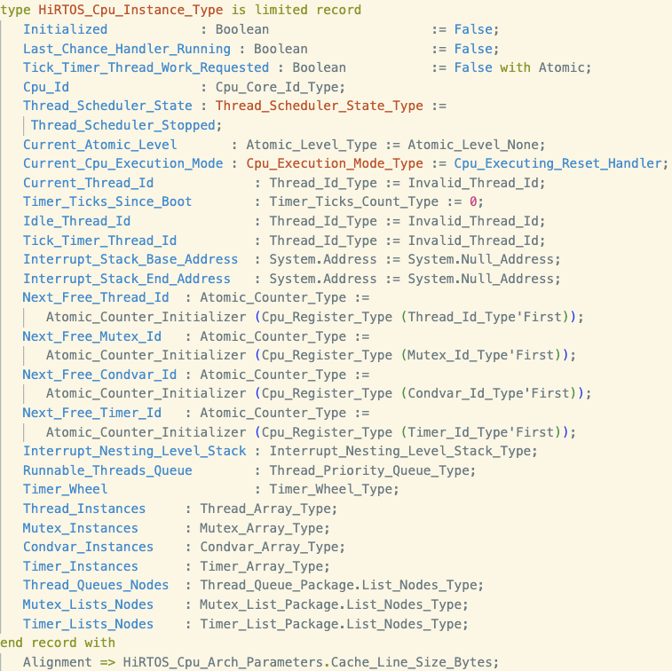
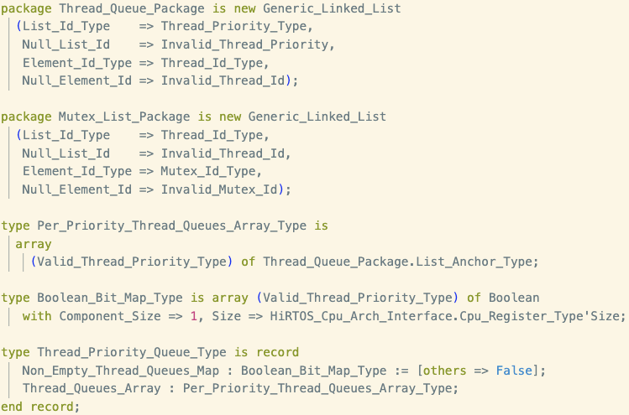
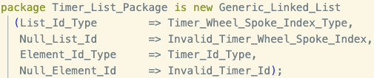
HiRTOS Design Overview (4)
HiRTOS pointer-less data structures
pointer-less linked lists
pointer-less linked lists
Arrays of RTOS objects
Arrays of nodes for linked lists of the corresponding type
pointer-less
linked lists
Notes:
These object pools are just RTOS-private global arrays of the corresponding
RTOS object types, sized at compile time via configuration parameters, whose
values are application-specific.
No actual RTOS object pointers exposed to application code.
No dynamic allocation/deallocation of
RTOS objects is supported and no static allocation of RTOS objects in mem-
ory owned by application code is supported either. All this prevents HiRTOS
internal state from being accidentally or intentionally corrupted from applica-
tion code.
ISRs are seen as hardware-scheduled threads that have higher priority than
all software-scheduled threads. They can only be preempted by higher-priority
ISRs. They cannot block waiting on mutexes or condition variables.

Slide 9
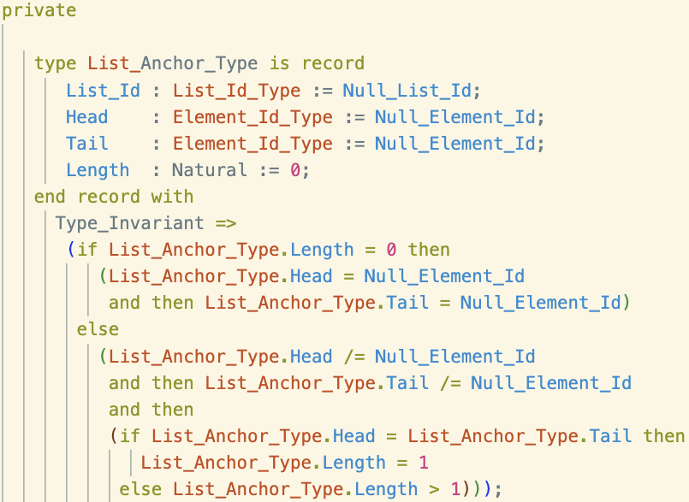
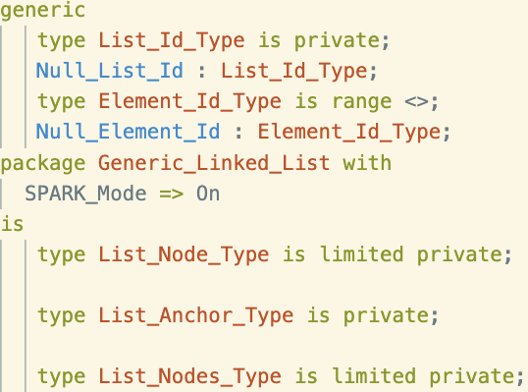
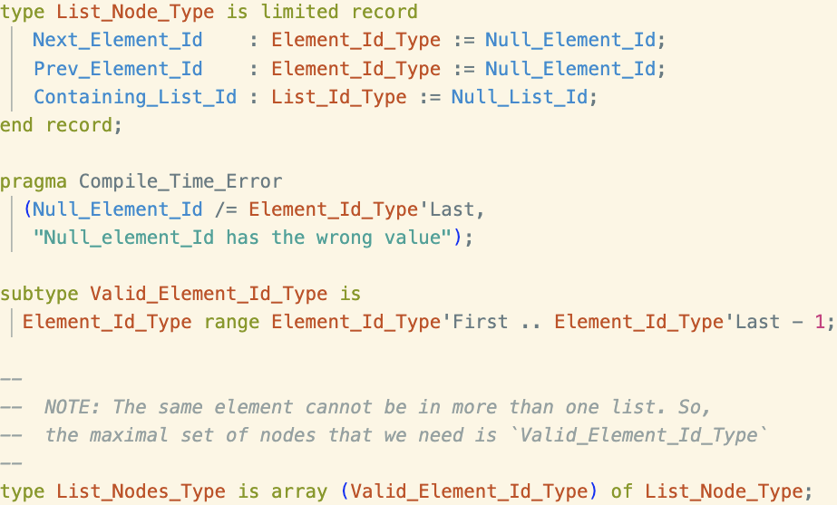
HiRTOS Design Overview (5)
HiRTOS pointer-less linked lists
Backing storage for all the linked lists (pairs of next/prev injective functions) of a given type
Backing storage for all the linked lists (pairs of “next/prev” injective functions) of a given type
Notes:
These object pools are just RTOS-private global arrays of the corresponding
RTOS object types, sized at compile time via configuration parameters, whose
values are application-specific.
No actual RTOS object pointers exposed to application code.
No dynamic allocation/deallocation of
RTOS objects is supported and no static allocation of RTOS objects in mem-
ory owned by application code is supported either. All this prevents HiRTOS
internal state from being accidentally or intentionally corrupted from applica-
tion code.
ISRs are seen as hardware-scheduled threads that have higher priority than
all software-scheduled threads. They can only be preempted by higher-priority
ISRs. They cannot block waiting on mutexes or condition variables.

Slide 10
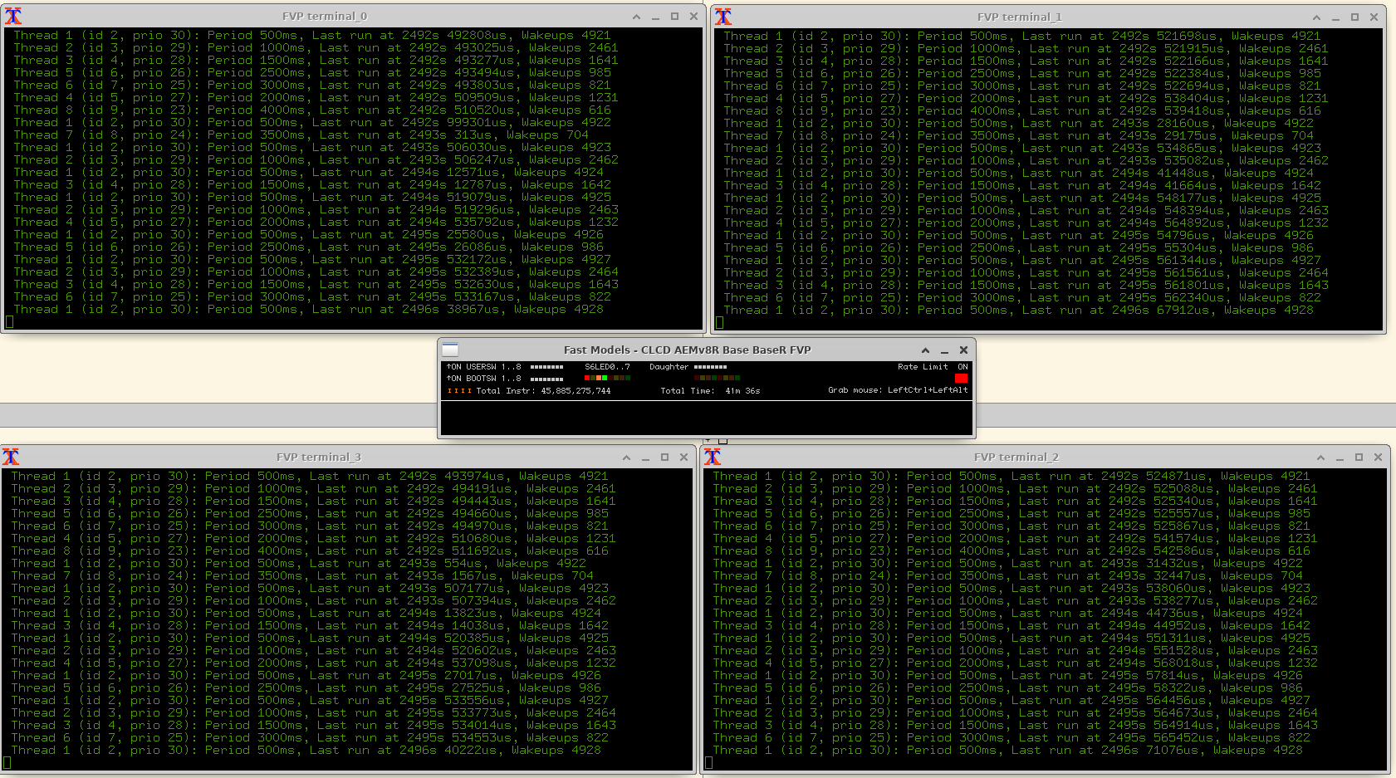
HiRTOS Supported Platforms
ARM Fixed Virtual Platform (FVP) Simulator for ARMv8-R (ARM Cortex-R52 processor with 4 cores)
Notes:
These object pools are just RTOS-private global arrays of the corresponding
RTOS object types, sized at compile time via configuration parameters, whose
values are application-specific.
No actual RTOS object pointers exposed to application code.
No dynamic allocation/deallocation of
RTOS objects is supported and no static allocation of RTOS objects in mem-
ory owned by application code is supported either. All this prevents HiRTOS
internal state from being accidentally or intentionally corrupted from applica-
tion code.
ISRs are seen as hardware-scheduled threads that have higher priority than
all software-scheduled threads. They can only be preempted by higher-priority
ISRs. They cannot block waiting on mutexes or condition variables.

Slide 11
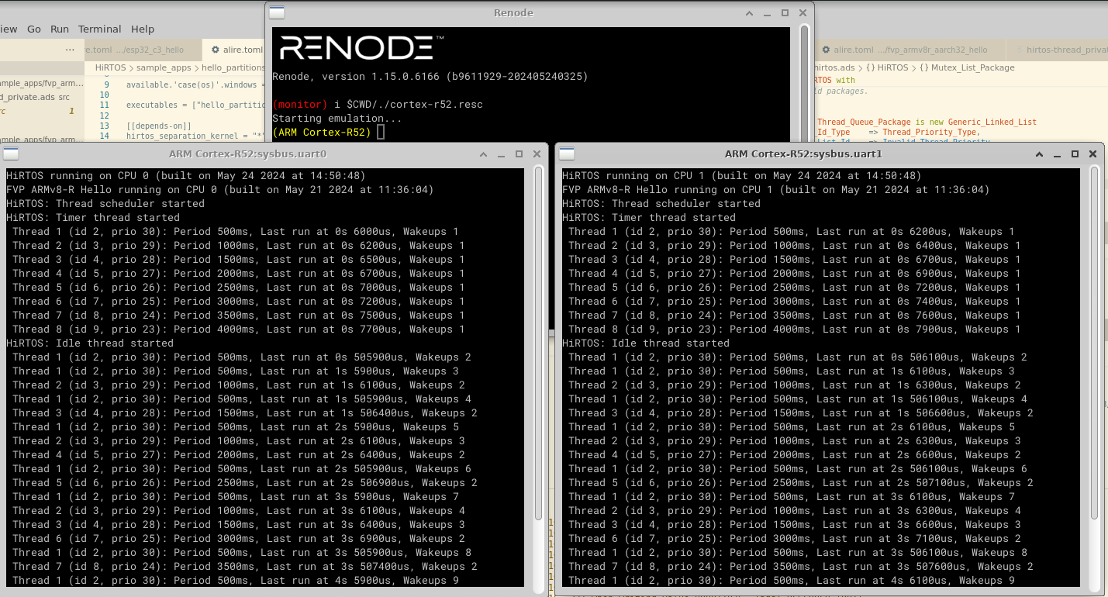
HiRTOS Supported Platforms (2)
ARM Cortex-R52-SMP Renode Simulator configuration (2 cores)
Notes:
These object pools are just RTOS-private global arrays of the corresponding
RTOS object types, sized at compile time via configuration parameters, whose
values are application-specific.
No actual RTOS object pointers exposed to application code.
No dynamic allocation/deallocation of
RTOS objects is supported and no static allocation of RTOS objects in mem-
ory owned by application code is supported either. All this prevents HiRTOS
internal state from being accidentally or intentionally corrupted from applica-
tion code.
ISRs are seen as hardware-scheduled threads that have higher priority than
all software-scheduled threads. They can only be preempted by higher-priority
ISRs. They cannot block waiting on mutexes or condition variables.

Slide 12
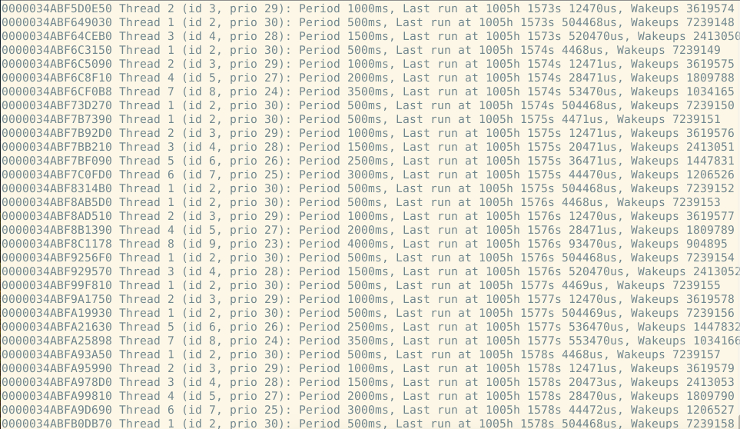
HiRTOS Supported Platforms (3)
RISC-V-based ESP32-C3 board (single-core)
Notes:
These object pools are just RTOS-private global arrays of the corresponding
RTOS object types, sized at compile time via configuration parameters, whose
values are application-specific.
No actual RTOS object pointers exposed to application code.
No dynamic allocation/deallocation of
RTOS objects is supported and no static allocation of RTOS objects in mem-
ory owned by application code is supported either. All this prevents HiRTOS
internal state from being accidentally or intentionally corrupted from applica-
tion code.
ISRs are seen as hardware-scheduled threads that have higher priority than
all software-scheduled threads. They can only be preempted by higher-priority
ISRs. They cannot block waiting on mutexes or condition variables.

Slide 13
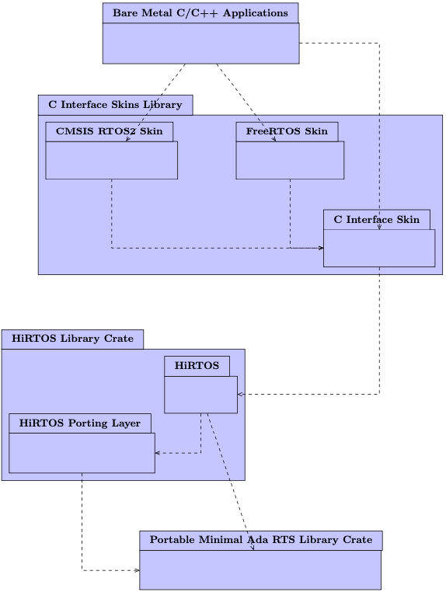
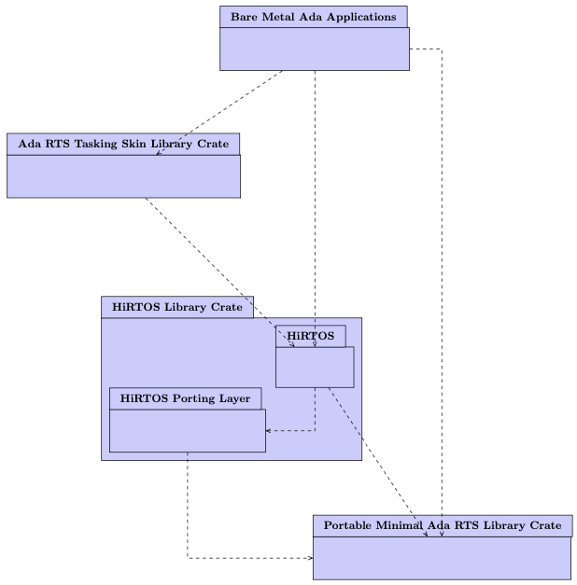
HiRTOS Usage Architecture Vision
Using HiRTOS from C/C++
Using HiRTOS from Ada

Slide 14
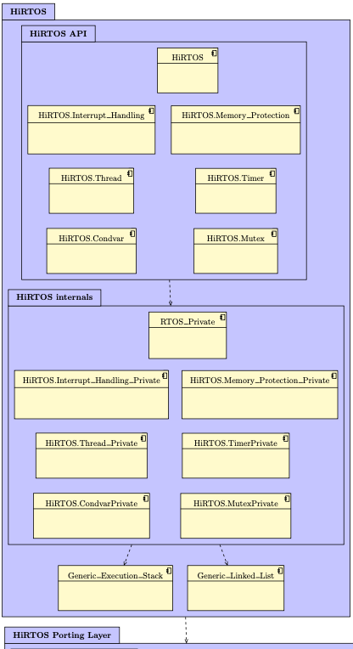
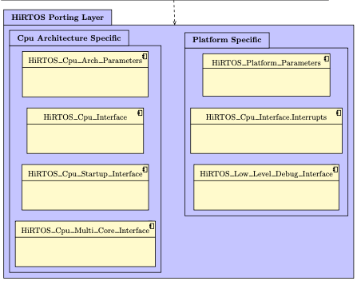
HiRTOS Code Architecture

Slide 15
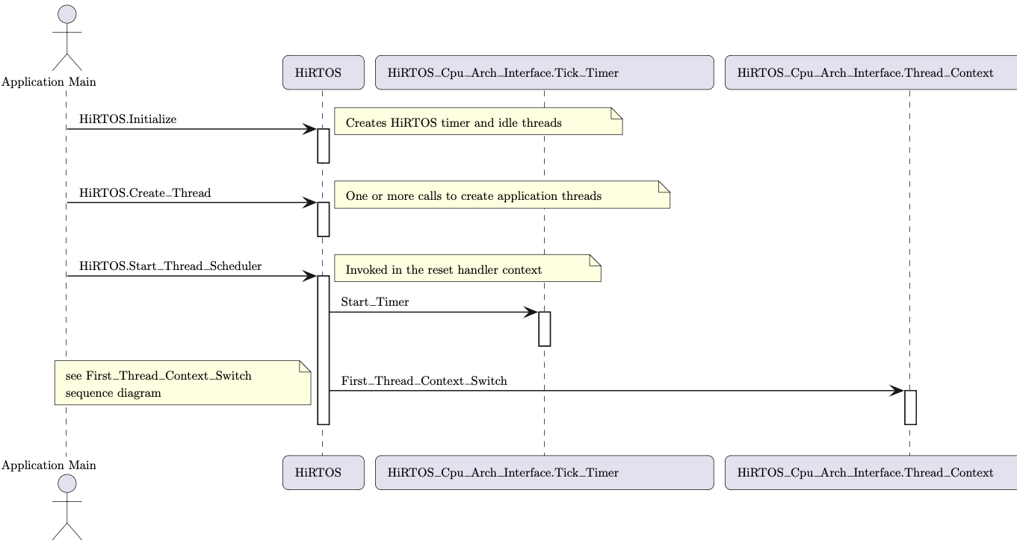
HiRTOS Thread Scheduler
HIRTOS Thread Scheduler Initialization

Slide 16
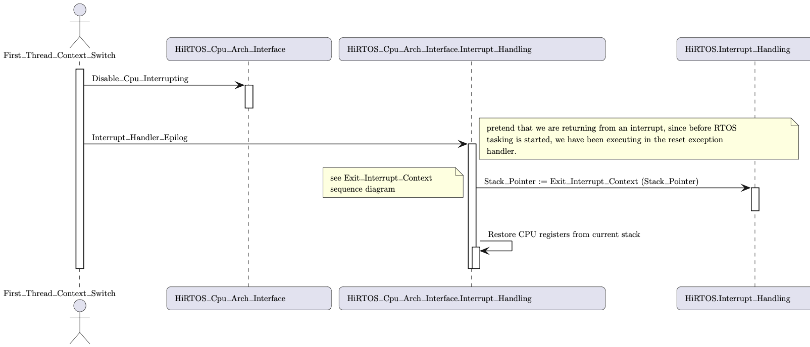
HiRTOS Thread Scheduler (2)
HIRTOS Thread Scheduler Initialization (cont.)
highest priority
thread stack

Slide 17
HiRTOS Thread Scheduler (3)
Asynchronous Thread Context Switch
In HiRTOS, thread preemption is implemented by invoking the thread scheduler on the exit path of an interrupt handler.
When an interrupt fires while a thread is running, the executing thread’s CPU context is saved on thread’s stack by the interrupt handler prolog.
Then, before calling the actual interrupt handler, the stack is switched to the interrupt handling stack. After the interrupt handler returns, the interrupt handler epilog invokes the HiRTOS thread scheduler, to select the highest
priority runnable thread.
Then, if the newly selected thread is different from the one that was running before the interrupt, the extended context of the old thread is saved and the extended context of the new thread is restored.

Slide 18
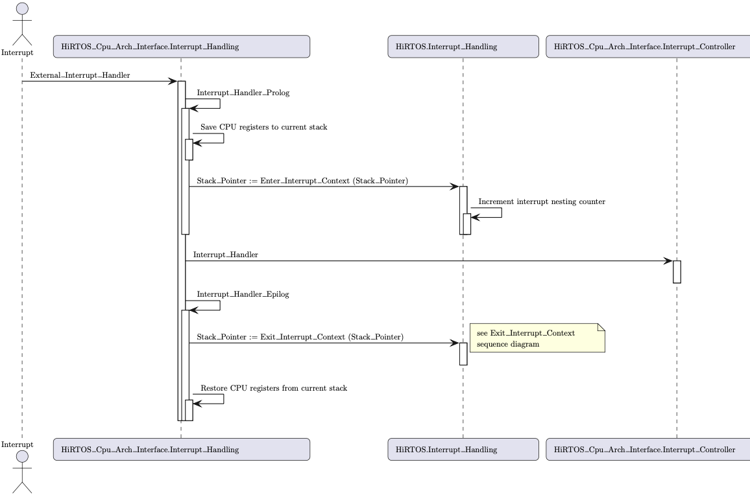
HiRTOS Thread Scheduler (4)
Asynchronous Thread Context Switch (cont.)
Interrupt handling stack
New thread stack

Slide 19
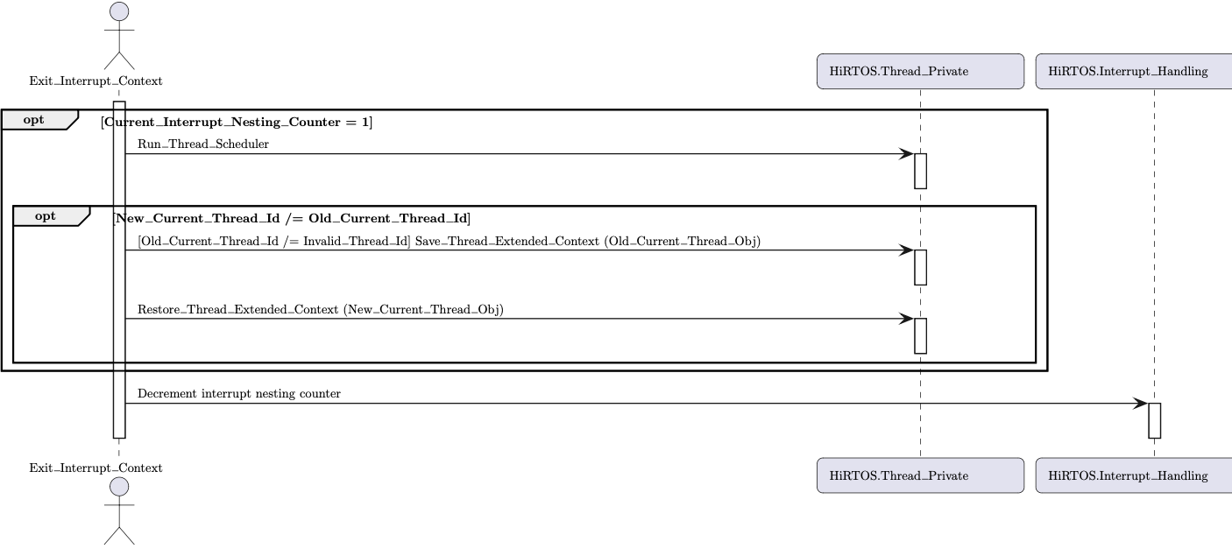
HiRTOS Thread Scheduler (5)
Asynchronous Thread Context Switch (cont.)

Slide 20
HiRTOS Thread Scheduler (6)
In HiRTOS, a synchronous thread context switch occurs when:
A thread calls HiRTOS.Condvar.Wait
A thread calls HiRTOS.Condvar.Signal or HiRTOS.Condvar.Broadcast,
and there are threads waiting on the condition variable
A thread calls HiRTOS.Mutex.Acquire and the mutex is not available
A thread calls HiRTOs.Mutex.Release and there are threads waiting to
acquire the mutex
A thread calls HiRTOS.Thread.Thread_Delay_Until (which calls HiRTOS.Condvar.Wait)
A thread calls HiRTOS.Thread.Suspend_Current_Thread
A thread calls HiRTOS.Thread.Resume_Thread
A thread calls HiRTOS.Restore_Atomic_Level and the old atomic level is Atomic_Level_None

Slide 21
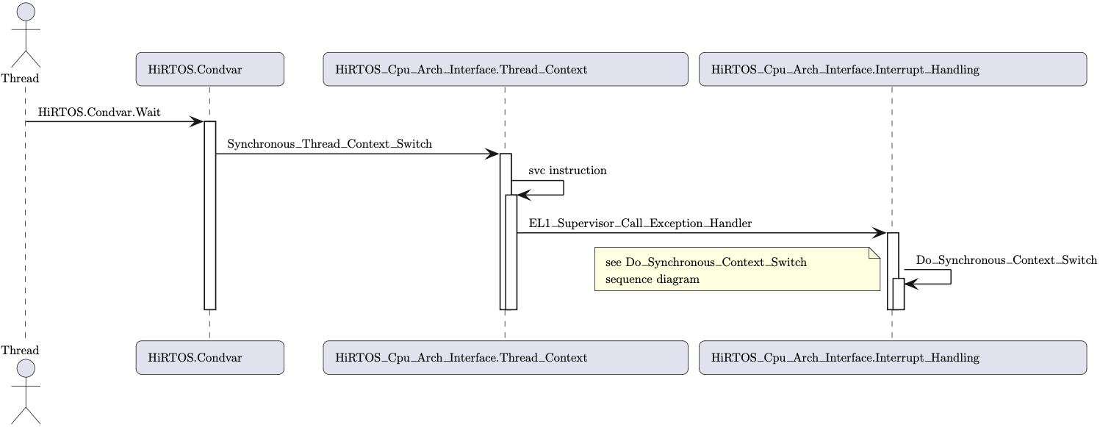
HiRTOS Thread Scheduler (7)
Synchronous Thread Context Switch

Slide 22
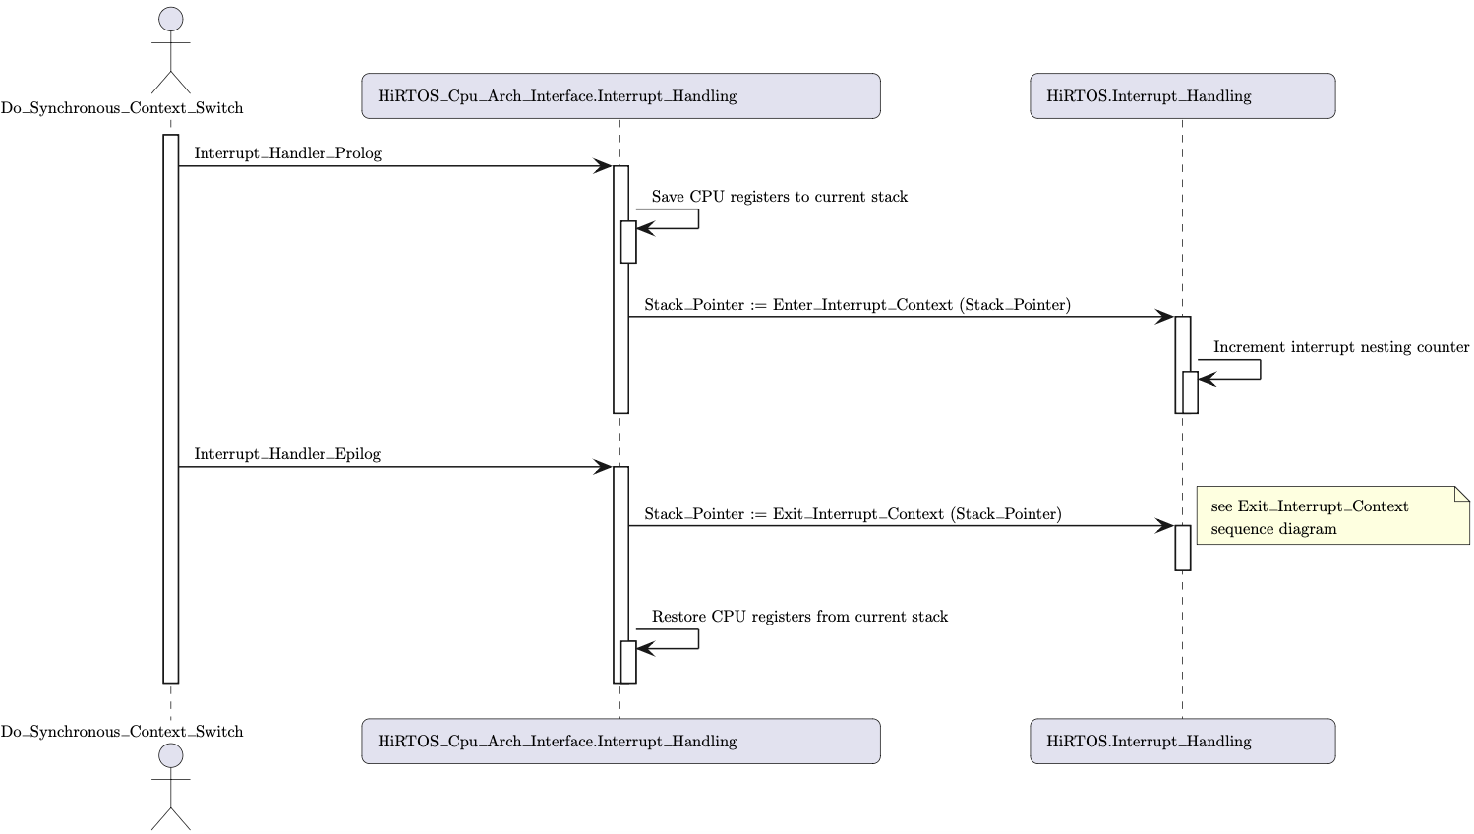
HiRTOS Thread Scheduler (8)
Synchronous Thread Context Switch (cont.)
Interrupt handling stack
New thread stack

Slide 23
HiRTOS Separation Kernel Overview
A separation kernel can be seen as an RTOS that schedules partitions
instead of threads
CPU needs to support hypervisor privilege mode and two-stage memory
protection
A partition is a spatial and temporal separation/isolation unit on which a bare-metal or RTOS-based application runs.​
Each partition consists of one or more address ranges covering disjoint portions of RAM and MMIO space that only that partition can access​
HiRTOS uses the hypervisor-controlled MPU to enforce isolation between partitions “address spaces”​
Each partition can only use the supervisor-controlled MPU within its own address space

Slide 24
HiRTOS Separation Kernel Overview (2)
Each partition also has its own interrupt vector table and its own set of physical interrupts.
Physical peripherals can be assigned to individual partitions (discrete device assignment).
No device virtualization is supported.
In a multi-core platform, there is one separation kernel instance per CPU Core.
Each instance is independent of each other. No resources are shared.
The CPU core is time-sliced among the partitions running on the same
separation kernel instance.
Partitions are bound to the CPU core in which they were created.
Partitions are created at boot time before starting the partition scheduler on
the corresponding CPU core. Partitions cannot be destroyed or terminated.

Slide 25
HiRTOS Separation Kernel Overview (3)
The separation kernel code itself runs in hypervisor privilege mode.
All partitions run at a privilege lower than hypervisor mode. Partitions can communicate with the separation kernel via hypervisor calls
Inter-partition communication is not supported yet
A shared-memory-based mailbox mechanism could be provided in the future

Slide 26
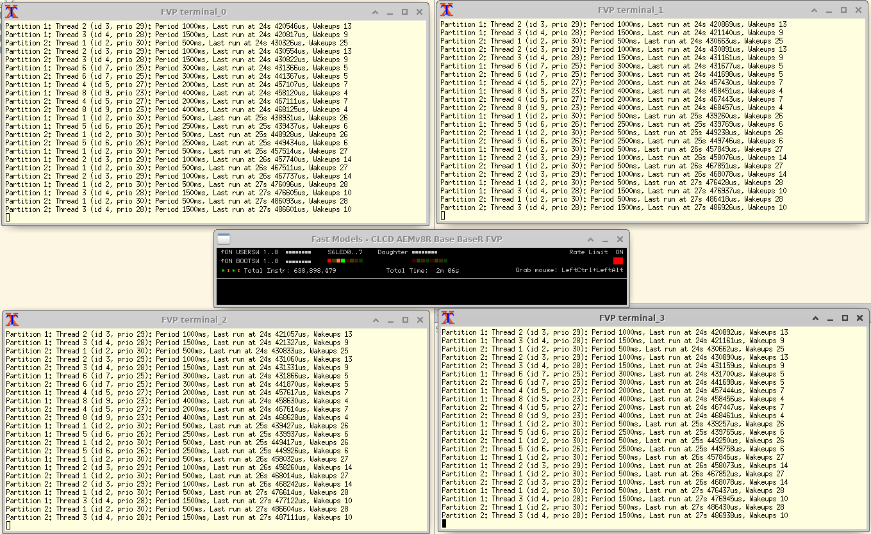
HiRTOS Separation Kernel Running on ARM FVP Simulator for ARMv8-R
Notes:
These object pools are just RTOS-private global arrays of the corresponding
RTOS object types, sized at compile time via configuration parameters, whose
values are application-specific.
No actual RTOS object pointers exposed to application code.
No dynamic allocation/deallocation of
RTOS objects is supported and no static allocation of RTOS objects in mem-
ory owned by application code is supported either. All this prevents HiRTOS
internal state from being accidentally or intentionally corrupted from applica-
tion code.
ISRs are seen as hardware-scheduled threads that have higher priority than
all software-scheduled threads. They can only be preempted by higher-priority
ISRs. They cannot block waiting on mutexes or condition variables.

Slide 27
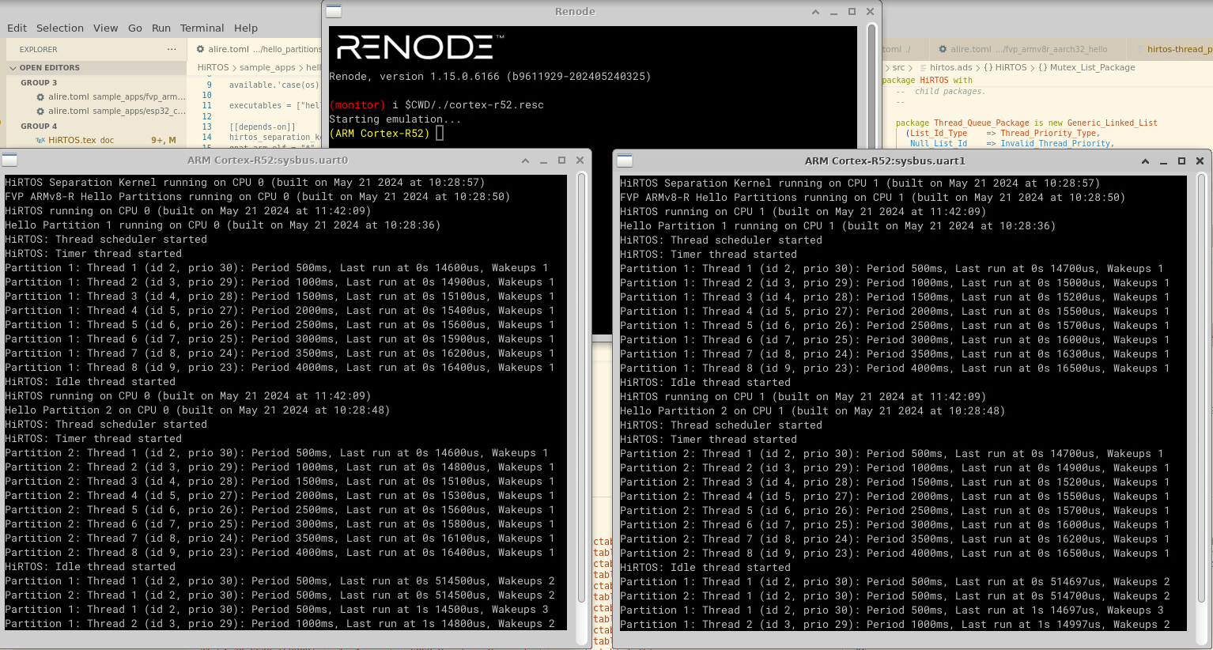
HiRTOS Separation Kernel Running on Renode Simulator Configured for ARMv8-R
Notes:
These object pools are just RTOS-private global arrays of the corresponding
RTOS object types, sized at compile time via configuration parameters, whose
values are application-specific.
No actual RTOS object pointers exposed to application code.
No dynamic allocation/deallocation of
RTOS objects is supported and no static allocation of RTOS objects in mem-
ory owned by application code is supported either. All this prevents HiRTOS
internal state from being accidentally or intentionally corrupted from applica-
tion code.
ISRs are seen as hardware-scheduled threads that have higher priority than
all software-scheduled threads. They can only be preempted by higher-priority
ISRs. They cannot block waiting on mutexes or condition variables.

Slide 28
Porting HiRTOS to a new platform
Implement CPU-architecture-specific interfaces for the new CPU architecture, including:
Startup code
Interrupt handling prolog and epilog code
Interrupt controller driver
CPU-architecture-specific timer driver (if available)
Memory protection unit (MPU) driver
Implement platform-specific interfaces for the new SoC or board, including:
UART driver
External timer driver (if needed)
Platform-specific hardware initialization

Slide 29
Future Work
Change the idle thread to be a ”safety patrol” thread to check
safety invariants and liveness properties during spare CPU cycles
Add inter-core communication functionality to the HiRTOS kernel
Add inter-partition communication functionality to the HiRTOS
separation kernel
Port HiRTOS to other embedded CPU architectures such as
ARMv7-M, ARMv8-M, 64-bit ARMv8-R and 64-bit RISC-V
Port The HiRTOS separation kernel to RISC-V platforms with
Hypervisor mode
Do Formal Verification of HiRTOS code using gnatprove

