Slide 1
HiRTOS: A Multi-Core RTOS written in SPARK Ada
J. Germán Rivera
(jgrivera67@gmail.com)
Industrial Track Presentation
28th Ada-Europe International Conference on
Reliable Software Technologies (AEiC 2024)
11-14 June 2024, Barcelona, Spain

Slide 2
Agenda
HiRTOS Design Overview
HiRTOS Z Specification Highlights
HiRTOS Thread Scheduler TLA+ Model
Lessons Learned

Slide 3
What is HiRTOS?
HiRTOS: High-Integrity RTOS
A small real-time operating system kernel and separation kernel written in
SPARK Ada, and designed for simplicity, code safety and determinism.
HiRTOS targets deeply embedded software applications that run in small single-core and multi-core embedded platforms
HiRTOS won the “2023 Alire Embedded Crate of the Year” award
HiRTOS is available for download as two Alire crates:
HiRTOS kernel at https://alire.ada.dev/crates/hirtos
HiRTOS separation kernel at https://alire.ada.dev/crates/hirtos_separation_kernel
HiRTOS code is available in GitHub at https://github.com/jgrivera67/HiRTOS

Slide 4
Why Writing an RTOS in Ada?
An RTOS can be seen as a safety-critical component of many deeply
embedded software systems.
Yet, most RTOSes are written in C (which is an unsafe language).
It would be safer to use an RTOS written in a safer language such as
Ada, or in the even safer SPARK Ada language subset.
Also, given that bare-metal Ada runtimes are available only for a very
limited number of embedded platforms, more portable Ada bare-metal
applications could be written using an Ada RTOS + a minimal platform-
independent Ada runtime.

Slide 5
Why writing HiRTOS in SPARK Ada?
Ada has built-in ”programming-by-contract” constructs
Contracts allow the programmer to express correctness properties, such as
preconditions, postconditions, object state invariants and loop invariants, as
code
This encourages a more rigorous and methodical way of writing code “asserts”
With SPARK, contracts can be formally verified with gnatprove
This has not been done for HiRTOS yet
One challenge of using contracts effectively is to have awareness of all
the correctness conditions that should be checked (asserted) in the
code.
Modeling code in a formal notation like Z can help identify/elicit such correctness
conditions in a more thorough and methodical way

Slide 6
HiRTOS Design Overview
In a multi-core platform, there is one HiRTOS instance per CPU.
Each HiRTOS instance is independent of each other. No RTOS resources
are shared between CPUs.
No communication/synchronization between CPU cores is supported by
HiRTOS.
Mutexes and condition variables are the only synchronization
primitives in HiRTOS
Other synchronization primitives such as semaphores, event flags and
message queues can be implemented on top of mutexes and condition
variables.
HiRTOS mutexes support both priority inheritance and priority
ceiling protocols. (Protocol chosen at mutex creation time)

Slide 7
HiRTOS Design Overview (2)
HiRTOS condition variables can also be waited on while having interrupts disabled, not just while holding a mutex.
This prevents missing ”thread wakeups”, when signaling condition
variables from interrupt service routines. (Semaphore not needed)
HiRTOS atomic levels can be used to disable the thread
scheduler or to disable interrupts at and below a given priority or to
disable all interrupts.
Threads are bound to the CPU core in which they were created, for the lifetime of the thread.
No thread migration between CPU cores is supported

Slide 8
HiRTOS Design Overview (3)
All RTOS objects such as threads, mutexes and condition variables are allocated internally by HiRTOS from statically allocated internal object arrays
Once allocated, RTOS objects cannot be deallocated
RTOS object handles provided to application code are just indices into these internal object arrays.
All application threads run in unprivileged mode by default
In unprivileged mode, a thread can only access its own stack.
To access global variables or MMIO space, application threads must explicitly request permission to HiRTOS.
Notes:
These object pools are just RTOS-private global arrays of the corresponding
RTOS object types, sized at compile time via configuration parameters, whose
values are application-specific.
No actual RTOS object pointers exposed to application code.
No dynamic allocation/deallocation of
RTOS objects is supported and no static allocation of RTOS objects in mem-
ory owned by application code is supported either. All this prevents HiRTOS
internal state from being accidentally or intentionally corrupted from applica-
tion code.
ISRs are seen as hardware-scheduled threads that have higher priority than
all software-scheduled threads. They can only be preempted by higher-priority
ISRs. They cannot block waiting on mutexes or condition variables.

Slide 9
Using Z to design HiRTOS
Z is a software modeling notation based on discrete mathematics
structures (such as sets, relations and functions) and predicate
logic.
With Z, data structures can be specified in terms of mathematical structures
Data structure invariants and Pre/Post-condition contracts for major functionality
can be specified using mathematical predicates
HiRTOS internal data structures were modeled in Z at a level of
abstraction that could be mapped directly to corresponding
data types in Ada.
The Z model guided design decisions at the code level, resulting in a
completely pointer-less implementation, which makes HiRTOS code safer.

Slide 10
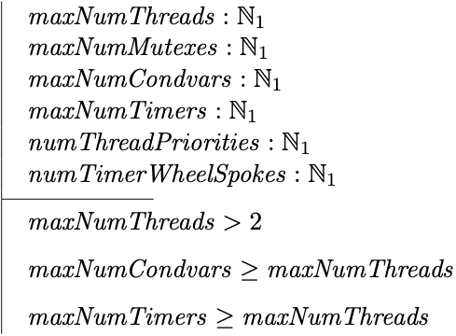
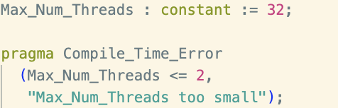
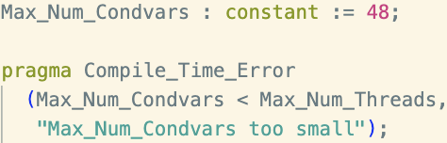
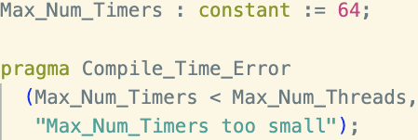
HiRTOS Z Specification Highlights
HiRTOS Configuration Parameters

Slide 11
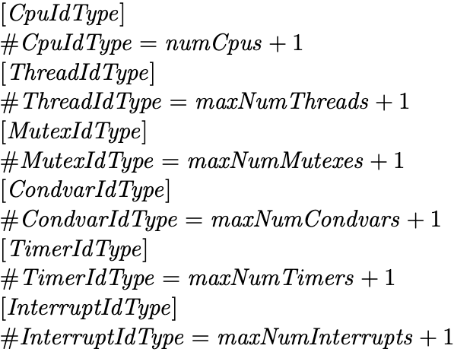
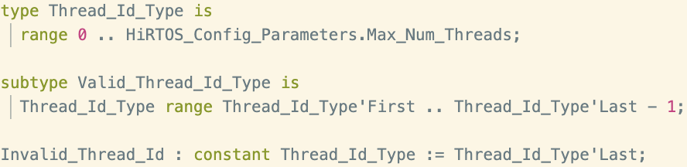
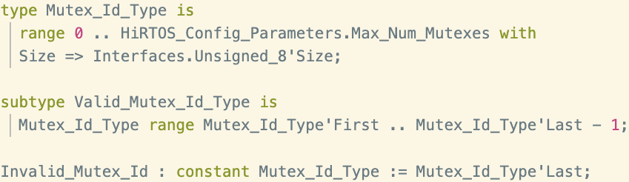
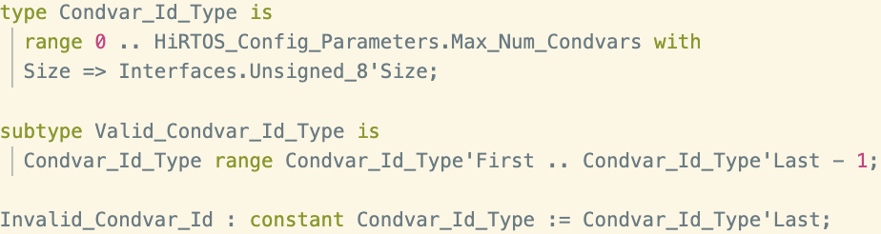
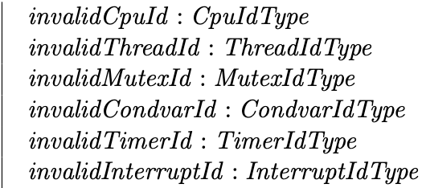
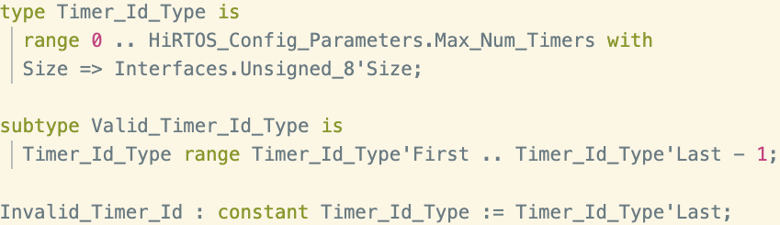
HiRTOS Z Specification Highlights (2)
HiRTOS Primitive Types
Notes:
Z supports defining subranges of integers but they re not different types they are subsets of Natural or Integer

Slide 12

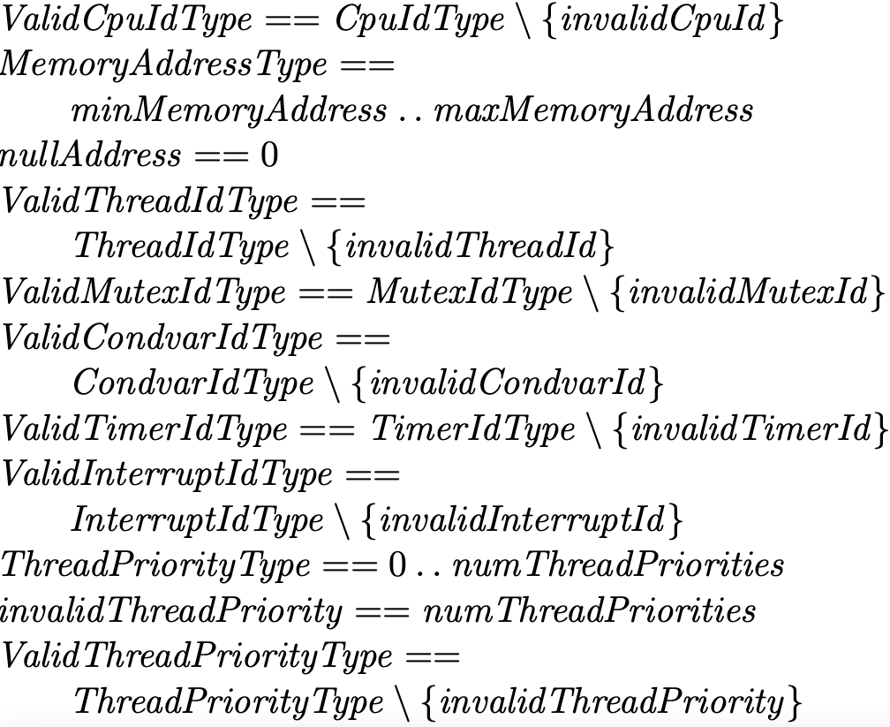
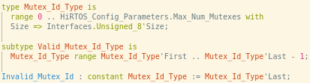
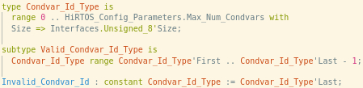
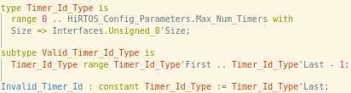
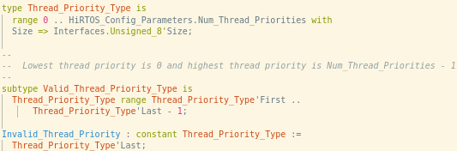
HiRTOS Z Specification Highlights (3)
HiRTOS Primitive Types (cont.)

Slide 13
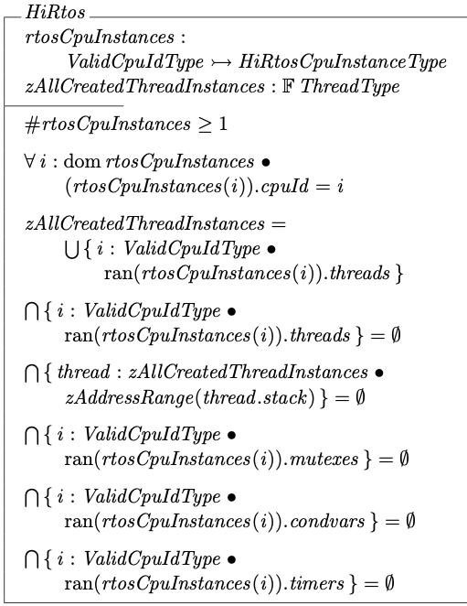
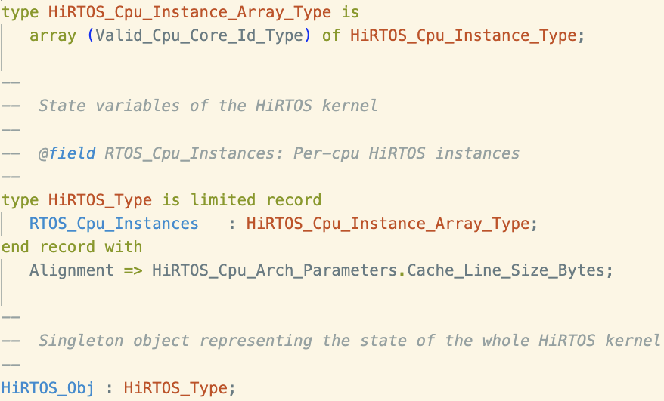
HiRTOS Z Specification Highlights (4)
HiRTOS State Variables
State invariants:
A thread cannot be in two CPUs at the same time
Thread stacks do not overlap
RTOS resources are not shared across CPUs
Notes:
Invariants:

Slide 14
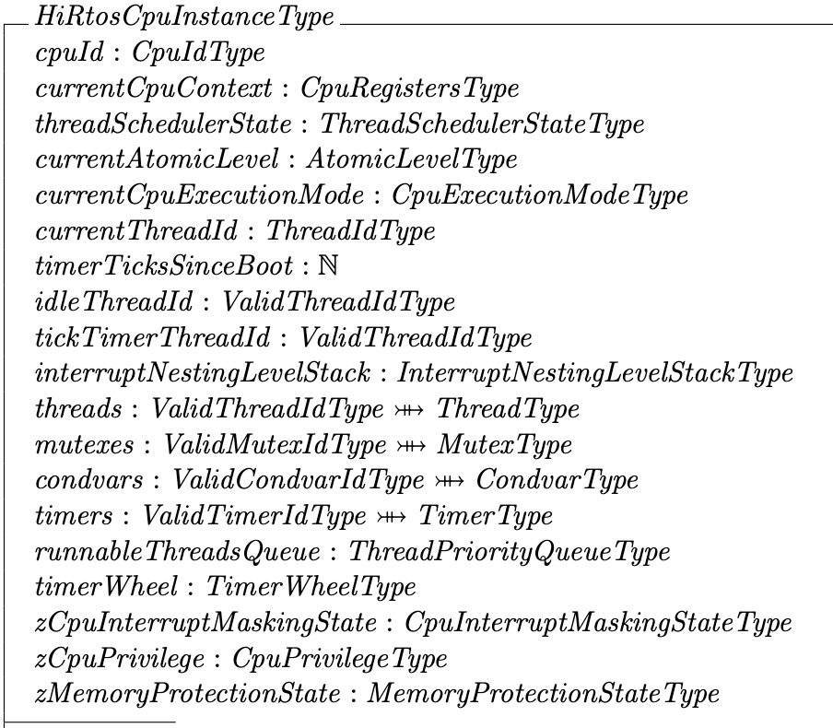
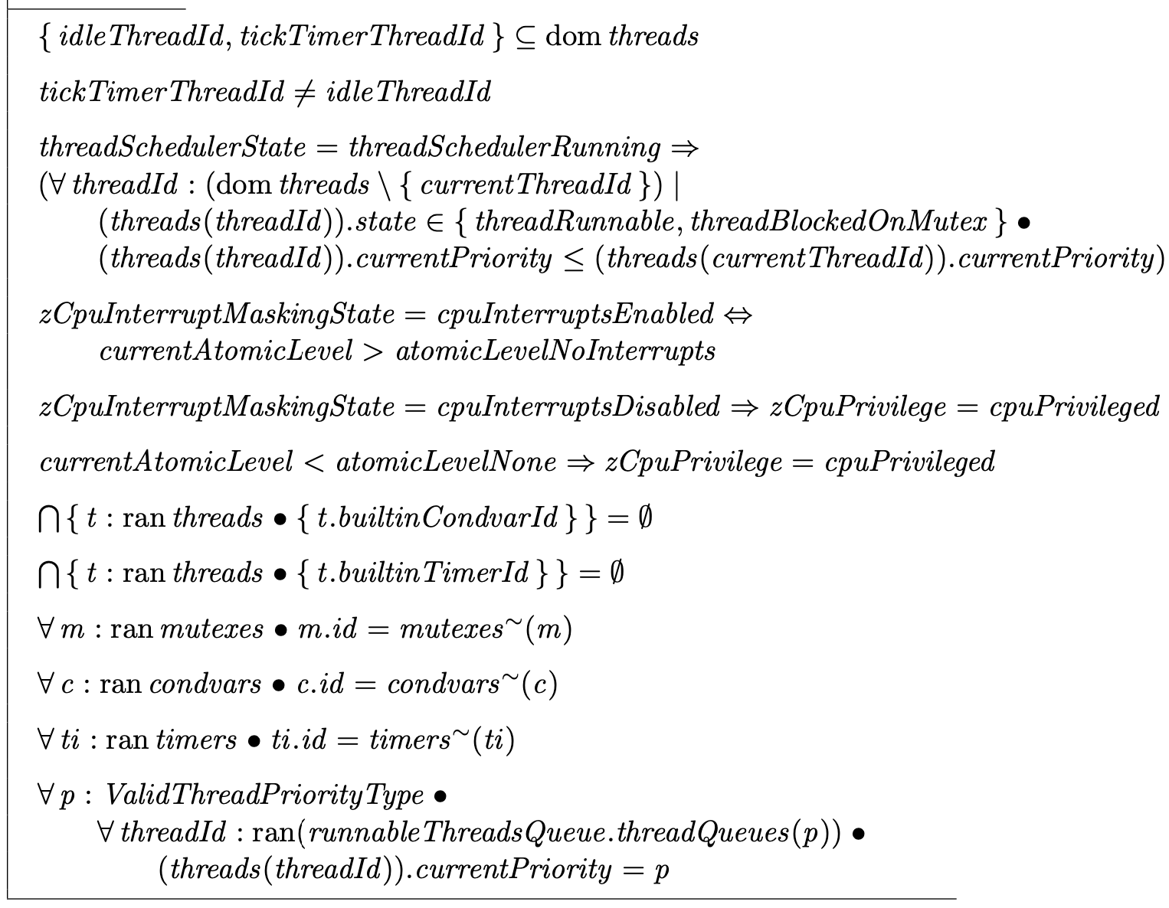
HiRTOS Z Specification Highlights (5)
HiRTOS State Variables (cont.)
state invariants
Finite partial injective functions representing
“partially used” arrays of RTOS objects
Notes:
These object pools are just RTOS-private global arrays of the corresponding
RTOS object types, sized at compile time via configuration parameters, whose
values are application-specific.
No actual RTOS object pointers exposed to application code.
No dynamic allocation/deallocation of
RTOS objects is supported and no static allocation of RTOS objects in mem-
ory owned by application code is supported either. All this prevents HiRTOS
internal state from being accidentally or intentionally corrupted from applica-
tion code.
ISRs are seen as hardware-scheduled threads that have higher priority than
all software-scheduled threads. They can only be preempted by higher-priority
ISRs. They cannot block waiting on mutexes or condition variables.

Slide 15
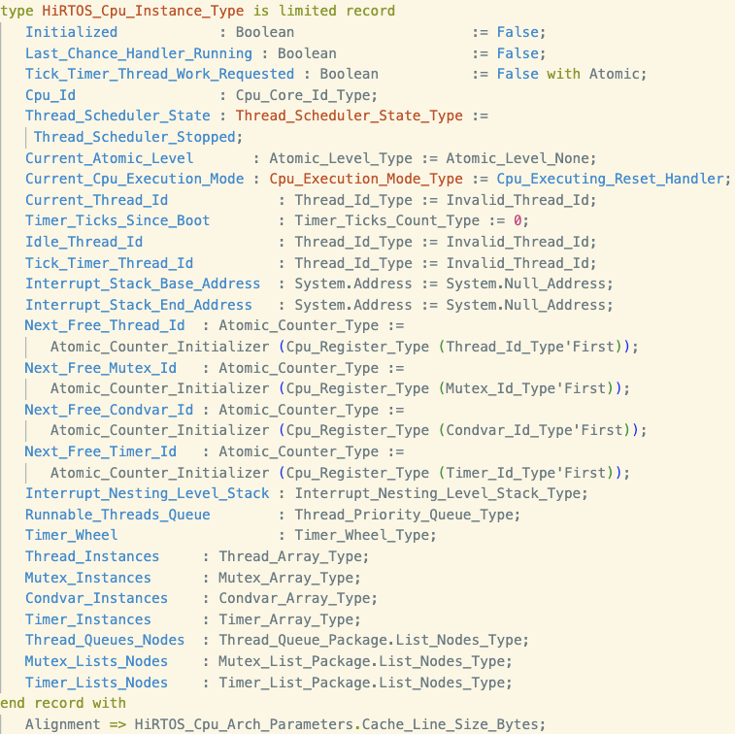
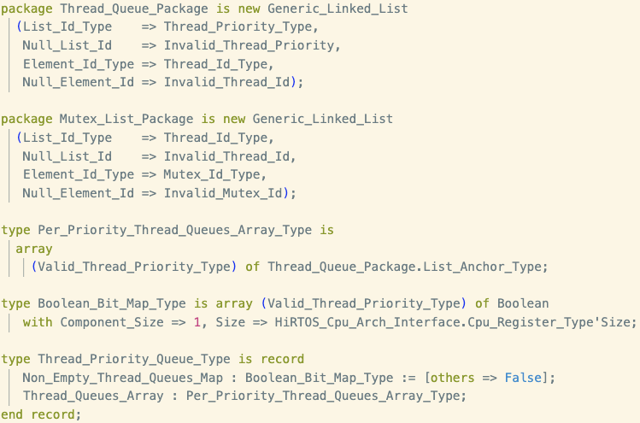
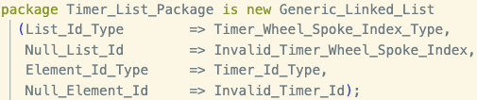
HiRTOS Z Specification Highlights (6)
HiRTOS State Variables (cont.): Pointer-less data structures
pointer-less linked lists
pointer-less linked lists
Arrays of RTOS objects
Arrays of nodes for linked lists of the corresponding type
pointer-less
linked lists
Notes:
These object pools are just RTOS-private global arrays of the corresponding
RTOS object types, sized at compile time via configuration parameters, whose
values are application-specific.
No actual RTOS object pointers exposed to application code.
No dynamic allocation/deallocation of
RTOS objects is supported and no static allocation of RTOS objects in mem-
ory owned by application code is supported either. All this prevents HiRTOS
internal state from being accidentally or intentionally corrupted from applica-
tion code.
ISRs are seen as hardware-scheduled threads that have higher priority than
all software-scheduled threads. They can only be preempted by higher-priority
ISRs. They cannot block waiting on mutexes or condition variables.

Slide 16
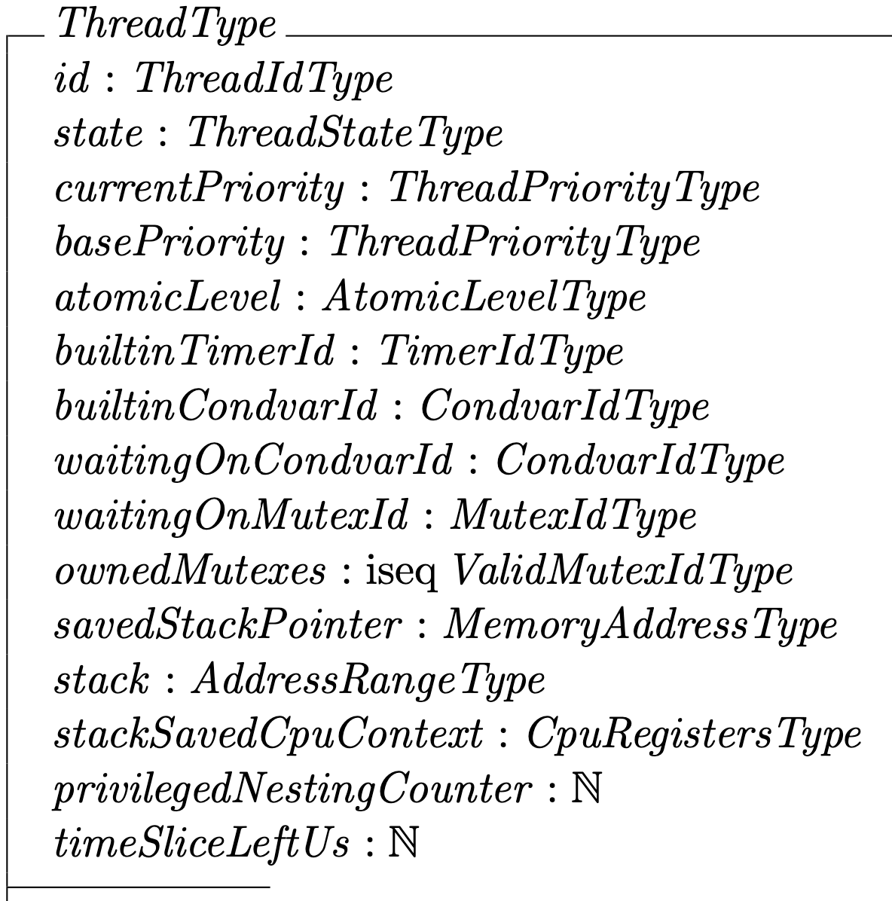
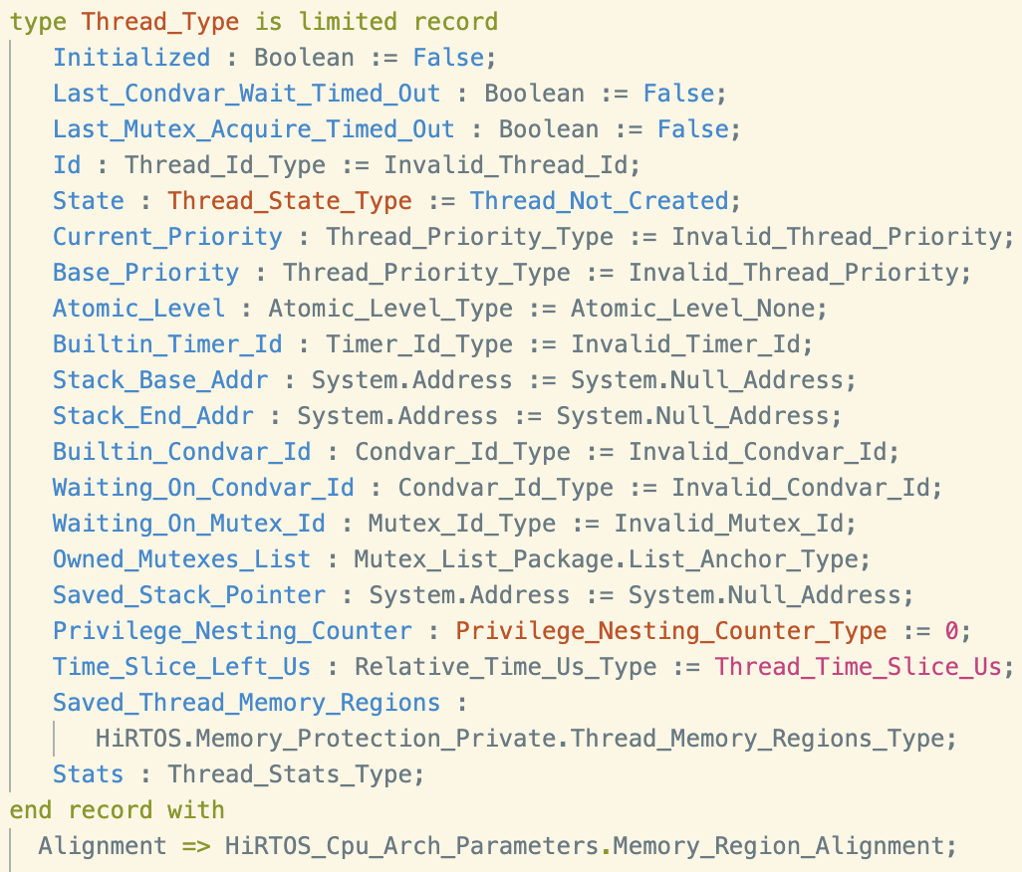
HiRTOS Z Specification Highlights (7)
HiRTOS State Variables (cont.)

Slide 17
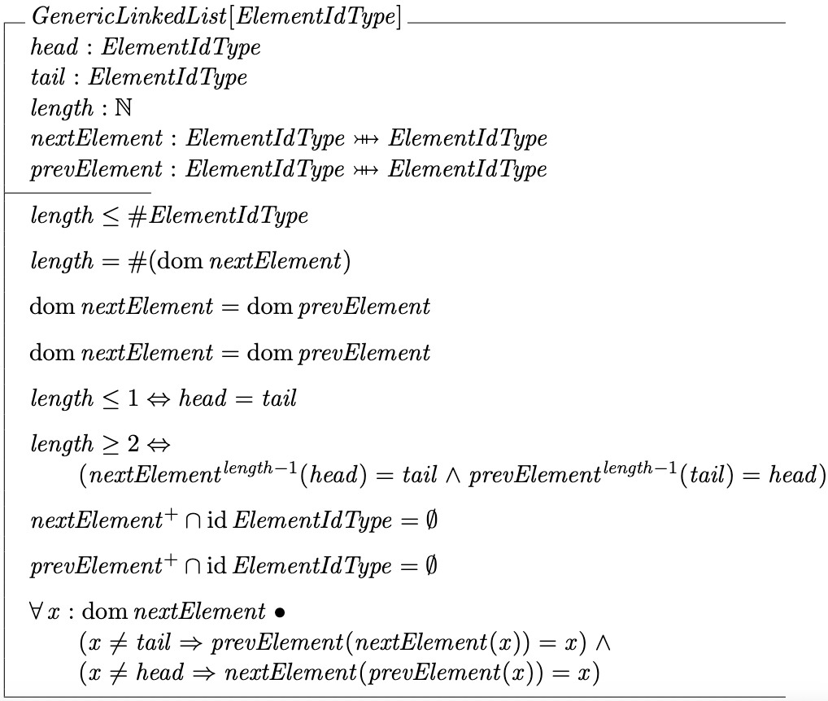
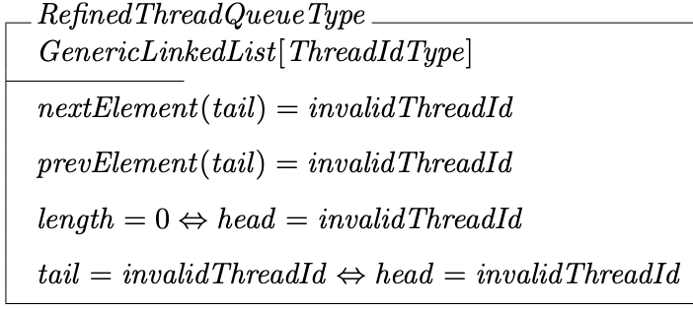
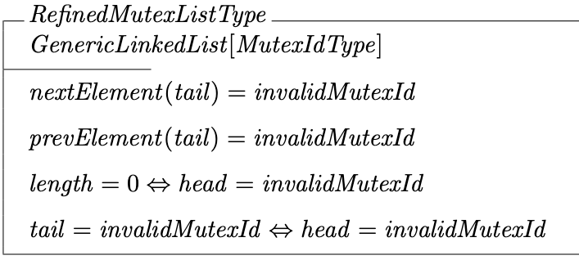
HiRTOS Z Specification Highlights (8)
HiRTOS pointer-less linked lists
Notes:
These object pools are just RTOS-private global arrays of the corresponding
RTOS object types, sized at compile time via configuration parameters, whose
values are application-specific.
No actual RTOS object pointers exposed to application code.
No dynamic allocation/deallocation of
RTOS objects is supported and no static allocation of RTOS objects in mem-
ory owned by application code is supported either. All this prevents HiRTOS
internal state from being accidentally or intentionally corrupted from applica-
tion code.
ISRs are seen as hardware-scheduled threads that have higher priority than
all software-scheduled threads. They can only be preempted by higher-priority
ISRs. They cannot block waiting on mutexes or condition variables.

Slide 18
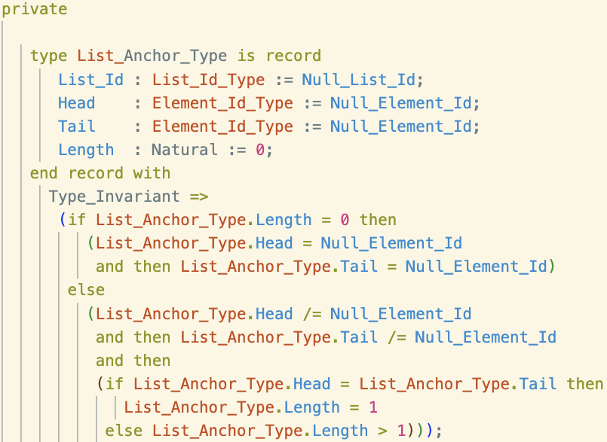
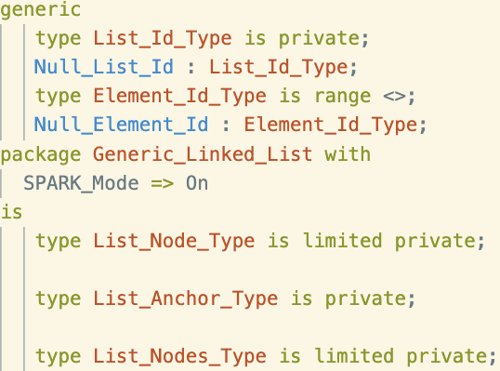
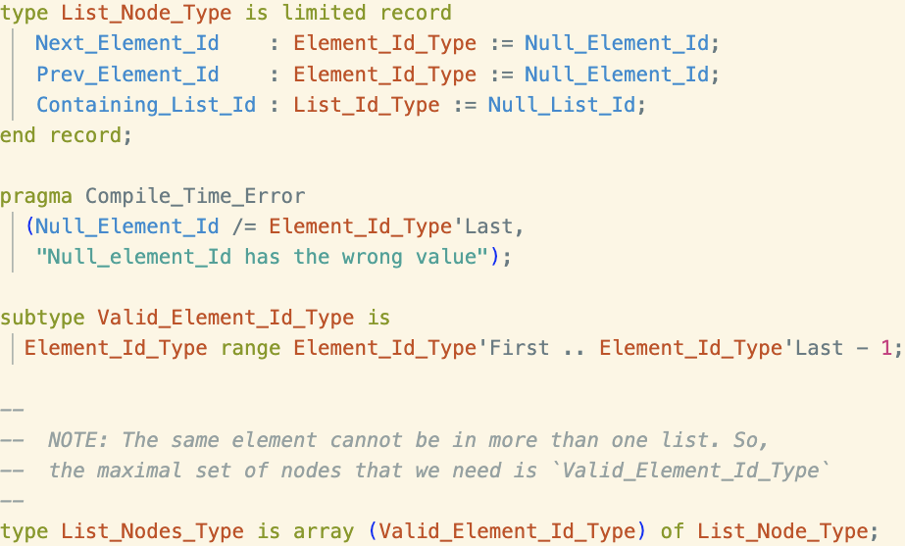
HiRTOS Z Specification Highlights (9)
HiRTOS pointer-less linked lists (cont.)
Backing storage for all the linked lists (pairs of next/prev injective functions) of a given type
Backing storage for all the linked lists (pairs of “next/prev” injective functions) of a given type
Notes:
These object pools are just RTOS-private global arrays of the corresponding
RTOS object types, sized at compile time via configuration parameters, whose
values are application-specific.
No actual RTOS object pointers exposed to application code.
No dynamic allocation/deallocation of
RTOS objects is supported and no static allocation of RTOS objects in mem-
ory owned by application code is supported either. All this prevents HiRTOS
internal state from being accidentally or intentionally corrupted from applica-
tion code.
ISRs are seen as hardware-scheduled threads that have higher priority than
all software-scheduled threads. They can only be preempted by higher-priority
ISRs. They cannot block waiting on mutexes or condition variables.

Slide 19
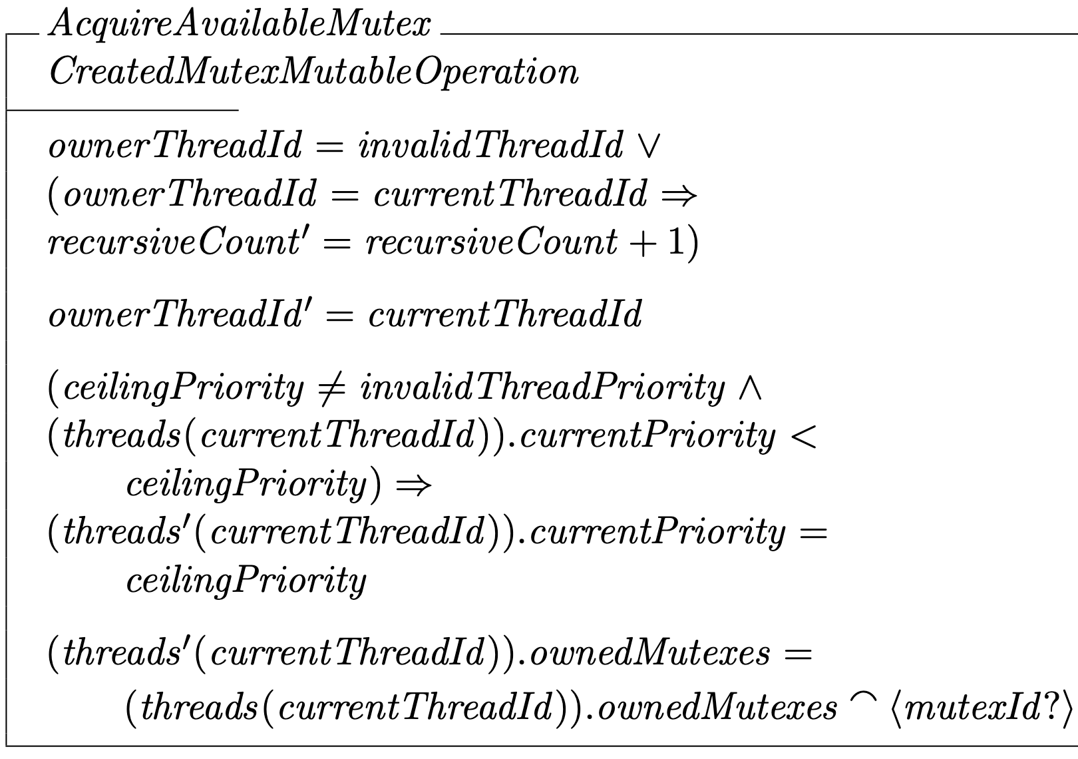
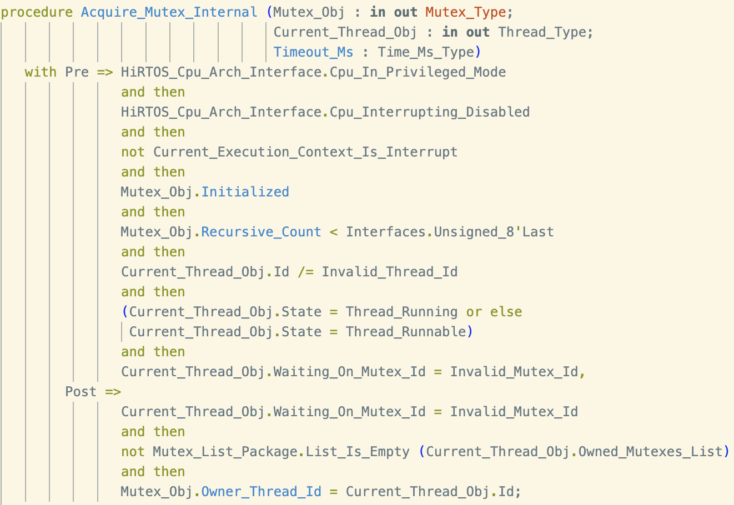
HiRTOS Z Specification Highlights (10)
HiRTOS operations:

Slide 20
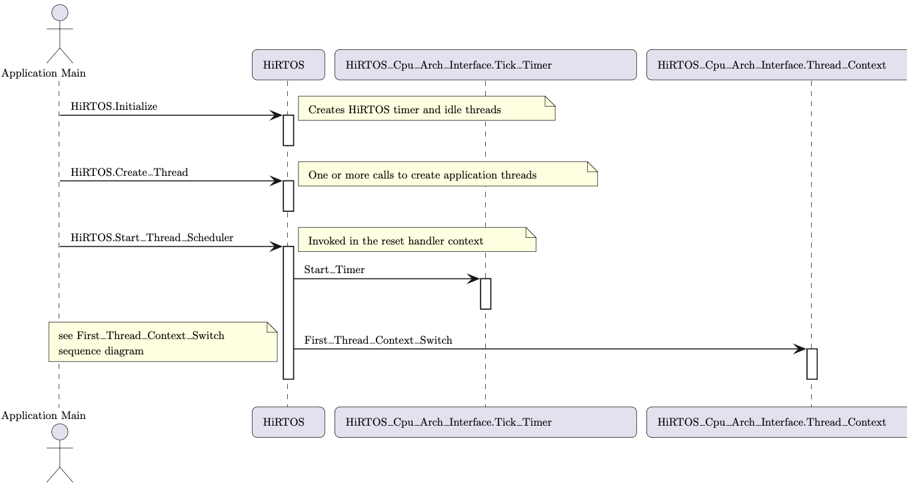
HiRTOS Thread Scheduler
HIRTOS Thread Scheduler Initialization

Slide 21
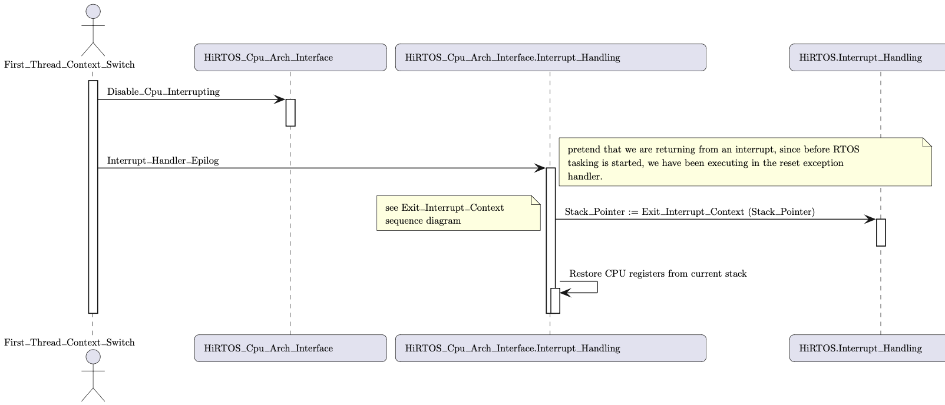
HiRTOS Thread Scheduler (2)
HIRTOS Thread Scheduler Initialization (cont.)
highest priority
thread stack

Slide 22
HiRTOS Thread Scheduler (3)
Asynchronous Thread Context Switch
In HiRTOS, thread preemption is implemented by invoking the thread scheduler on the exit path of an interrupt handler.
When an interrupt fires while a thread is running, the executing thread’s CPU context is saved on thread’s stack by the interrupt handler prolog.
Then, before calling the actual interrupt handler, the stack is switched to the interrupt handling stack. After the interrupt handler returns, the interrupt handler epilog invokes the HiRTOS thread scheduler, to select the highest
priority runnable thread.
Then, if the newly selected thread is different from the one that was running before the interrupt, the extended context of the old thread is saved and the extended context of the new thread is restored.

Slide 23
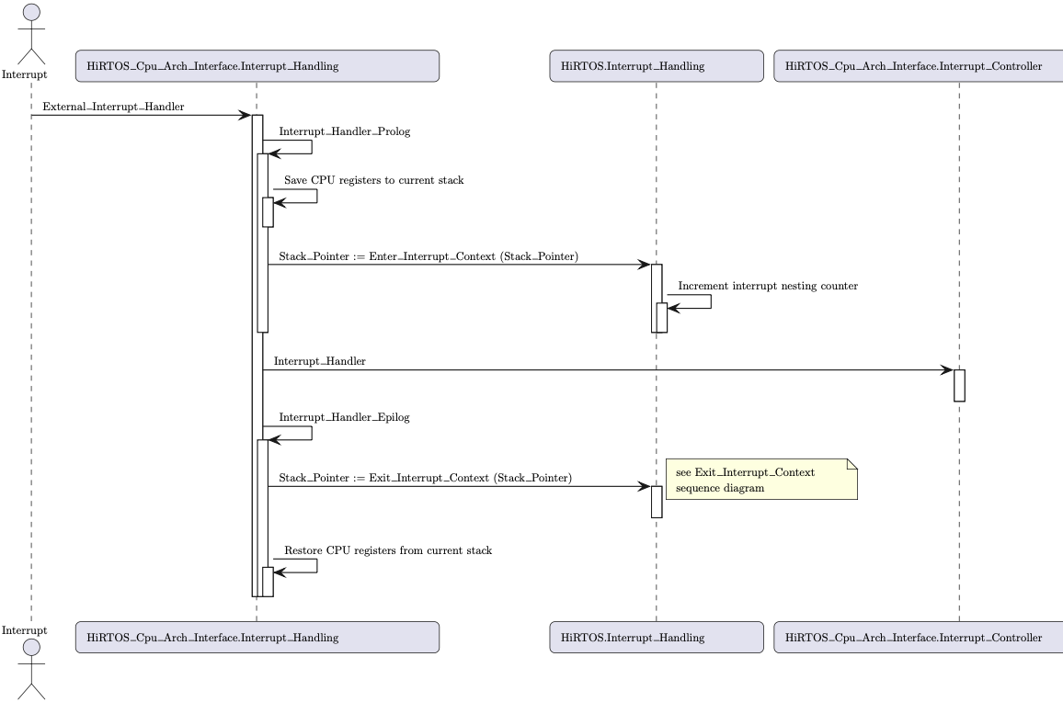
HiRTOS Thread Scheduler (4)
Asynchronous Thread Context Switch (cont.)
Interrupt handling stack
New thread stack

Slide 24
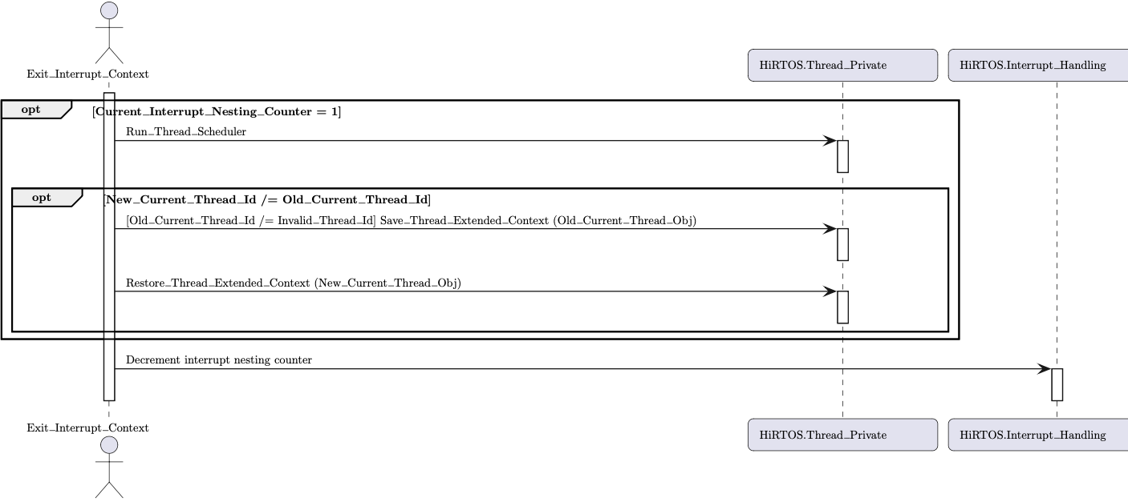
HiRTOS Thread Scheduler (5)
Asynchronous Thread Context Switch (cont.)

Slide 25
HiRTOS Thread Scheduler (6)
In HiRTOS, a synchronous thread context switch occurs when:
A thread calls HiRTOS.Condvar.Wait
A thread calls HiRTOS.Condvar.Signal or HiRTOS.Condvar.Broadcast,
and there are threads waiting on the condition variable
A thread calls HiRTOS.Mutex.Acquire and the mutex is not available
A thread calls HiRTOs.Mutex.Release and there are threads waiting to
acquire the mutex
A thread calls HiRTOS.Thread.Thread_Delay_Until (which calls HiRTOS.Condvar.Wait)
A thread calls HiRTOS.Thread.Suspend_Current_Thread
A thread calls HiRTOS.Thread.Resume_Thread
A thread calls HiRTOS.Restore_Atomic_Level and the old atomic level is Atomic_Level_None

Slide 26
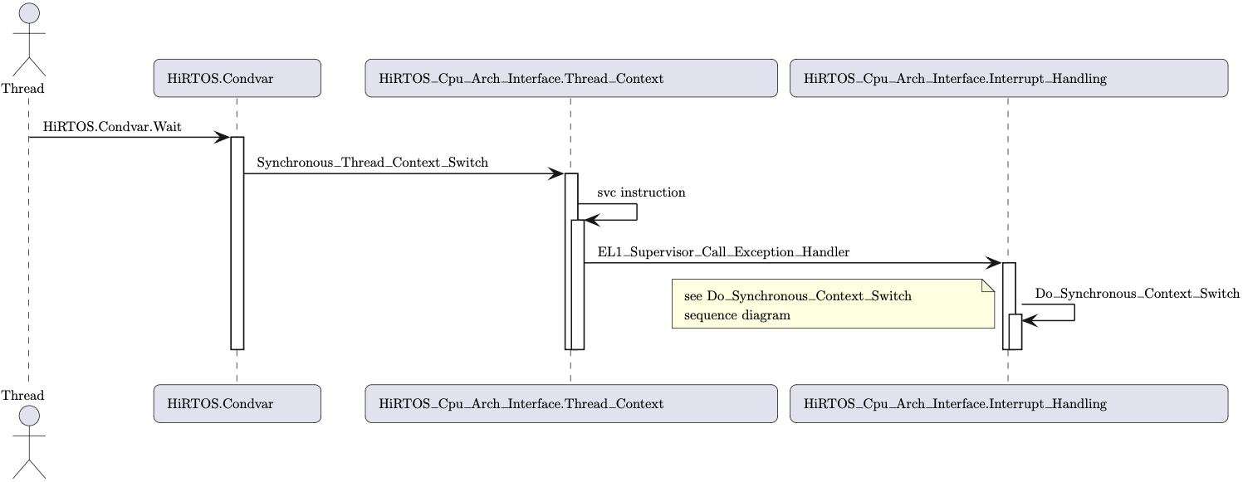
HiRTOS Thread Scheduler (7)
Synchronous Thread Context Switch

Slide 27
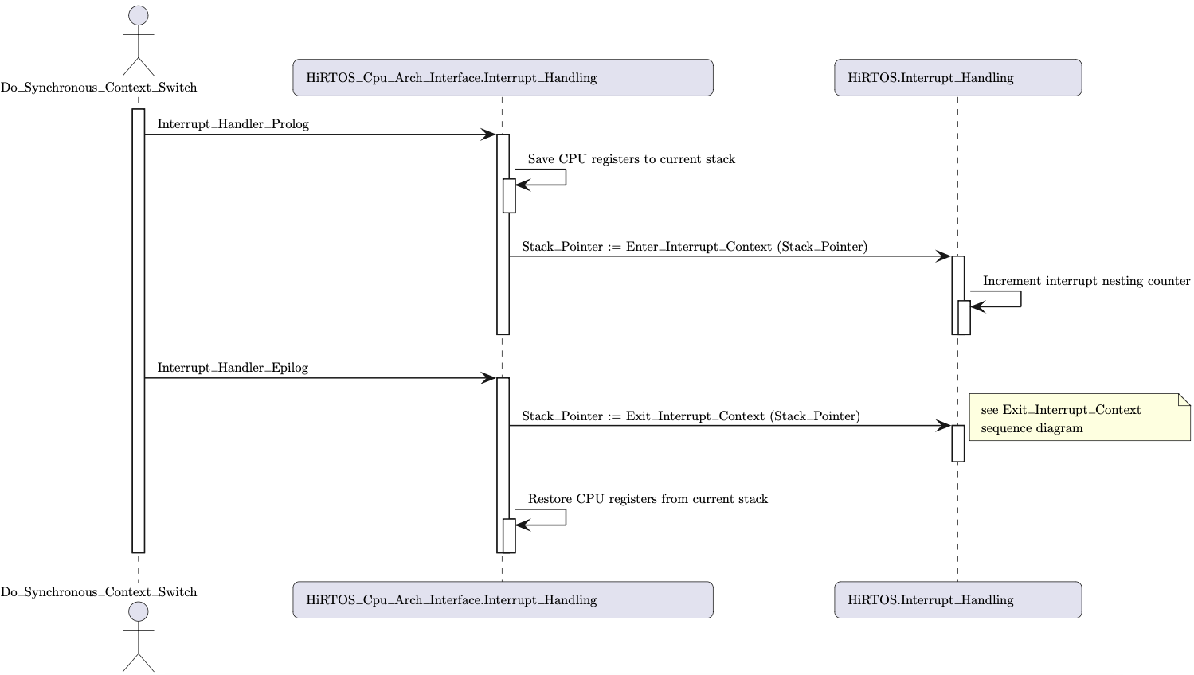
HiRTOS Thread Scheduler (8)
Synchronous Thread Context Switch (cont.)
Interrupt handling stack
New thread stack

Slide 28
Using TLA+ to Verify HiRTOS Design
TLA+ is a mathematical language for modeling concurrent systems and distributed systems
Like Z, it is based on set theory and first-order logic (but it is type-less)
Unlike Z, it also uses temporal logic
Safety invariants and liveness properties of a TLA+ model can be verified
using the TLC model checker
PlusCal is a higher-level (procedural) modeling/specification language on top of TLA+
A PlusCal model is “compiled” to an equivalent pure TLA+ model
A TLA+/PlusCal model of the HiRTOS thread scheduler was created from the Z spec and the SPARK Ada code
The TLA+ model was verified using the TLC model checker

Slide 29
HiRTOS Thread Scheduler TLA+ Model
HiRTOS TLA+/PlusCal modeling had different goals from Z modeling
Z modeling helped design/specify overall HiRTOS functionality:
HiRTOS internal data structures and their state invariants
HiRTOS operations and their pre-conditions/post-conditions
Z modeling inspired Ada data structure design choices and API contracts
TLA+ modeling helped verify correctness of HiRTOS scheduler design:
Only a slice of HiRTOS functionality is modeled and the model is more like a test case of a simple multi-threaded program, rather than the whole RTOS
A mutex priority inheritance design flaw was uncovered during modeling
Complete TLA+/PlusCal model is 700 lines of text
TLC run of the HiRTOS scheduler model took 7+ hours to run to verify successfully 10 invariants and 3 liveness properties.

Slide 30
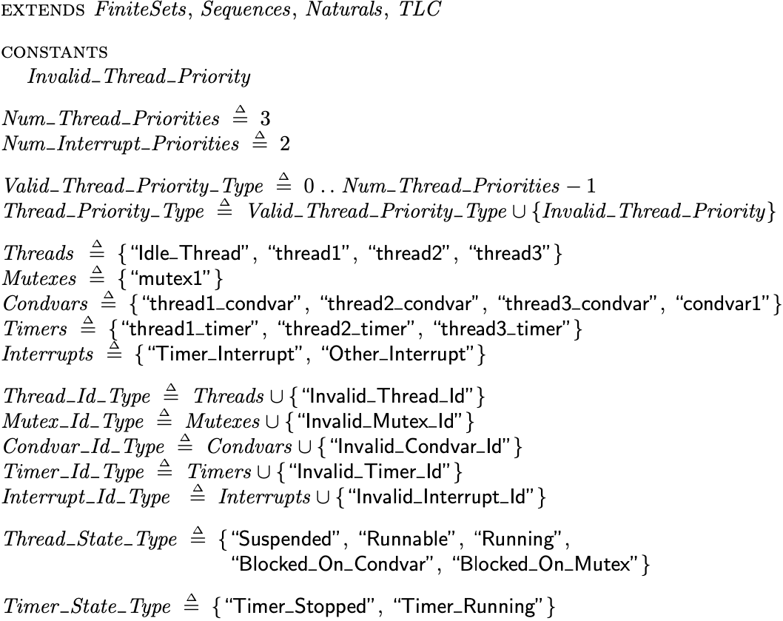
HiRTOS Thread Scheduler TLA+ Model (2)
TLA+ Declarations
Unspecified special value defined in TLC config as a “model value”
Valid thread Ids

Slide 31
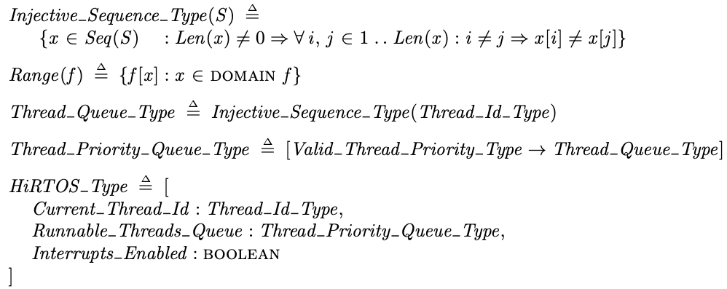
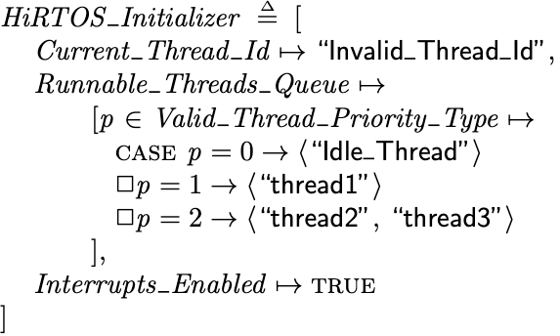
HiRTOS Thread Scheduler TLA+ Model (3)
TLA+ Declarations (cont.)
Simplified state of a per-CPU HiRTOS instance
HiRTOS instance state before thread scheduler starts running

Slide 32
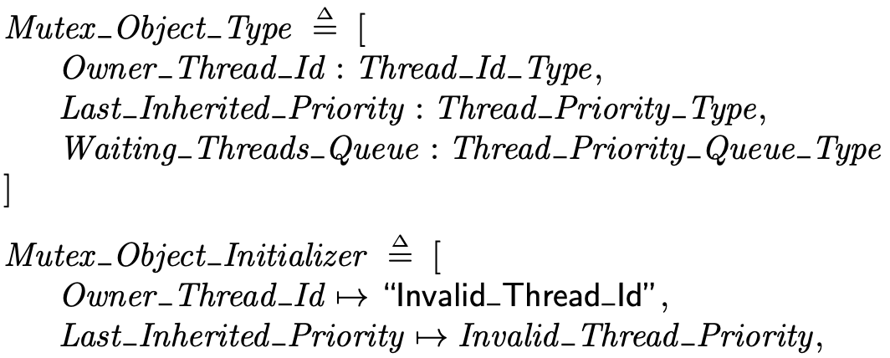
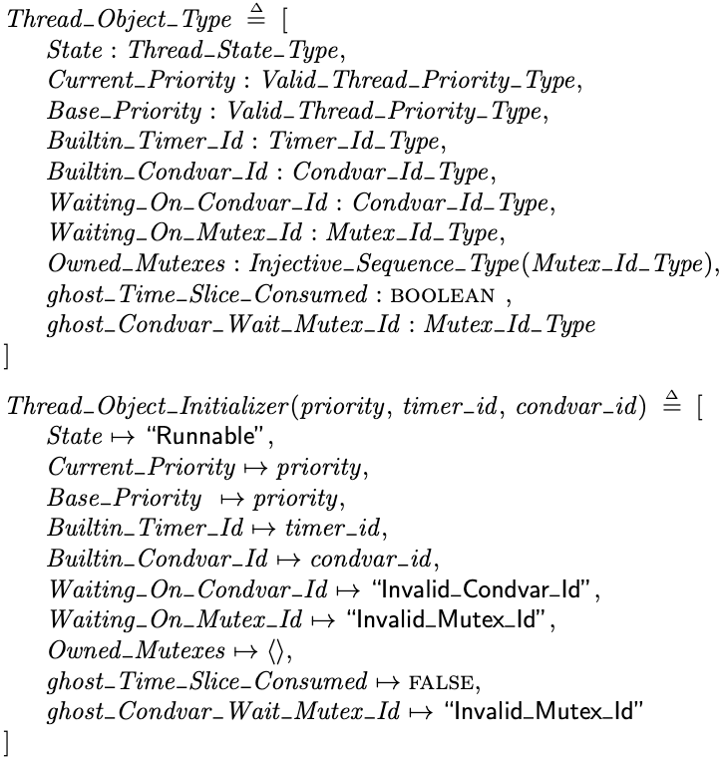
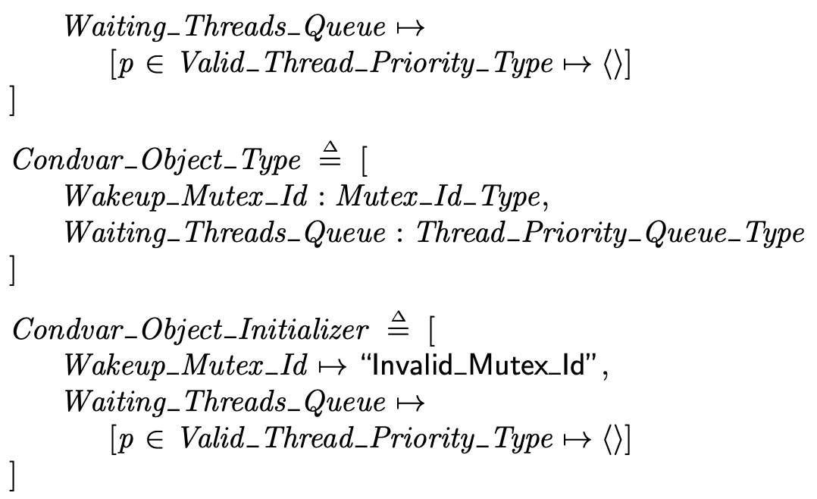
HiRTOS Thread Scheduler TLA+ Model (4)
TLA+ Declarations (cont.)

Slide 33
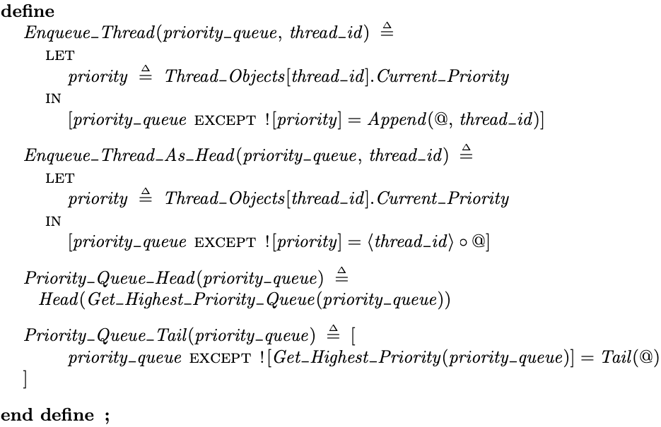
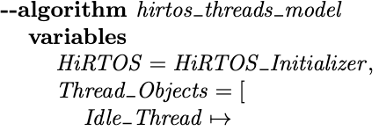
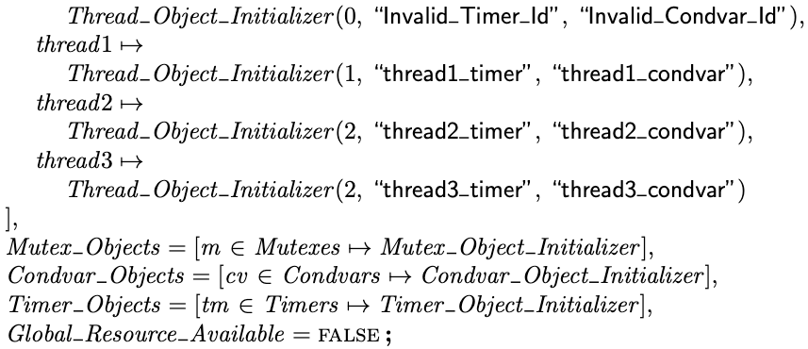
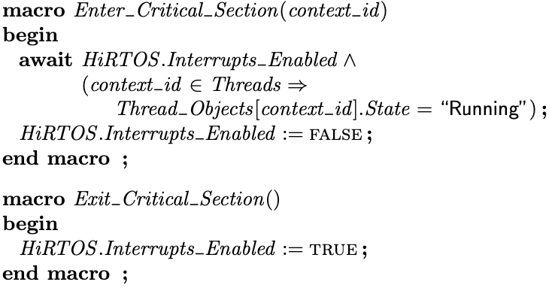
HiRTOS Thread Scheduler TLA+ Model (5)
PlusCal model

Slide 34
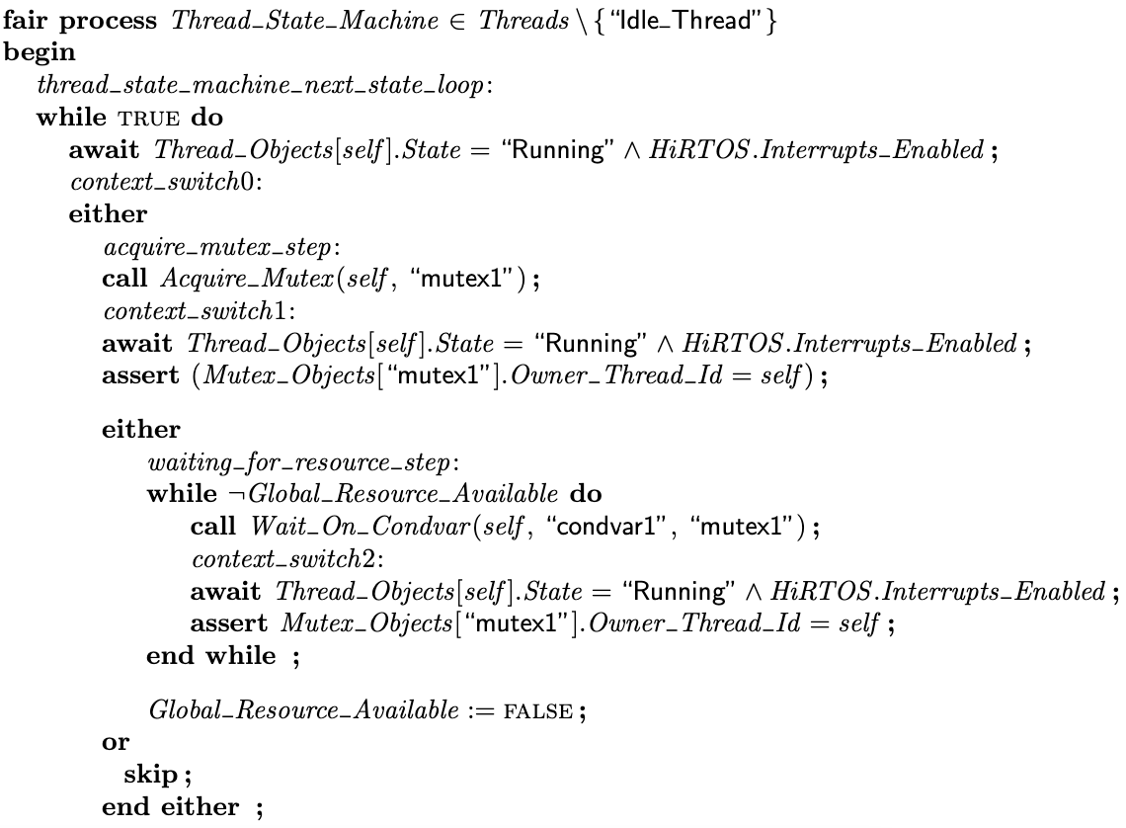
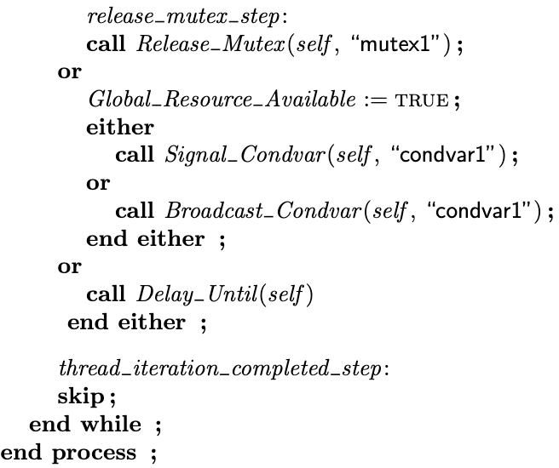
HiRTOS Thread Scheduler TLA+ Model (6)
PlusCal model (cont.)

Slide 35



HiRTOS Thread Scheduler TLA+ Model (7)
PlusCal model (cont.)

Slide 36

HiRTOS Thread Scheduler TLA+ Model (8)
PlusCal model (cont.)

Slide 37


HiRTOS Thread Scheduler TLA+ Model (9)
PlusCal model (cont.)

Slide 38







HiRTOS Thread Scheduler TLA+ Model (10)
The PlusCal model is ”compiled” to pure TLA+:

Slide 39

HiRTOS Thread Scheduler TLA+ Model (11)
Invariants

Slide 40


HiRTOS Thread Scheduler TLA+ Model (12)
Invariants (cont.)

Slide 41

HiRTOS Thread Scheduler TLA+ Model (12)
Liveness Properties

Slide 42
Lessons Learned
Light-weight use of formal methods even without doing formal
proofs can still be useful and practical in the real world
Programming-by-contract can be done more methodical and rigorous by
doing mathematical modeling before writing code
Cleaner/simpler data structures can be designed. For example,
HiRTOS pointer-less data structures were inspired by Z modeling.
Potential benefits from writing formal models at a level of abstraction closer to code:
Code could be generated automatically from a “closer-to-code” Z model.
Model-checking of a “closer-to-code” TLA+ model can be an effective
alternative to unit testing, especially for concurrent code

Slide 43
Lessons Learned (2)
What could have been done better and possible next steps:
Do Formal Verification of SPARK code using gnatprove
Generate SPARK Ada code for data structures from mathematical data
structures written in Z or TLA+
Write TLA+/PlusCal model before writing Ada code and perhaps generate
partial SPARK Ada code from the PlusCal model automatically
Runtime checking of some safety invariants and liveness properties could be offloaded to a low-priority “safety patrol” thread to leverage idle CPU cycles.

Slide 44
Lessons Learned (3)
Avoiding the use of pointers makes code safer, provided that a fully
strong-typed language like Ada is used.
Programming by contract is a very powerful technique to catch bugs
earlier, during initial development and during maintenance.
Adding more thorough contracts increases runtime overhead unless they are compiled out from production code:
But they can only be safely compiled out if formally verified with gnatprove
How awesome would be if the GNAT compiler had an “-Ocontracts” switch, to
make GNAT run gnatprove automatically and optimize away those contracts that
gnatprove is able to prove

Slide 45
“We shall do a much better programming job, provided that we approach the task with a full appreciation of its tremendous difficulty, provided that we stick to modest and elegant programming languages, provided that we respect the intrinsic limitations of the human mind and approach the task as Very Humble Programmers.”
Edsger W. Dijkstra, 1972

