Slide 1
IoT Stack Demo with the FRDM-K64F board
Germán Rivera
(jgrivera67@gmail.com)

Slide 2
Overview
IoT Demo: Hardware Topology
command to set color of RGB LED on all boards
propagation of command to all other boards
connected to the switch via a UDP multicast
message

Slide 3
Overview (2)
IoT Demo: Software Topology

Slide 4
Overview (3)
IoT Demo: Detailed Software Topology

Slide 5
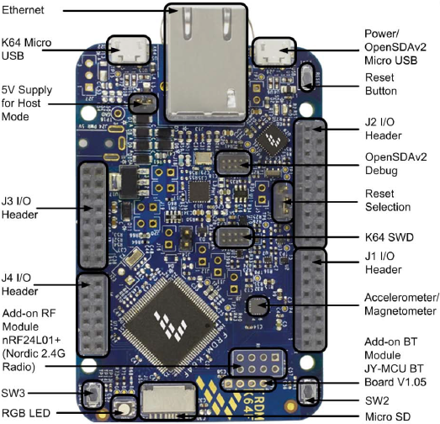
Overview (4)
The FRDM-K64F board IoT peripherals
Ethernet interface
Bluetooth module interface
(UART interface)
RF module interface
(SPI interface)

Slide 6
Software Architecture Diagrams
Hardware Context Diagram

Slide 7
Software Architecture Diagrams (2)
Software Context Diagram

Slide 8
Software Architecture Diagrams (3)
Runtime Architecture
Timer ISR

